Slide 1
The True Story of the Three Little Pigs
Concept of Perspective
Read Aloud Unit 2, Week 2, Day 3

Slide 2
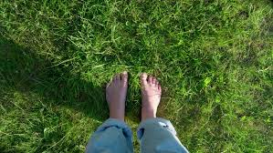
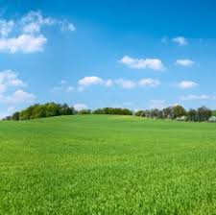
A human’s perspective of a grassy meadow.

Slide 3
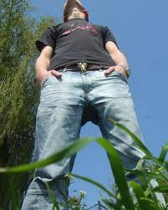
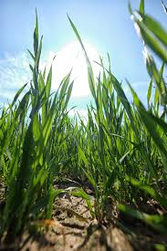
An ant’s perspective of a human, and of a grassy meadow.

