Slide 1
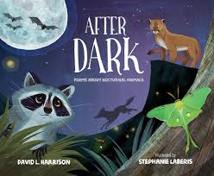
“Owl Rules” (Screech Owl)
By David L. Harrison
From After Dark: Poems about Nocturnal Animals

Slide 2
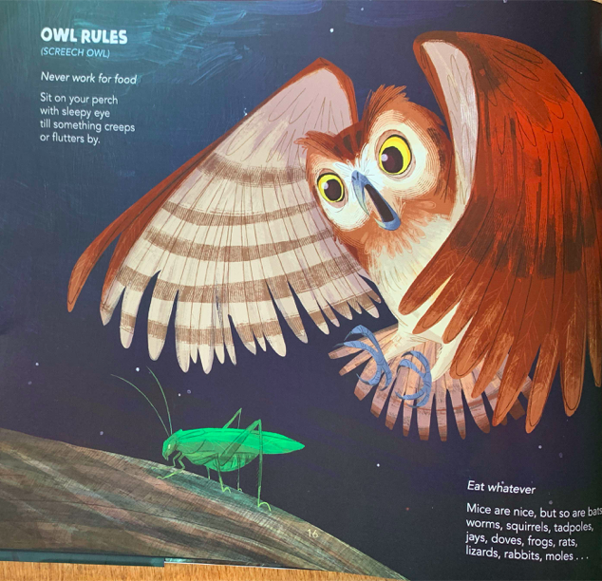
Never work for food
Sit on your perch
with sleepy eye
till something creeps
or flutters by.

Slide 3
Eat whatever
Mice are nice, but so are bats,
worms, squirrels, tadpoles,
jays, doves, frogs, rats,
lizards, rabbits, moles…

Slide 4
Who needs a nest?
Don’t waste effort
with twigs and thatch.
They’re only eggs.
They’re going to hatch.

Slide 5
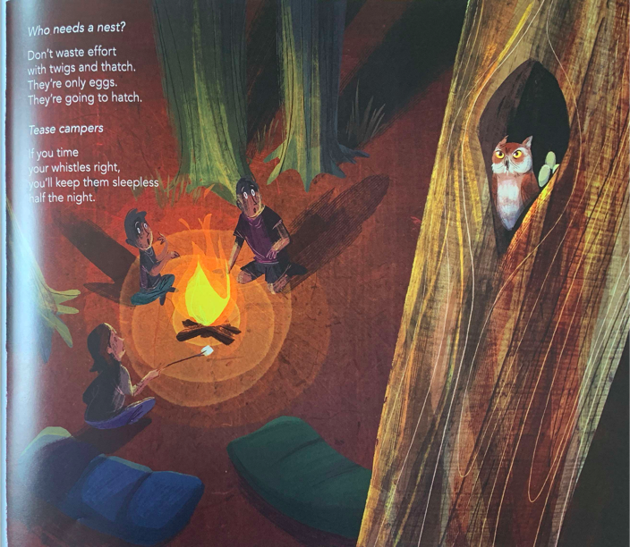
Tease campers
If you time
your whistles right,
you’ll keep them sleepless
half the night.

