Slide 1
Amphibians
Unit 2, Week 2, Day 1

Slide 2
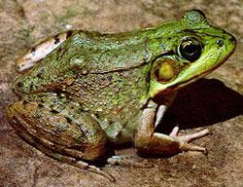
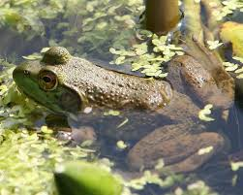
Living in water
Or living on land,
Being an amphibian
Must be grand!

Slide 3
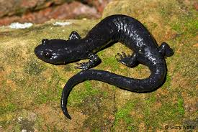
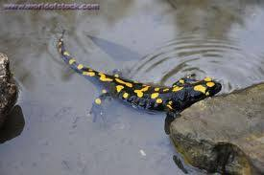
If I were a frog,
salamander, or toad,
I would jump in a lake
or crawl on a road.

Slide 4
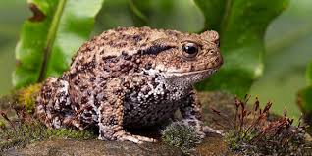
Living in water
Or living on land,
Being an amphibian
Must be grand!

