Slide 1
Where is the story Lon Po Po from?
FK2 Unit 2, Week 8, Day 2

Slide 2
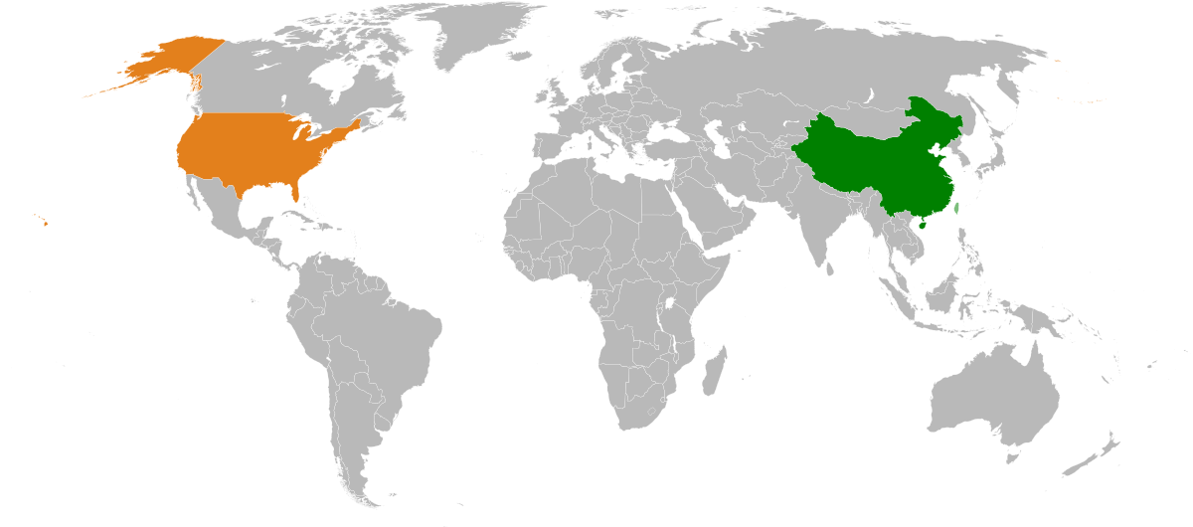
Lon Po Po is a tale from China. China is a country in the continent of Asia.
China
Boston, Massachusetts, USA

