Slide 1
Read Aloud Week 5, Day 4
Selected pages for close reading

Slide 2
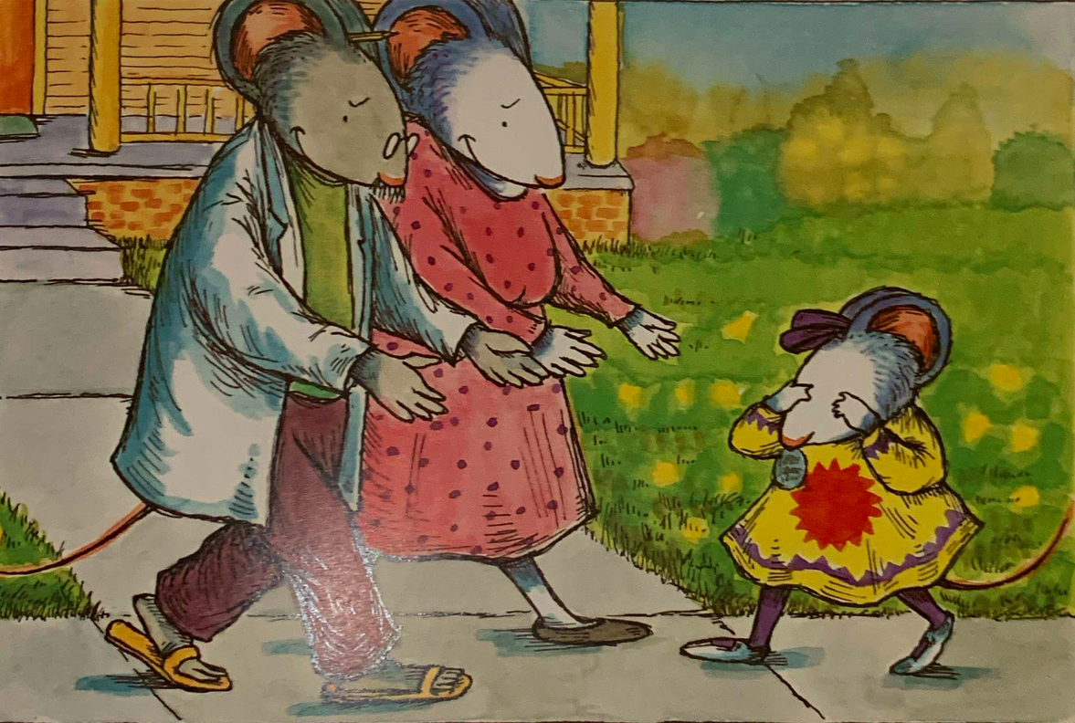
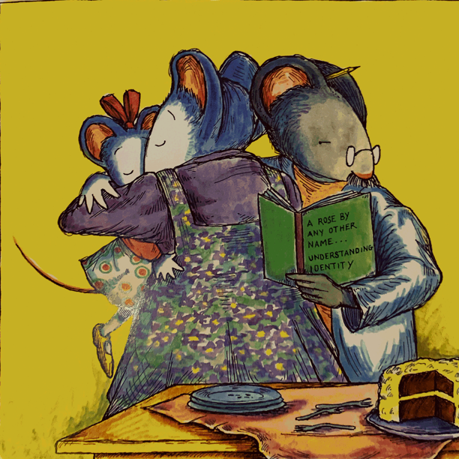
“Your name is beautiful.”
“And precious and priceless and fascinating and winsome,” said her father.
“It’s everything you are,” said her mother.
“Absolutely perfect,” said her father.

Slide 3
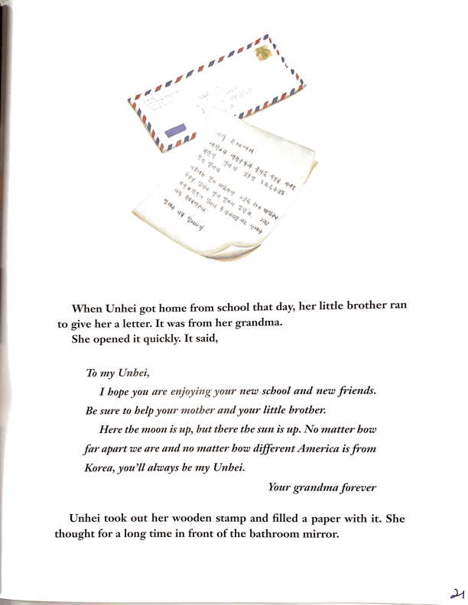
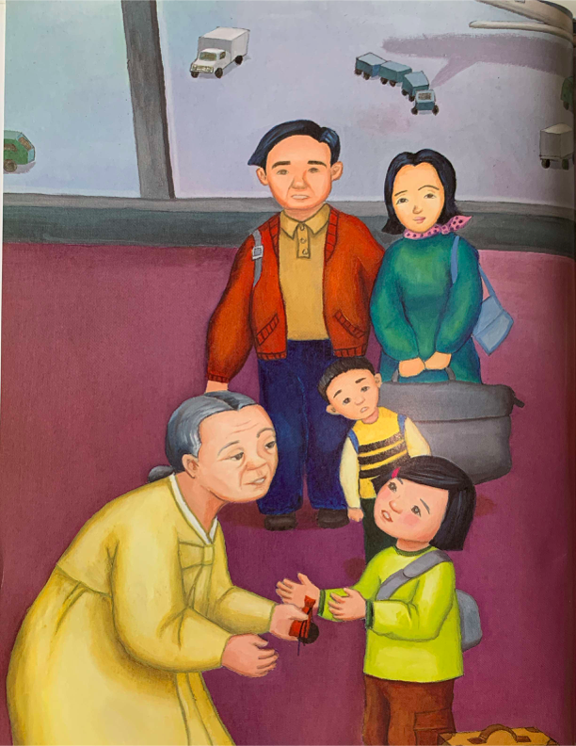

Slide 4
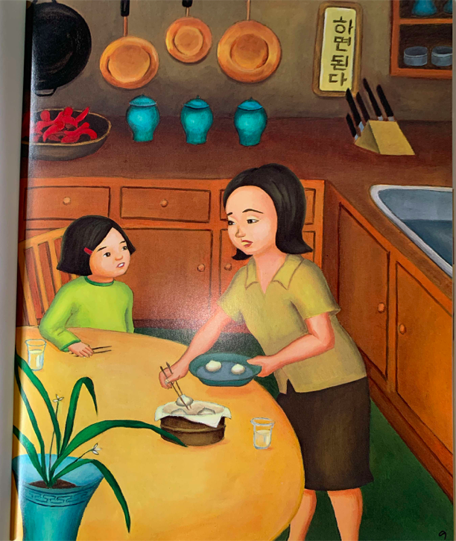
Her mother looked at her with surprise. “Why? Unhei is a beautiful name. Your grandma and I went to a name master for it.”
“But it’s so hard to pronounce,” Unhei complained. “I don’t want to be different from all the American kids.”
You are different, Unhei,” her mother said. “That’s a good thing!”

Slide 5
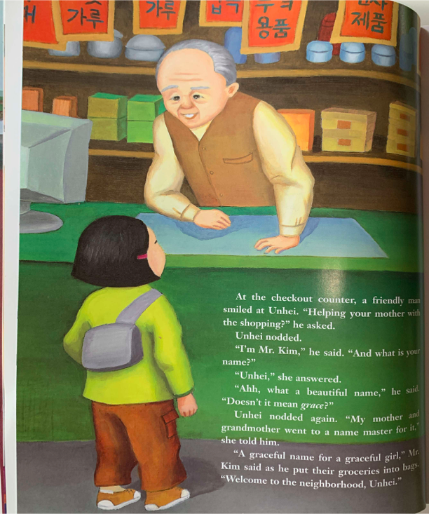
“Unhei,” she answered.
“Ahh, what a beautiful name,” he said. “Doesn’t it mean grace?”

Slide 6
How are Chrysanthemum’s and Unhei’s family communities similar?

Slide 7
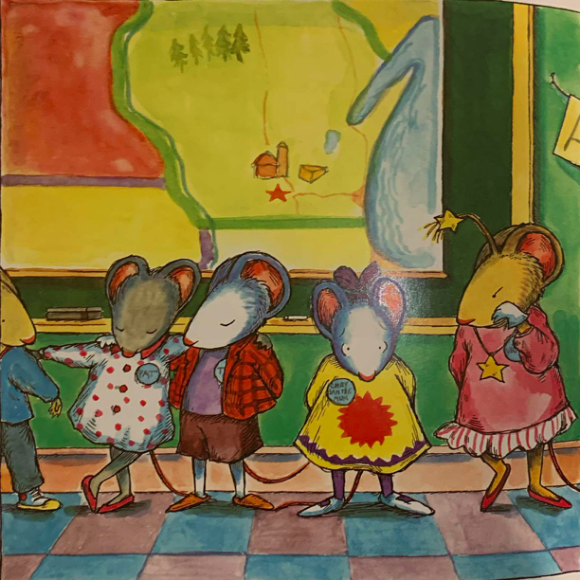
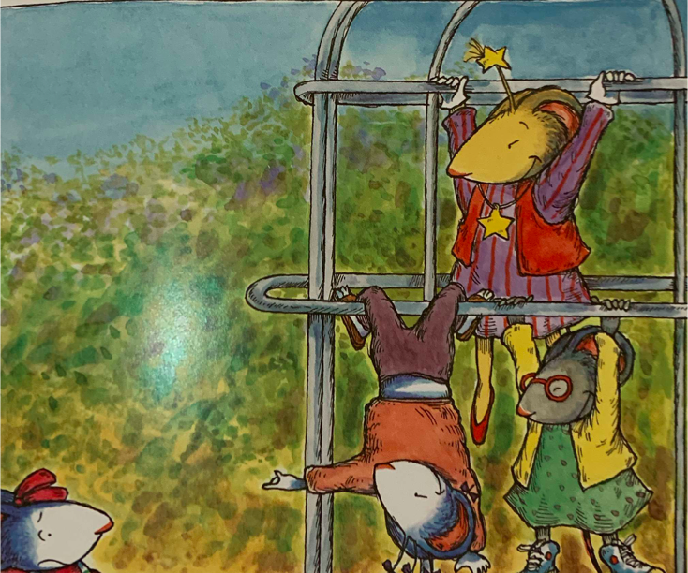

Slide 8
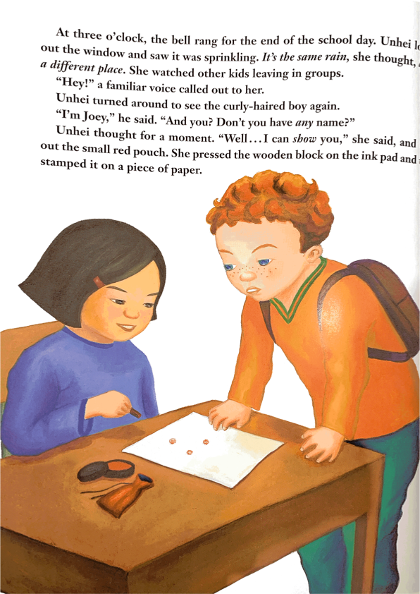
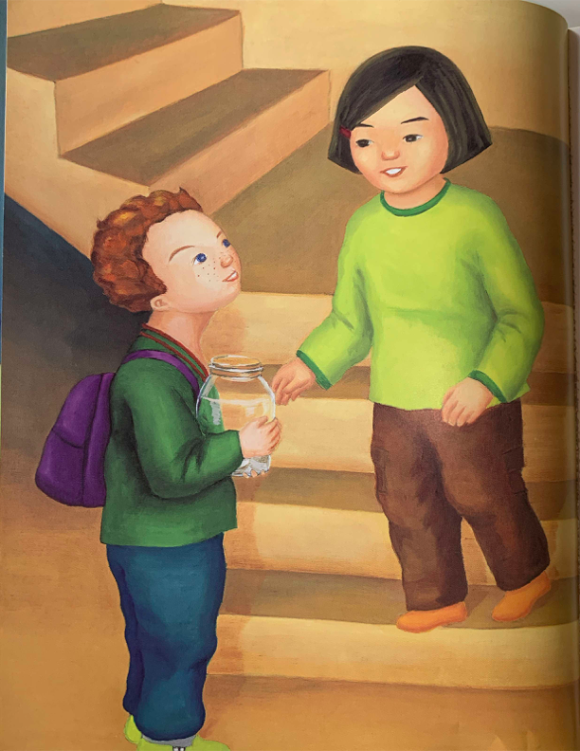

Slide 9
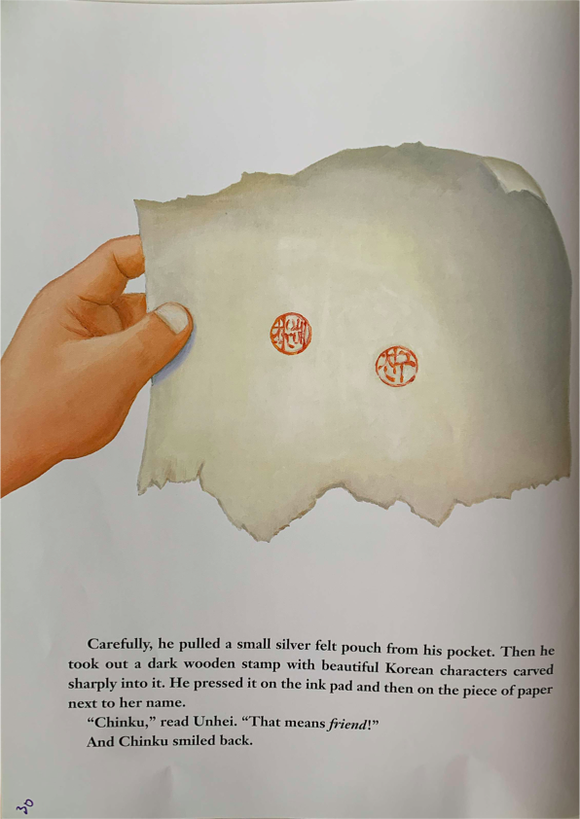
“Chinku,” read Unhei. “That means friend!”
And Chinku smiled back.

Slide 10
How is Joey a caring member of Unhei’s community?

