Slide 1
Estuaries Images
Read Aloud Week 3 Day 1

Slide 2
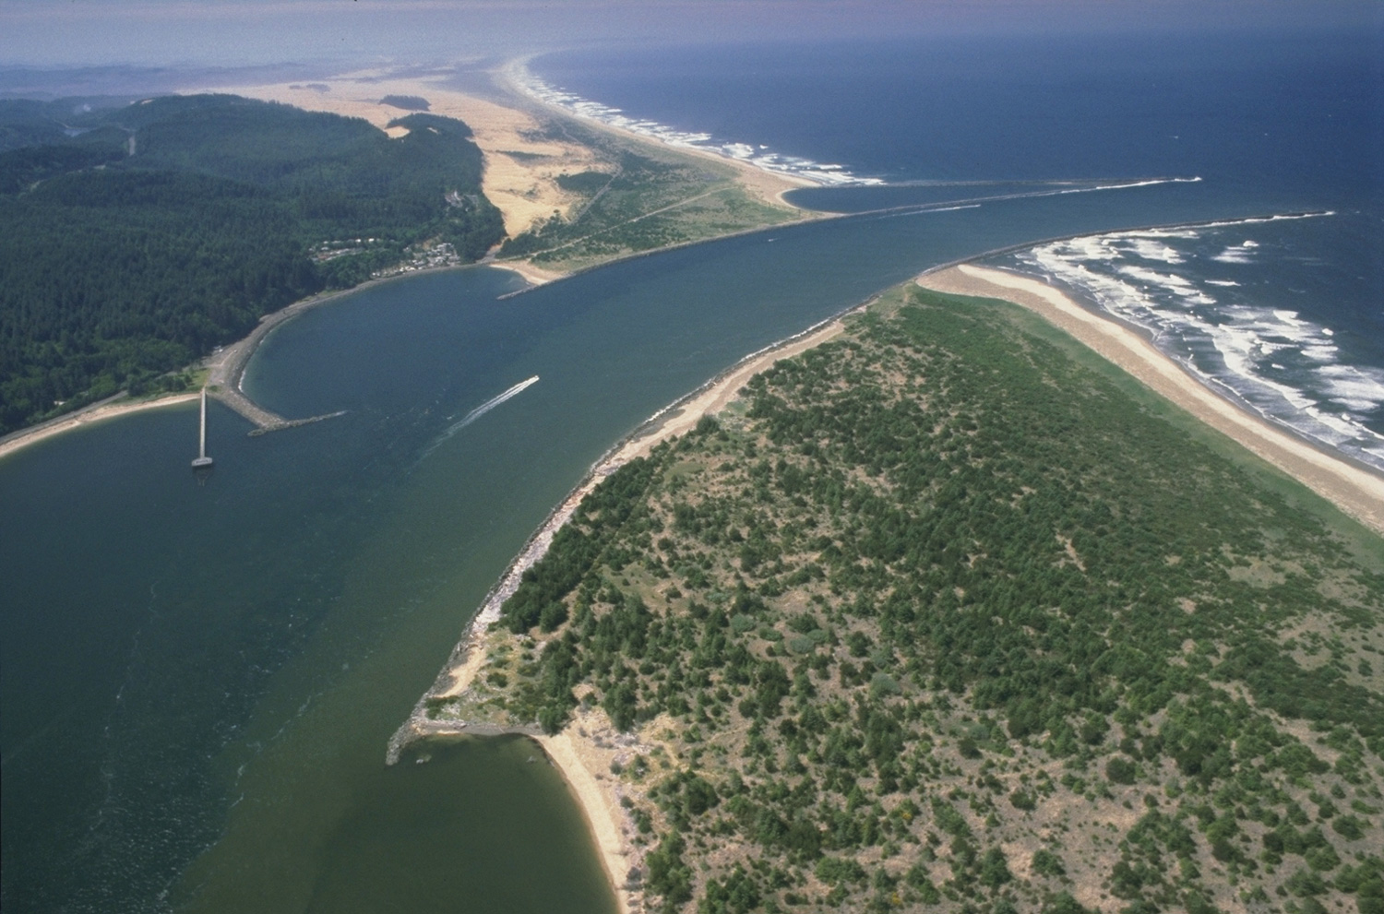
This is the Umpqua River estuary in Oregon. This view is the opposite view of the river that is on page 7.

Slide 3
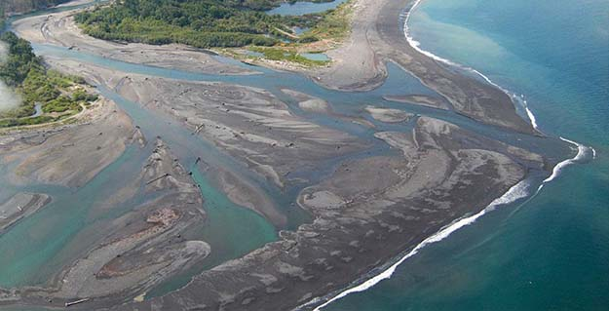
The Elwha River in Washington is used by chinook, coho, chum, sockeye, and pink salmon.

Slide 4
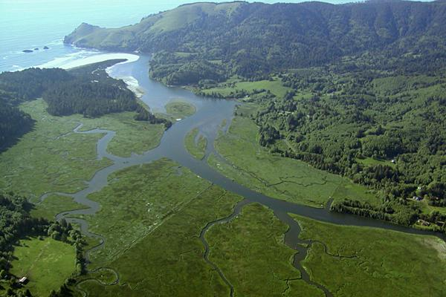
This the mouth of the Salmon River near Cascade Head, Oregon.

