Slide 1
Evidence-Based Responses
Part 1: Direct Instruction and Writing from Sources

Slide 2
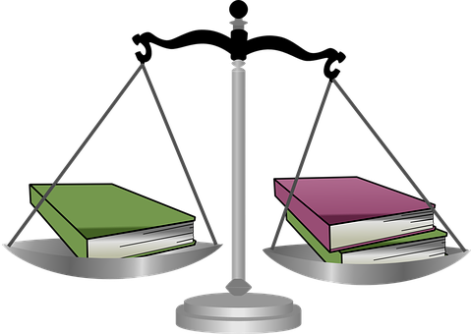
What is the role of evidence when creating a response to inquiry?
Notes:
Many of us have watched police procedurals and understand that the burden of proof in a court case relies on the presentation of reliable evidence. This idea of identifying the best and most useful evidence is also helpful when planning investigations in our classrooms. As with our favorite detectives, it is important that we let the evidence lead us to a conclusion. We should not simply search for the evidence that will confirm our current idea.

Slide 3
Evidence Based Responses
Evidence is not just from reading. Evidence may come from a variety of sources including print and digital texts, personal interviews, observation, and experience.
Close reading develops critical thinking and analysis skills which must also be applied to academic discourse, viewing, and listening.
Do you assess listening?
Notes:
Evidence comes from a variety of sources including text, digital sites, discussions, interviews, observations, and experiences. Each discipline includes preferred sources of information including books in ELA; experience and observation in science’ primary sources such as journals, letters, and diaries in history; and data trends in mathematics and health sciences to name just a few. An interdisciplinary project provides students the opportunity to move between types of sources and methods of collecting evidence to inform decision making and responses.

Slide 4
Evidence
How do you know whether your students are effectively using evidence to support their responses?
Develop student constructed responses that may be brief writing or other types of responses. Be specific and consistent with item construction.
Create accountable talk protocols to enhance evidence-based discussion.
Notes:
How do you know whether your students are effectively using evidence to support their responses. One source of data comes from our state assessments. If you can access your historical data, look for performance on CR or constructed response items. These are the types of items where students write the answers rather than selecting a response. Did your students generally earn all available points for CR items? There is evidence of instructional strength or area for improvement.

Slide 5
DIRECT INSTRUCTION
How to begin teaching students to use evidence effectively and ethically at lower elementary grades
Notes:
While this part of the presentation is intended for the lower grades, upper grade students who are not familiar with evidence-based responses will benefit from this type of instruction but may need less practice.

Slide 6
Writing From Sources
Using evidence in written responses
Notes:
A logical beginning is framed in literacy skill development. Begin with reading and writing skills. This is the most direct method of developing analysis skills and understanding methods of developing responses.

Slide 7
What is “writing from sources”?
Analytical writing tied to literary and informational texts;
writing in response to sources;
writing about sources.
Students analyze the source, make valid claims about the source, and support those claims with evidence from the source.
Notes:
“writing from sources” includes familiar writing tasks such as literary analysis and research projects.
“Writing from sources is, in general, analytical writing in response to literary and informational texts. Students are expected to use evidence from texts to present careful analyses, well-defended claims, and clear information.
Inevitably, it is integrated closely with Reading in ELA, history/social studies, science, and technical subjects.
Rather than asking students questions they can answer from their prior knowledge or experience, the standards expect students to answer questions that depend on their having closely read and understood the text.”

Slide 8
What is “writing from sources”?
Writing well-grounded and thoroughly supported arguments and informational reports.
Using evidence from texts and other sources to present careful analyses, well-defended claims, and clear information.
Generating reports from research; writing from multiple sources (beyond text).
Notes:
Across all content area learning, students should be creating responses based on stimulus. For now, we will explore writing short responses and focus on the types of resources students will encounter during disciplinary instruction.

Slide 9
Prompt
Explain how penguins stay warm in the Antarctic climate.
Use evidence from the texts to support your response.
Explain: comprehend/understand
Use: apply
Notes:
The construction of the prompt is important. Don’t overload. Begin each part with a verb. Consult Bloom’s taxonomy to make sure you are addressing the target level. In this case, we are assessing comprehension of the sources and raising the assessment level to application by requiring students to use evidence from the texts support.

Slide 10
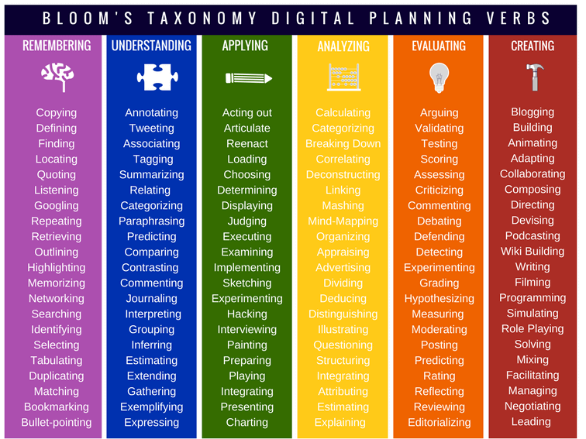
https://www.teachthought.com/critical-thinking/blooms-taxonomy-verbs-2/
Notes:
Remember to consider the cognitive scale that you use locally and make sure that your prompt is aligned to the appropriate level. Visual from https://www.teachthought.com/critical-thinking/blooms-taxonomy-verbs-2/

Slide 11
Prompt
Explain how penguins stay warm in the Antarctic climate. Use evidence from both texts to support your response.
https://stateofmaine.sharepoint.com/:b:/t/DOEOfficeofInnovation-InnovativeInstructionTeam/EThEoUeGS0VIgSS-SRLynA0B9p0KrkI0Tm-e5w156LQElA?e=DJfNvI
https://stateofmaine.sharepoint.com/:b:/t/DOEOfficeofInnovation-InnovativeInstructionTeam/EYEexGnc0rdAkiG45OVV1c0BGcq2Xgt4CRna0aCXl6RRRQ?e=2Eb5d6
Notes:
Provide the sources in the beginning. Curate reliable sources that are appropriate for the development level of the students. It is important to determine whether you want students to use evidence from both texts or just one in the response.

Slide 12
End of Part 1
Continue to
Recognizing Bias and Collecting Evidence

