Slide 1
Educational Stability for Highly Mobile Students
Webinar Training Session 2018-19
April 8, 2019
1:00 - 2:30 PM

Slide 2
Agenda
Welcome & Introductions
Migrant Education
Military Families
Homeless Education
Foster Care
Best Practices / Resource Sharing
tinyurl.com/mainedoe2019

Slide 3
Chat: What school district are you representing, and what are your roles in your district?

Slide 4
Outcomes
Qualifications of each group
Educational Rights
Supports for schools and students
Effective strategies for all groups
Better prepared to support Maine’s highly mobile students!

Slide 5
Why Educational Stability
Frequent school transitions may have lasting academic, social, and emotional impacts.
Maximizing educational stability can
improve attendance
minimize educational gaps
help families stay connected

Slide 6
Chat: What are the main factors contributing to student/family mobility in your school communities?

Slide 7
Migrant Education Program
Title I Part C

Slide 8
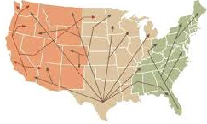
Purpose
Ensure migrant students achieve same academic success as peers - HS diploma
Supplemental educational services: Instructional, Advocacy, Transportation, Support, Counseling, Referrals
Four populations: 0-2, Pre-K,
In-school, Out of School Youth

Slide 9
Who qualifies?
Children who are new to your district in the past 3 years (or moved during the summer) and
Have a household member who has worked in agriculture or fishing

Slide 10
Services for Migrant Children provided by Mano en Mano
Facilitation of Enrollment
Ensure Equal Access & Comparable Services
Provide Supplemental Educational Support
Migrant Students automatically qualify for free lunch!

Slide 11
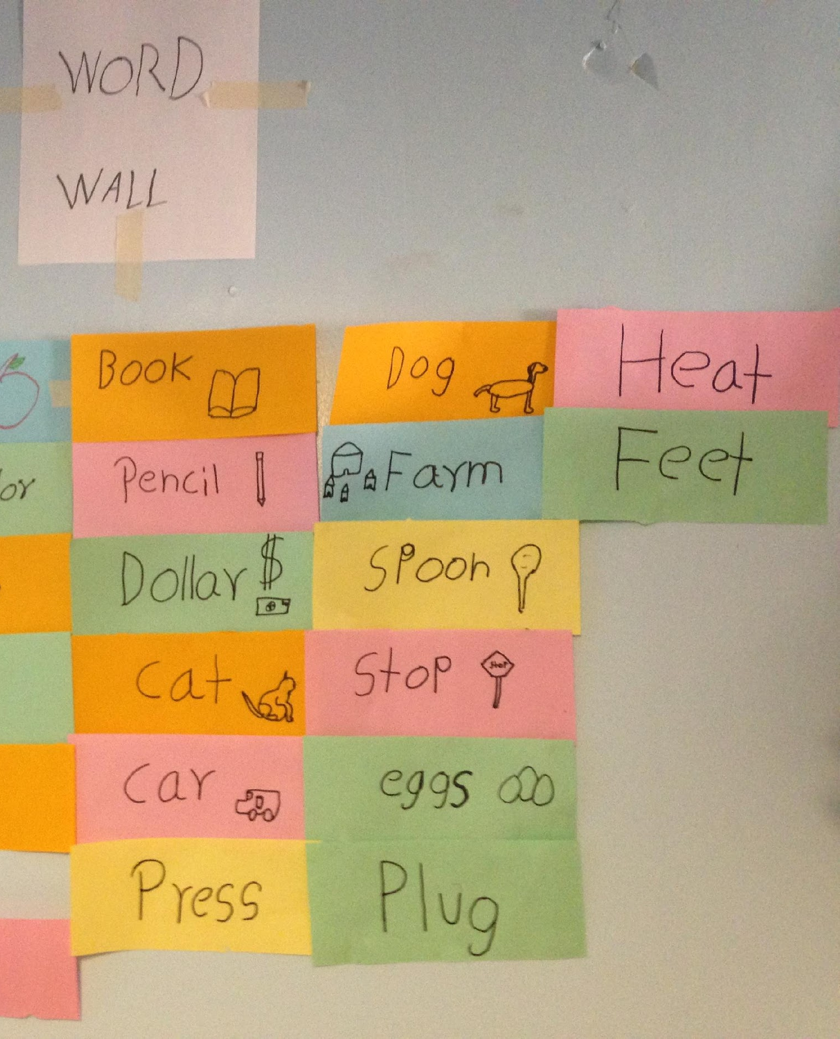
Regular School Year Services

Slide 12
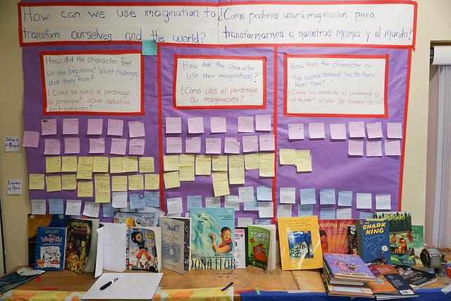
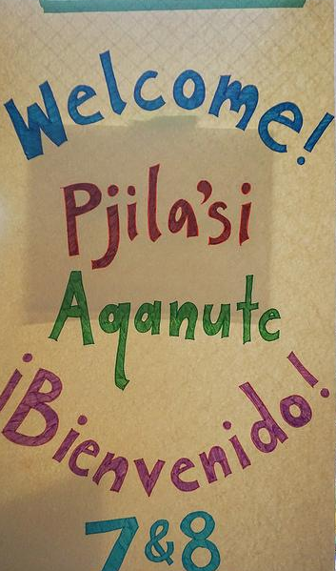
Summer Services: PBL & Blueberry Harvest School

Slide 13
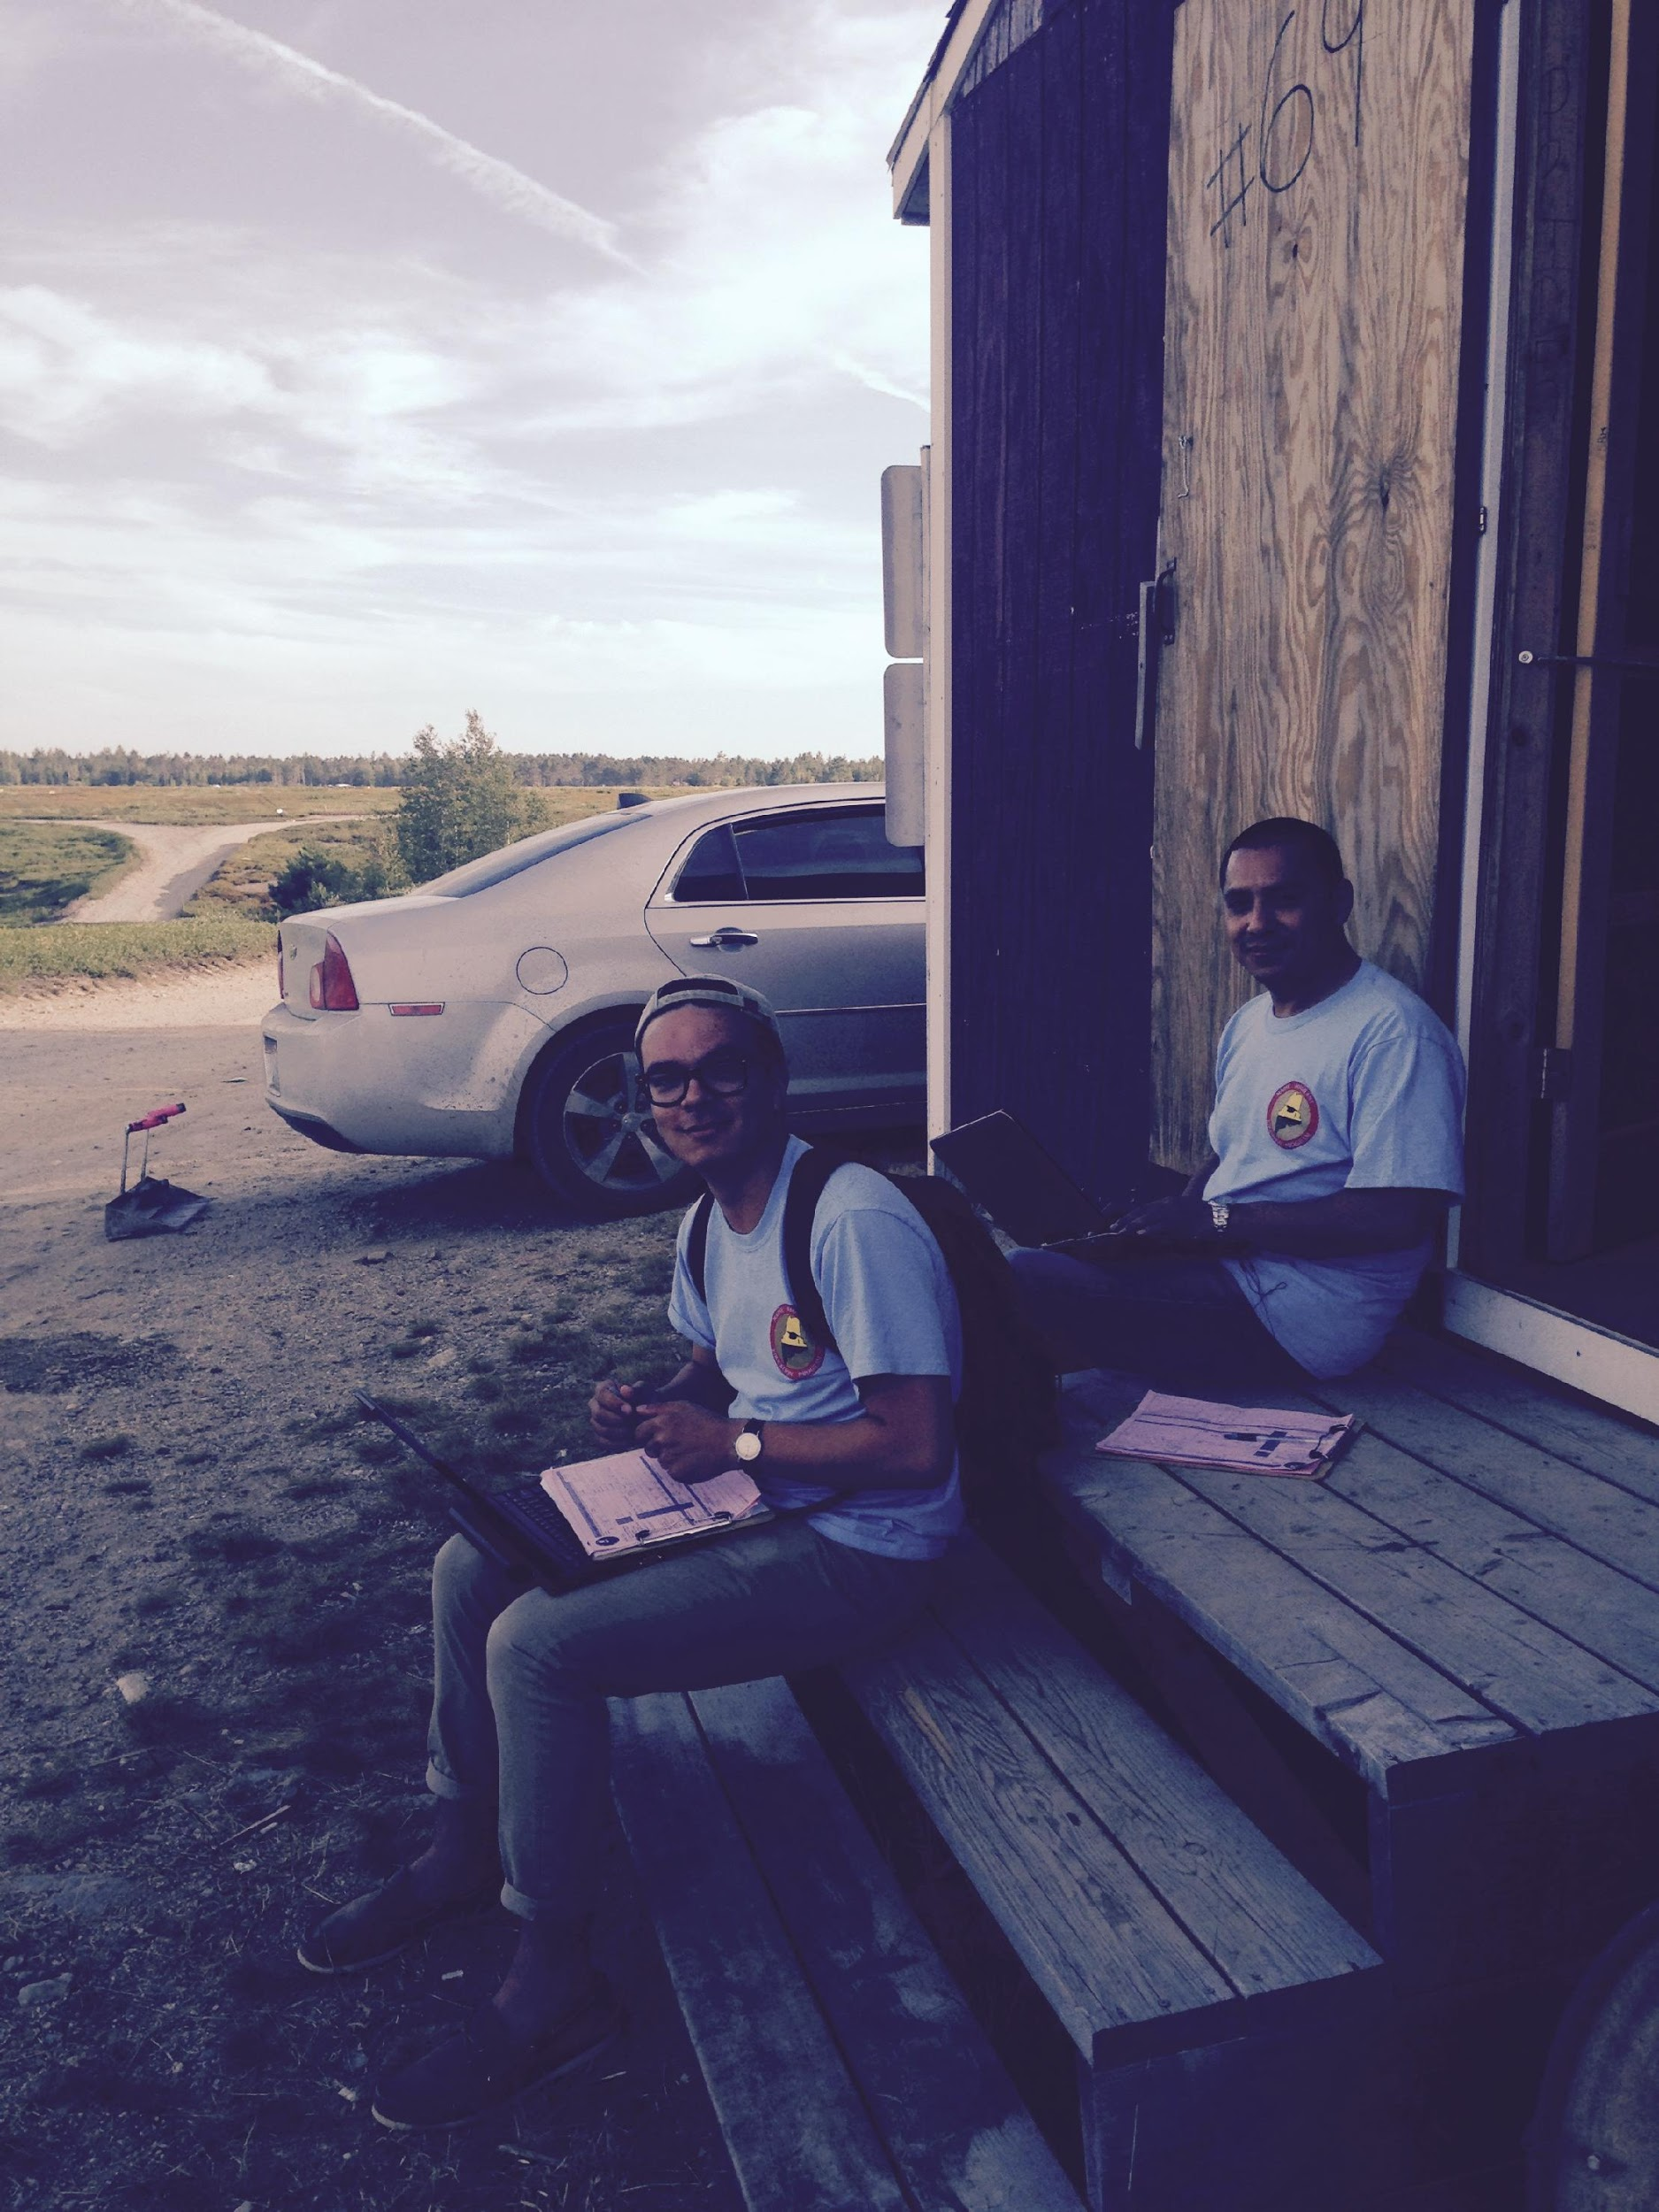
How do we find eligible students?

Slide 14
How can you help?
Have you seen this before?

Slide 15
Chat: What strategies do your schools use to identify highly mobile students?

Slide 16
SUPPORTING OUR MILITARY FAMILIES
KRISTEN FERULLO
SCHOOL LIAISON OFFICER

Slide 17
WHO AM I & WHAT DO I DO?
ROLE OF THE SCHOOL LIAISON OFFICER (SLO)
SCHOOL TRANSITION SUPPORT (PCS)
DEPLOYMENT & REINTEGRATION SUPPORT
K-12 SPECIAL EDUCATION NAVIGATION
HOME SCHOOL SUPPORT
PARTNERSHIP IN EDUCATION (PIE)
POST-SECONDARY PREPARATION OPPORTUNITIES
COMMAND, INSTALLATION, SCHOOL, COMMUNITY COMMUNICATIONS

Slide 18
NEEDS & CONCERNS OF OUR MILITARY KIDS
Emotional
the 2 Week Rule
Educational
Making New Friends - The Lunchroom
Fear of getting attached to new friends
Participation in Extracurricular activities & sports
Deployment
Reintegration
1 in 15 have lost a family member to war
Families will experience 6-9 moves throughout their military career
Transfer of credits, grades & coursework
Redundant & missed testing
Graduation requirements
Transfer of Special Education Services
Changes in schedule & grading

Slide 19
WHEN THE BOTTOM FALLS OUT
Deployment & Reintegration
Deployments can be very sudden and the timeline for coming home can change frequently.
Families don’t often inform the school or others.
Kids can experience the phases of grief during this time.
Kids can go through heightened emotions & behavioral challenges.
How can we help?
Having a service member come home can be more stressful than having them deployed for some families.
A new family normal has been established
Children have grown & changed
Communication
Expectations
Service Member Coping with “normal”

Slide 20
Chat: What strategies do your schools use to welcome highly mobile students and families and help them integrate into new school communities?

Slide 21
MIC3
MILITARY INTERSTATE COMPACT CHILDREN’S COMMISSION

Slide 22
THE NAVY SERVES AS THE MILITARY REPRESENTATIVE FOR ME & NH. I SERVE AS THE SUBJECT MATTER EXPERT (SME) IN EDUCATION FOR BOTH STATES UNDER THE PNSY COMMANDING OFFICER.
Military Interstate Children’s Compact Commission (MIC3)
K/1 Entrance Ages
Transfer of Records
Placement & Attendance
Graduation Requirements
Special Education Services
Immunizations
Extracurricular Participation
The Compact seeks to level the playing field for highly transient military children through addressing Educational Transition Issues.
The Compact is NOT intended to impact curriculum or local standards of education.

Slide 23
MIC3 IS LAW IN ALL 50 STATES
MIC3 Questions??
Kristen Ferullo, SLO
Kristen.Ferullo@navy.mil
www.MIC3.net
The Compact Covers Children of
1. Active Duty Military including Guard & Reserves (Title 10)
2. Commissioned Officers of NOAA & USPHS
3. Medically Discharged/Retired service members up to 1 year to their final home of record
4. Service Members perished up to one year
Military Impacted Schools Association

Slide 24
Maine Military Identifier
NEW FORM
SY 18-19 ESSA Mandate
Current Data Highly Inconsistent
New Form seeks to Educate families
Provides concise data to those who can support
Opens opportunities for resources
WHY?
Active support agencies do not know where military families reside
Identifying National Guard & Reserve families is critical
Schools and families need support & understanding
Resources and educational opportunities available

Slide 25
FEDERAL IMPACT AID
Data Collection
At the beginning of each school year
Questionnaire in 1st day paperwork
One form PER CHILD
Educate Admin Teams of its importance
Must answer the WHY?
Answering more than the minimum!! Need for accurate data on National Guard & Reserve
DOE Impact Aid
Section 8003(b)(1) Basic Support Military Connected Students make up roughly 3% of the LEA’s average daily attendance.
Section 8003(d) Children With Disabilities Additional payment for services for military connected students with disabilities as defined by IDEA
DOD Supplemental Aid
*Must Survey Entire LEA*

Slide 26
What can we do to Support Our Military Families?
ADD A MILITARY FAMILY SECTION TO YOUR DISTRICT WEBPAGE INCLUDE THE FOLLOWING
www.navymwrmidlant.com/pnsy/slo and everything on the family resource slide!
EDUCATE YOUR ADMINISTRATORS & TEACHERS WE WILL EVEN DO IT FOR YOU! PROVIDE A WELCOMING COMMITTEE VETERAN’S DAY CELEBRATION
APRIL: MONTH OF THE MILITARY CHILD

Slide 27
RESOURCES FOR FAMILIES
Worldwide School Liaison Directory www.dodea.edu/partnership
Maine National Guard Family Program www.me.ngb.army.mil/family
Maine National Guard Youth Program www.me.ngb.army.mil/family/youth.aspx
Free Online homework help & Tutoring for military kids www.tutor.com/military
SAT/ACT Prep www.eKnowledge.com/PortsmouthNavalShipyard
Military One Source www.militaryonesource.com
Military Child Education Coalition www.militarychild.org
National Military Child Family Association www.militaryfamily.org
Military Interstate Children’s Compact Commission www.MIC3.net
The Education Trust www.edtrust.org
Guide to Online School www.accreditedschoolsonline.org
Parent Advocacy Council for Educational Rights www.pacer.org
Learning Disabilities Information www.ldonline.org
Center for Parent Information & Resources (CPIR) www.parentcenterhub.org

Slide 28
SCHOOL RESOURCES
Military Impacted Schools Association (MISA) www.militaryimpactedschoolsassociation.org
National Military Family Association (NMFA) www.militaryfamily.org
Military Interstate Children’s Compact Commission www.MIC3.net
Penn State Clearing House for Military Families www.militaryfamilies.pus.edu
National Math & Science Initiative www.NMS.org
Department of Defense Education Activities(DoDEA) www.dodea.edu/partnerships.index.cfm
Military One Source www.militaryonesource.com
Military Child Education Coalition (MCEC) www.militarychild.org

Slide 29
Thank You for Supporting Our Military Families!
Kristen Ferullo
Military School Liaison Officer
Facebook @ MENHSchoolLiaison
Maine National Guard Youth Program
Facebook @ MENGYouthProgram

Slide 30
Chat: What strategies do your schools have in place to help students stay on track and graduate on time?

Slide 31
The McKinney-Vento Act
Supporting Education Stability for Homeless Children and Youth

Slide 32
Who is homeless?
Homelessness is defined as lacking fixed, regular, and adequate nighttime residence, and includes:
Shelters and transitional housing
Doubling up due to economic hardship, loss of housing, similar reason
Motel or hotel
Unsheltered/inadequately sheltered - living in campgrounds, parks, cars, other places not meant to be housing, substandard housing
No minimum or maximum age or duration
Unaccompanied homeless youth - not physically staying with parent/legal guardian
Migrant youth in above situations are also homeless

Slide 33
Homeless students in Maine
2016-17 Total of 2515 identified
30% increase since 2014-15
Doubled Up 61% Unaccompanied 21%
Shelter/Transitional Housing 22% IDEA 32%
Motel/Hotel 13% EL 12%
Unsheltered 4% Migrant 0%

Slide 34
Homeless Students: How are they doing?
For 2016-17
Chronically absent 43% (17% for all students)
RLA proficient 23% (55% for all students)
Math proficient 15% (38% for all students)
4 yr grad rate 59% (87% for all students)

Slide 35
Core Rights
School selection - schools of origin and residence
Immediate enrollment
Dispute resolution (eligibility and placement)
Equal access to available programs/Maximum integration into regularly available programs
Transportation
Free school meals
Title IA support/comparable services
Confidentiality about housing status

Slide 36
Chat: What strategies do your schools use to facilitate immediate enrollment of highly mobile students?

Slide 37
Other Key Homeless Liaison Responsibilities
Identification
Providing info and referrals
Informing parents about their children’s rights, educational opportunities , and meaningful opportunities for parent involvement
Ensuring public notice of educational rights of homeless youth
Training other school personnel
Collaborating with other agencies
Verifying homeless status for students applying to post-secondary programs
Do you have the time and capacity to
dedicate to these varied functions?

Slide 38
Foster Care Educational Provisions

Slide 39
Foster Care - Title I Part A Provisions
Ensures educational stability
Establishes specific educational rights
Requires a district foster care point of contact
Requires a state foster care point of contact at both DOE and DHHS

Slide 40
Definition of Students in Foster Care
Students in 24-hour out-of-home care, placed away from their parents or guardians, and for whom DHHS has placement and care responsibilities
Students previously identified as “awaiting foster care” (in emergency, short term placements) under McKinney-Vento
Foster homes can include group homes, foster homes, kinship foster homes

Slide 41
Educational Rights of Students in Foster Care
School of Origin
Transportation
Best Interest Determination
Immediate Enrollment

Slide 42
School of Origin
School the student was attending when placed in foster care, or at the time of a subsequent change in foster care placement. Students should remain enrolled in their school of origin, unless, after a best interest determination, it is decided to be in their best interest not to.

Slide 43
Best Interest Determination (BID)
Decisions about which school a student will attend should be made collaboratively, and consider a wide variety of factors
Should include those in the best position to understand the student’s unique needs
Student should remain in their school of origin until the BID is complete

Slide 44
Chat: Who should be involved in the Best Interest Determination?

Slide 45
Student, parent/guardian, foster parent
Educational decision maker, legal representative
Social worker, education coordinator
District POC, special education, guidance counselor, teacher
District POC – from district of foster placement

Slide 46
Chat: What should we consider when making a best interest determination for school placement?

Slide 47
Other Considerations for BID
Is the school of origin in the best interest for a limited duration of time?

Slide 48
Other Considerations (cont’d)
Transportation costs should NOT be a factor in determining the best interest.

Slide 49
Transportation
Districts and DHHS must collaborate to establish policies to ensure students who need transportation to remain in their school of origin can. Absent another agreement, districts of origin are responsible for providing transportation to and from the school of origin. Districts should document all costs associated with this transportation.

Slide 50
Chat: What strategies do your schools use to provide transportation for highly mobile students?

Slide 51
Immediate Enrollment
If BID supports attending school locally (where placed in foster care), districts must enroll immediately, with or without documentation, including academic, health, discipline and/or special education records.
Notice to LEA (from DHHS), includes emergency contact, residence, social worker, record release, transportation needs, etc.

Slide 52
School Selection Disputes
After the BID, DHHS has the authority to make final decisions about the best interest, but a school district may dispute. During the dispute resolution process, the student must attend the school selected by DHHS. Transportation must be provided if needed.

Slide 53
Role of District Foster Care POC
Ensure that students in foster care are:
identified and supported through coordination between Districts and DHHS
are enrolled in and regularly attending school

Slide 54
District Foster Care POC
Participate in making and documenting BIDs with DHHS representatives
Ensure school enrollment of students and timely transfer of records

Slide 55
District Foster Care POC
Develop procedures for coordinating cost-effective transportation
Facilitate professional development for district staff

Slide 56
Closing
Materials Posted at tinyurl.com/mainedoe2019
Coming soon: PD samples, Feedback Form
Chat: Questions/comments

Slide 57
Thank You!
Tyler Backus, School Finance & Compliance Coordinator
Military Family Education Liaison
(207) 624-6635
tyler.backus@maine.gov
Kristen Ferullo, Military School Liaison Officer
Portsmouth Naval Shipyard
(207) 318-1730
kristen.ferullo@navy.mil
Gayle Erdheim, Truancy, Dropout, Alternative Ed., & Homeless Ed. Consultant
(207) 624-6637
gayle.erdheim@maine.gov
Amelia Lyons, Consultant for Migratory & Highly Mobile Students
(207) 624-6722
amelia.lyons@maine.gov

