Slide 1
Weekly Words
Unit 3, Week 7
Notes:
celebration: an activity done to honor or celebrate something or someone
commerce: buying and selling goods and services
influence: power that has an effect on someone or something
kinship: a feeling of sharing common values, ideas, or characteristics; a feeling of being related, like to family
opportunity: a chance for a better situation or outcome
promote: to support or encourage; to tell about something in a public way
translate: to change into the words of another language
understanding: sympathy toward or appreciation about other people

Slide 2
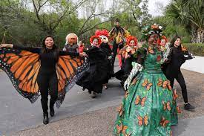
celebration
noun
an activity done to honor or celebrate something or someone
Notes:
celebration (noun)
Elaboration:
The people in this group are having a celebration in honor of Monarch butterflies and their migration from the United States to Mexico.
Think, Pair, Share prompt:
Tell your partner about a celebration you have been part of!
https://www.valleycentral.com/news/local-news/butterfly-migration-celebration-in-mcallen/

Slide 3
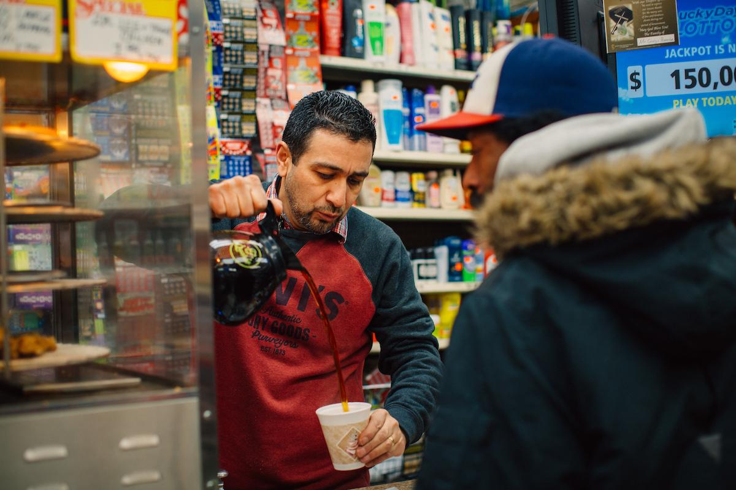
commerce
noun
buying and selling goods and services
Notes:
commerce (noun)
Elaboration:
These people are participating in commerce: one is selling a cup of coffee, and the other is buying it. Those are both sides of commerce.
Think, Pair, Share prompt:
When do you or other people in your family participate in commerce? What do you buy or sell?
https://www.citybureau.org/stories/2017/4/3/inside-englewoods-best-corner-store

Slide 4
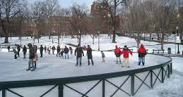
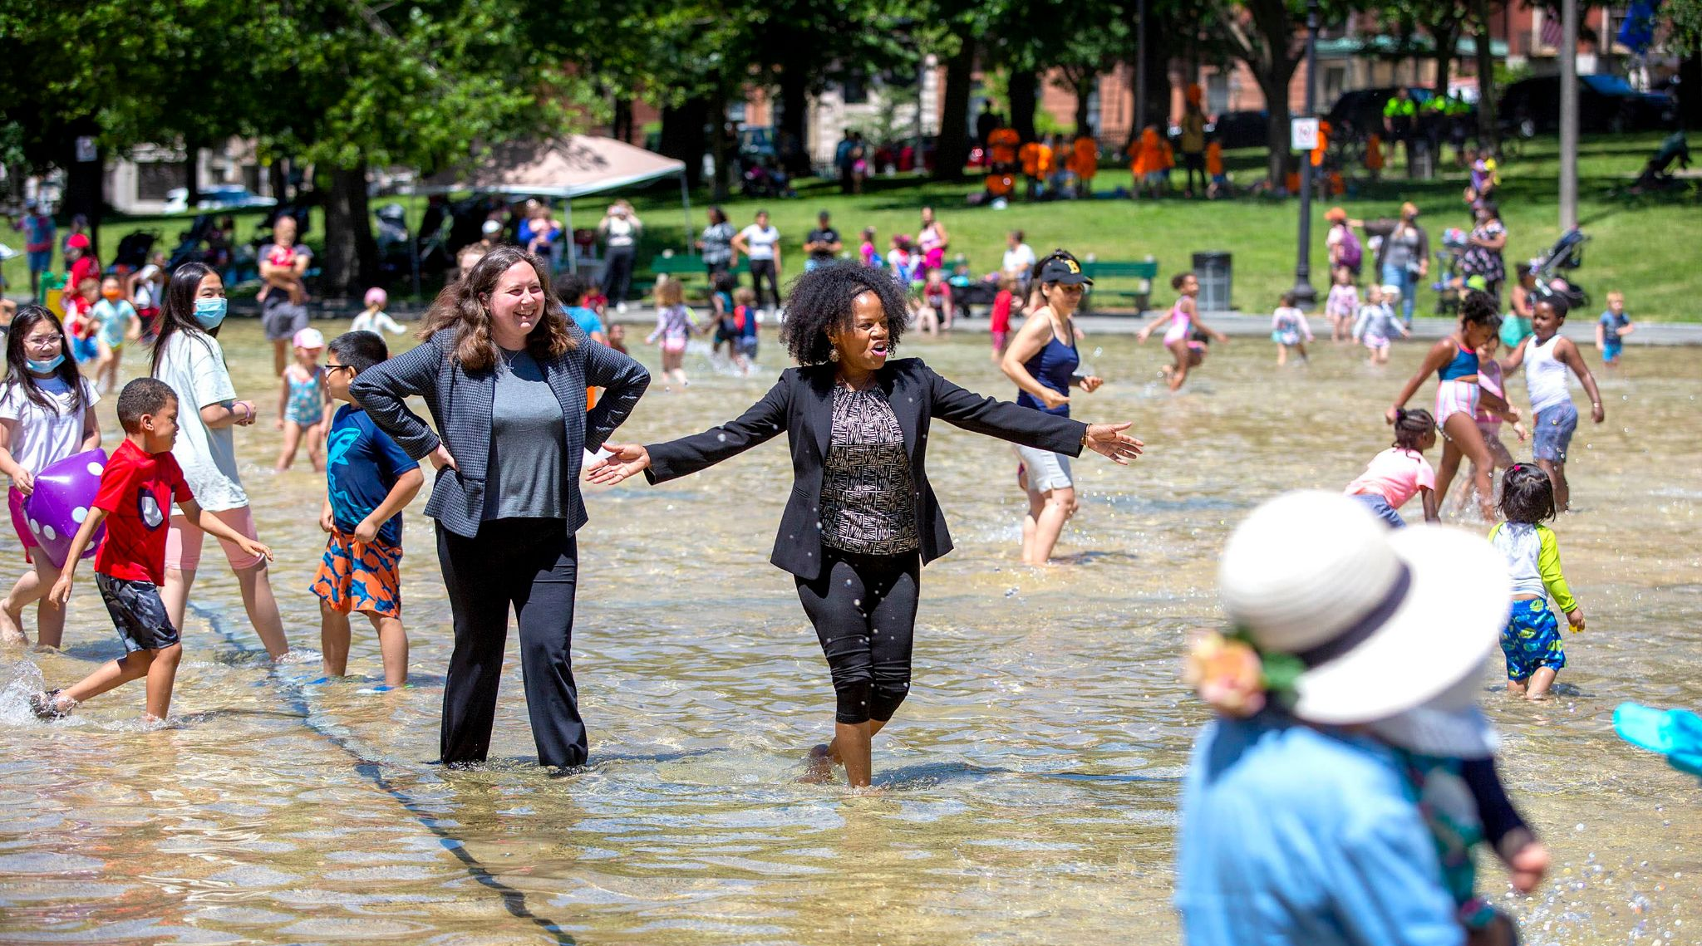
influence
noun
power that has an effect on someone or something
Notes:
influence (noun)
Elaboration:
Weather has an influence on the activities of people and animals. Maybe you have been ice skating in the winter and then playing in the same pond over the summer.
Think, Pair, Share prompt:
What are some ways that the weather has an influence on things people do?
https://www.bcheights.com/2020/12/01/frog-pond-closes-for-ice-skating-for-first-time/, https://www.wbur.org/news/2021/06/25/janey-frog-pond

Slide 5

kinship
noun
a feeling of sharing common values, ideas, or characteristics; a feeling of being related, like to family
Notes:
kinship (noun)
Elaboration:
Kinship can be thought of as a tree, with lots of different parts that are all related in some way. You can feel kinship with people in your family, or with someone you have just met but who you have lots in common with. Think of when you are with someone and you think, “I feel exactly the same way! We are connected!” You feel affinity for one another.
Whole group prompt:
Can you think of a character in a book we have read whom you feel kinship with?
https://www.basicgoodness.com/2014/eps-68-family-constellation-adventure/

Slide 6
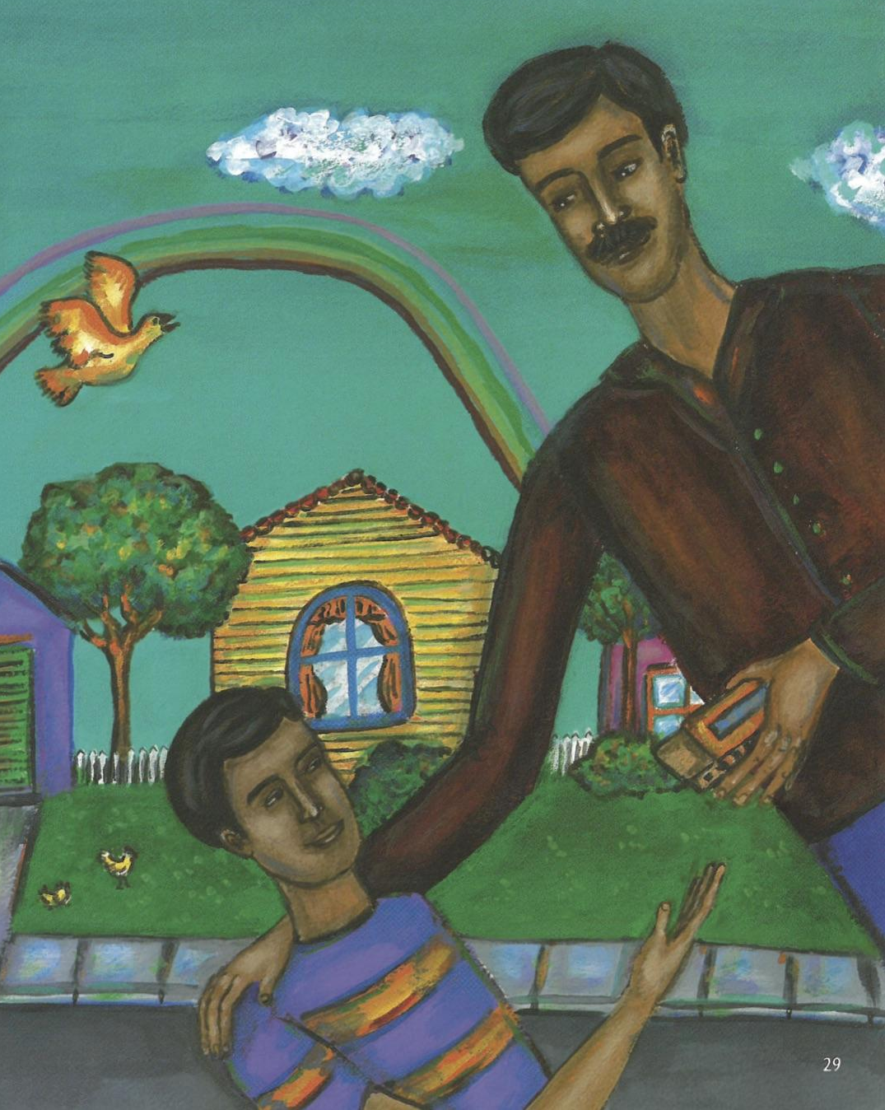
opportunity
noun
a chance for a better situation or outcome
Notes:
opportunity (noun)
Elaboration:
In The Upside Down Boy, Juan Felipe Herrera describes his first opportunity to go to school, when he was eight years old. In this story, he has another opportunity to perform for his classmates, when his uncle gives him a harmonica. Opportunities can feel exciting and also a bit worrisome.
Think, Pair, Share prompt:
This week you will have an opportunity to _____ in school. How do you feel about that?
OR:
What is an opportunity you have had? How did you feel about it at the time?
Illustration from The Upside Down Boy | El niño de cabeza by Elizabeth Gómez, written by Juan Felipe Herrera

Slide 7

promote
verb
to support or encourage;
to tell about something in a public way
Notes:
promote (verb)
Elaboration:
When you are working on an important project, or if you hear about something, and you want other people to know about it, you can promote it—tell others about it.
Think, Pair, Share prompt:
Imagine there is going to be a festival in town. What are a few ways you could promote it so everyone finds out about it and plans to come?
https://www.eventbrite.com/blog/how-to-promote-event-social-media-ds00/

Slide 8
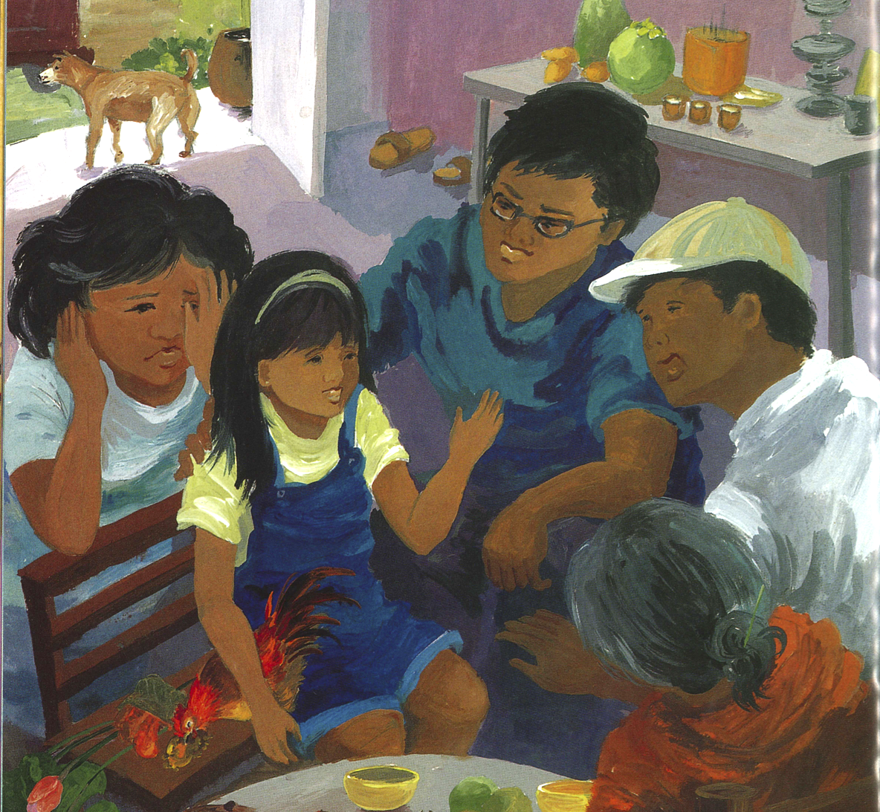
translate
verb
to change into the words of another language
Notes:
translate (verb)
Elaboration:
The people in Ami Chi’s family don’t all speak the same language. They find many ways to communicate, but sometimes it’s most useful to have someone to translate. That person, the translator, can speak both languages. Ami Chi’s grandmother speaks Vietnamese, and Ami Chi speaks English. Her parents can translate—they can tell one what the other is saying by switching back and forth between the two languages they know.
Think, Pair, Share prompt:
Share a time when you translated or saw another person translate for another person. What languages were used? What was the situation?
OR:
What do you think it would be like to be in a place where you didn’t speak the language and you didn’t have anyone to translate?
Illustration from Going Home, Coming Home by Ann Phong, written by Truong Tran

Slide 9
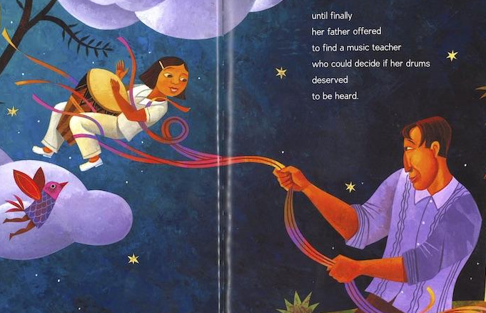
understanding
noun
sympathy toward or appreciation about other people
Notes:
understanding (noun)
Elaboration:
You know the verb “understand,” to get the meaning of something, like when you are reading a book.
Another meaning is to have sympathy for, or to appreciate somebody.
“Understanding” is a noun—the feeling of appreciating something about others.
In Drum Dream Girl, the drummer waits a long time for her father to develop an understanding about how important it felt to her to play the drums.
Think, Pair, Share prompt:
Have you developed a new understanding about [something related to the unit: muralists, musicians, etc…] through the work we are doing in this unit?
Illustration from Drum Dream Girl: How One Girl’s Courage Changed Music by Rafael López, written by Margarita Engle

