Slide 1
Compound Words
Vocabulary & Language Week 7, Days 3-4

Slide 2
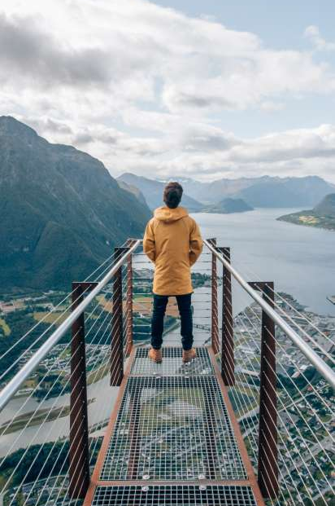
worldview
world view
Notes:
https://www.visitnorway.com/places-to-go/fjord-norway/northwest/andalsnes/

Slide 3
worldview
noun
a way of thinking about the world, a person’s whole perspective
Notes:
https://www.visitnorway.com/places-to-go/fjord-norway/northwest/andalsnes/

Slide 4
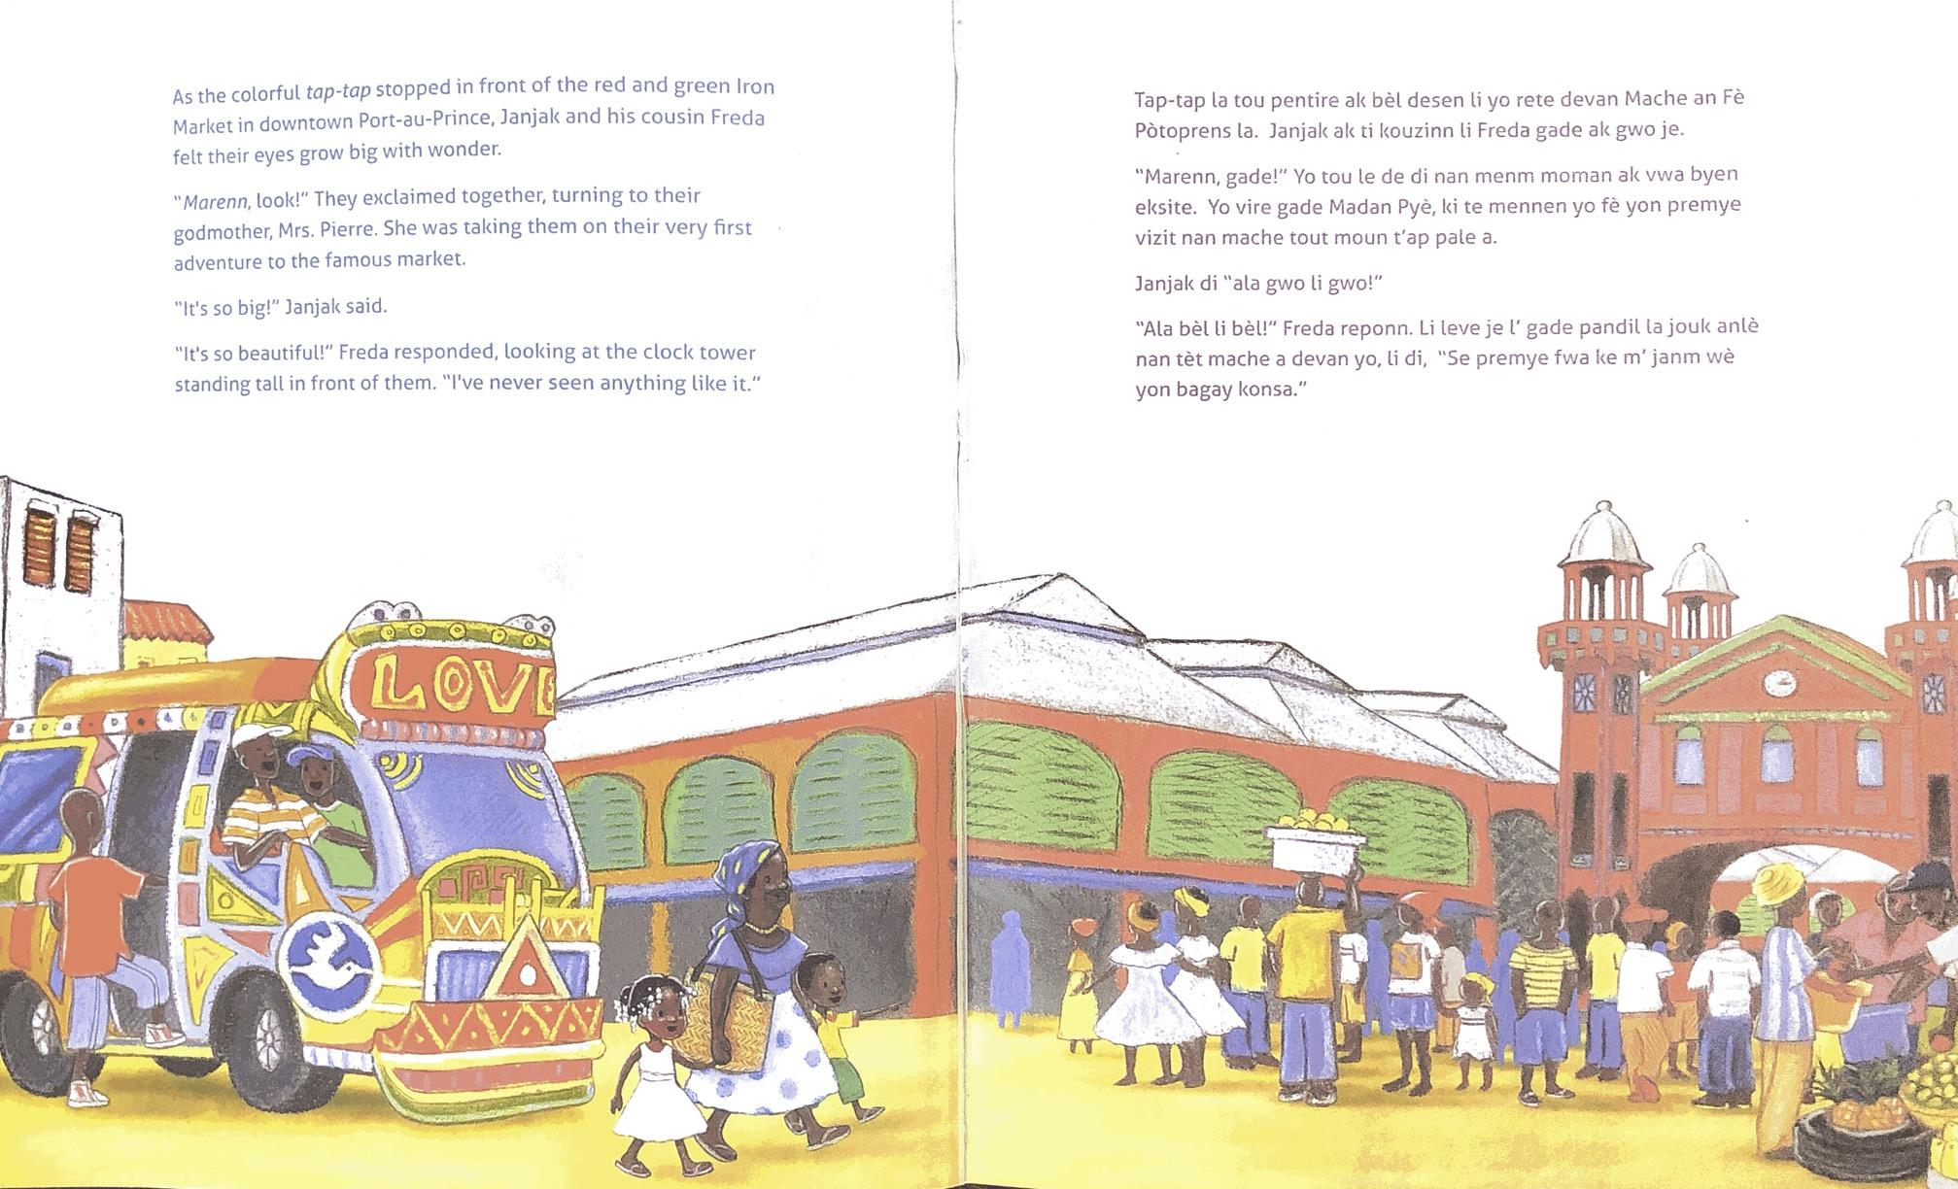
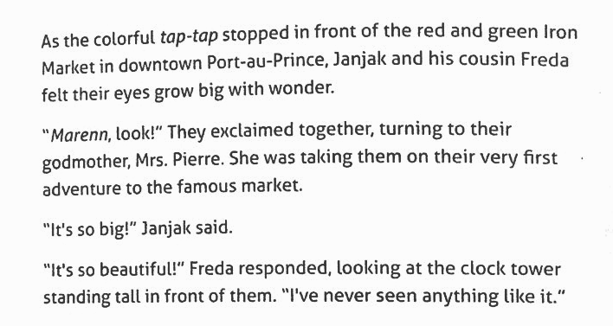

Slide 5
downtown
down town

Slide 6
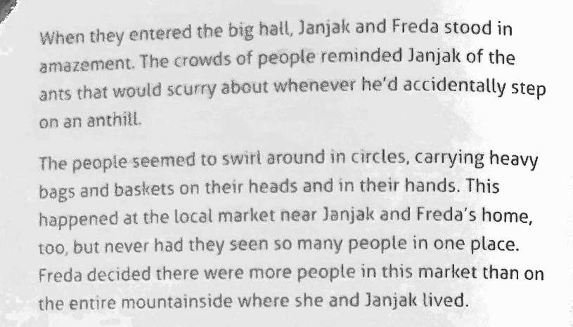
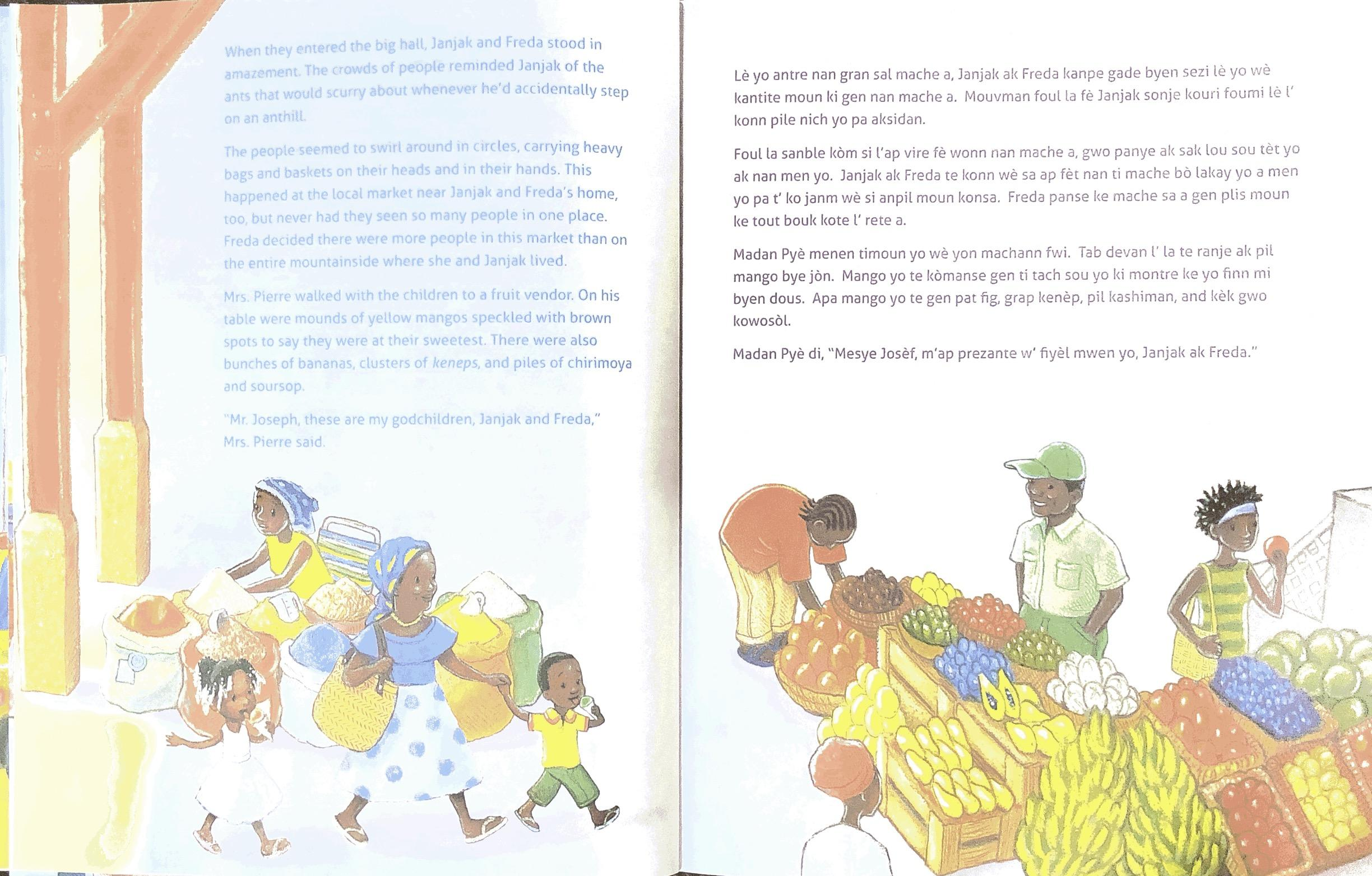

Slide 7
anthill
ant hill

Slide 8
mountainside
mountain side

Slide 9

Compound Words
Remember, compound words are made when two or more words are put together to form a word with a new meaning.

Slide 10
Compound Words
Today you will write 3 compound words.
You can use the words below to get started, or you can write your own words.
with | air | car | fly | room | way
drive | milk | ship | bath | tub | butter
shake | port | in | out | side | hall

Slide 11
Compound Words
After you write your compound words, tell them to a partner.
Show and read your first word.
Say what the first part of the compound word means.
Say what the second part of the compound word means.
Say what the compound word means.
Repeat Steps 1-4 for your other compound words.

