Slide 1
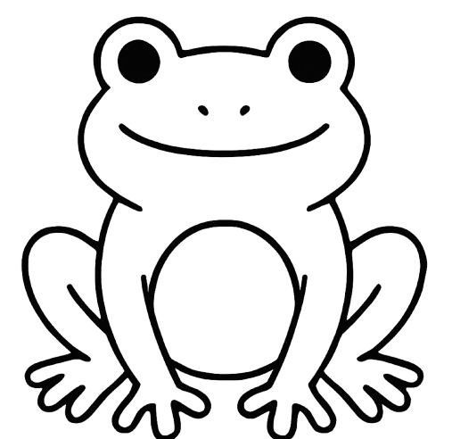
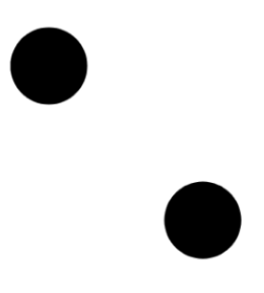

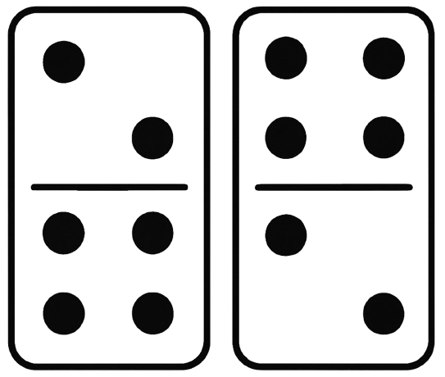
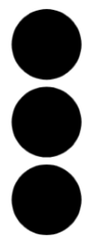
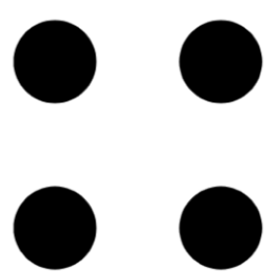
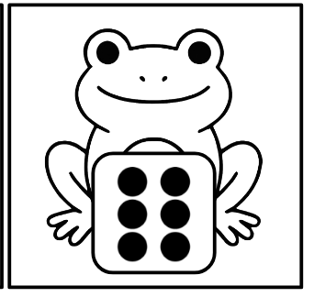
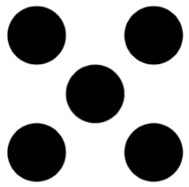

Unit 2: Week 1
Math Center
We can find number combinations. We can subitize the dots on dominoes and find different ways to compose numbers.

Slide 2
1
2
3
4
5
6
7
8
9
10
11
12
Print for center

Slide 3


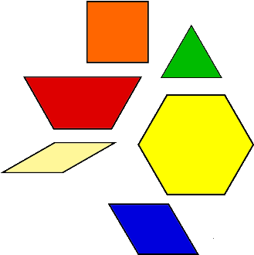
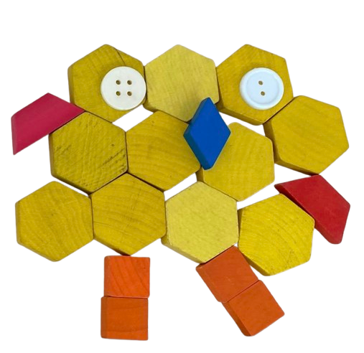
Unit 2: Week 2
Math Center
Imaginary Creatures
We can be inspired by the book Fish Is Fish and create our own imaginative creatures using math tools. We can make it more challenging by using a spinner to pick which shapes to use.
?
?

Slide 4
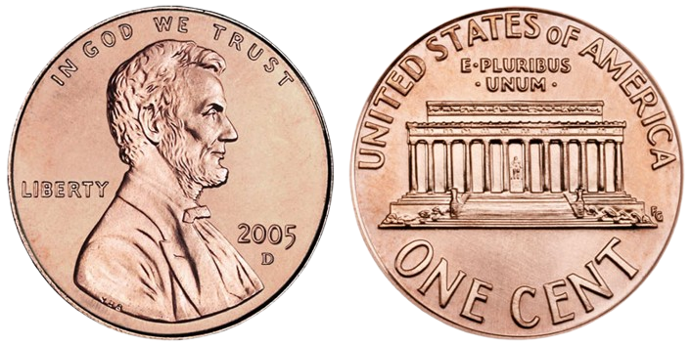
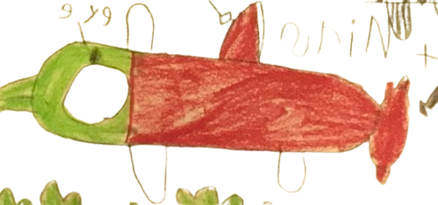
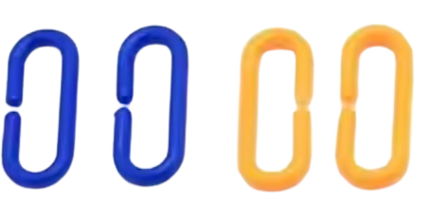
Unit 2: Week 3
Math Center
cubes
We can make fish inspired by our read aloud and research. We can measure our fish and compare the lengths to other fish.
pennies
links
Print as labels for measurement items

Slide 5
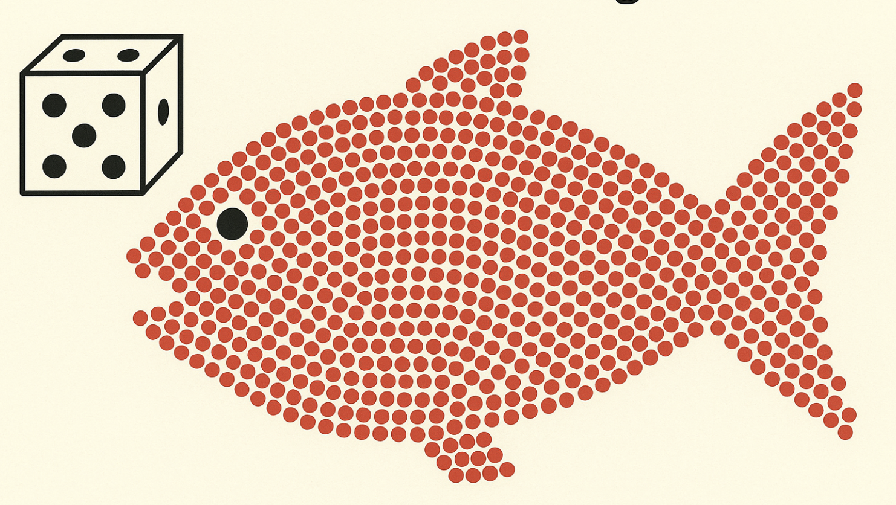
Unit 2: Week 4
1 | 2 | 3 | 4 | 5 | 6 | 7 | 8 | 9 | 10
11 | 12 | 13 | 14 | 15 | 16 | 17 | 18 | 19 | 20
21 | 22 | 23 | 24 | 25 | 26 | 27 | 28 | 29 | 30
31 | 32 | 33 | 34 | 35 | 36 | 37 | 38 | 39 | 40
41 | 42 | 43 | 44 | 45 | 46 | 47 | 48 | 49 | 50
51 | 52 | 53 | 54 | 55 | 56 | 57 | 58 | 59 | 60
61 | 62 | 63 | 64 | 65 | 66 | 67 | 68 | 69 | 70
71 | 72 | 73 | 74 | 75 | 76 | 77 | 78 | 79 | 80
81 | 82 | 83 | 84 | 85 | 86 | 87 | 88 | 89 | 90
91 | 92 | 93 | 94 | 95 | 96 | 97 | 98 | 99 | 100
Math Center
We can roll a dot cube and add the number of fish to the large fish outline. Like in Swimmy, we can use teamwork to fill the fish completely!

Slide 6
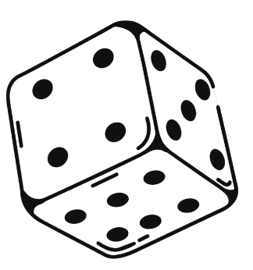
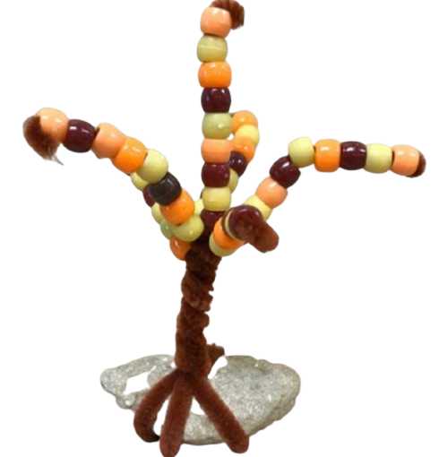
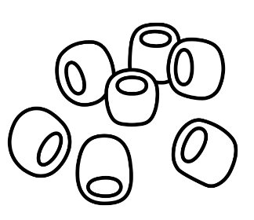
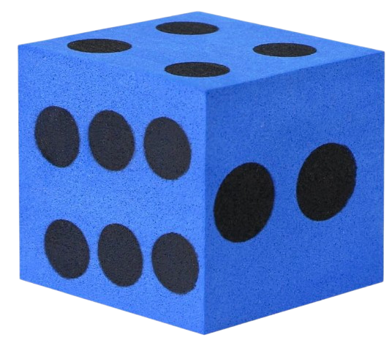
Unit 2: Week 5
Unit 2: Week 5
Math Center
Roll and Build
We can roll a die and add leaves to our trees to make a forest for the owls.
1.
Roll dot cube
Count out beads
2.
String beads on tree branch
3.

Slide 7
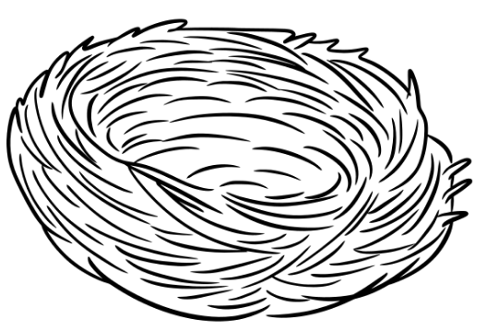
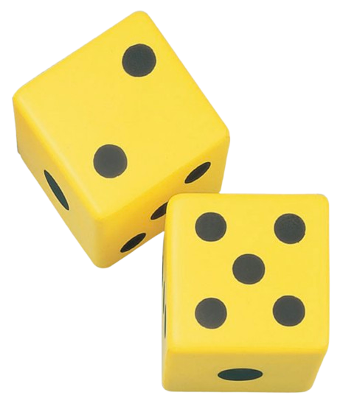
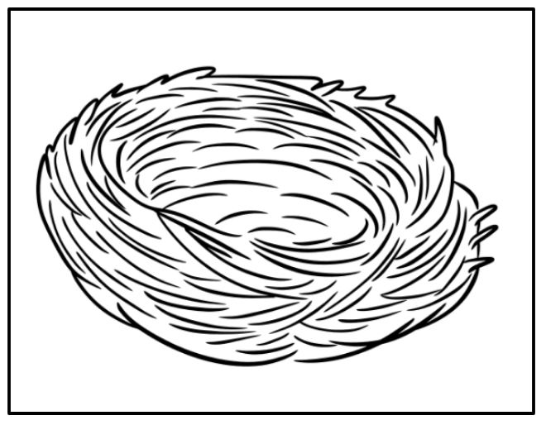
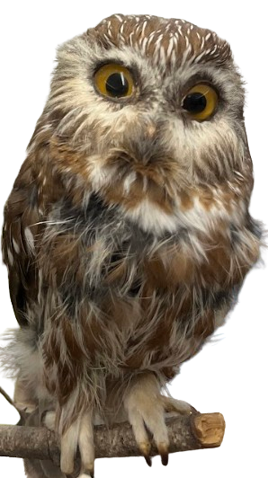
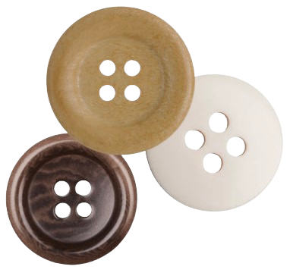
Unit 2: Week 6
Math Center
We can add two dice together. We can use math tools to solve the problems and add the total to the owls nest.
Use these cards or make your own nest using beautiful stuff

Slide 8
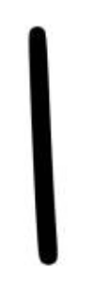
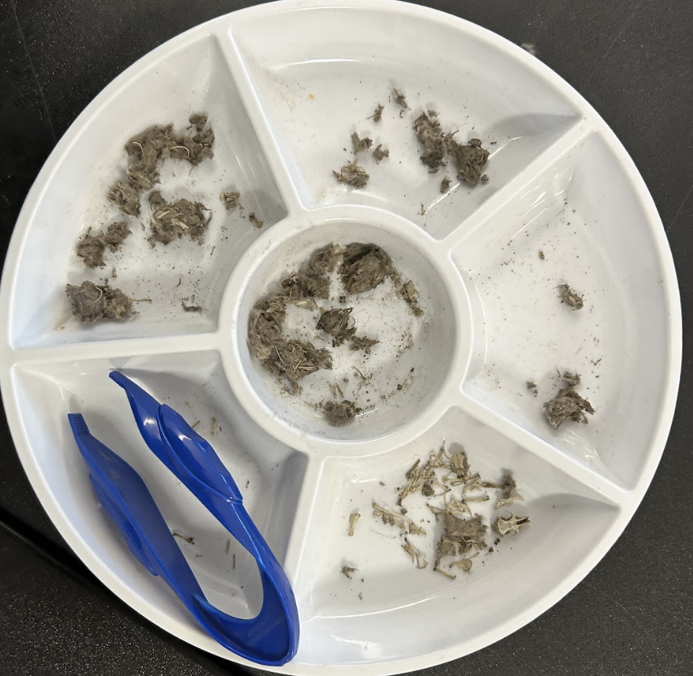
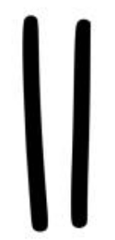
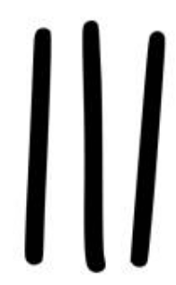
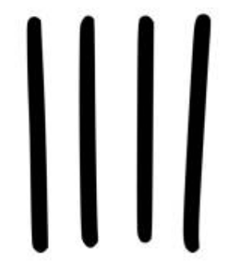
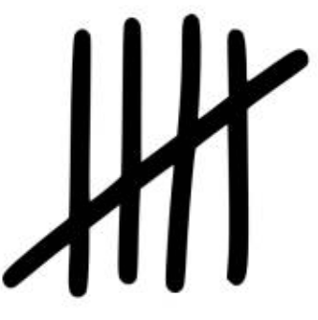
Unit 2: Week 7
Use this link to access a bone chart to support the work at this center.
Math Center
We can explore math concepts while investigating owl pellets. We can use tally marks to show number totals.
1
Tally Mark
Chart
2
3
4
5

Slide 9

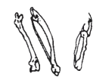
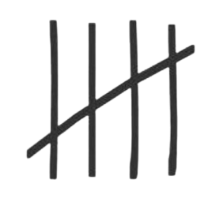
Owl Pellet Tally Chart

Slide 10
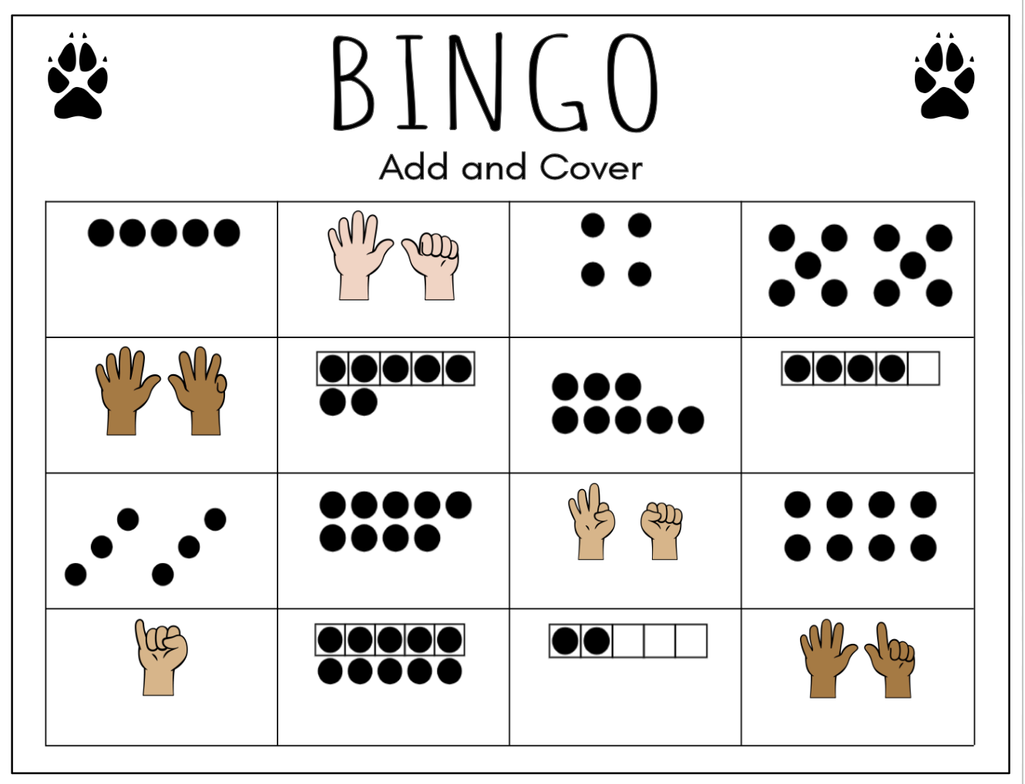
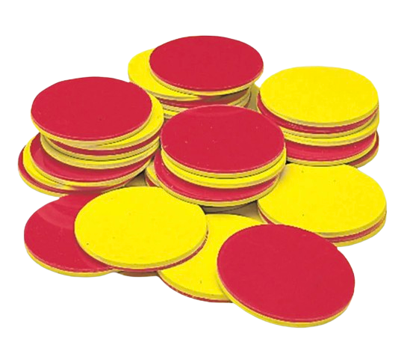
Unit 2: Week 8
Math Center
We can roll 2 cubes onto a dot mat and count to determine the total number of dots. We can place a counter on any squares that show the same total.

Slide 11
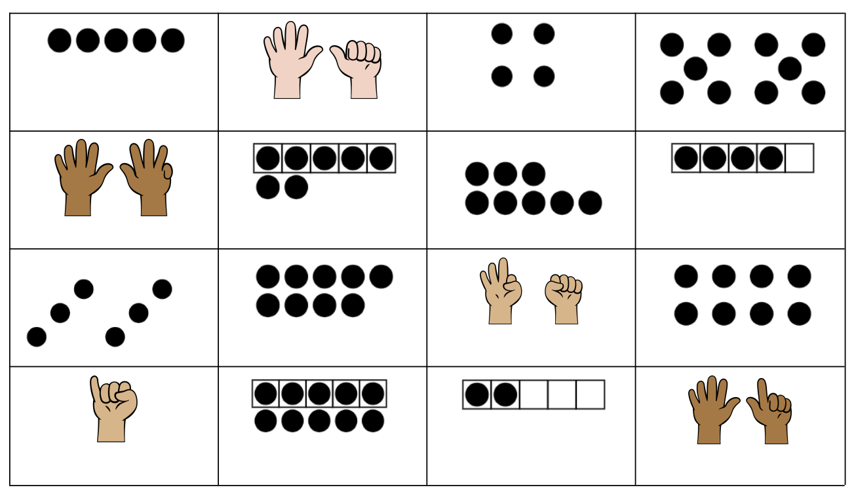

BINGO
Add and Cover

Slide 12
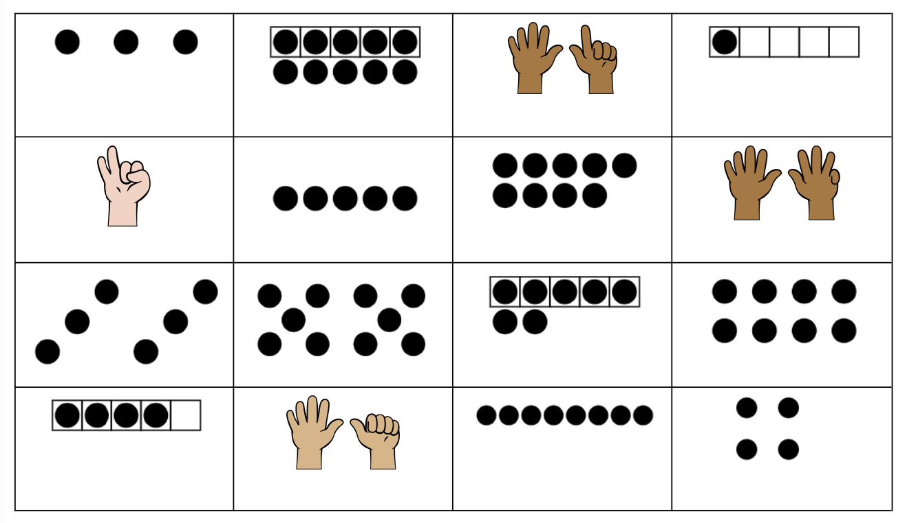
BINGO
Add and Cover

Slide 13
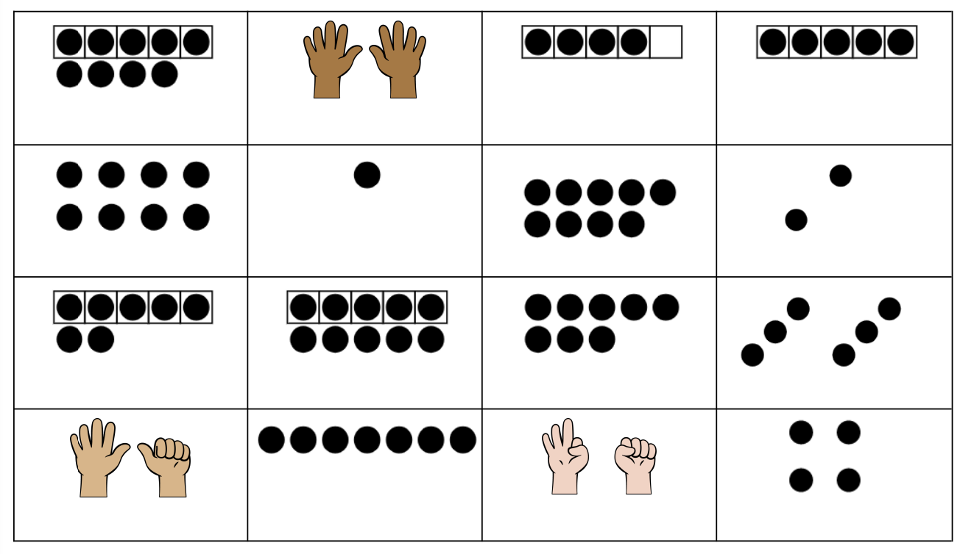
BINGO
Add and Cover

Slide 14
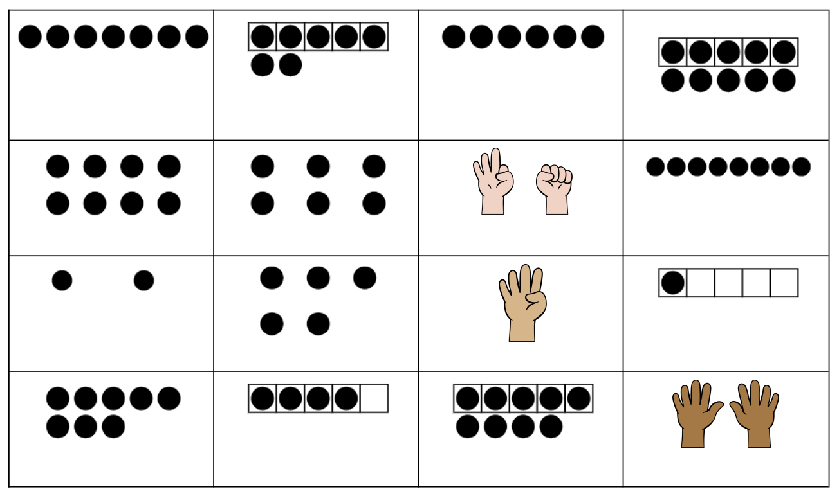
BINGO
Add and Cover

Slide 15
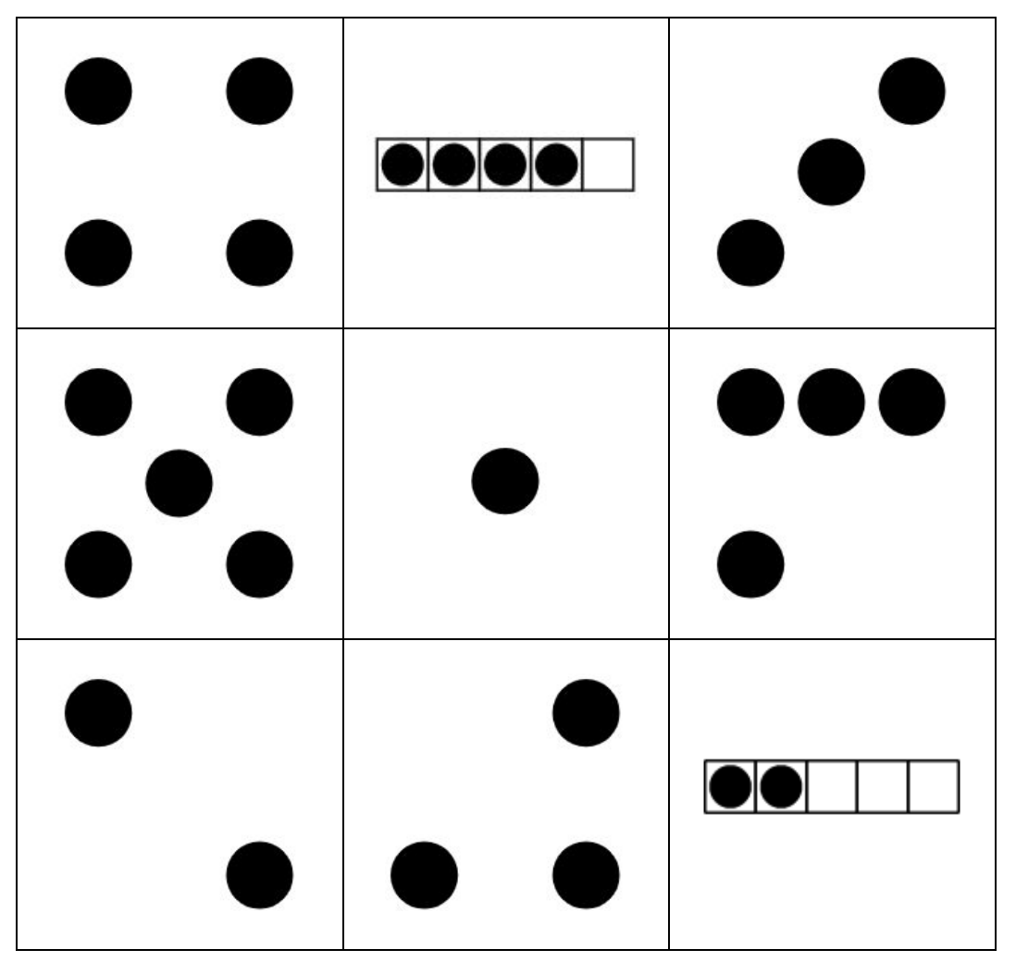
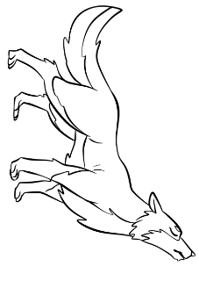
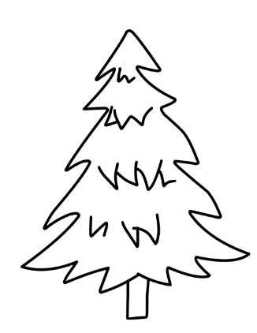
BINGO
Add and Cover Mat

Slide 16
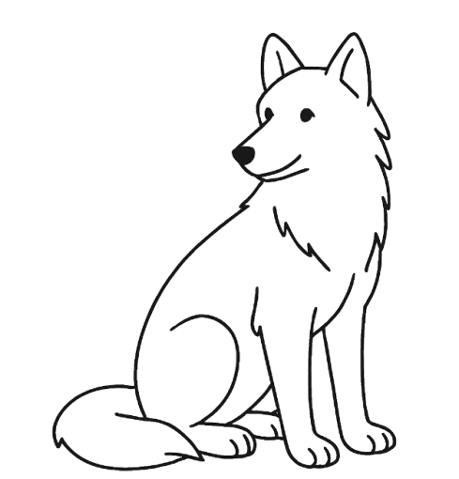
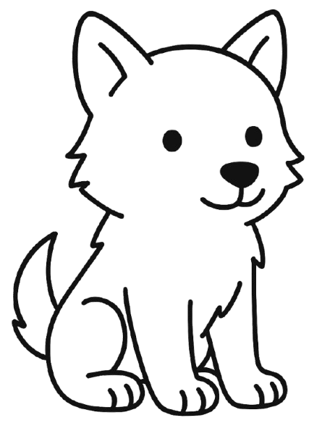
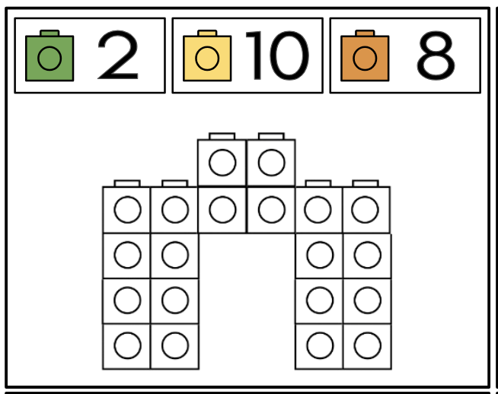
Unit 2: Week 9
Math Center
wolf
wolf
We can make wolf dens using math cubes. We can use the correct number of cubes as listed on the den cards. We can also make our own dens using different combinations of cubes.
wolf pup
wolf pup
Tape onto blocks or use binder clips to help wolves stand up for this activity.

Slide 17
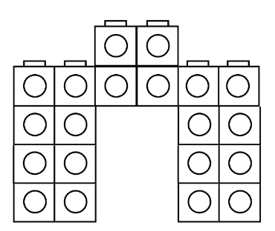
2
10
8
6
4
10
3
10
7
9
1
10

Slide 18
Students use these to make their own

