Slide 1
Weekly Words
Unit 2, Week 4
Notes:
approach (n): a way of doing or dealing with something
approach (v): 1. to come or go near to; 2. to begin or prepare to work on
barrier: something that blocks the way
deposit (v): to place or put down
fertile: able to produce farm crops or other plants
relationship: connection
sediment: material deposited by water, wind, or ice
suitable: right for the situation, appropriate

Slide 2
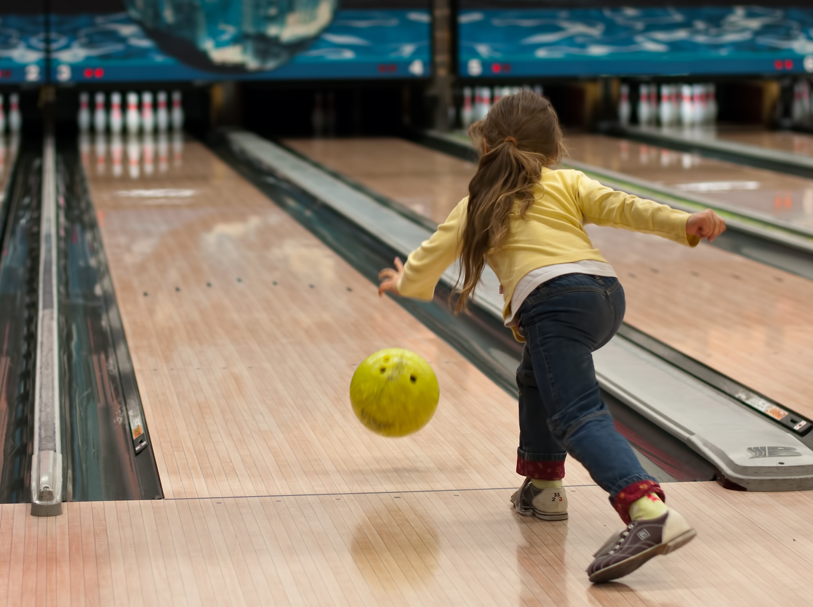
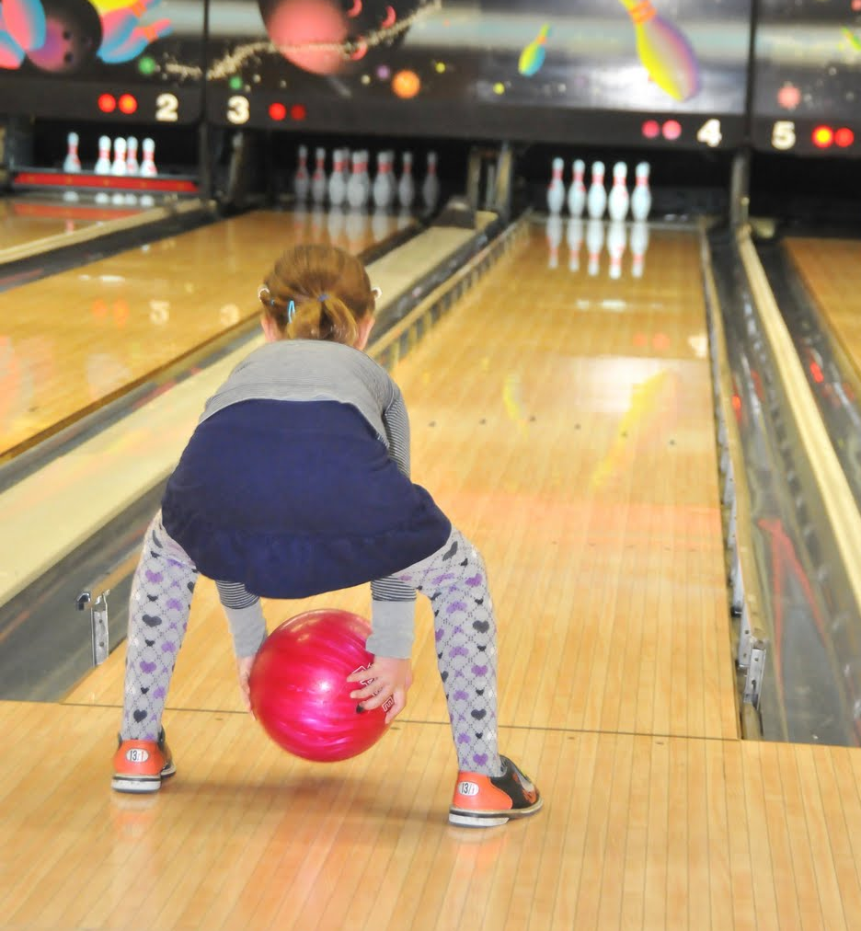
approach
noun
a way of doing or dealing with something
Notes:
approach (noun)
Elaboration:
Here is a word that can be used as a noun or a verb. Here, it is used as a noun; it names something. One person has a one-handed approach to bowling; the other person has a two-handed approach. They can both knock down the bowling pins at the end of the alley!
Think, Pair, Share prompt:
What is your approach to drawing a picture of something you have not drawn before? What is your strategy for getting started?
https://blog.pitsco.com/blog/get-bowled-over, https://blogsomemoore.com/2013/11/05/inclusion-its-critical/

Slide 3
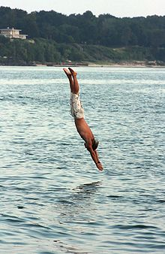
approach
verb
1. to come or go near to;
2. to begin or prepare to work on
Notes:
approach (verb)
Elaboration:
Here, approach is a verb, an action. This swimmer approaches the water head first! We can say that the swimmer plunges headfirst into the water!
Think, Pair, Share prompt:
If you were going into cold water, how would you approach it? Would you go in with small steps, or by plunging right in?
https://en.wikipedia.org/wiki/Diving_(sport)

Slide 4
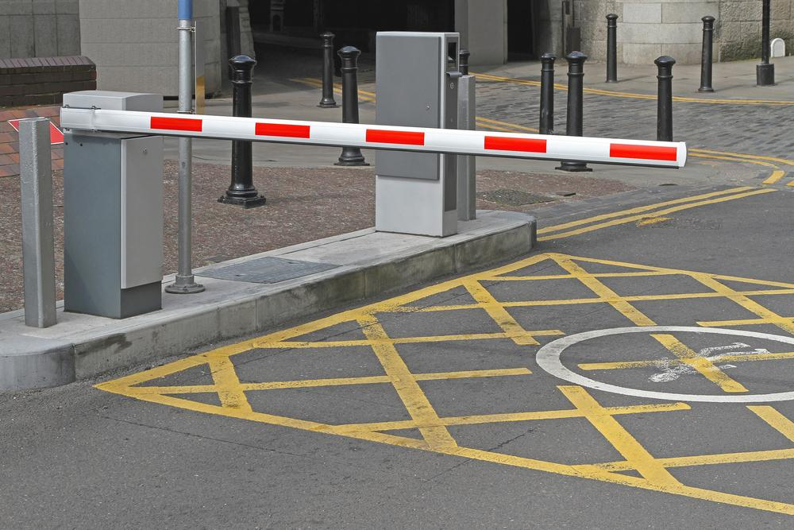
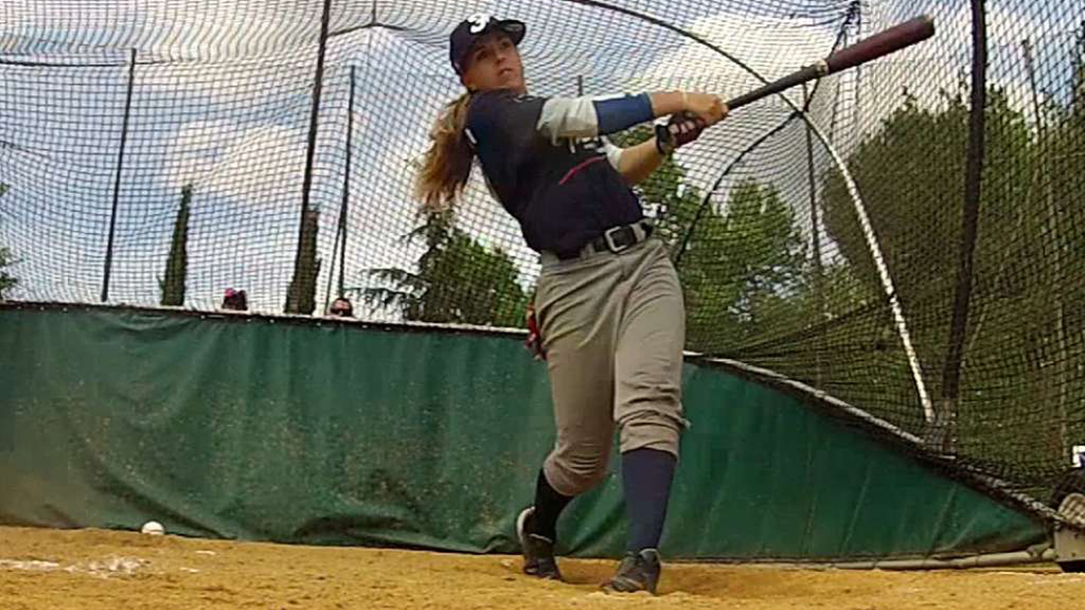
barrier
noun
something that blocks the way
Notes:
barrier (noun)
Elaboration:
Cars can’t leave this parking lot until a driver pays money to open the gate. The gate is a barrier.
A barrier can be put up for safety; the fence behind a baseball player keeps balls from going toward the people who are watching the game!
Think, Pair, Share prompt:
Try to name another barrier you find in your life. Think of something that blocks the way, or prevents some kind of movement.
https://www.sealitup.ca/products/barrier-gates/, https://www.mlb.com/news/melissa-mayeux-france-eligible-sign-mlb/c-132044338

Slide 5
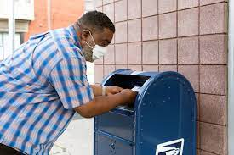
deposit
verb
to place or put down
Notes:
deposit (verb)
Elaboration:
We deposit letters in a mailbox. That’s one way we can communicate with people far away. The mail carrier picks it up and sends it on its way.
In our study, we are thinking about how water picks up and deposits dirt in other places to change the land.
In both cases, the meaning is to put something down in a place.
Think, Pair, Share prompt:
What do you deposit in your cubby when you come to school each morning?
https://www.washingtonpost.com/business/2020/08/14/people-are-freaking-out-about-mailbox-removals-postal-service-says-its-routine/

Slide 6
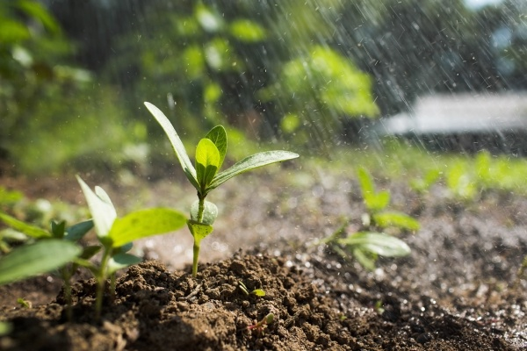
fertile
adjective
Able to produce farm crops or other plants
Notes:
fertile (adjective)
Elaboration:
We can tell the difference between fertile land and infertile land by looking at whether plants can grow there. Soil in a river’s delta is very fertile, because of all the nutrients that are transported, or carried, there by the movement of the river.
Think, Pair, Share prompt:
If you were a farmer with a plot of fertile land, what would you grow?
https://blog.nationwide.com/fertile-soil/

Slide 7

relationship
noun
connection
Notes:
relationship (noun)
Elaboration:
What we eat affects how healthy we are; there’s a relationship between food and health.
Think, Pair, Share prompt:
Think about a rainy or very cold day. What’s the relationship between the weather and your activities?
https://www.raps.org/news-and-articles/news-articles/2018/7/nutrition-in-health-and-disease-management

Slide 8
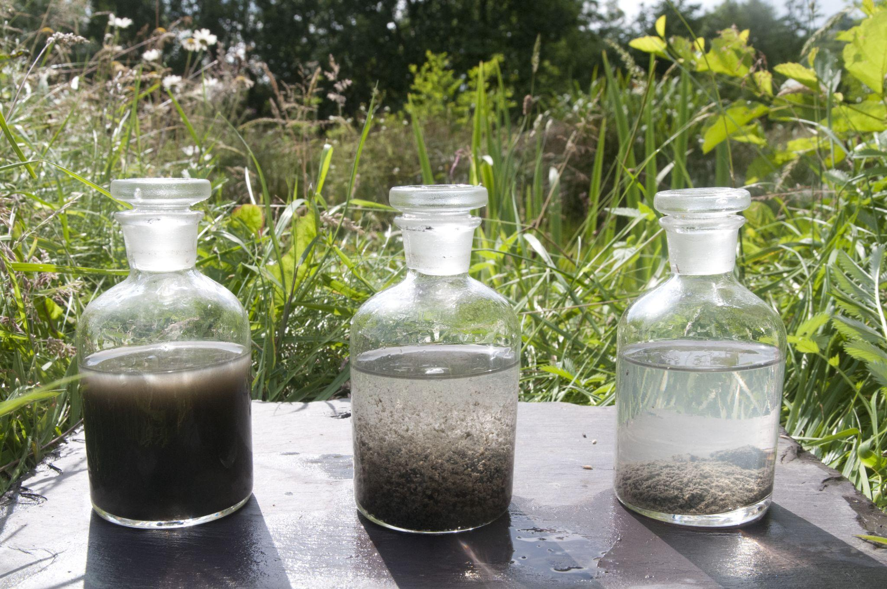
sediment
noun
material deposited by water, wind, or ice
Notes:
sediment (noun)
Elaboration:
In these jars we can see how, if you leave cloudy water to sit still for a while, the sediment, or tiny pieces of matter, sink to the bottom. Sediment is what water moves from one place to another; when sediment builds up, land is formed.
Think, Pair, Share prompt:
Have you ever noticed any sediment on the street after a storm? What did you see?
https://www.frogenvironmental.co.uk/clearflow-sediment-control/

Slide 9
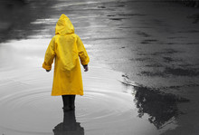
suitable
adjective
right for the situation,
appropriate
Notes:
suitable (adjective)
Elaboration:
This child’s coat is suitable for the weather—a raincoat is just right for a rainy day! A raincoat would not be suitable for a hot, sunny day at the beach.
Think, Pair, Share prompt:
What kinds of clothes are suitable for a very cold day?
https://www.publicdomainpictures.net/en/view-image.php?image=29819&picture=child-in-a-raincoat

