Slide 1
The Changing
Mississippi River
Text Talk Week 4, Day 5

Slide 2
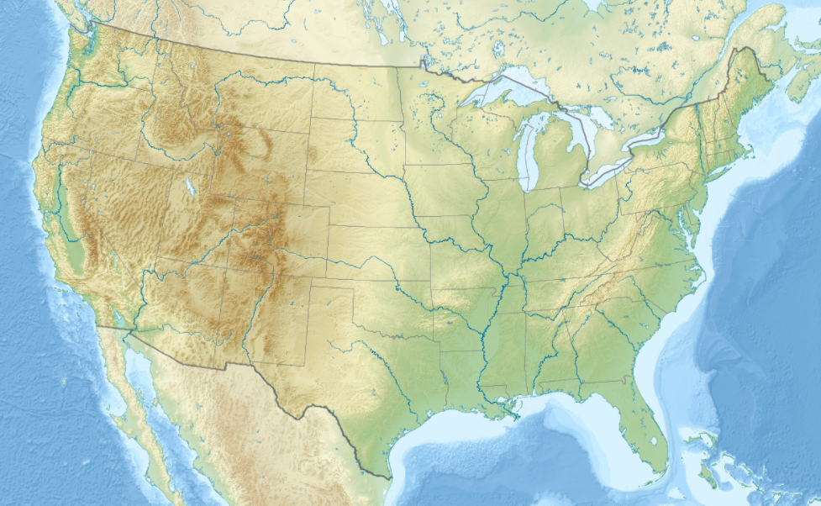

Slide 3
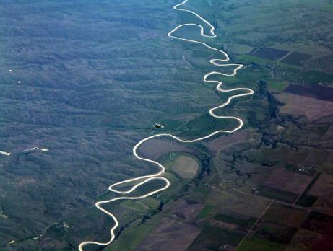
Mississippi River

Slide 4
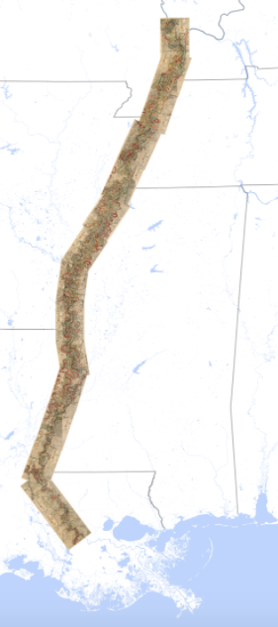
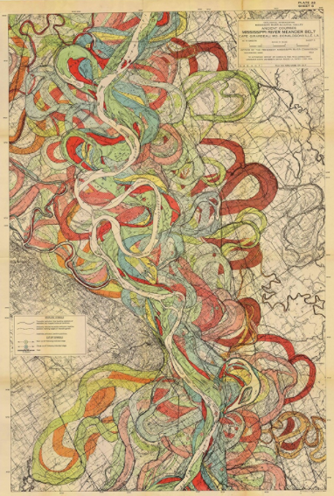

Slide 5
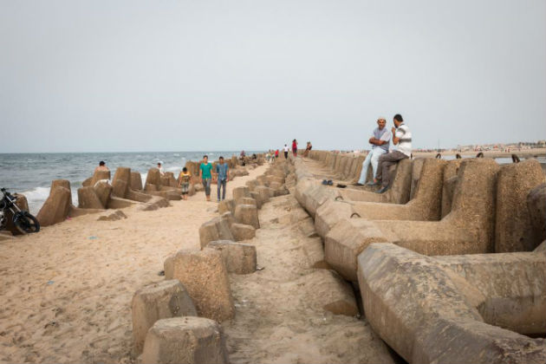
About 30 years ago, a seawall was built in Baltim using these cement blocks.
Notes:
Baltim built a seawall in 1992 out of large, concrete tetrapod blocks. This has slowed—but not stopped—the sea’s advance. This type of structure, known as a revetment, has an average life span of 30 to 50 years. Already the wall is half-buried in sand.
All along the coast, cities and towns like Baltim have constructed sea walls to try and hold back the water, but even with these measures in place, Husseiny predicted that no fewer than 10 million people would be displaced in the next 30 years.

Slide 6
Citations
Slide 2: Source: Wikimedia Commons
Slide 3: http://naturalb3auty.blogspot.com/2011/01/mississippi-river.html
Slide 4: http://www.radicalcartography.net/index.html?fisk
Slide 5: http://www.motherjones.com/environment/2015/11/egypt-nile-river-climate-change/

