Slide 1
Runoff
Science and Engineering Week 4, Lesson 2

Slide 2
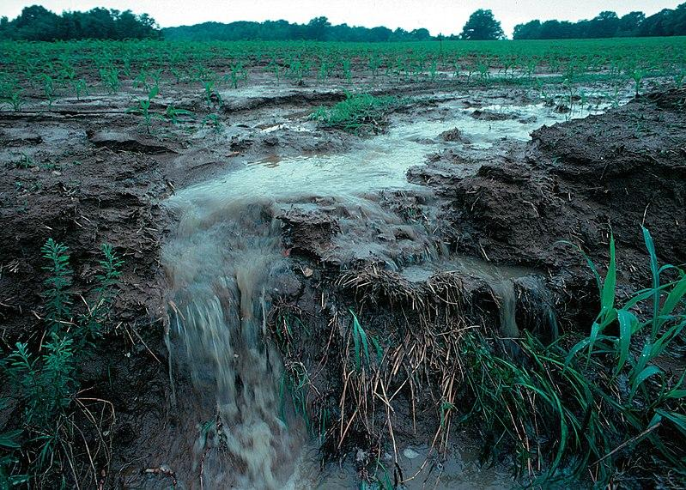
https://commons.wikimedia.org/wiki/File:Runoff_of_soil_%26_fertilizer.jpg

