Slide 1
Landforms Images
Writing Week 4, Day 1

Slide 2
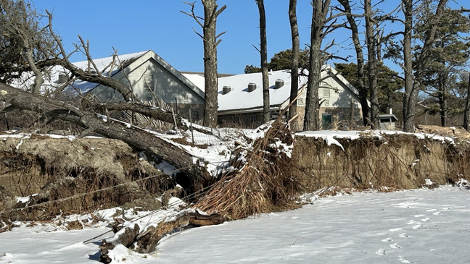
Notes:
Thompson Island, Boston

Slide 3
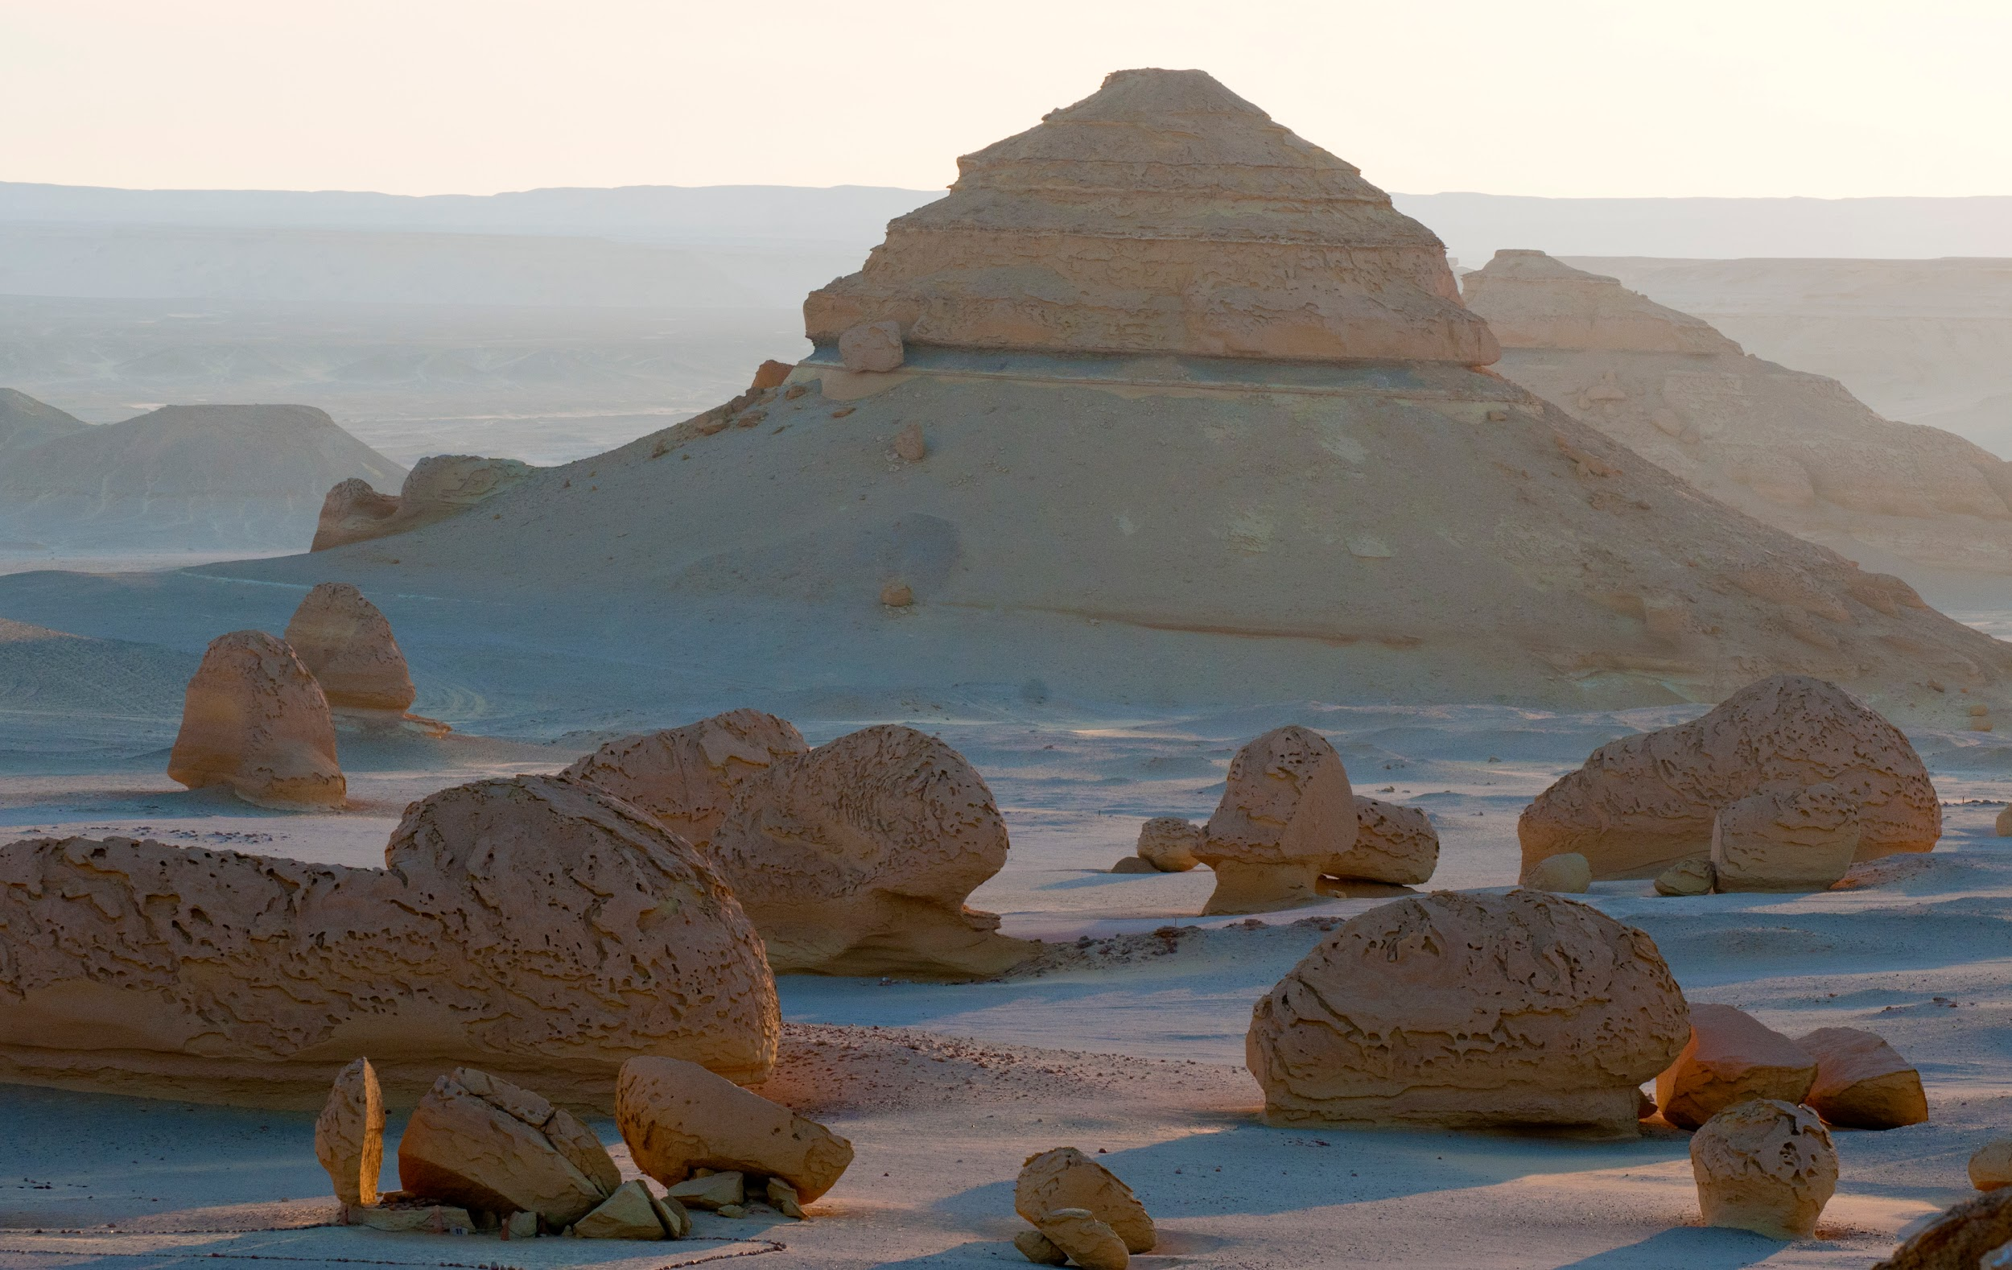
Notes:
Desert landforms formed by wind erosion at Wadi El Hitan, Valley of the Fossils | UNESCO World Heritage Site
Wadi Al-Hitan, Egypt, North Africa, Africa

Slide 4
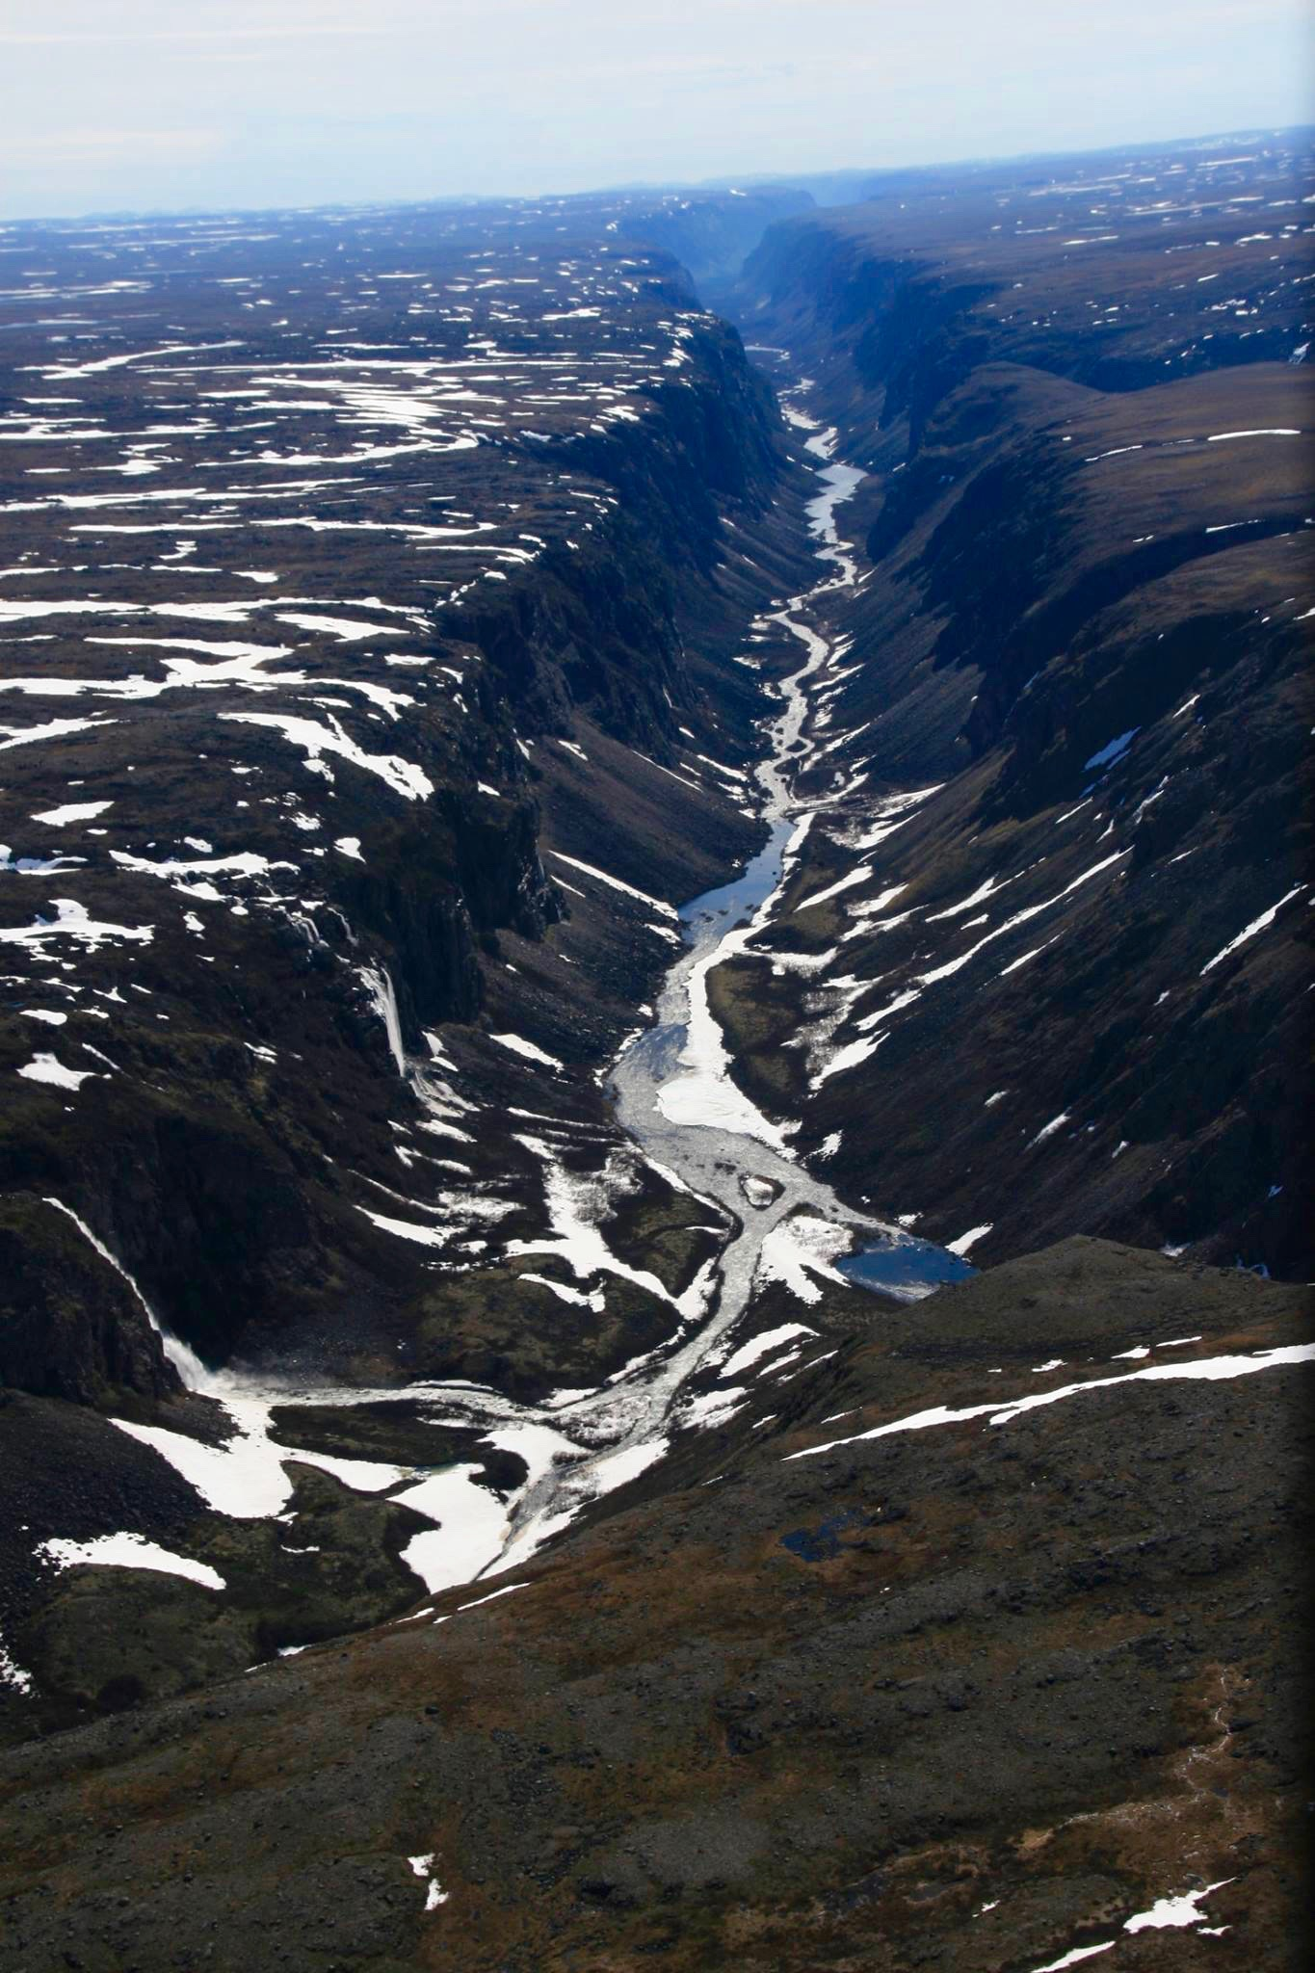
Notes:
Fraser River Valley, British Columbia, Canada
Valley formed by glaciers

Slide 5
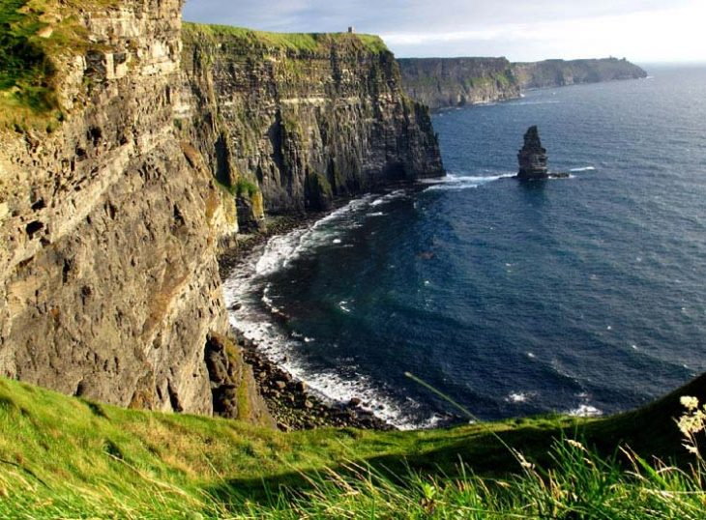
Notes:
Cliffs of Moher, with O’Brien’s Tower
Clare, Ireland
O’Brien’s Tower was separated from the cliff over time because of erosion.

Slide 6
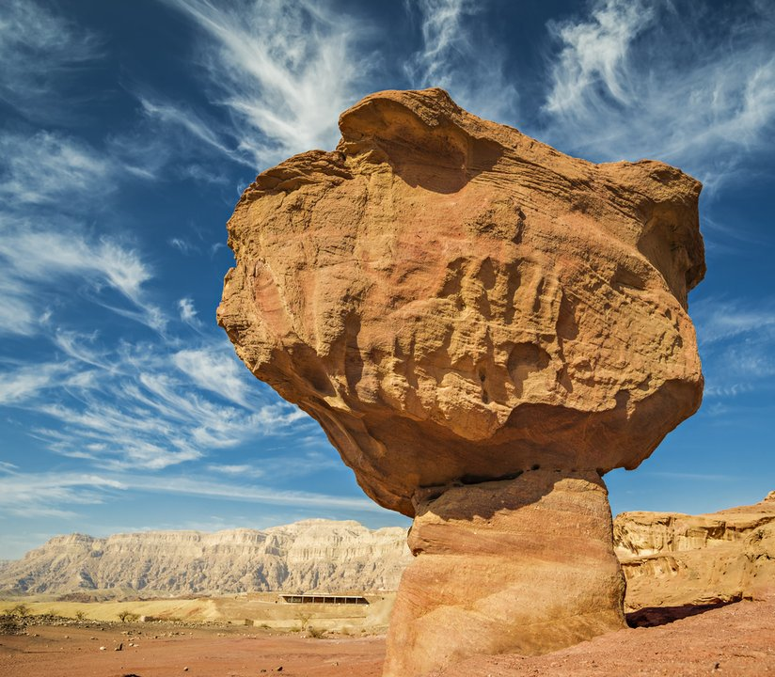
Notes:
The Mushroom, in Timna Valley, Israel, formed by wind and rain over millions of years

Slide 7
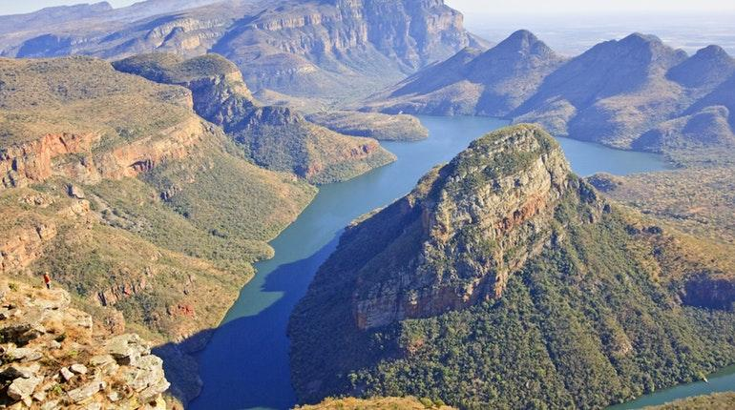
Notes:
Blyde River Canyon, South Africa

Slide 8
Citations
Slide 2: photo: https://wgme.com/news/local/dunes-damaged-at-popham-beach-threatening-coastal-communities-and-wildlife
Slide 3: https://mass.pbslearningmedia.org/resource/148907400-unesco-world-heritage-sites/desert-landforms-formed-by-wind-erosion-at-wadi-el-hitan-valley-of-the-fossils-unesco-world-heritage-site/#.WcU7cdOGPVo
Slide 4: http://helimob.com/project/canadian-arctic/
Slide 5: https://www.cliffsofmoher.ie/
Slide 6: Photo: Sergei25/Shutterstock; https://www.fromthegrapevine.com/travel/explore-odd-formations-timna-valley
Slide 7: Photograph: Christian Heinrich, Getty Images; https://www.lonelyplanet.com/south-africa/blyde-river-canyon/attractions/blyde-river-canyon-nature-reserve/a/poi-sig/1060988/1320517

