Slide 1
Report Adjectives
Writing Week 4, Day 3

Slide 2
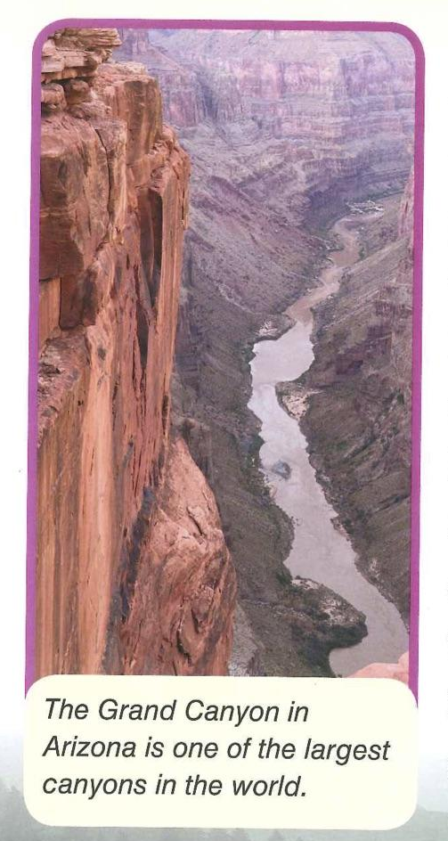
The Grand Canyon in Arizona is one of the largest canyons in the world.

Slide 3
The Grand Canyon in Arizona is one of the largest canyons in the world.

Slide 4
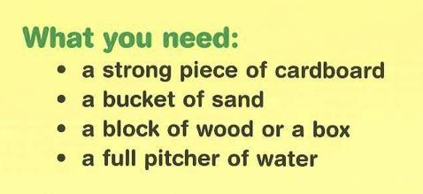
Remember, adjectives describe the nouns. They answer these questions:
How many/much?
What kind?
What like?
Which ones? Whose?

Slide 5
The Grand Canyon in Arizona is one of the largest canyons in the world.

Slide 6
Circle the nouns that name your landform.
Underline the adjectives that describe your landform. Remember, adjectives answer these questions:
How many/much?
What kind?
What like?
Which ones? Whose?

