Slide 1
Erosion at
the Nile River, Egypt
Text Talk Week 4, Day 4

Slide 2
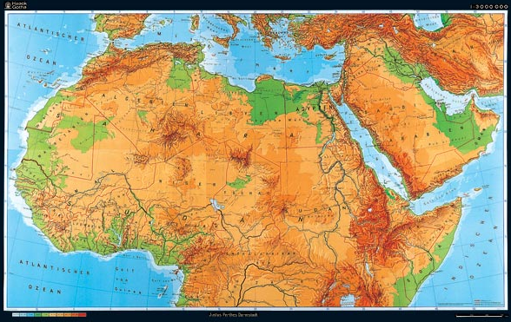
Map of North Africa

Slide 3
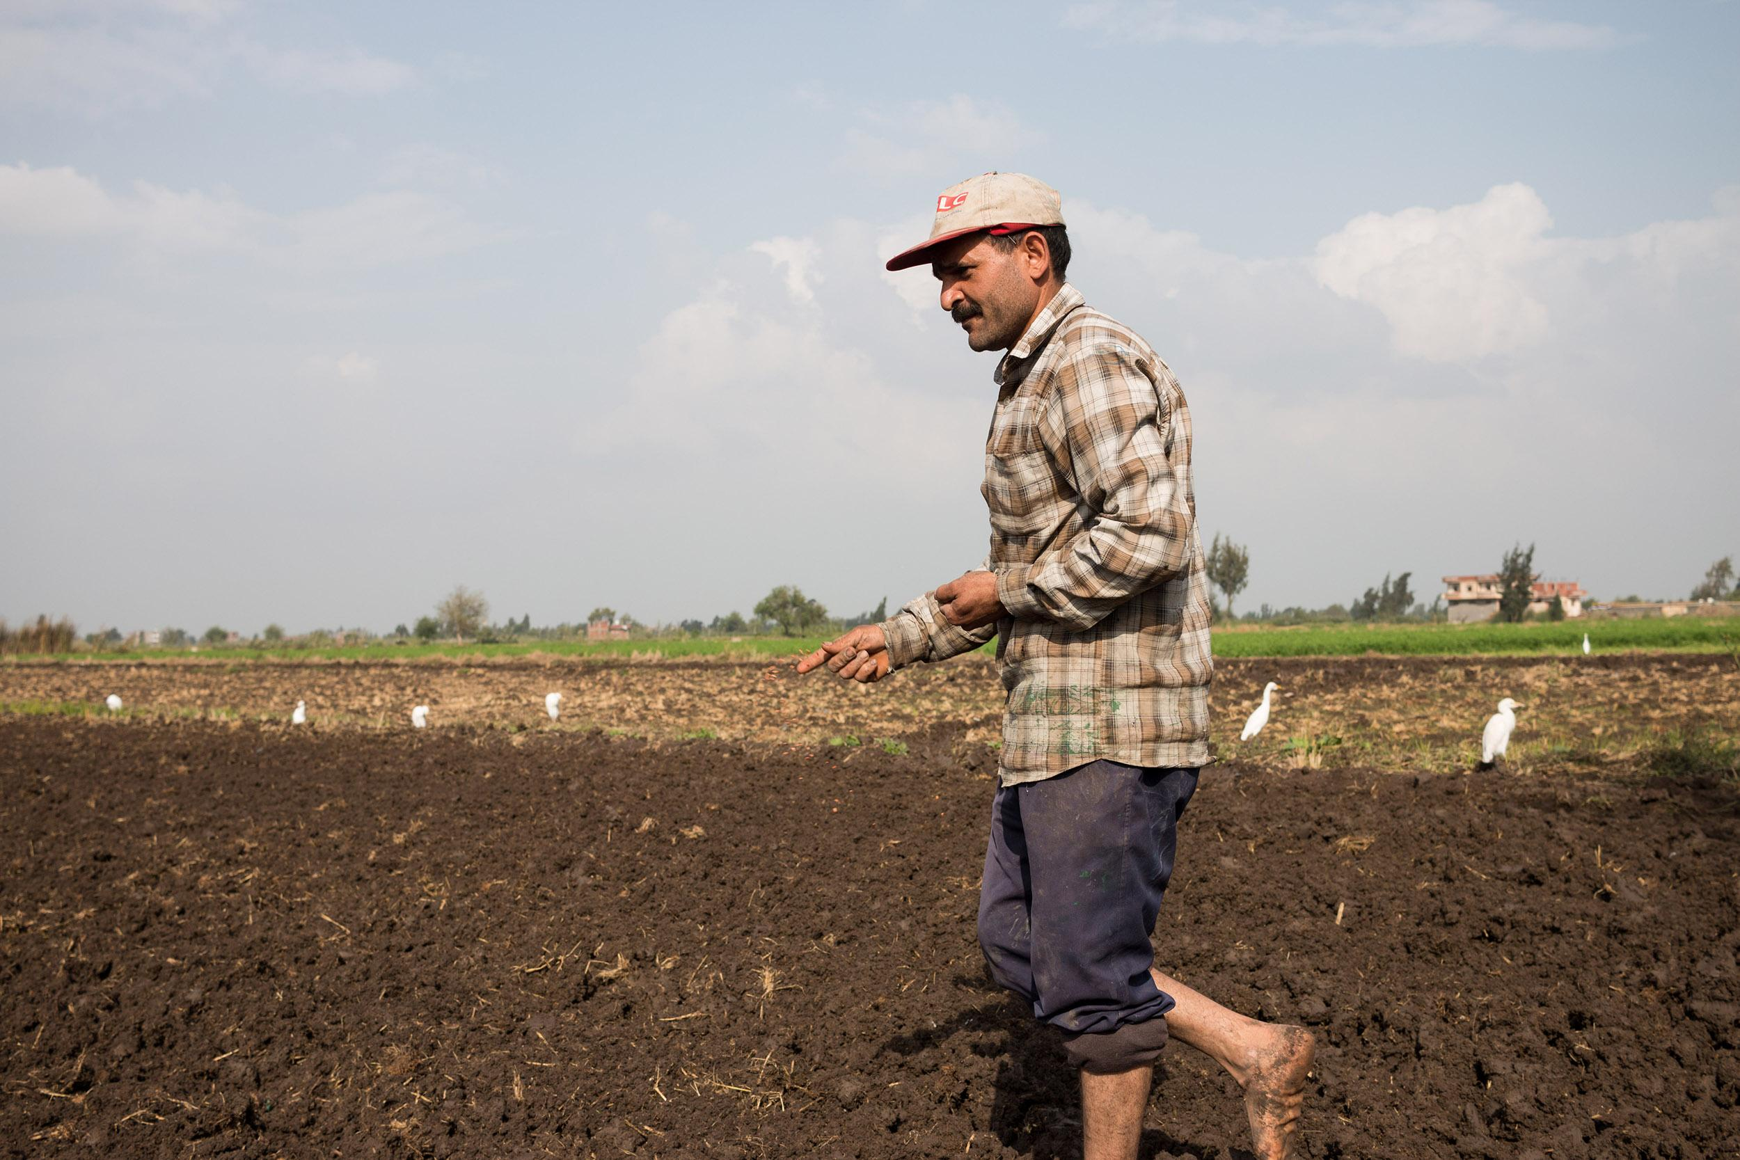
Instead of getting fresh water from the Nile River, Abdullah Salam’s fields are soaking up salt water from the Mediterranean Sea.
Notes:
Abdullah Salam walks in his field, spreading wheat seeds for the winter season. Farmers like Salam in Egypt’s Nile Delta are struggling with lower crop yields as the nearby Mediterranean rises and increases the soil’s salinity. One acre used to yield three tons. Now it yields barely over half that amount.Nicholas Linn for Newsweek

Slide 4
Nile River, country of Egypt, continent of Africa

Slide 5
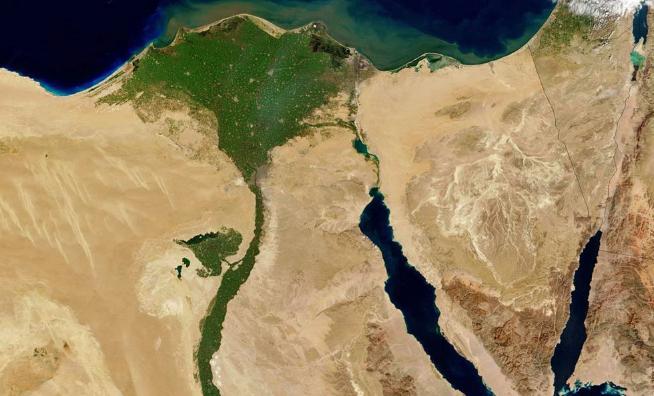

Slide 6
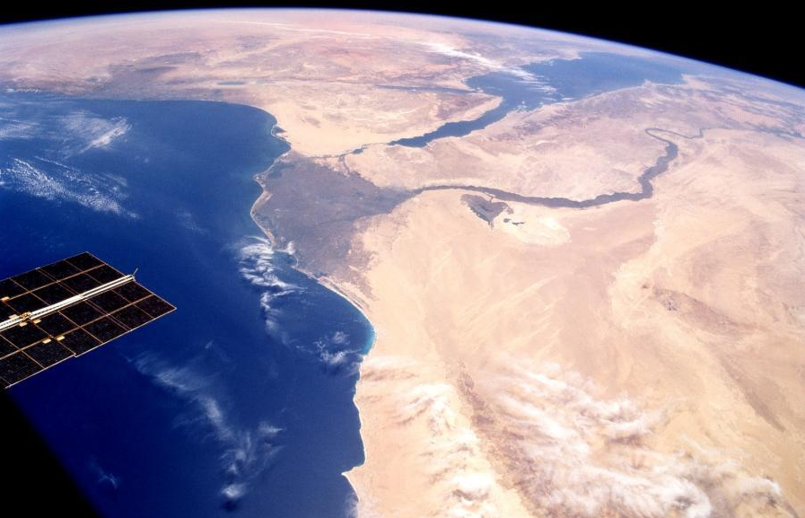

Slide 7
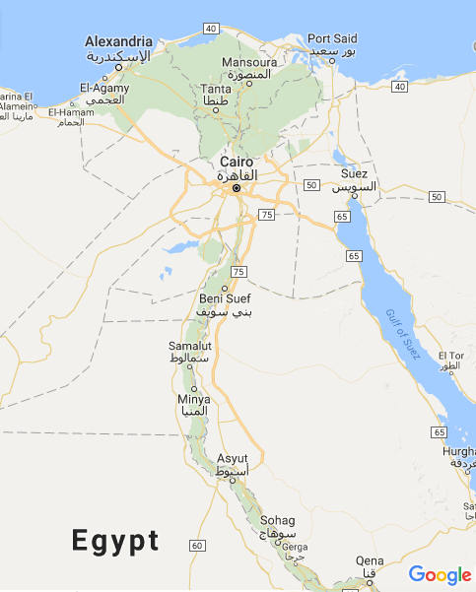

Slide 8
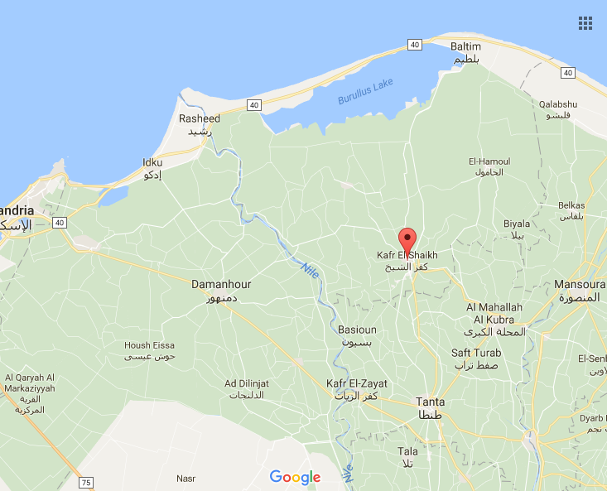

Slide 9
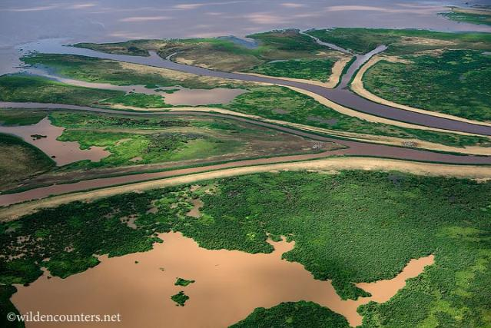

Slide 10
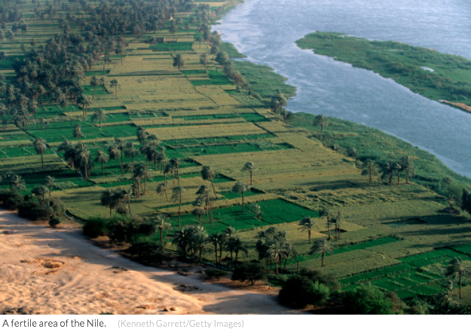
A fertile area of the Nile River

Slide 11
Instead of getting fresh water from the Nile River, Abdullah Salam’s fields are soaking up salt water from the Mediterranean Sea.
Notes:
Abdullah Salam walks in his field, spreading wheat seeds for the winter season. Farmers like Salam in Egypt’s Nile Delta are struggling with lower crop yields as the nearby Mediterranean rises and increases the soil’s salinity. One acre used to yield three tons. Now it yields barely over half that amount.Nicholas Linn for Newsweek

Slide 12
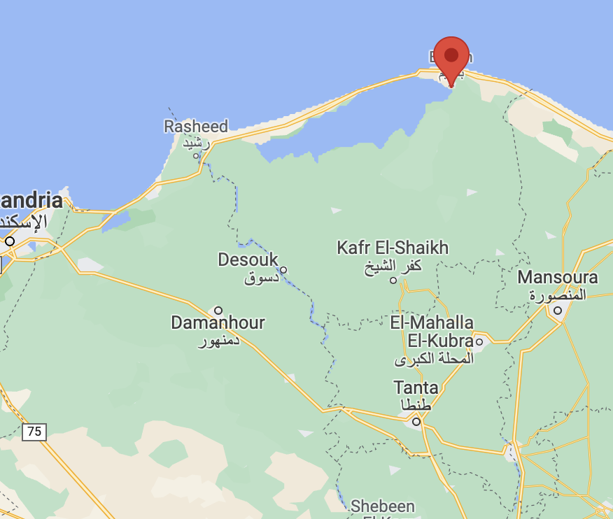
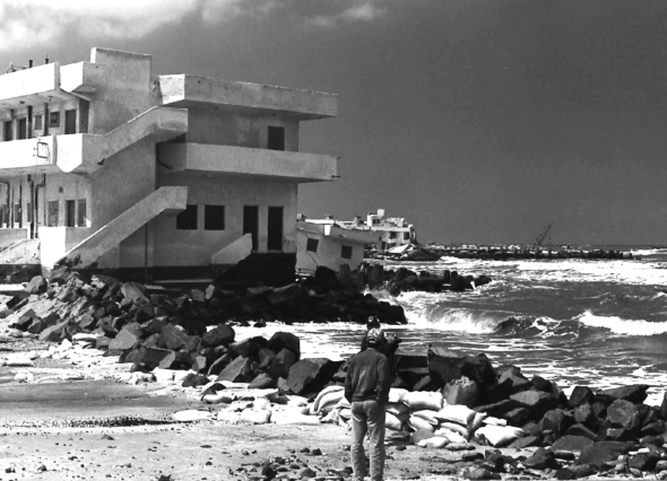
Many Egyptians go on vacation to the town of Baltim, right on the edge of the Mediterranean Sea.
Caption this photograph!

Slide 13
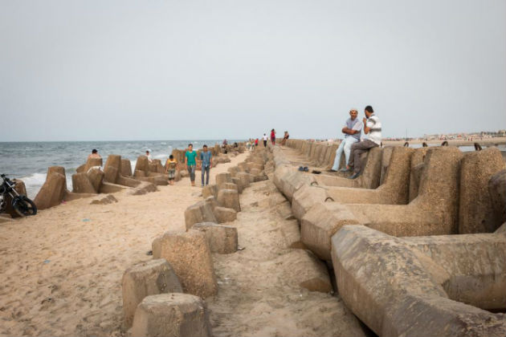
About 30 years ago, a seawall was built in Baltim using these cement blocks.
Notes:
Baltim built a seawall in 1992 out of large, concrete tetrapod blocks. This has slowed—but not stopped—the sea’s advance. This type of structure, known as a revetment, has an average life span of 30 to 50 years. Already the wall is half-buried in sand.
All along the coast, cities and towns like Baltim have constructed sea walls to try and hold back the water, but even with these measures in place, Husseiny predicted that no fewer than 10 million people would be displaced in the next 30 years.

Slide 14
Citations
Slides 2 and 4: http://www.sestopotere.com/wp-content/uploads/nord-africa.jpg
Slides 3, 11, and 13: Photo: Nicholas Linn, Egypt's Nile River Delta Is Sinking Into the Sea – Mother Jones
Slide 5: photo: Jeff Schmaltz, NASA Visible Earth, Photos: Nile Valley in Egypt—Water Makes the Desert Bloom
Slide 6: http://pixdaus.com/view-of-nile-river-delta-red-sea-sinai-peninsula-from-space-/items/view/43147/
Slide 7: The Nile River
Slides 8 and 12: https://www.google.com/maps/place/Kafr+El-Shaikh,+Qism+Kafr+El-Shaikh,+Kafr+El-Shaikh,+Gharbia+Governorate,+Egypt/@31.1271275,30.659462,9z/data=!4m5!3m4!1s0x14f7ab78f233021f:0xc2cdebb004a208f8!8m2!3d31.1063198!4d30.9419751
Slide 9: http://wildencounters.net/gallery2/v/landscapes/africa/0065+-+Aerial+shot+of+the+Omo+river+delta_+N_+Lake+Turkana_+Ethiopia.jpg.html
Slide 10: Kenneth Garrell/Getty Images, Egypt's Nile Delta threatened by looming crisis of water and food shortages

