Slide 1



Slide 2
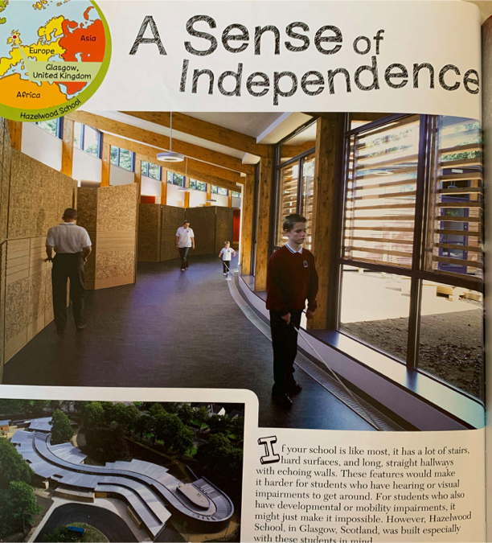
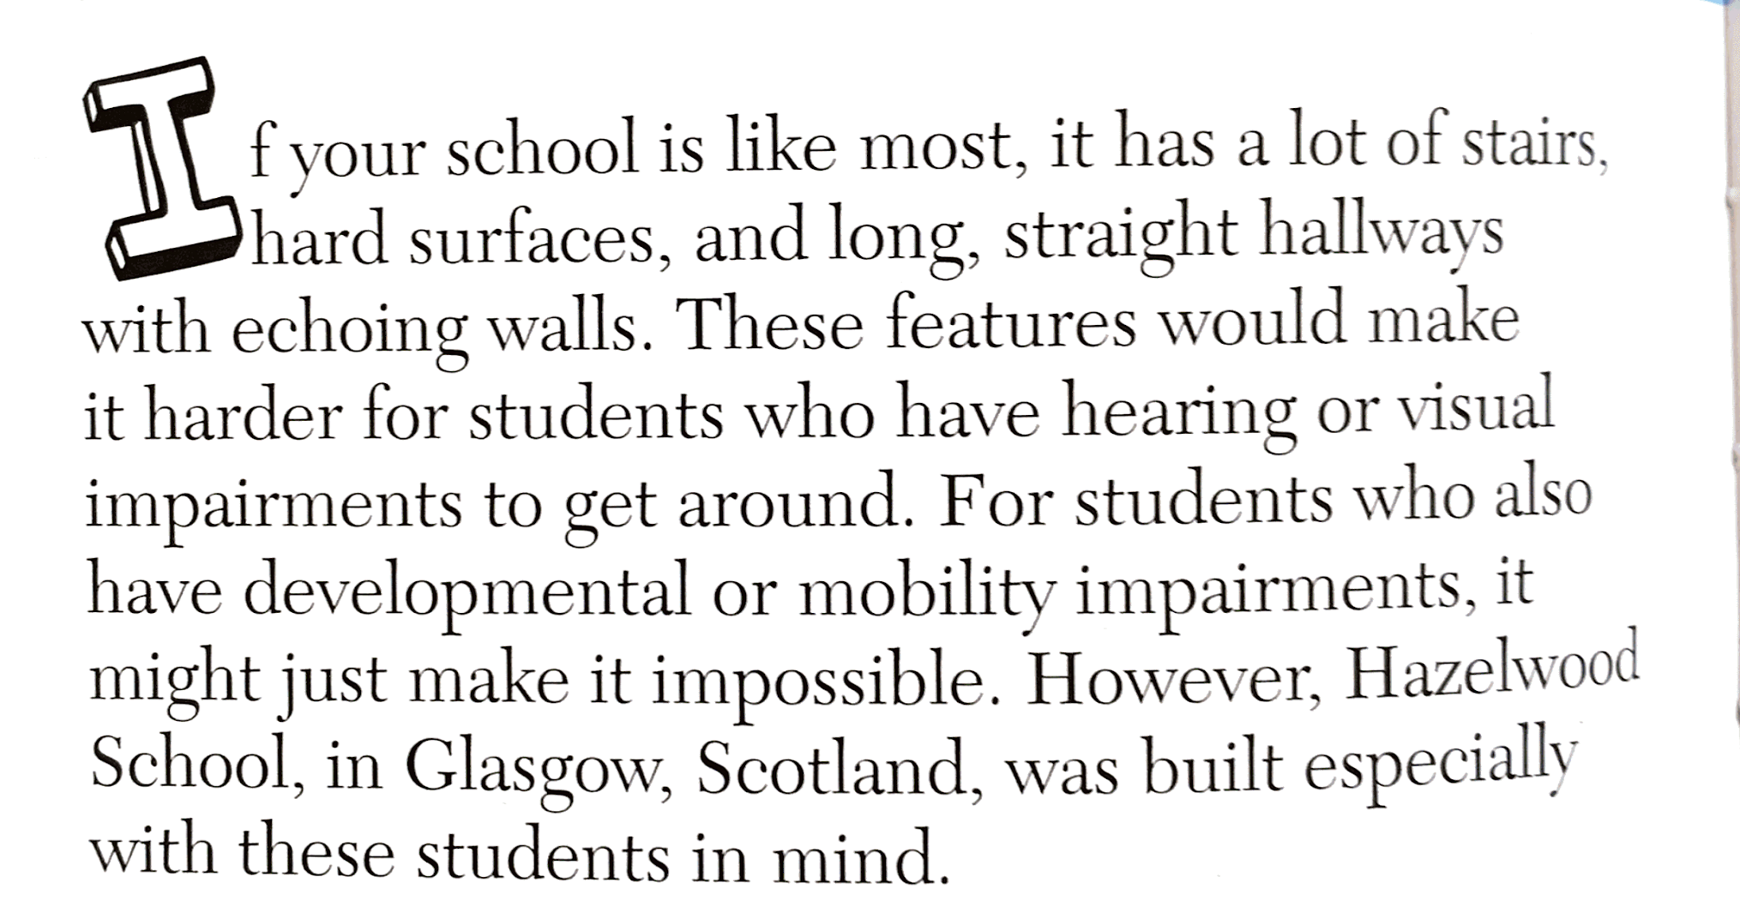

Slide 3
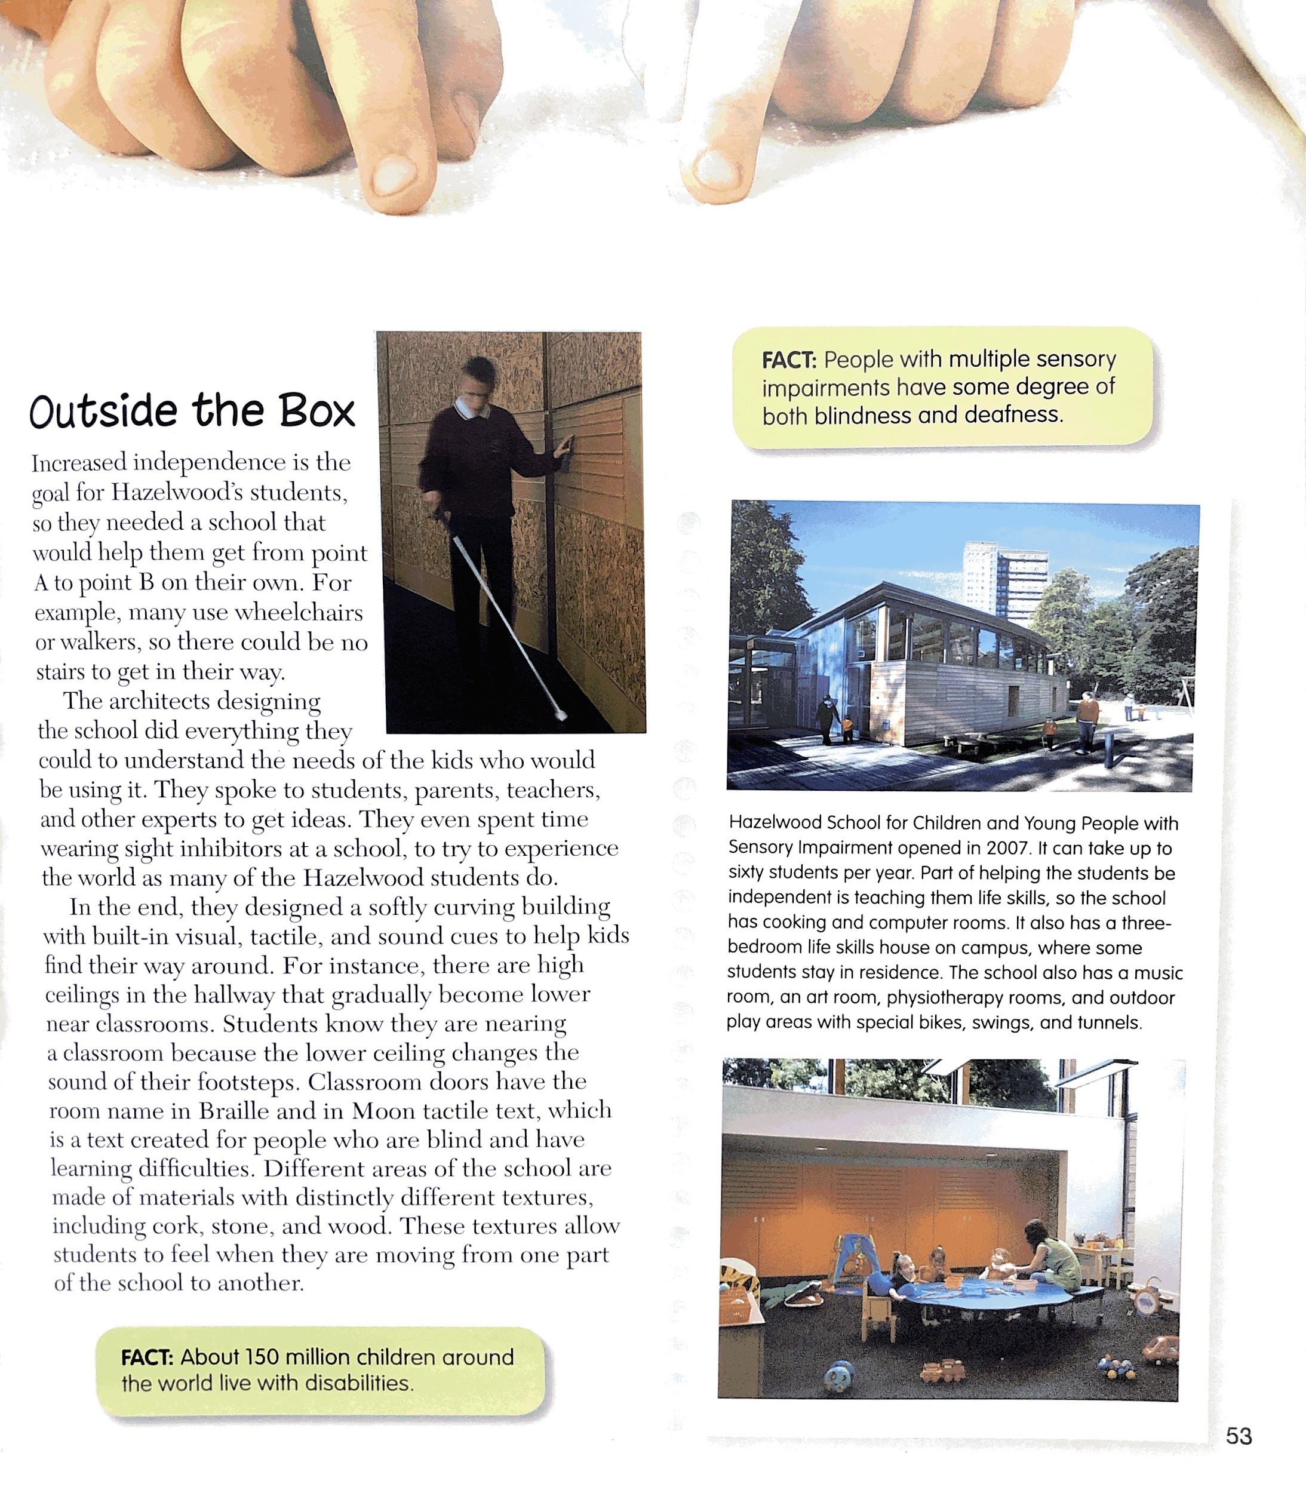

Slide 5
Article 29
Your education should help you use and develop your talents and abilities. It should also help you learn to live peacefully, protect the environment and respect other people.

