Slide 1
Weekly Words
Unit 3, Week 1
Notes:
bond: a strong, positive feeling or shared interest that brings people together
connect: to join together, to link
custom: a way of acting that is usual for a person or group
foreign: having to do with a country that is not one's own; unfamiliar
identity: all of the parts that communicate how a person or thing is known
immigrant: someone who comes from one place to settle in another place
infer: to make a guess based on facts and observation
unfamiliar: not known or recognized

Slide 2
bond
noun
a strong, positive feeling or shared interest that brings people together
Notes:
bond (noun)
Elaboration:
A bond is a connection, a feeling of closeness. We create bonds with people who enjoy activities we enjoy, or with people who feel the same way we do about something. It feels good to have a bond with someone.
Think, Pair, Share prompt:
How would you describe the bond between this person and her dog? Why might this bond be important?
https://www.wshs-dg.org/resource-center/ask-the-vet-pet-watch/132-ask-the-vet/273-human-animal-bond

Slide 3

connect
verb
to join together, to link
Notes:
connect (verb)
Elaboration:
People find lots of ways to connect with others who are close by and far away. This group of people is gathered close together, so we can infer that they know each other well; they are connected to each other. And it looks like they are also connecting with other people they care about who are not close by, through technology.
Let’s add the suffix: -tion to the base word “connect”: connec-tion: connection. When we remove the t from the base word and add this suffix, we get a noun, “connection.”
Think, Pair, Share prompt:
What are two ways you connect with people you care about?
https://www.prudential.com.sg/opus/articles/long-distance-relationships-family-friends

Slide 4
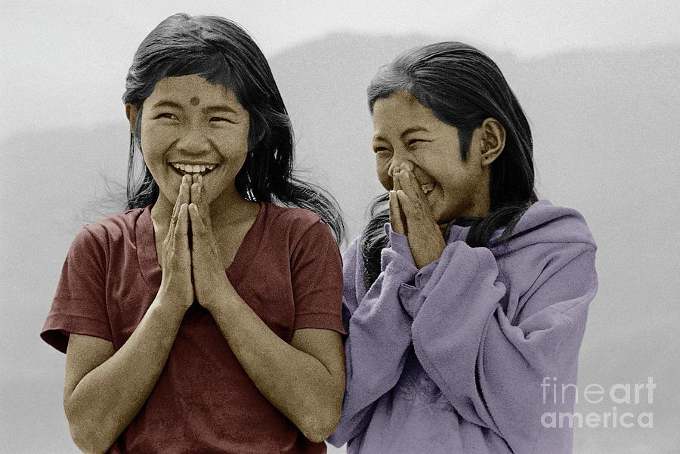
custom
noun
a way of acting that is usual for a person or group
Notes:
custom (noun)
Elaboration:
Greetings are one kind of custom. In India, Nepal, and Bangladesh, people have a custom of greeting each other with this gesture and the word “Namaste.” It is a greeting that shows great respect and also joy.
Other examples of customs are how a group of people celebrates special holidays, how they dress, and the music, art, and dances they create.
Think, Pair, Share prompt:
What is a special custom in your family or community? [Offer a relevant example such as Boston’s First Night, a neighborhood celebration, or a particular school custom.]
https://fineartamerica.com/featured/nepali-girls-namaste-greeting-himalayas-craig-lovell.html

Slide 5
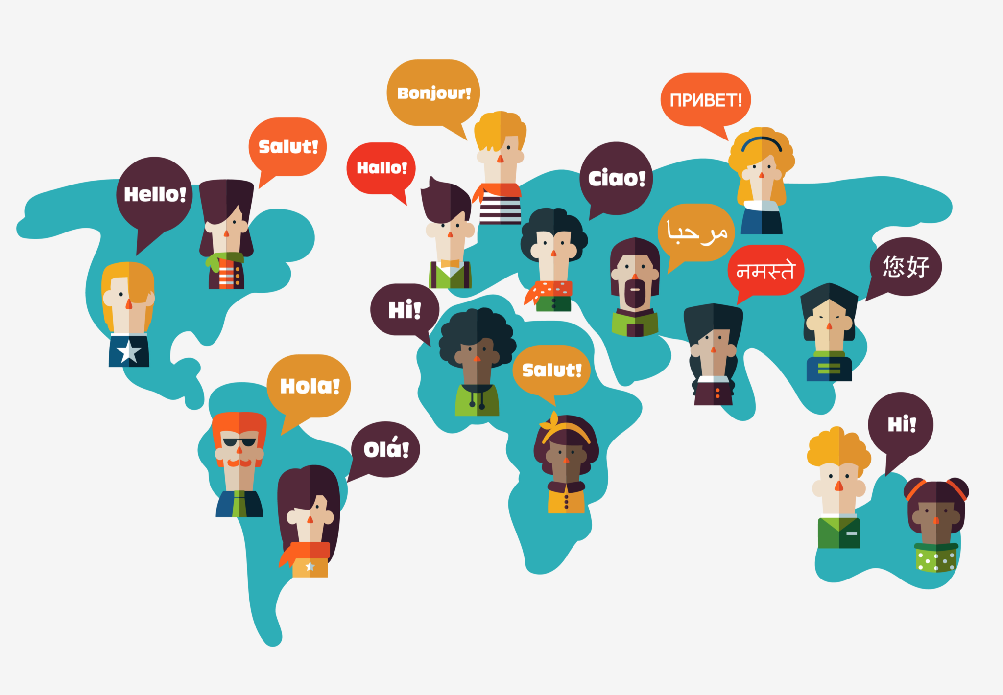
foreign
adjective
having to do with a country that is not one’s own; unfamiliar
Notes:
foreign (adjective)
Elaboration:
If something is not familiar to you, it’s foreign. Often, the adjective “foreign” describes something that is unfamiliar because it comes from a different place. A foreign language is one that is spoken in a different country.
When we add the suffix -er to “foreign” we get “foreigner.” The word becomes a noun meaning a person from another country.
Think, Pair, Share prompt:
What foreign language would you like to learn to speak?
What foreign country would you like to visit?
https://kaleela.com/five-of-the-top-foreign-languages-to-learn-in-2021/

Slide 6

identity
noun
all of the parts that communicate how a person or thing is known
Notes:
identity (noun)
Elaboration:
The language you speak, the things you love to do, the way you look, the place your family comes from… these are parts of your identity—who you are and how people know you.
Think, Pair, Share prompt:
What are some important parts of your identity?
https://hbr.org/2019/09/the-benefits-of-bringing-your-whole-identity-to-work

Slide 7
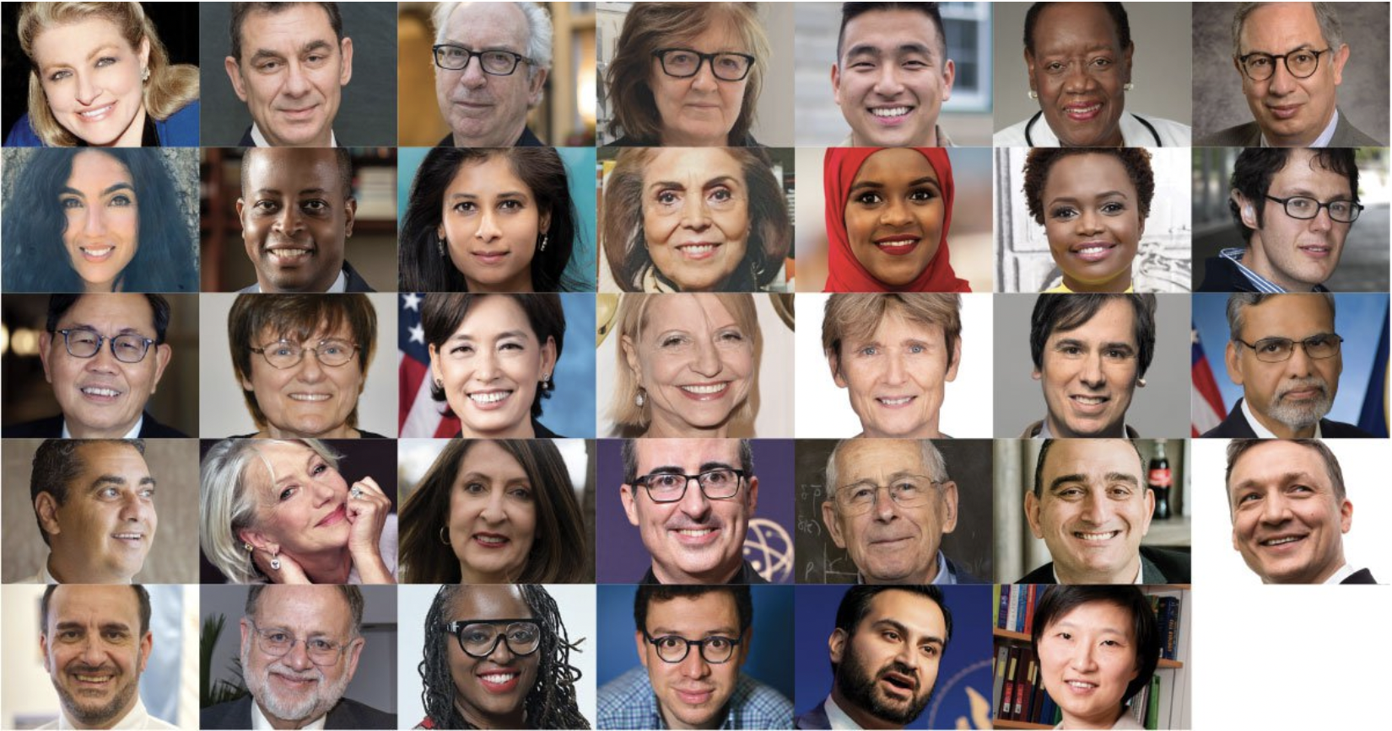
immigrant
noun
someone who comes from one place to settle in another place
Notes:
Immigrant (noun)
Elaboration:
People move from one country to another for many different reasons. Immigrants come to the US from many different parts of the world. They bring important things with them. There are often many things immigrants have to figure out, because they are in a new place.
Think, Pair, Share prompt:
What are some things people could do to make a new immigrant feel welcome here in Boston?
If you or your family are immigrants, what are some things you can do to make another new immigrant feel welcome here?
https://www.carnegie.org/awards/award/great-immigrants/

Slide 8
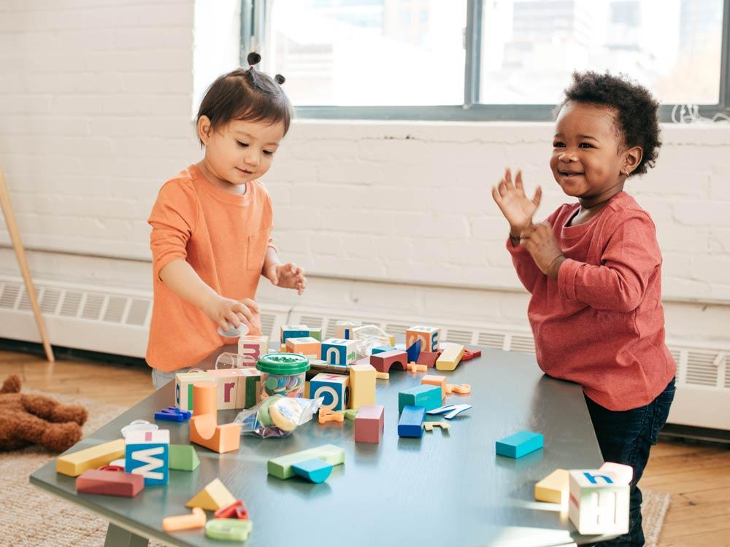
infer
verb
to make a guess based on facts and observation
Notes:
infer (verb)
Elaboration:
Sometimes we don’t get a lot of information just from what someone says or just from words in a text. We can pay attention to facial expressions, body language, illustrations, and other clues to get more meaning.
Think, Pair, Share prompt:
What do you infer about how these children are feeling based on what you see in the photo?
https://raisingchildren.net.au/autism/school-play-work/play-learning/playing-with-others-autistic-children

Slide 9
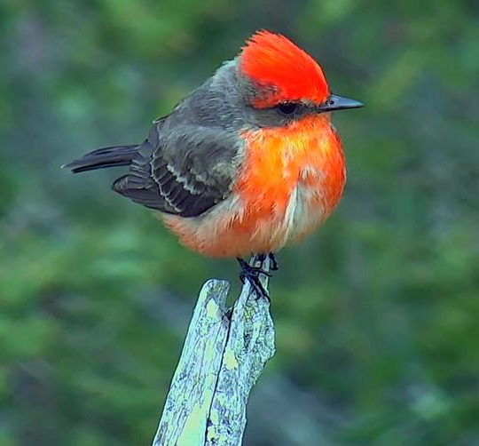
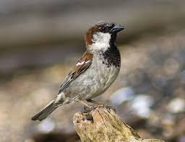
unfamiliar
adjective
not known or recognized
Notes:
unfamiliar (adjective)
Elaboration:
The prefix “un” means not. “Familiar” means we have seen it before, or we know about it.
This bird called a vermillion flycatcher is unfamiliar to us because it doesn’t live around Boston. The house sparrow is probably familiar to all of you—it’s very common in Boston and many other places.
Think, Pair, Share prompt:
When you see something that is unfamiliar, you might feel excited, or you might feel nervous. Imagine you are an immigrant from a place where it never snows, and now that you are living in Boston there is a big snow storm. The snow is unfamiliar to you! How might you feel?
https://lcnme.com/currentnews/back-back-sightings-rare-birds-astonish-delight-local-birdwatchers/, https://www.birdwatchersdigest.com/bwdsite/learn/identification/sparrows-allies/house-sparrow.php

Slide 10
Weekly Words
Unit 3, Week 2
Notes:
beat: a repeated sound, as played on a drum
evoke: to bring forward in the mind or in action
melody: the main tune of the music
pitch: the high or low quality of a sound
rhythm: regular, repeated pattern of sound
tempo: speed that a piece of music is played
tune: musical sounds with a melody and sometimes harmony
volume: amount of sound; loudness

Slide 11
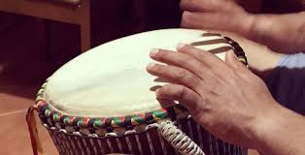

beat
noun
a repeated sound,
as played on a drum
Notes:
beat (noun)
Elaboration:
If you are listening to music and clapping along, you are usually clapping to the beat. Let’s try it.
[Click on the video to play the audio, and have children clap, stomp, or tap to the beat.]
Think, Pair, Share prompt:
Tell your partner: how did you know when to clap your hands? How did you find the beat?
Replay recording so children can reference it.
https://lynnemp.medium.com/match-forward-to-the-beat-of-your-own-drum-c8f431f2d49e

Slide 12

evoke
verb
to bring forward in the mind or in action
Notes:
evoke (verb)
Elaboration:
Maybe people find that the ocean evokes feelings of calm, especially the sound of waves lapping at the shore. For other people, the ocean might evoke the feeling of wanting to run and jump right in!
Think, Pair, Share prompt:
Close your eyes. Imagine yourself in a busy park, with noise around you. What feeling does that evoke in you?
https://www.livescience.com/38163-where-beach-sand-comes-from.html

Slide 13
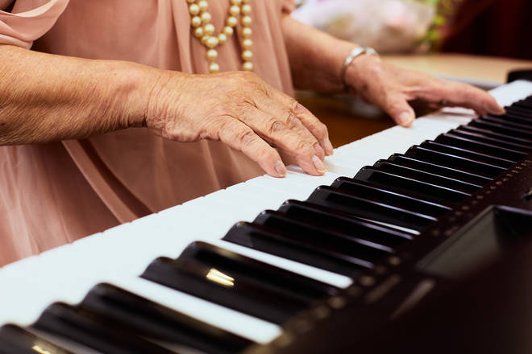
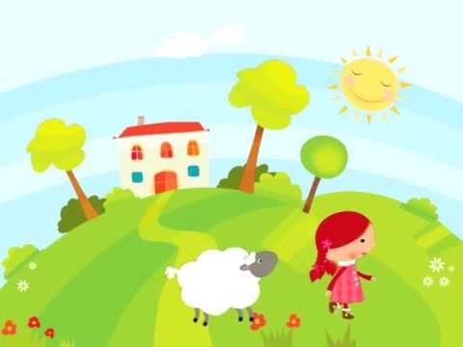
melody
noun
the main tune of the music
Notes:
melody (noun)
Elaboration:
This person is playing a piece of music on the piano. Even though she is playing many notes and sounds, there is a strong tune you could hum along to—the main part of the music. That’s called the melody.
I’m going to play a popular melody; see if you can guess the song. [Click on the video to play just the audio.]
How did you know the song?
Think, Pair, Share prompt:
Tell your partner about a song you love. Sing a little bit of it.
How does that melody make you feel?
https://www.classicfm.com/music-news/piano-practice-key-to-eternal-youth/

Slide 14
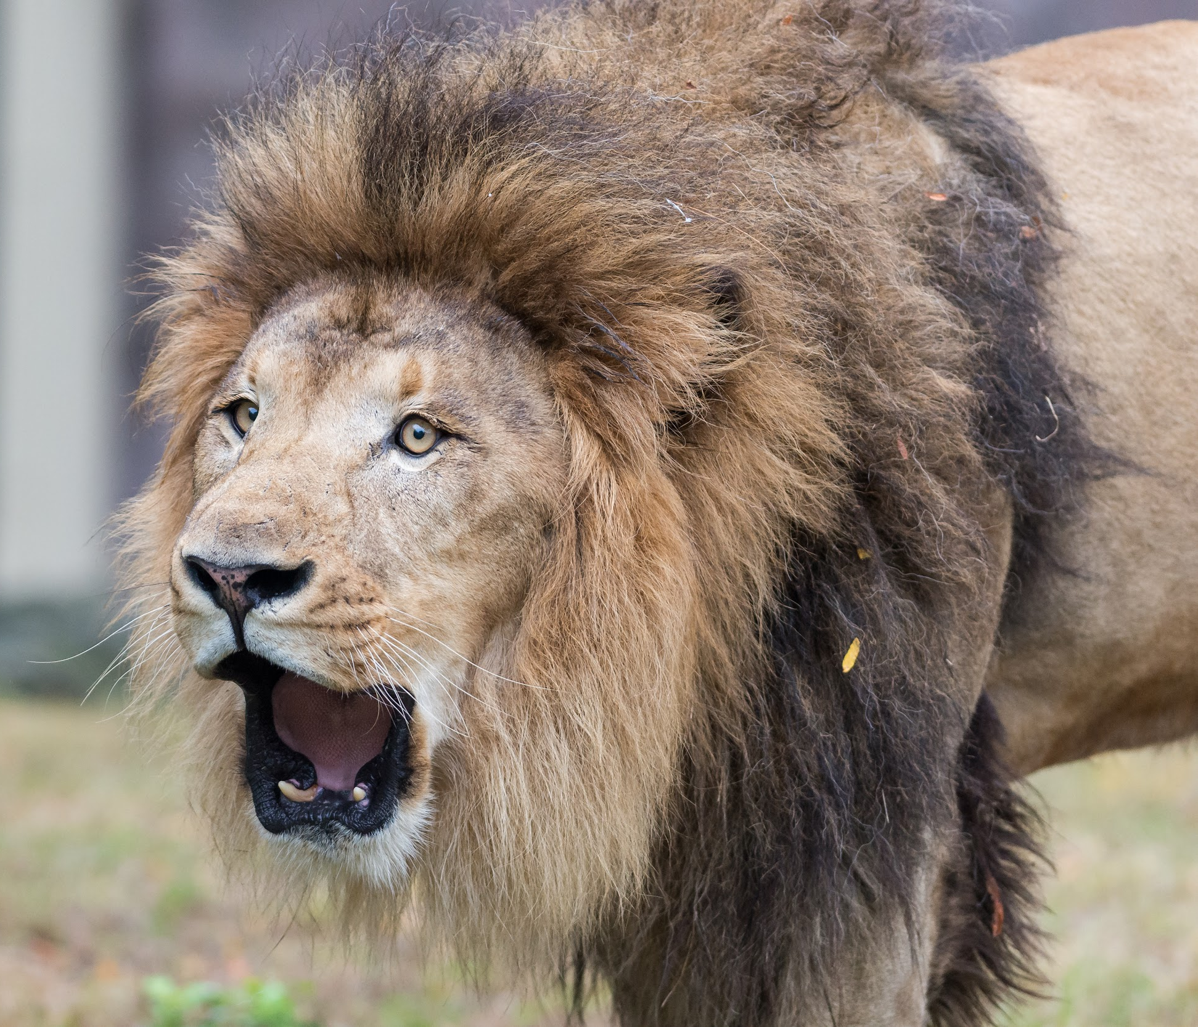
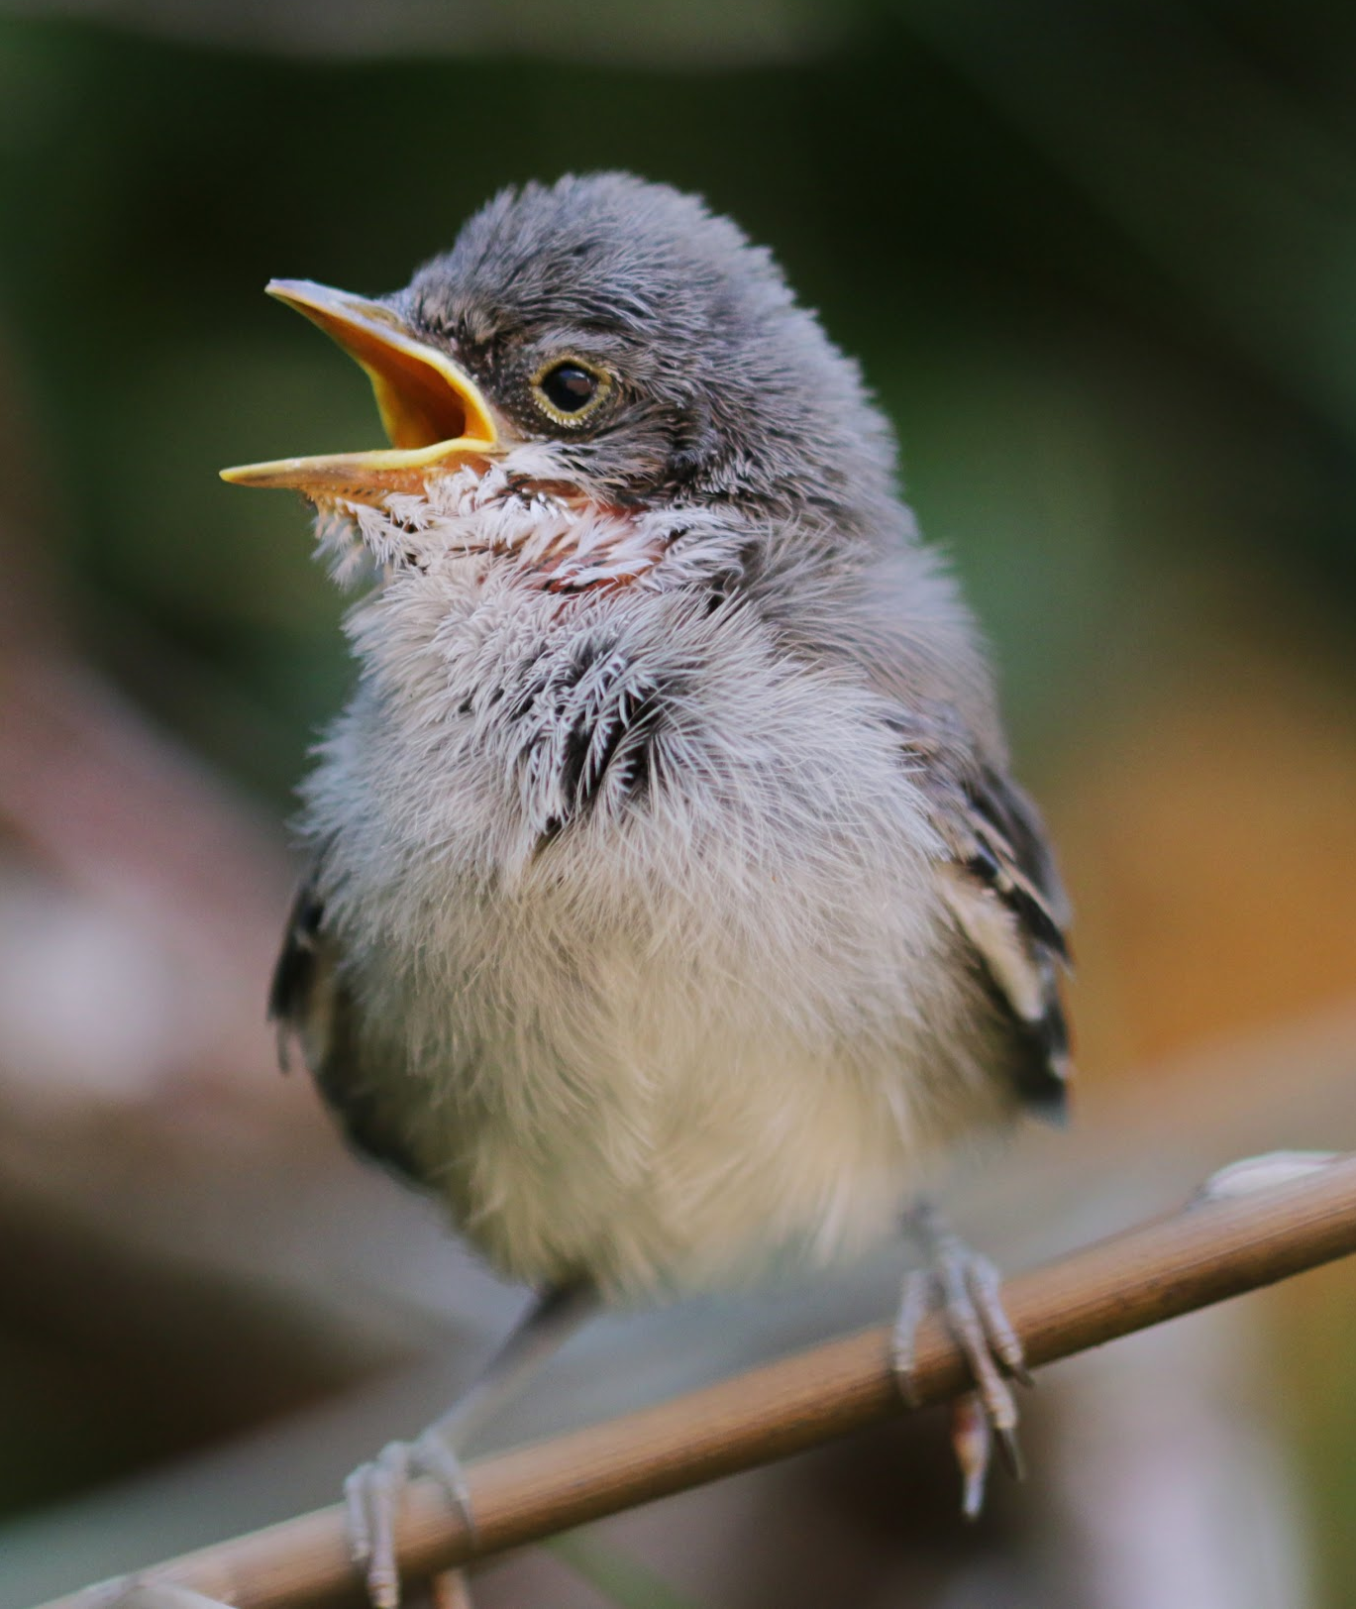
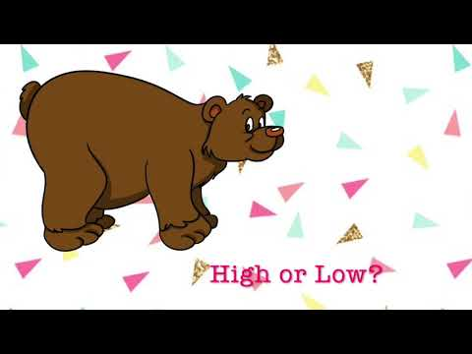
pitch
noun
the high or low quality of a sound
Notes:
pitch (noun)
Elaboration:
This word has lots of meanings you may have heard. In baseball, one player throws a pitch to the batter. A hill can have a steep pitch [make a hand gesture]. In music, the pitch is how high or low a sound is.
Whole group prompt:
Let’s listen to some sounds together and identify them as high and low. [Click on each image to play the just the audio, not the video.]
images: google images
sounds: https://www.youtube.com/watch?v=V9yp99xGP6s

Slide 15
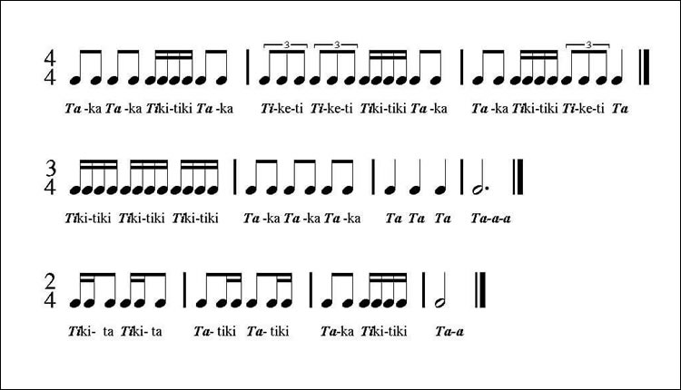
rhythm
noun
regular, repeated pattern of sound
Notes:
rhythm (noun)
Elaboration:
You can speak a rhythm, write a rhythm, play a rhythm. Let’s try this one.
Indicate and read the bottom rhythm, having children repeat after each phrase:
Tiki-ta Tiki-ta | Ta-tiki Ta-tiki | Ta-ka tiki-tiki | Ta - ah
This is how the rhythm is written as musical notes.
Think, Pair, Share prompt:
Can you create your own rhythm and teach it to your partner?
https://banddirector.com/brass/trombone/learn-to-practice-step-1-say-in-rhythm-stay-in-rhythm/

Slide 16
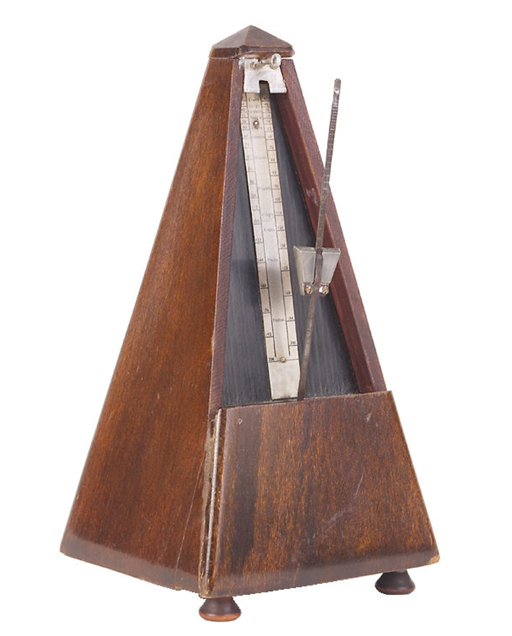
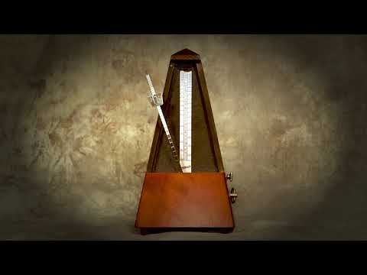
tempo
noun
speed that a piece of music is played
Notes:
tempo (noun)
Elaboration:
Many things can go fast or slow or at medium speed. In music, we call this the tempo. A metronome is a tool that musicians use to keep their tempo steady. They set it at a particular speed, and the little arm goes back and forth at this same speed without stopping or changing, making a clicking noise as it moves back and forth. Let’s see how it works.
[Play the video.]
You can also keep the tempo by tapping your knee with your hand, or tapping your foot.
Think, Pair, Share prompt:
Do you prefer music with a fast tempo or a slow tempo? Why?
https://www.oxfordlearnersdictionaries.com/definition/english/metronome

Slide 17
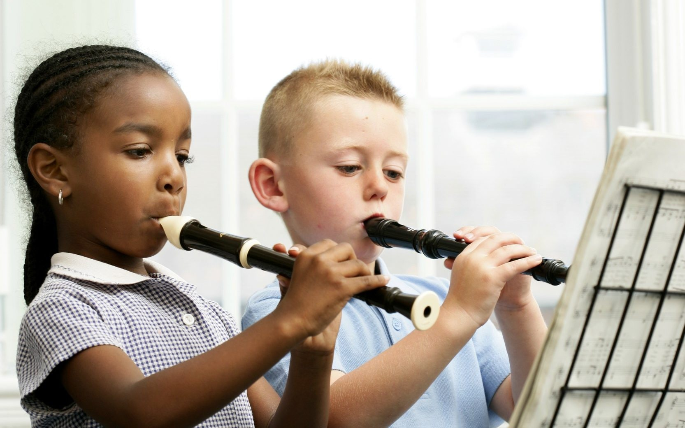

tune
noun
musical sounds with a melody and sometimes harmony
Notes:
tune (noun)
Elaboration:
These children are learning to play an instrument called a recorder. They are probably starting with a very simple tune so they can learn where to put their fingers to make the sounds and how to read the music. That tune can also be called the melody. Let’s listen.
[Click on the video, just to play the audio.]
Think, Pair, Share prompt:
If you could play any instrument, what is a tune might you like to play? Try to hum that tune to your partner.
https://www.telegraph.co.uk/music/news/wind-instruments-perfectly-safe-cant-band-play/

Slide 18
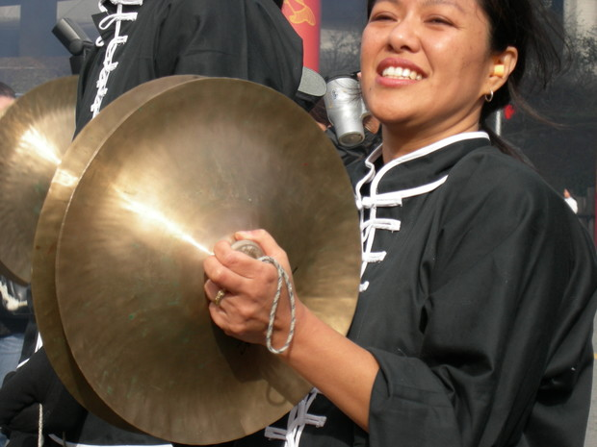
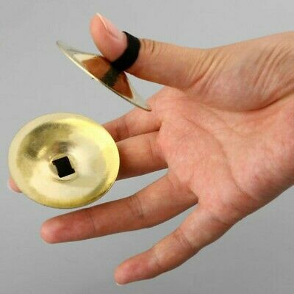


volume
noun
amount of sound; loudness
Notes:
volume (noun)
Elaboration:
We use our voices at different volumes in the classroom depending on what we are doing. When we are in Studios, our voices tend to be at a higher, or louder, volume than when we are writing or working in Stations.
Think, Pair, Share prompt:
Look at the images. Describe what you see.
https://www.wpr.org/sound-cymbals

Slide 19
Weekly Words
Unit 3, Week 3
Notes:
belief: an idea that is accepted as true; a strong opinion
compare: to notice similarities and differences
difference: a way that things are not alike
emotion: feeling
faith: confidence and belief in
journey (n): long trip from one place to another; (v): to go on a trip, to travel
similarity: a way that things are alike
worldview: a way of thinking about the world, a person’s whole perspective

Slide 20
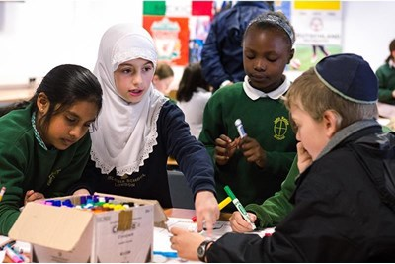
belief
noun
a strong opinion; an idea that is accepted as true
Notes:
belief (noun)
Elaboration:
We hold our beliefs inside ourselves. We make decisions and act according to our beliefs.
People in many communities hold the belief that the best way to solve problems is with cooperation; others hold the belief that each person needs to solve their own problems.
Your teacher has a strong belief that _____ [all children can learn].
Think, Pair, Share prompt:
What is one belief that is important to you? What do you think is true?
https://www.headteacher-update.com/best-practice-article/religion-culture-and-diversity/185375/

Slide 21
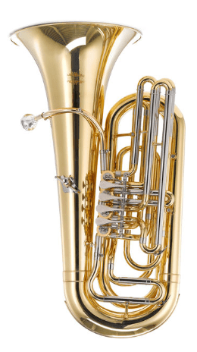
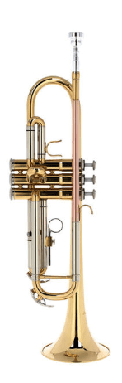
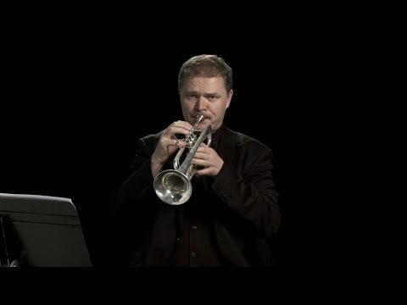

compare
verb
to notice similarities and differences
Notes:
compare (verb)
Elaboration:
We can compare all kinds of things: foods, shoes, people, ideas, places, activities like sports, or works of art. When we compare, we notice both the qualities that are the same and those that are different.
Here are two instruments, a tuba and a trumpet. Let’s listen. [Play each clip (each only a few seconds).]
Think, Pair, Share prompt:
Compare these two instruments. Think about how they look and how they sound. Name the similarities and the differences you notice.
https://www.thomann.de/blog/en/7-brass-instruments-differences-in-sound-and-playing-style/

Slide 22
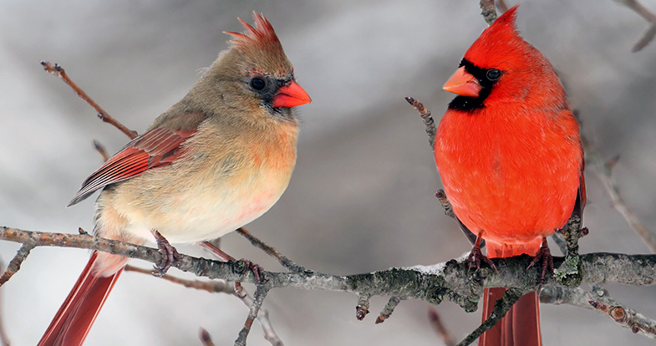
difference
noun
a way that things are not alike
Notes:
difference (noun)
Elaboration:
These are two of the same kind of bird; they are cardinals. The one on the left is a female and the one on the right is a male. That’s one difference, something that is not alike. What other differences can we find?
Think, Pair, Share prompt:
What are some differences between you and your partner?
https://www.wildaboutbirds.com/read/backyard-birds/northern-cardinal

Slide 23

emotion
noun
feeling
Notes:
emotion (noun)
Elaboration:
We have many, many different emotions, or feelings, and we experience them in response to things that happen or things we are thinking about. I might have an emotion of sadness because my friend moved away; I might have an emotion of joy or excitement when we get to visit each other again! There are no emotions that are good or bad; they are just the ways we feel.
Whole group prompt:
Name one emotion, and say when you have felt that way.
https://www.psychologicalscience.org/news/releases/the-emotions-we-feel-may-shape-what-we-see.html

Slide 24

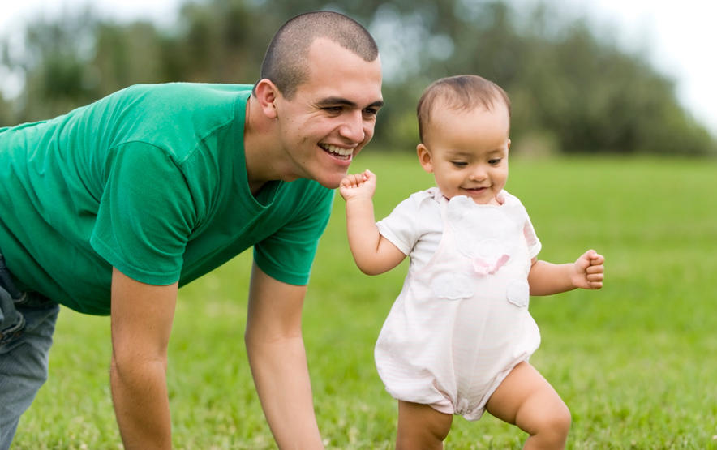
faith
noun
confidence and belief in
Notes:
faith (noun)
Elaboration:
Faith is related to “belief.” Having faith is about believing in something we cannot see. We can have faith in others, in ourselves, and in ideas.
These marks around the earth are symbols that represent different faiths. You might see one or more that you recognize.
This little one is just learning to walk independently. The grown up is letting the toddler go on their own, with faith that they will do it!
Think, Pair, Share prompt:
What connections do you make to this word? What do you have faith in—what do you believe in?
https://billtammeus.typepad.com/my_weblog/2020/04/4-22-20.html, https://www.babycenter.com/baby/baby-development/baby-milestone-walking_6507

Slide 25
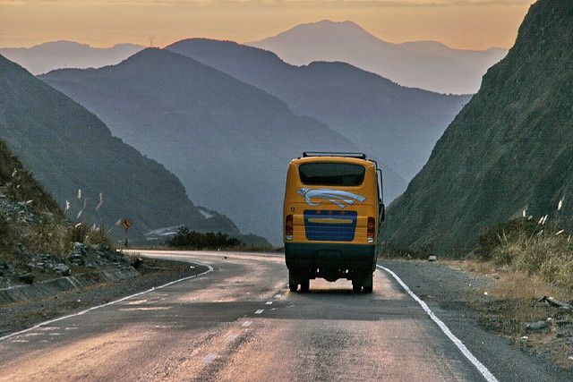
journey
noun
long trip from one place to another
verb
to go on a trip, to travel
Notes:
journey (noun and verb)
Elaboration:
This word can be used as a noun—a long trip from one place to another—or as a verb—to travel.
The people on this bus are taking a journey in South America. It looks like they are journeying through mountains.
Think, Pair, Share prompt:
Try to use the word as both a noun and a verb!
If you were to go on a journey, where might you go?
How would you journey to that place?
https://jessieonajourney.com/tips-for-bus-travel-in-south-america/

Slide 26
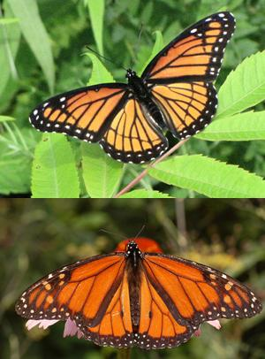
similarity
noun
a way that things are alike
Notes:
similarity (noun)
Elaboration:
These are two different kinds of butterflies: a monarch on the top, and a viceroy on the bottom. There are things about them that are alike. Let’s name some of these similarities…
Think, Pair, Share prompt:
What are some similarities between you and your partner?
https://science-u.org/experiments/magnificent-mimicry.html

Slide 27
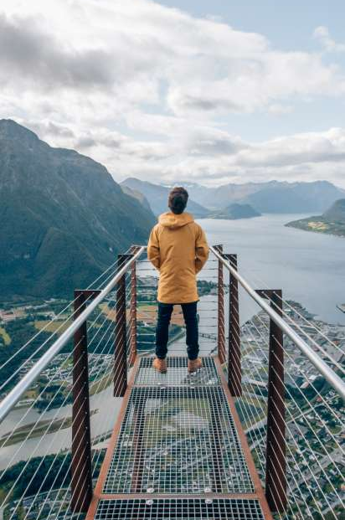
worldview
noun
a way of thinking about the world, a person’s whole perspective
Notes:
worldview (noun)
Elaboration:
Worldview is a compound word—two smaller words put together: “world” and “view.”
This person is looking out to a wide environment, and maybe also having thoughts about the places they see, communities, and ideas, and how they all go together and make sense. Part of my worldview is appreciating what different people can learn from each other.
Think, Pair, Share prompt:
Think back to the drum dream girl. Can you describe her worldview? What did she believe about how things could be?
https://www.visitnorway.com/places-to-go/fjord-norway/northwest/andalsnes/

Slide 28
Weekly Words
Unit 3, Week 4
Notes:
anticipation: the feeling of being hopeful or nervous about something that will soon happen
collective: relating to a group of individuals, considered all together
determined: focused on achieving a goal
homage: a way to show respect for something or someone
humanity: all people
individual: referring to one person
legacy: lasting reputation or impact
reputation: the way a person or thing is thought of by others

Slide 29
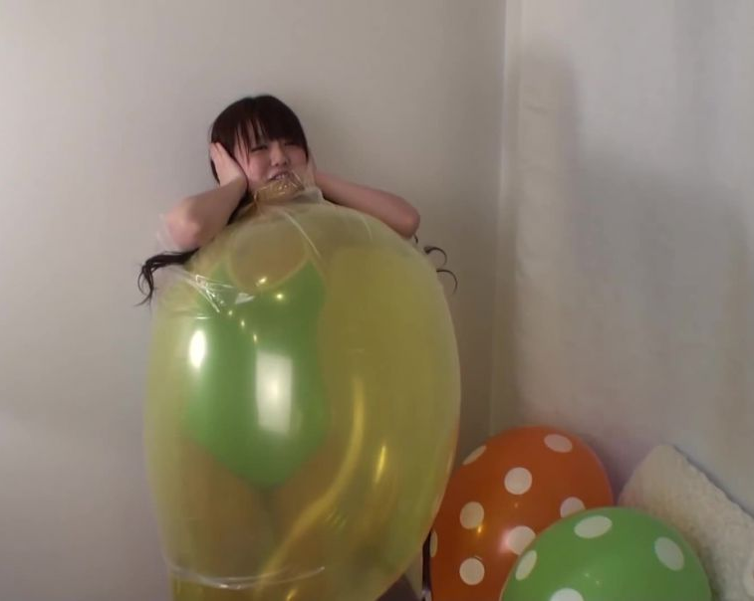
anticipation
noun
the feeling of being hopeful or nervous about something that will soon happen
Notes:
anticipation (noun)
Elaboration:
The balloon is going to burst! We can see this child’s anticipation in the way she holds her ears. What kind of anticipation does she feel? Maybe excited, maybe nervous, maybe some of both!
Think, Pair, Share prompt:
Imagine you are traveling to a new place or going to see your family far away. What does your anticipation feel like?
https://www.loonerpop.com/watch/balloon-explosion-hd-blow-to-pop-with-plastic-suit_BSBtl5O4AiZUsGE.html?lang=english

Slide 30
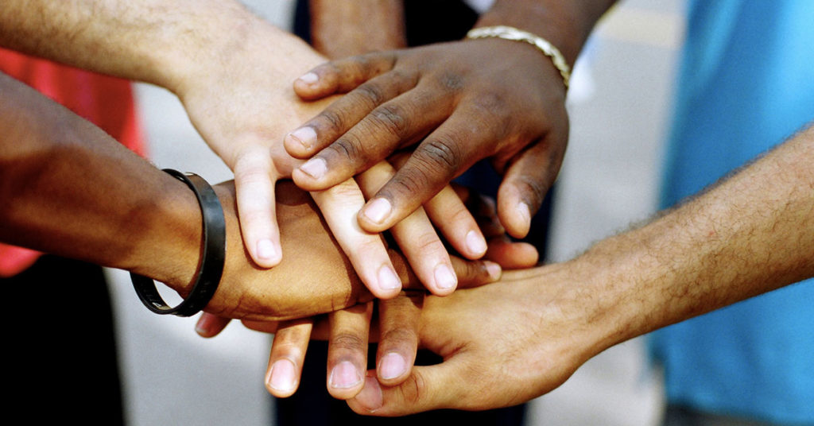
collective
adjective
relating to a group of individuals, considered all together
Notes:
collective (adjective)
Elaboration:
When we make a collective decision, we think about all the people involved and what is good for the whole group, not only about what each person wants.
Think, Pair, Share prompt:
What is one example of a collective decision we have made in our classroom to make it a good place for all learners?
https://blog.medicalgps.com/7-essentials-for-physician-practices-it-starts-with-a-daily-huddle/

Slide 31
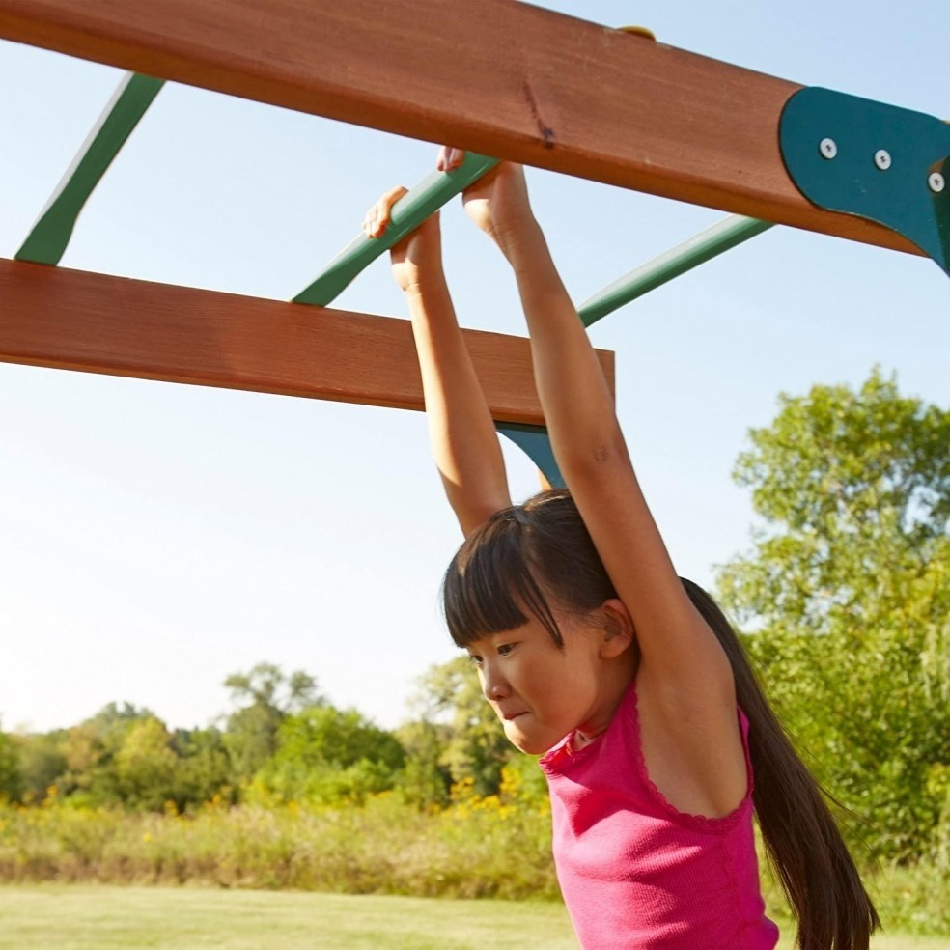
determined
adjective
focused on achieving a goal
Notes:
determined (adjective)
Elaboration:
This child has to be determined to master the climbing bars. She has decided that she is going to do it, and she does not look like she is going to give up.
Think, Pair, Share prompt:
Can you think of a time when you or someone you know has been determined to do something? Try to think of something that seemed really hard, and that you had to promise yourself that you were going to do anyway.
https://foter.com/7-science-based-benefits-of-monkey-bars-playtime

Slide 32

homage
noun
a way to show respect for something or someone
Notes:
homage (noun)
Elaboration:
In their book, Dream Street, two cousins, the writer Tricia Elam Walker and the artist Ekua Holmes, pay homage to the neighborhood they love and where they grew up. They give respect to a place they love through writing and collages.
Think, Pair, Share prompt:
Who is someone or what is a place you would give homage to? What would you do to show your respect for that person or place?
Cover of Dream Street, Tricia Elam Walker and Ekua Holmes

Slide 33
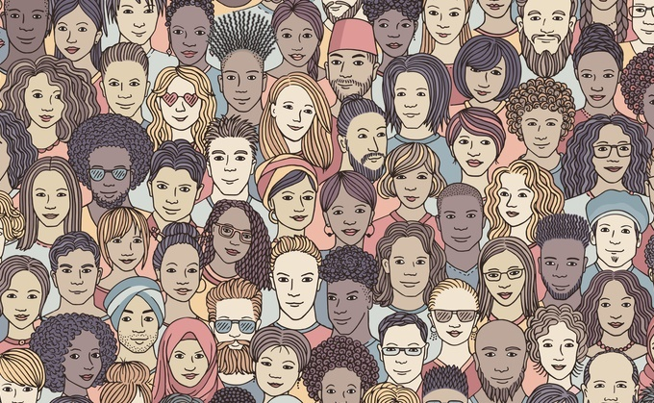
humanity
noun
all people
Notes:
humanity (noun)
Elaboration:
When we talk about humanity, we are referring to all people, all around the world. We might think about a wish for humanity, such as for happiness for all humanity, or for peace between all countries.
Think, Pair, Share prompt:
What is something that you think is important for humanity—all people—to think about or to do?
https://www.filmsforaction.org/articles/all-i-ask-is-that-you-see-my-humanity-which-means-seeing-the-humanity-in-all-people/

Slide 34
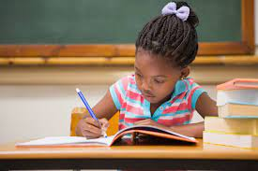
individual
adjective
referring to one person
Notes:
individual (adjective)
Elaboration:
Sometimes we work on a collective task, all together, like when we wrote a letter to _____ to advocate for _____. [Refer to the Unit 1 project or another group endeavor.]
Other times I ask you to do an individual task—to do something all by yourself—like an assessment.
Think, Pair, Share prompt:
Think of an individual activity you have done, briefly describe it, and talk about how you felt about it.
https://www.familyeducation.com/life/cognitive-psychological-development/i-need-help-my-five-year-old-writes-backward

Slide 35
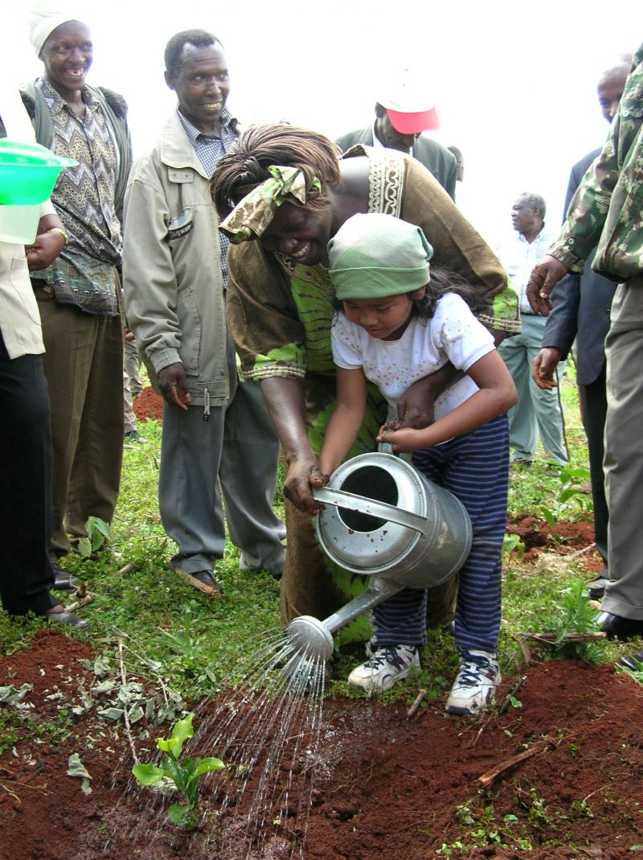
legacy
noun
lasting reputation or impact
Notes:
legacy (noun)
Elaboration:
In Kenya and all around the world, people plant trees to protect the health of the environment for all living things. This is part of the legacy of Wangari Maathai—the impact she has through her life and work.
[If known and relevant, make a connection to the person for whom the school is named: Our school is named for _____, who _____; a commitment to education/equal rights/etc. is part of their legacy.]
Think, Pair, Share prompt:
What legacy can you imagine having? You could say, “I want my legacy to be that _____.”
https://www.goldmanprize.org/blog/green-belt-movement-wangari-maathai/

Slide 36
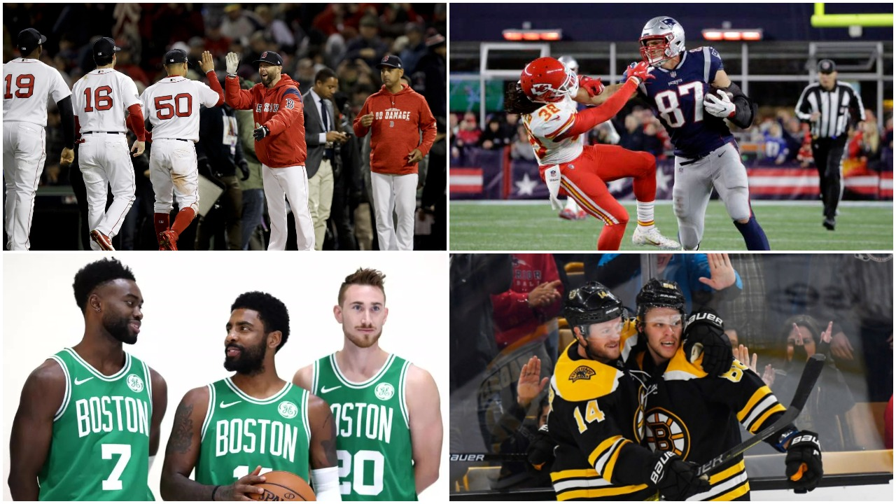
reputation
noun
the way a person or thing is thought of by others
Notes:
reputation (noun)
Elaboration:
The New England have a reputation for being a place where sports are important to many people. Even people who don’t really watch sports can say that New England is known for this.
Think, Pair, Share prompt:
Can you think of a place that has a reputation for something special—a good place to eat, a good place to play, a good place to visit in the summer? What is the place, and what is its reputation?
https://www.bostonsbigfour.com/this-week-in-boston-sports/

Slide 37
Weekly Words
Unit 3, Week 5
Notes:
arrange: to put in a certain order
devote: to commit to something, to keep working hard at it
generation: all of the people born and living at about the same time, or all of the people of about the same age
layer: to arrange something out flat on top of something else
reveal: to show something that was unknown
textile: a woven fabric
tradition: belief or custom that is handed down
weave (v): to lace together threads to create a fabric; (n): the pattern or construction of a fabric

Slide 38
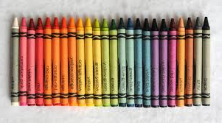
arrange
verb
to put in a certain order
Notes:
arrange (verb)
Elaboration:
Someone decided to arrange these crayons in a particular order, according to the rainbow. Objects can be arranged this way—by color—or by any other order, such as by number, by size, in alphabetical order, or by how often something gets used. People decide to arrange things in certain ways for different reasons.
Think, Pair, Share prompt:
Think about the place where we keep _____ [supplies for Studios, books, writing and drawing tools, coats and backpacks, etc; name a place appropriate for the classroom] OR Think about where your family keeps groceries.
Describe to your partner how things are arranged. Why are they arranged that way?
http://www.jennyscrayoncollection.com/2015/07/no-24p-crayola-crayons.html

Slide 39
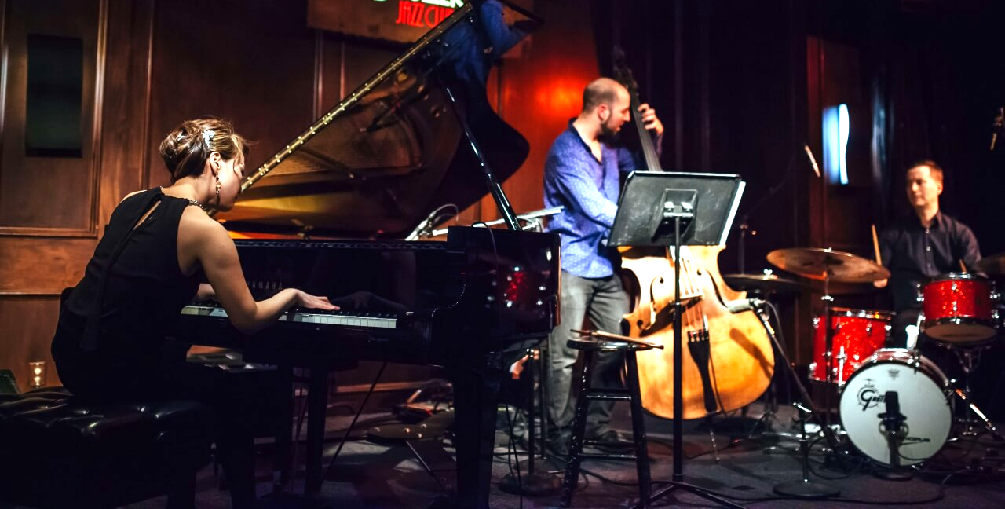
devote
verb
to commit to something, to keep working hard at it
Notes:
devote (verb)
Elaboration:
Yoko Miwa and her band are musicians. They devote themselves individually to playing their instruments as well as they can, and, collectively, to playing well together. They also devote a lot of time to practicing!
Think, Pair, Share prompt:
Why might it be important for a musician to devote herself to practicing?
Photo by Caroline Alden, https://artsparksmusic.com/yoko-miwa-trio/

Slide 40
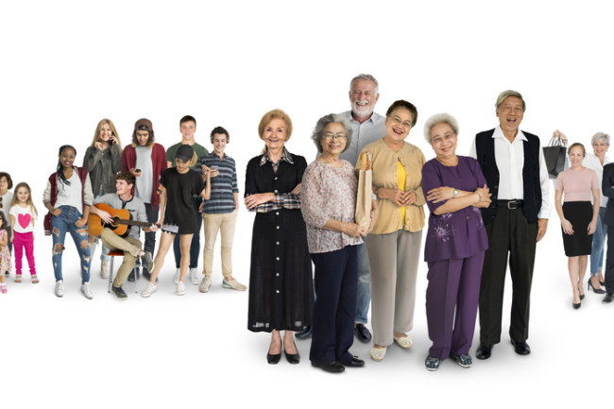
generation
noun
all of the people born and living at about the same time, or all of the people of about the same age
Notes:
generation (noun)
Elaboration:
This photo shows people grouped by generation: with older people in front, teenagers in the back, younger children behind them, and people in between on the side.
Think, Pair, Share prompt:
How many generations of people do you have in your family now?
How many generations live together with you?
https://www.discovermagazine.com/the-sciences/so-you-know-what-generation-you-belong-to-what-does-that-even-mean

Slide 41
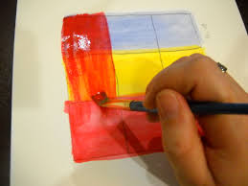
layer
verb
to arrange something out flat on top of something else
Notes:
layer (verb)
Elaboration:
We saw this word, “layer,” as a noun in Unit 2: a layer of dirt. Now we can use it as a verb—an action of putting something on top of something else.
Look how this person layers the paint, one color right on top of another. Layering the paint creates a special effect of more complex colors.
Think, Pair, Share prompt:
What might you layer on a bed? Why?
https://maggynitla.com/2012/12/03/tutorial-layering-acrylic-paint-colors/

Slide 42
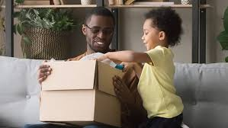
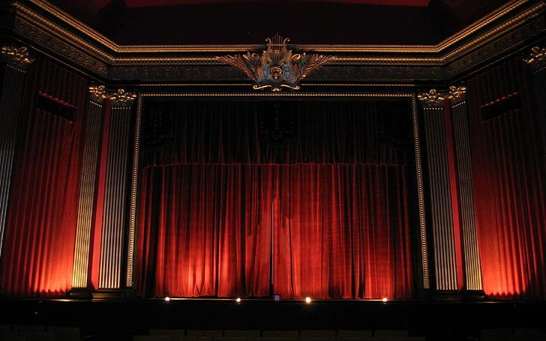
reveal
verb
to show something that was unknown
Notes:
reveal (verb)
Elaboration:
Opening a box reveals what’s inside.
Opening a book reveals its story!
Think, Pair, Share prompt:
When the curtain opens, what might it reveal? What’s behind that curtain?
https://www.todaysparent.com/family/activities/cool-subscription-boxes-for-kids/, https://www.wallpaperflare.com/red-window-curtains-theatre-waiting-stage-performance-space-wallpaper-ainz

Slide 43


textile
noun
a woven fabric
Notes:
textile (noun)
Elaboration:
Textiles come in endless colors and patterns. Often, the weave of a textile follows the traditions of a community—its designs, colors, and what the threads are made of.
Think, Pair, Share prompt:
Most of our clothing is made of textiles. Describe a textile you are wearing. What do you like about it?
https://www.unep.org/events/online-event/accelerating-sustainability-textile-value-chain-inspiring-action-and-behaviour, https://slotweedride.wordpress.com/2011/05/01/what-is-tweed/

Slide 44
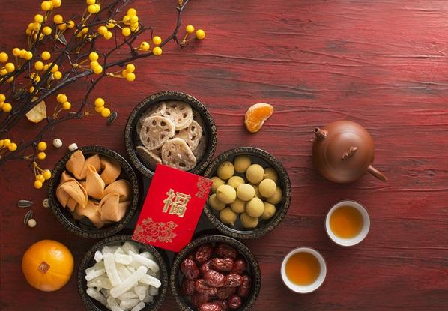
tradition
noun
belief or custom that is handed down
Notes:
tradition (noun)
Elaboration:
At celebrations or holidays, people follow certain traditions. They may eat certain foods, sing certain songs, tell certain stories, wear certain kinds of clothing, and do certain activities. At the Lunar New Year, people often exchange red envelopes with coins inside, as a promise of good fortune for the coming year.
Whole group prompt:
Tell your partner about something you celebrate and some of the traditions you follow.
https://homestay.cambridgenetwork.com/blog/preparing-for-chinese-new-year-homestay-happenings/

Slide 45
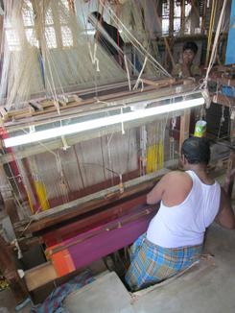

weave
verb
to lace together threads to create a fabric
noun
the pattern or construction of a fabric
Notes:
weave (verb, noun)
Elaboration:
People all around the world weave fabric by hand, on very simple cardboard box looms, and on very complex looms. Most of the clothes we wear are made from fabric that has been woven on machine looms. No matter how it’s done, weaving happens when threads going two different directions are laced together—over, under, over, under—to make a single piece of cloth.
We can describe the noun, weave, by saying that it is colorful, or striped, or thick, or made of cotton.
Think, Pair, Share prompt:
If you could weave something, what would it be? How would you use it? What kind of yarn, ribbon, or string would you use to weave it? What colors would you use?
https://design-altruism-project.org/2012/09/01/desperately-seeking-sari/, https://www.textileschool.com/270/major-fabric-weaving-patterns/

Slide 46
Weekly Words
Unit 3, Week 6
Notes:
culture: the beliefs, customs, arts, and traditions of a place or group of people
diversity: the quality of having many different kinds of people in a place
enrich: to improve the quality of something
heritage: the cultural history of a group of people
immigration: the act of moving to one country from another
population: a particular group or type of people (or animals) living in an area
portrait: a short biography or an image of a person
thrive: to grow and develop well

Slide 47
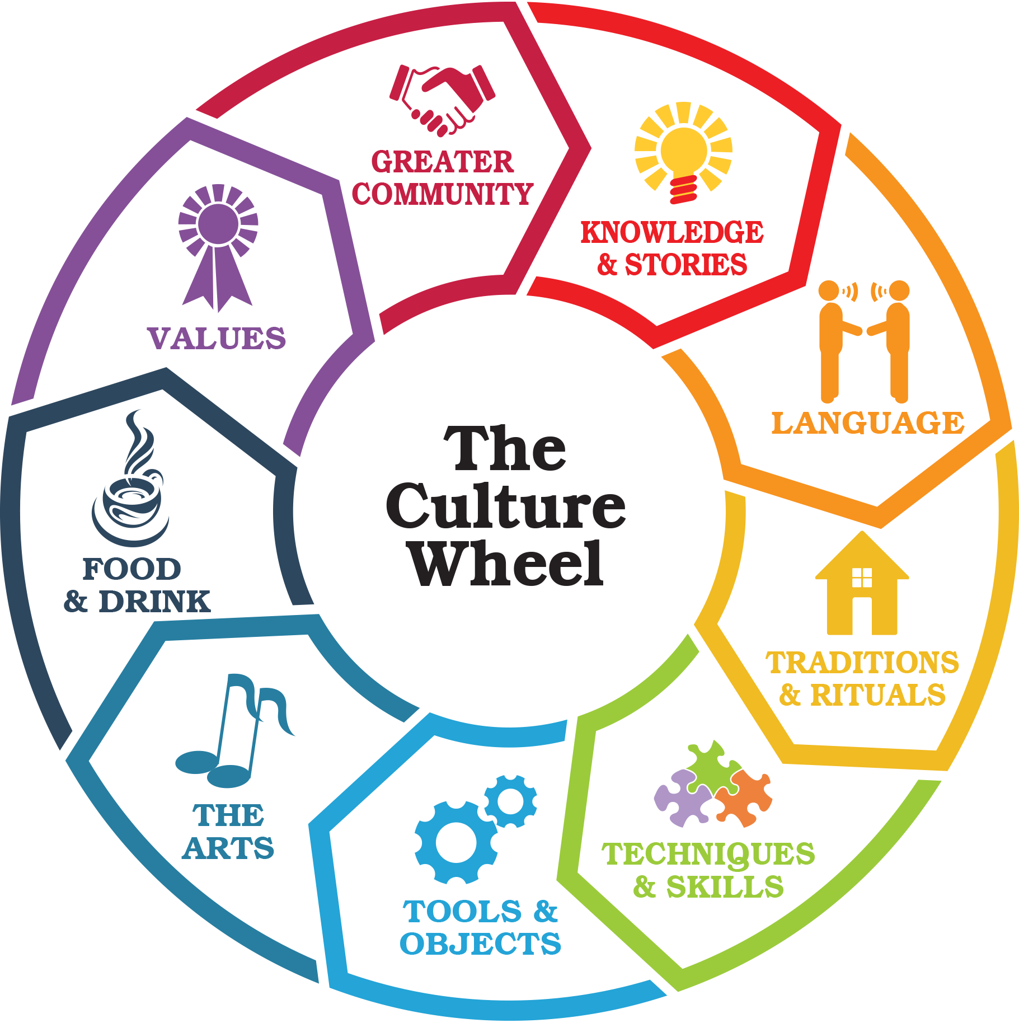
culture
noun
the beliefs, customs, arts, and traditions of a place or group of people
Notes:
culture (noun)
Elaboration:
Culture is an idea that includes many parts: how a group of people does things, how they communicate, what they believe, how they celebrate, what games they play, how they dress, what they eat, how they interact in their families, what education is like… Culture is everything we do!
Think, Pair, Share prompt:
What is something you do with your friends or family that communicates something about your culture?
https://www.bridgestogether.org/celebrating-our-culture-a-new-how-to-guide/

Slide 48
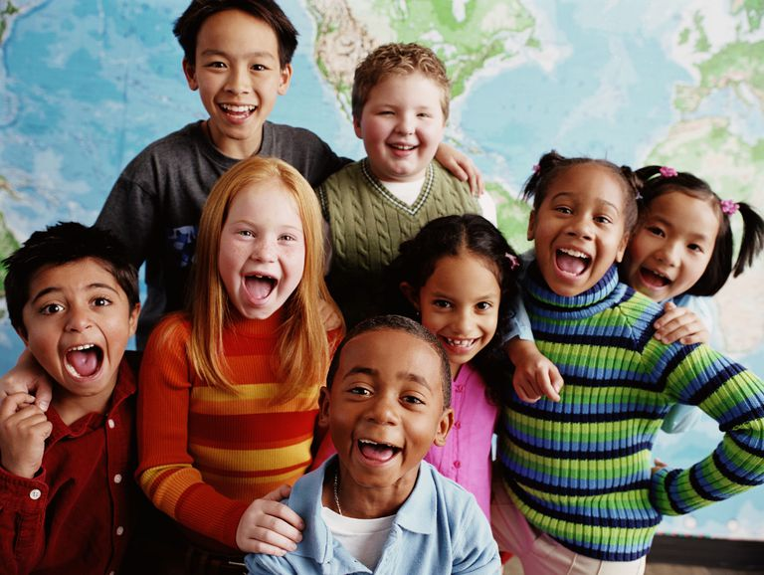
diversity
noun
the quality of having many different kinds of people in a place
Notes:
diversity (noun)
Elaboration:
Some places have a lot of diversity—so many different people contributing their ideas and traditions.
Think, Pair, Share prompt:
How does the diversity of the texts we read help us understand communities around the world?
https://www.cccoe.k12.ca.us/departments/curriculum_and_instruction/english_learner__title_i_i_i_technical_assistance

Slide 49
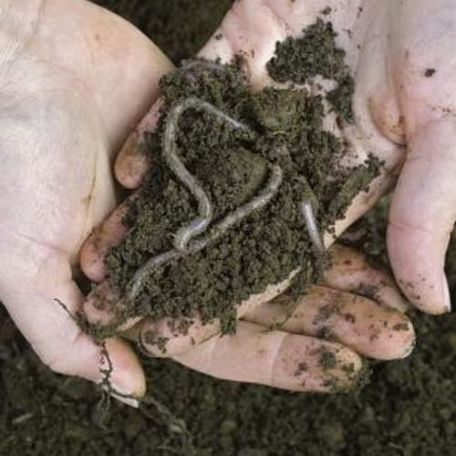
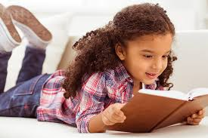
enrich
verb
to improve the quality of something
Notes:
enrich (verb)
Elaboration:
We enrich garden soil by adding worms—the worms give the soil air and nutrients required for healthy plants.
We can enrich our minds by reading to get new ideas.
Think, Pair, Share prompt:
Talk together about a time when reading gave you a new idea.
https://www.finegardening.com/article/earthworms-help-build-your-soil, https://readingeggs.com/articles/2019/01/08/what-is-reading-fluency/

Slide 50
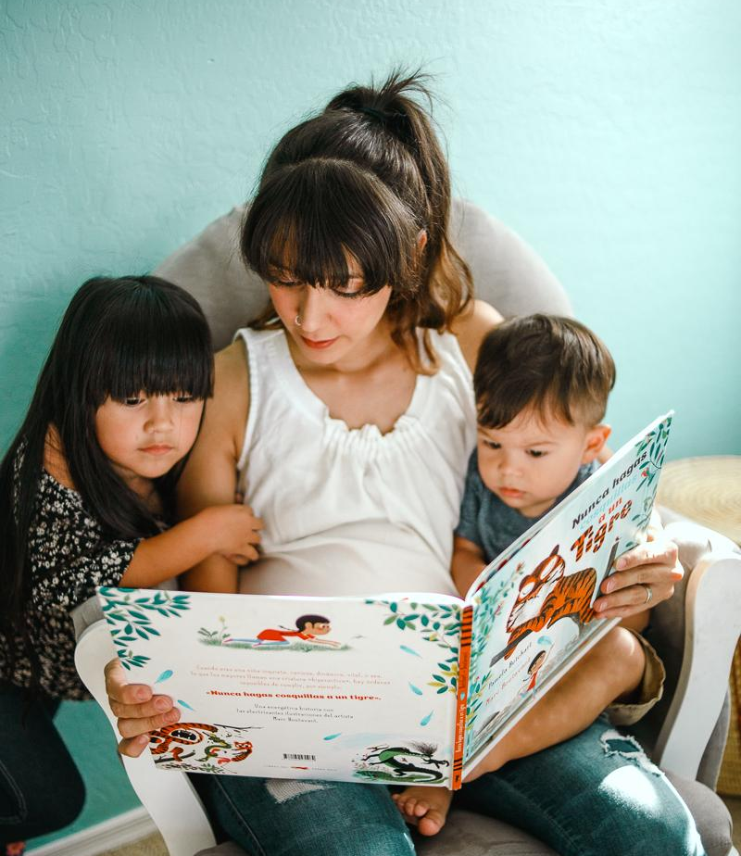
heritage
noun
the cultural history of a group of people
Notes:
heritage (noun)
Elaboration:
Spanish is the language this family speaks at home. It is part of their heritage. The mother speaks Spanish and passes the language, part of her heritage, on to her children.
Along with language, a person’s heritage might also include ways of cooking and eating, traditions, and ways of communicating. For example, you could say that “Storytelling is part of my heritage,” if your family includes storytellers through the generations.
https://www.chicanamama.com/family-spanish-reading-project-with-sol-book-box/

Slide 51

immigration
noun
the act of moving to one country from another
Notes:
immigration (noun)
Elaboration:
We have seen the word “immigrant”—someone who comes from one place to settle permanently in another place. We can see that “immigration” is related to the word “immigrant.” When we talk about immigration, we often refer to groups of people who settle in a new country. We can use this word to describe, for example, how the immigration of people from _____ [use a classroom-appropriate place] to the United States makes the country a more diverse and interesting place.
Think, Pair, Share prompt:
What are some ways that immigration makes a place more interesting? What do immigrants bring?
https://whoswholegal.com/features/australias-immigration-programme

Slide 52
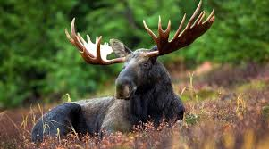
population
noun
a particular group or type of people (or animals) living in an area
Notes:
population (noun)
Elaboration:
Maine has a large population of moose. There are many of them in our state!
Think, Pair, Share prompt:
What is a question you have about the population of our school, or about the population of Maine?
https://nhrabbitreports.org/species/new-england-cottontail, https://www.outdoors.org/articles/amc-outdoors/packlist/how-many-moose-are-in-new-england-fall-is-a-good-time-to-look

Slide 53
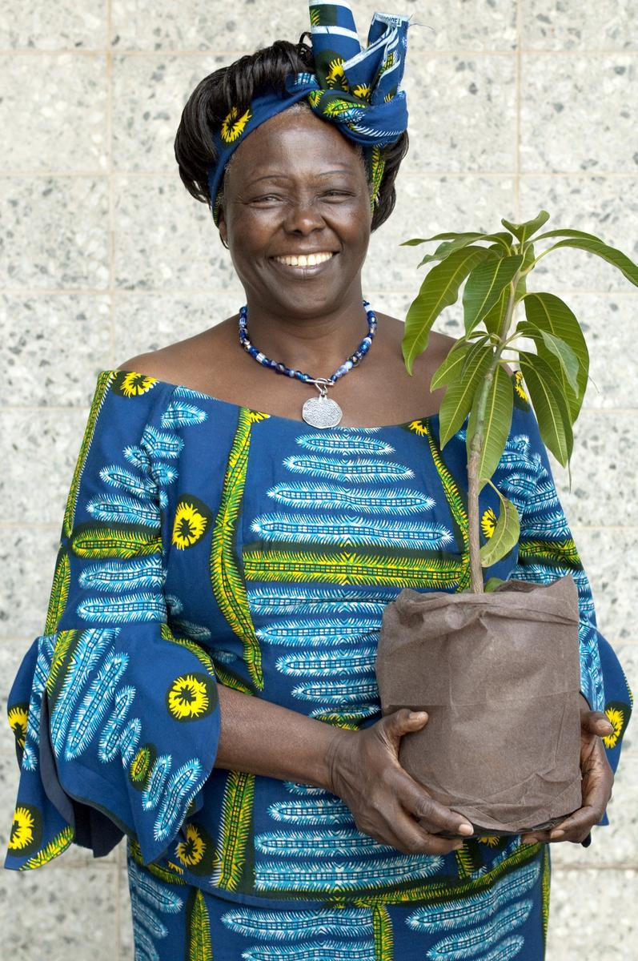



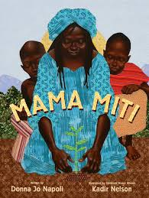
portrait
noun
a short biography or an image of a person
Notes:
portrait (noun)
Elaboration:
Here are some portraits of Wangari Maathai. One is a photograph, and one is a collage by the artist Eleanor Turvey. You could also say that these books are also portraits, because they each tell a story of her life.
Think, Pair, Share prompt:
If someone were going to make a portrait of you, what would you want them to include? What media would you like them to use?
https://womenscenter.unc.edu/2016/03/inspiration-for-womens-history-month-wangari-maathai/, https://eleanorturvey.com/product/wangari-maathai-one-humanity/

Slide 54

thrive
verb
to grow and develop well
Notes:
thrive (verb)
Elaboration:
Exercise and fresh air are two things that help people of all ages thrive—to live happy, healthy lives.
Think, Pair, Share prompt:
What else can you think of that helps people thrive?
https://www.cancer.org/latest-news/fun-and-fitness-for-the-whole-family.html

Slide 55
Weekly Words
Unit 3, Week 7
Notes:
celebration: an activity done to honor or celebrate something or someone
commerce: buying and selling goods and services
influence: power that has an effect on someone or something
kinship: a feeling of sharing common values, ideas, or characteristics; a feeling of being related, like to family
opportunity: a chance for a better situation or outcome
promote: to support or encourage; to tell about something in a public way
translate: to change into the words of another language
understanding: sympathy toward or appreciation about other people

Slide 56

celebration
noun
an activity done to honor or celebrate something or someone
Notes:
celebration (noun)
Elaboration:
The people in this group are having a celebration in honor of Monarch butterflies and their migration from the United States to Mexico.
Think, Pair, Share prompt:
Tell your partner about a celebration you have been part of!
https://www.valleycentral.com/news/local-news/butterfly-migration-celebration-in-mcallen/

Slide 57

commerce
noun
buying and selling goods and services
Notes:
commerce (noun)
Elaboration:
These people are participating in commerce: one is selling a cup of coffee, and the other is buying it. Those are both sides of commerce.
Think, Pair, Share prompt:
When do you or other people in your family participate in commerce? What do you buy or sell?
https://www.citybureau.org/stories/2017/4/3/inside-englewoods-best-corner-store

Slide 58


influence
noun
power that has an effect on someone or something
Notes:
influence (noun)
Elaboration:
Weather has an influence on the activities of people and animals. Maybe you have been ice skating in the winter and then playing in the same pond over the summer.
Think, Pair, Share prompt:
What are some ways that the weather has an influence on things people do?
https://www.bcheights.com/2020/12/01/frog-pond-closes-for-ice-skating-for-first-time/, https://www.wbur.org/news/2021/06/25/janey-frog-pond

Slide 59

kinship
noun
a feeling of sharing common values, ideas, or characteristics; a feeling of being related, like to family
Notes:
kinship (noun)
Elaboration:
Kinship can be thought of as a tree, with lots of different parts that are all related in some way. You can feel kinship with people in your family, or with someone you have just met but who you have lots in common with. Think of when you are with someone and you think, “I feel exactly the same way! We are connected!” You feel affinity for one another.
Whole group prompt:
Can you think of a character in a book we have read whom you feel kinship with?
https://www.basicgoodness.com/2014/eps-68-family-constellation-adventure/

Slide 60

opportunity
noun
a chance for a better situation or outcome
Notes:
opportunity (noun)
Elaboration:
In The Upside Down Boy, Juan Felipe Herrera describes his first opportunity to go to school, when he was eight years old. In this story, he has another opportunity to perform for his classmates, when his uncle gives him a harmonica. Opportunities can feel exciting and also a bit worrisome.
Think, Pair, Share prompt:
This week you will have an opportunity to _____ in school. How do you feel about that?
OR:
What is an opportunity you have had? How did you feel about it at the time?
Illustration from The Upside Down Boy | El niño de cabeza by Elizabeth Gómez, written by Juan Felipe Herrera

Slide 61

promote
verb
to support or encourage;
to tell about something in a public way
Notes:
promote (verb)
Elaboration:
When you are working on an important project, or if you hear about something, and you want other people to know about it, you can promote it—tell others about it.
Think, Pair, Share prompt:
Imagine there is going to be a festival in town. What are a few ways you could promote it so everyone finds out about it and plans to come?
https://www.eventbrite.com/blog/how-to-promote-event-social-media-ds00/

Slide 62

translate
verb
to change into the words of another language
Notes:
translate (verb)
Elaboration:
The people in Ami Chi’s family don’t all speak the same language. They find many ways to communicate, but sometimes it’s most useful to have someone to translate. That person, the translator, can speak both languages. Ami Chi’s grandmother speaks Vietnamese, and Ami Chi speaks English. Her parents can translate—they can tell one what the other is saying by switching back and forth between the two languages they know.
Think, Pair, Share prompt:
Share a time when you translated or saw another person translate for another person. What languages were used? What was the situation?
OR:
What do you think it would be like to be in a place where you didn’t speak the language and you didn’t have anyone to translate?
Illustration from Going Home, Coming Home by Ann Phong, written by Truong Tran

Slide 63

understanding
noun
sympathy toward or appreciation about other people
Notes:
understanding (noun)
Elaboration:
You know the verb “understand,” to get the meaning of something, like when you are reading a book.
Another meaning is to have sympathy for, or to appreciate somebody.
“Understanding” is a noun—the feeling of appreciating something about others.
In Drum Dream Girl, the drummer waits a long time for her father to develop an understanding about how important it felt to her to play the drums.
Think, Pair, Share prompt:
Have you developed a new understanding about [something related to the unit: muralists, musicians, etc…] through the work we are doing in this unit?
Illustration from Drum Dream Girl: How One Girl’s Courage Changed Music by Rafael López, written by Margarita Engle

