Slide 1
Biography Verb Tense
Writing Unit 3 Week 7 Day 3

Slide 2
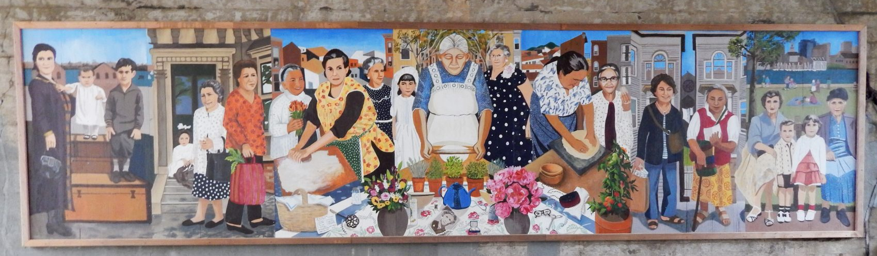
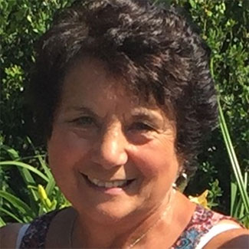

ROSE TINO DELLO RUSSO
Rose came to the U.S. from Italy in 1958 when she was 10 years old. She owned a fabric store, Tino’s Fabrics, for many years. Currently she works at a school and volunteers for the elderly.
Notes:
http://www.wbur.org/artery/2017/12/08/east-boston-immigrant-grandmothers-mural
https://www.boston.gov/departments/immigrant-advancement/immigrants-love/immigrant-grandmothers-subjects

Slide 3
Record of Events:
She owned a fabric store, Tino’s Fabrics, for many years.

Slide 4
Conclusion:
Currently she works at a school and volunteers for the elderly.

