Slide 1
Biography Adjectives
Writing Unit 3 Week 7 Day 4

Slide 2
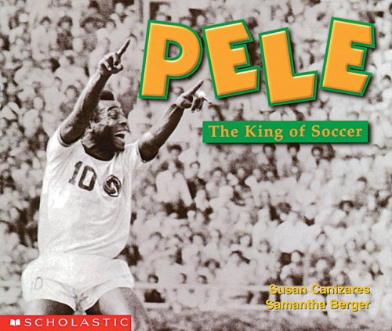
Adjectives describe nouns.
They answer these questions:
How many/much?
What kind?
What like?
Which ones? Whose?

Slide 3
Pelé was a great soccer player.

Slide 4
Pelé was a great soccer player.
What? player
What kind?
soccer
What like?
great

Slide 5
The great soccer player Pelé helped soccer to become a well-known and popular sport in the United States.

Slide 6
Pelé was a great soccer player.
Pelé was a great soccer player.
The great soccer player Pelé helped soccer to become a well-known and popular sport in the United States.

