Slide 1
Haitian Art
Art for Change Gallery
Text Talk Week 7, Day 3

Slide 2
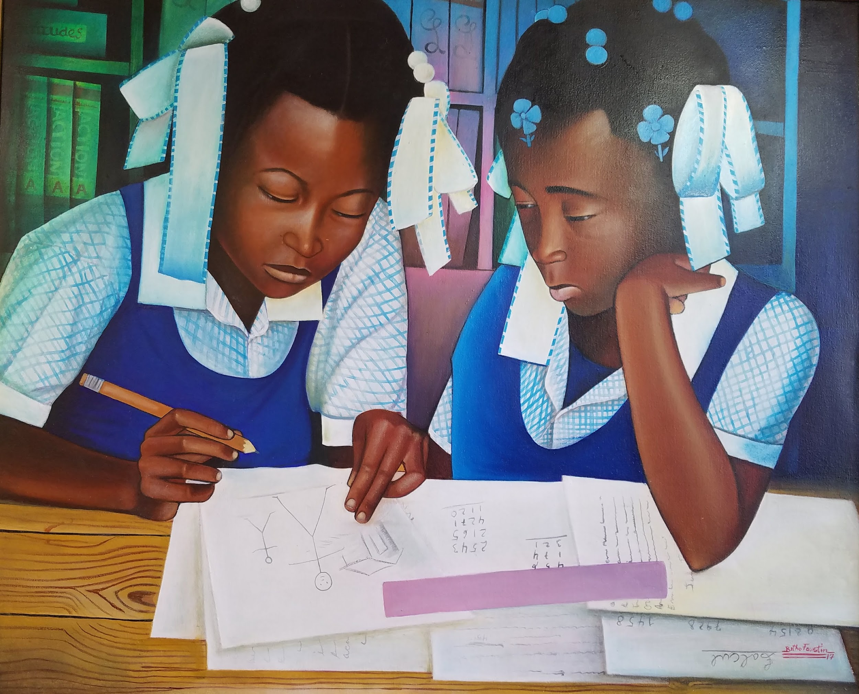
Bithos Faustin
School

Slide 3
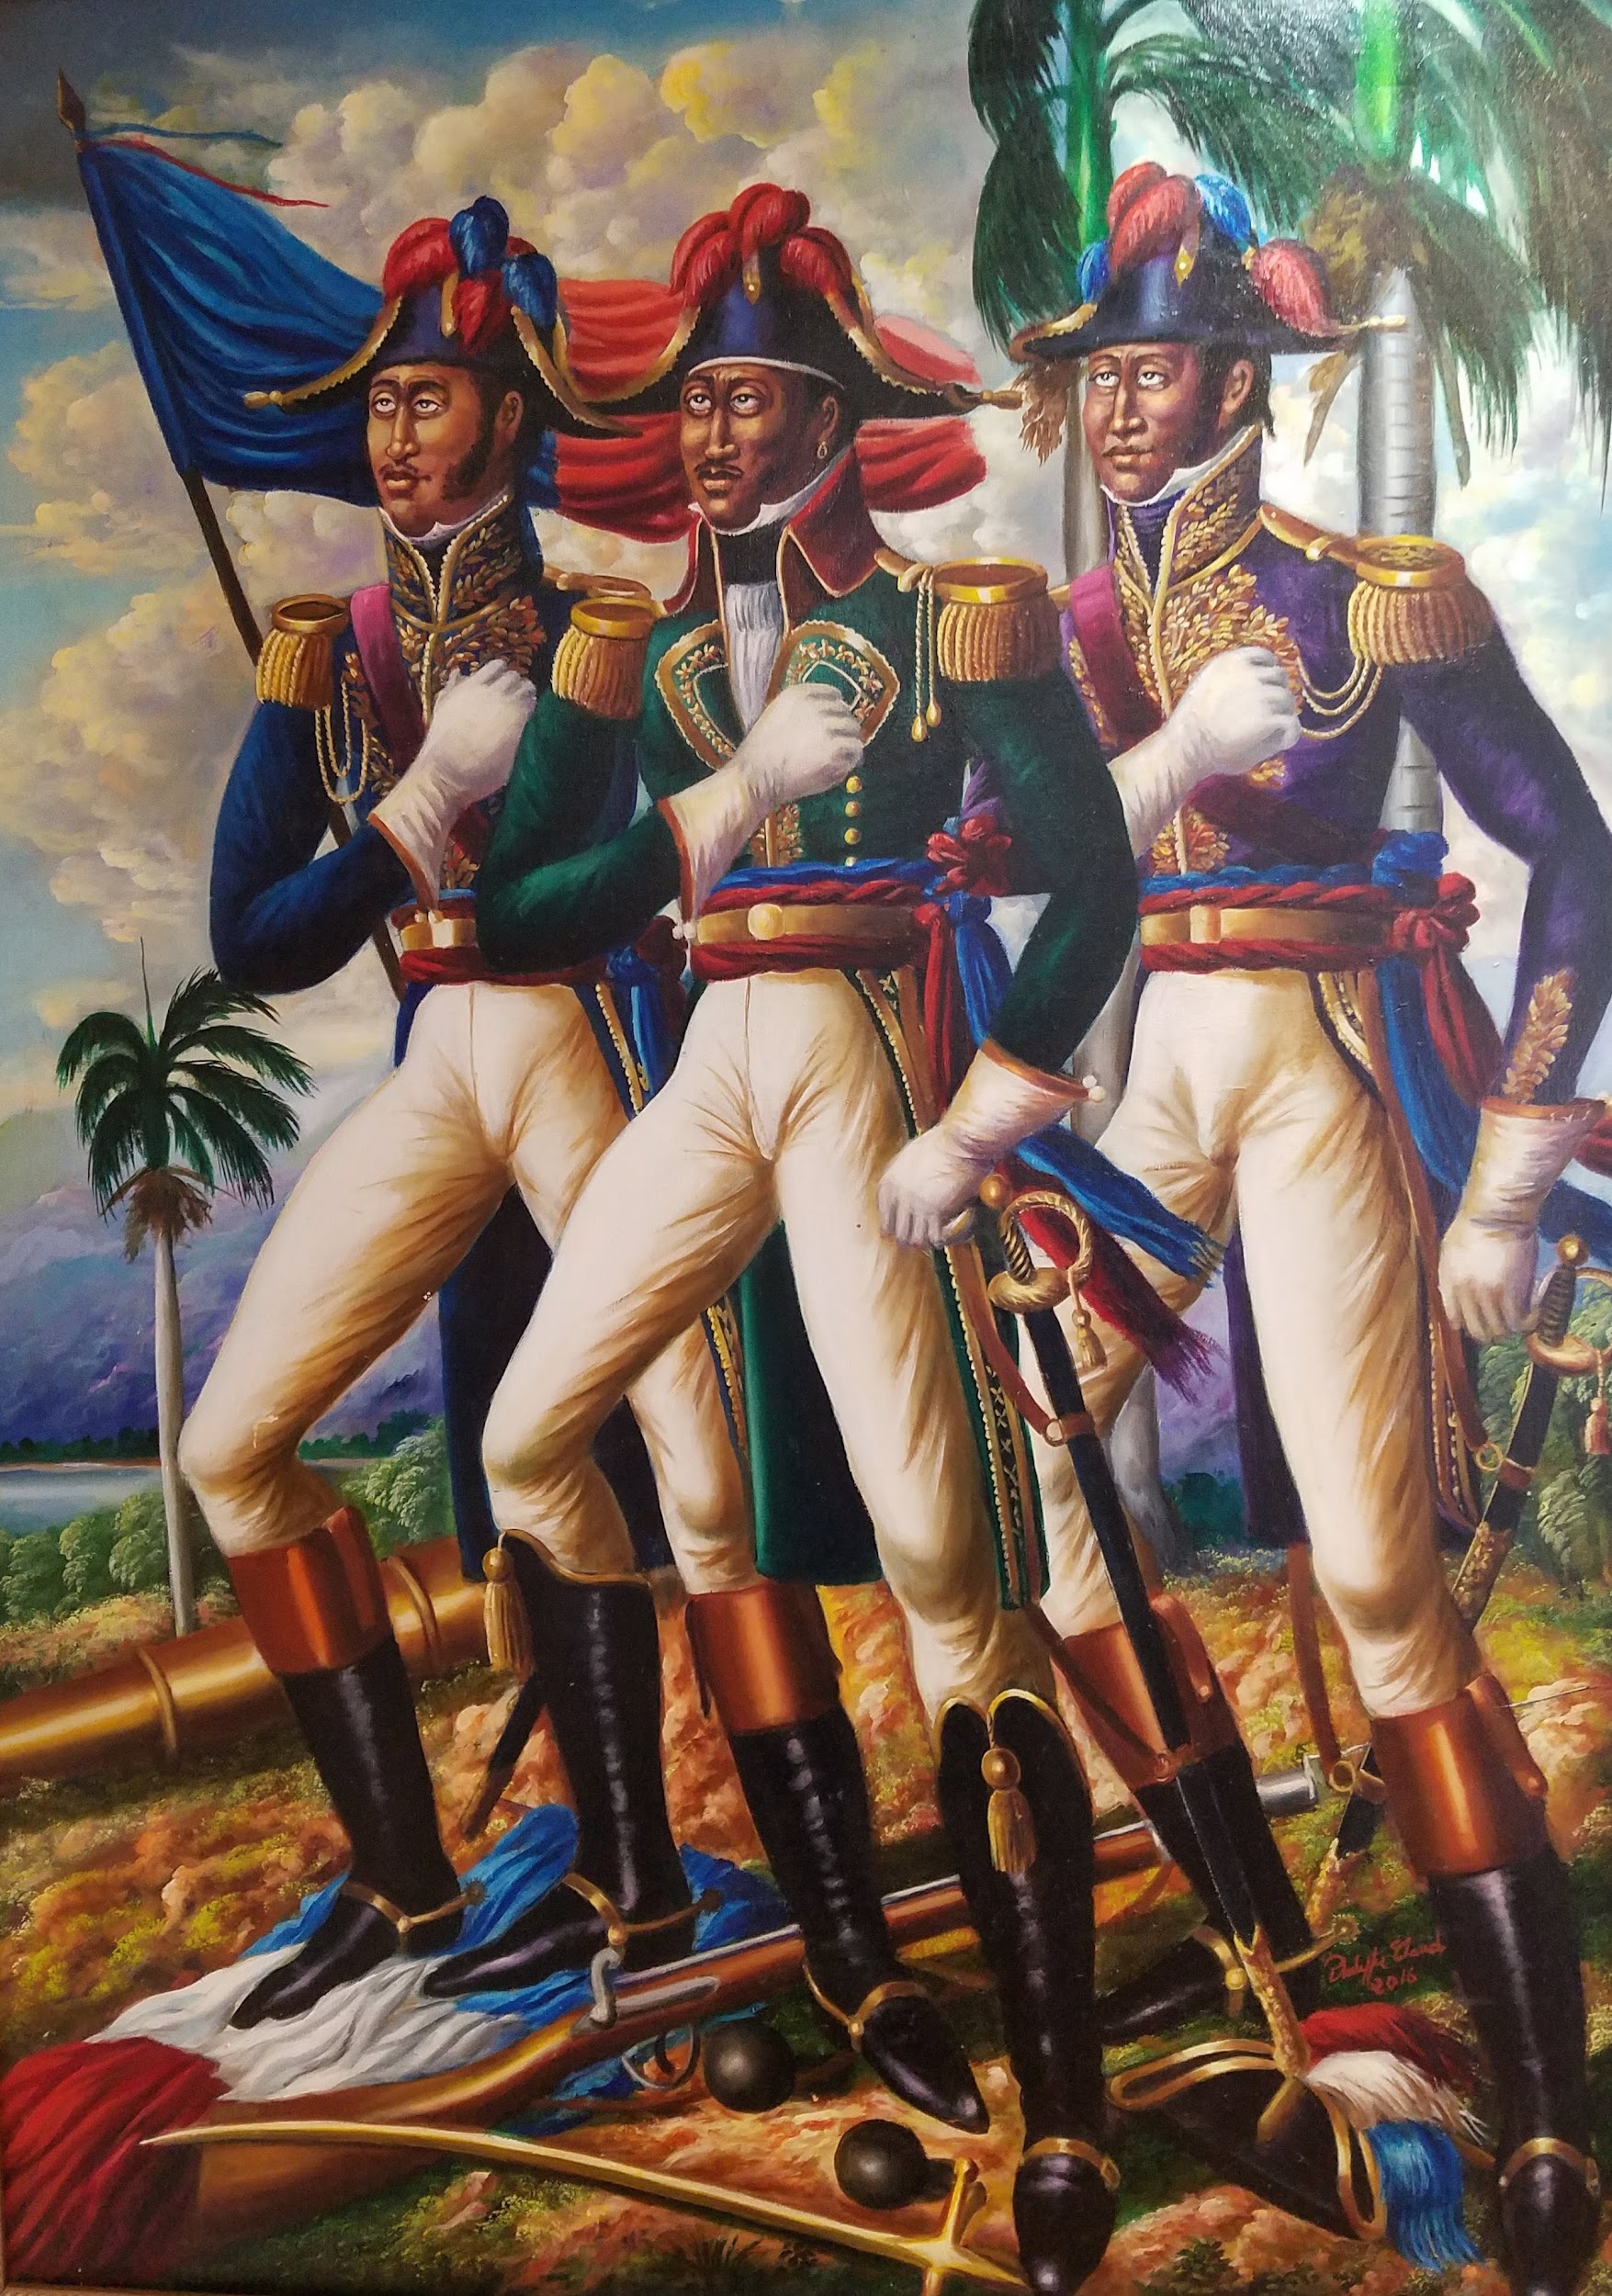
Phillipe Claude
The Haitian Heroes
Notes:
Haiti is the world's oldest black republic and one of the oldest republics in the Western Hemisphere.

Slide 4
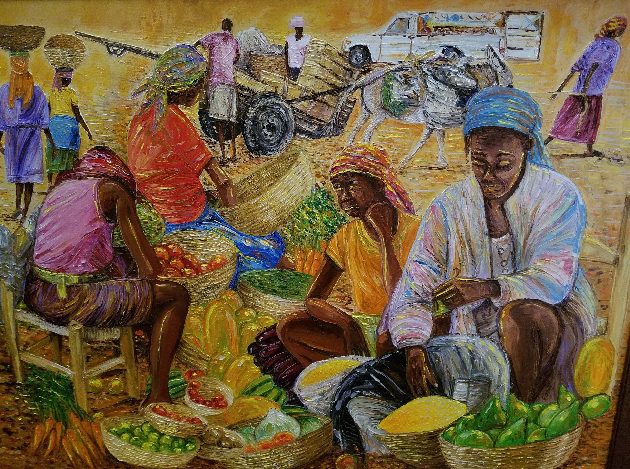
Jonas Exume
Open Market

Slide 5
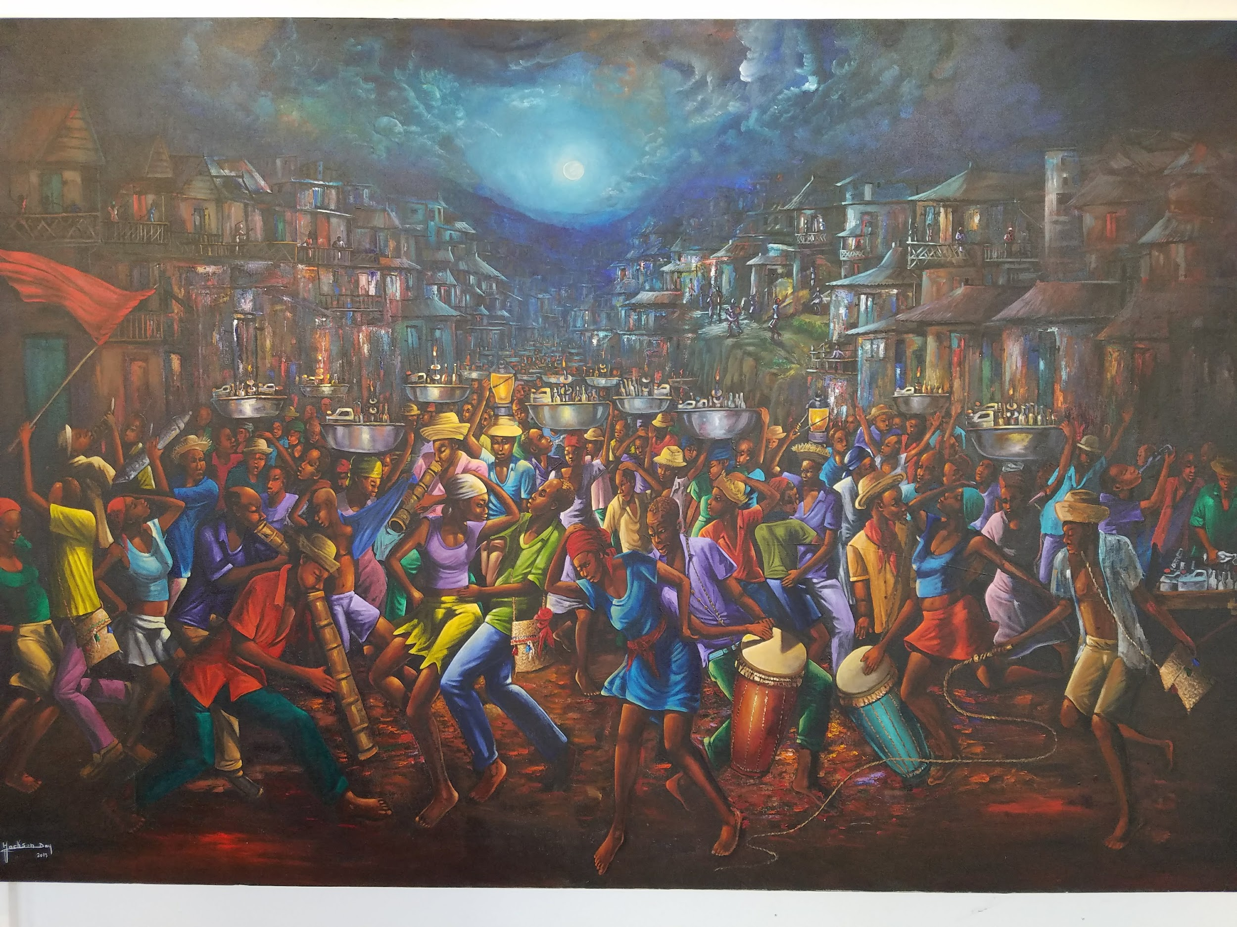
Jackson Day
RaRa

Slide 6
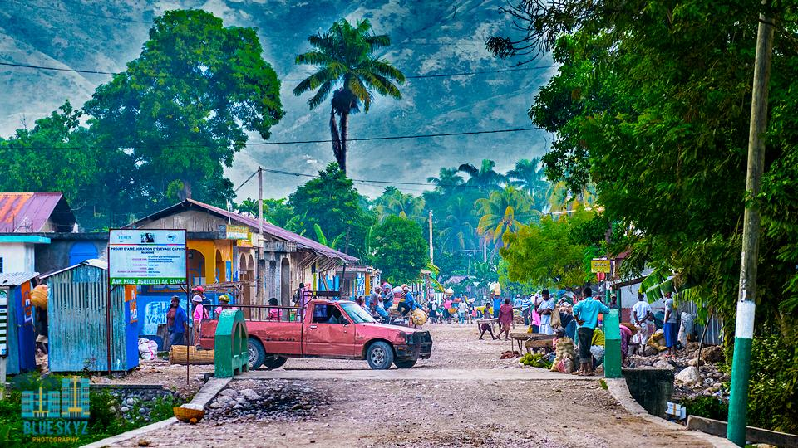

Slide 7
Jackson Day, RaRa

Slide 8
Citations
Slides 2 - 5, 8 : Used by permission of Art for Change Gallery
Slides 6 and 7: http://cja.org/where-we-work/haiti/

