Slide 1
Art of JoeSam.
Text Talk Week 7, Day 5

Slide 2
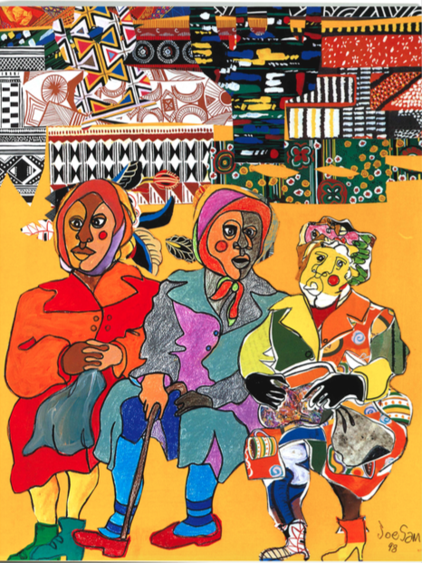
My Three Aunts, Honoring Our Ancestors

Slide 3
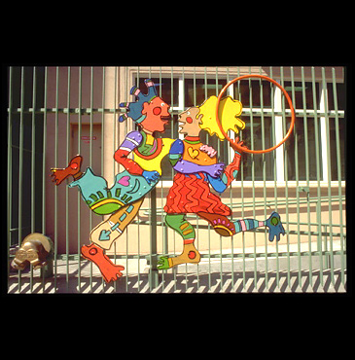
Dancing Kids, Tenderloin Children’s Center, San Francisco, California

Slide 4
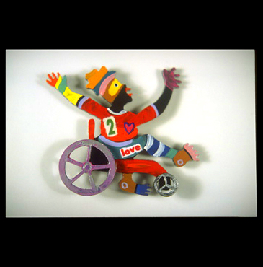
Girl in Wheelchair, Facility Neighborhood Center, Orlando, Florida

Slide 5
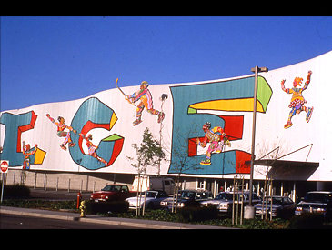
Ice Play, Ice Centre of San Jose, California

Slide 6
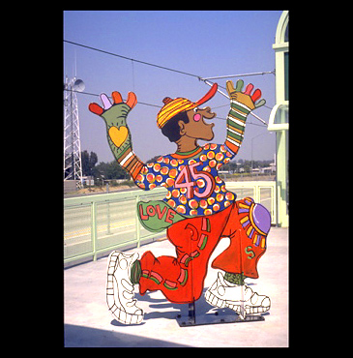
Hide N Seek, Metro Rail Station, Los Angeles, California

