Slide 1
Biography Phrases of Time
Writing Unit 3 Week 6 Day 4

Slide 2

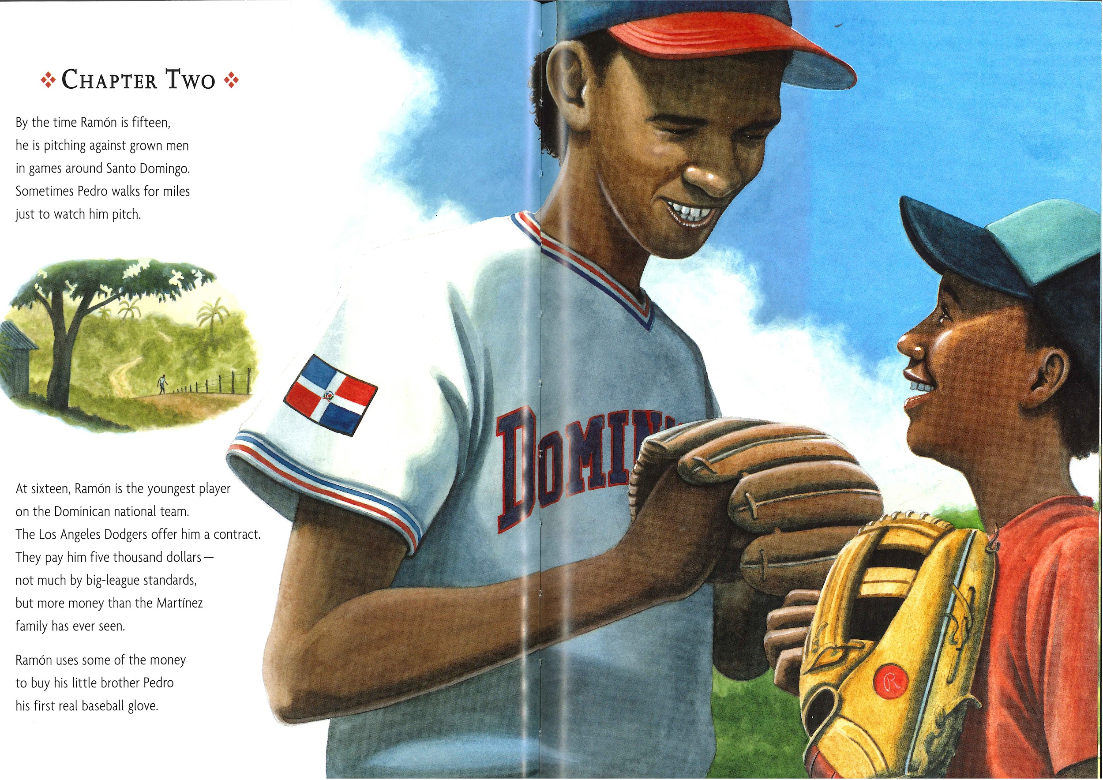

Slide 3
By the time Ramón is fifteen, he is pitching against grown men in games around Santo Domingo.

Slide 4
Sometimes Pedro walks for miles just to watch him pitch.

Slide 5
At sixteen, Ramón is the youngest player on the Dominican national team.

Slide 6
By the time Ramón is fifteen
Sometimes
At sixteen

