Slide 1
Weekly Words
Unit 3, Week 6
Notes:
culture: the beliefs, customs, arts, and traditions of a place or group of people
diversity: the quality of having many different kinds of people in a place
enrich: to improve the quality of something
heritage: the cultural history of a group of people
immigration: the act of moving to one country from another
population: a particular group or type of people (or animals) living in an area
portrait: a short biography or an image of a person
thrive: to grow and develop well

Slide 2
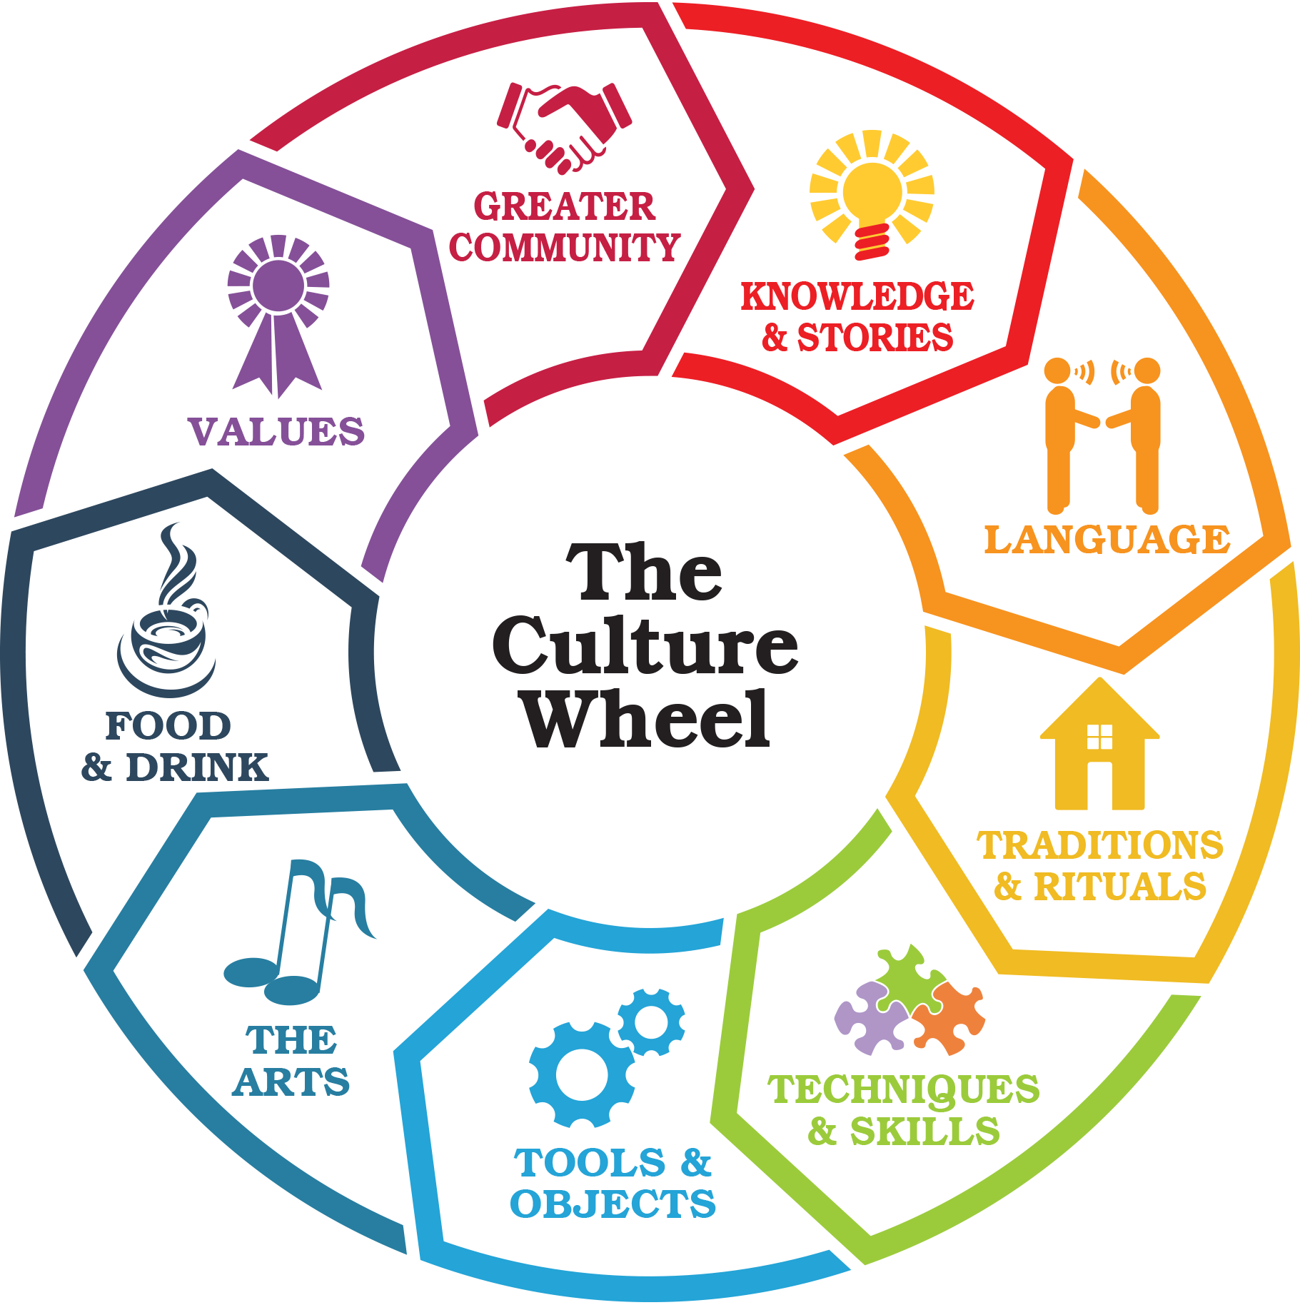
culture
noun
the beliefs, customs, arts, and traditions of a place or group of people
Notes:
culture (noun)
Elaboration:
Culture is an idea that includes many parts: how a group of people does things, how they communicate, what they believe, how they celebrate, what games they play, how they dress, what they eat, how they interact in their families, what education is like… Culture is everything we do!
Think, Pair, Share prompt:
What is something you do with your friends or family that communicates something about your culture?
https://www.bridgestogether.org/celebrating-our-culture-a-new-how-to-guide/

Slide 3
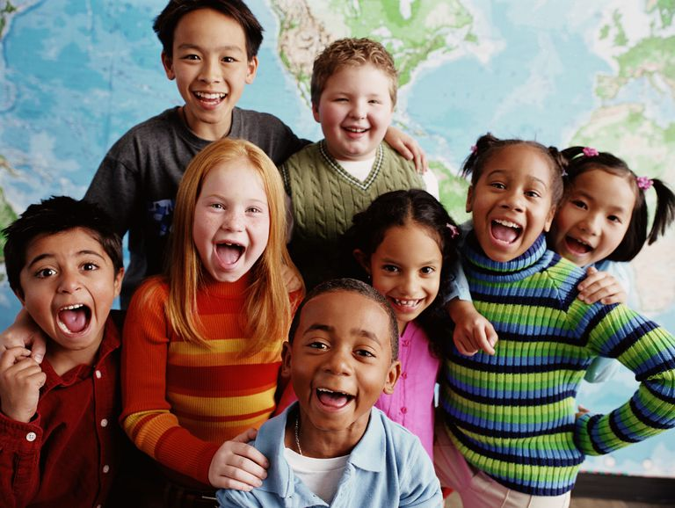
diversity
noun
the quality of having many different kinds of people in a place
Notes:
diversity (noun)
Elaboration:
Some places have a lot of diversity—so many different people contributing their ideas and traditions.
Think, Pair, Share prompt:
How does the diversity of the texts we read help us understand communities around the world?
https://www.cccoe.k12.ca.us/departments/curriculum_and_instruction/english_learner__title_i_i_i_technical_assistance

Slide 4
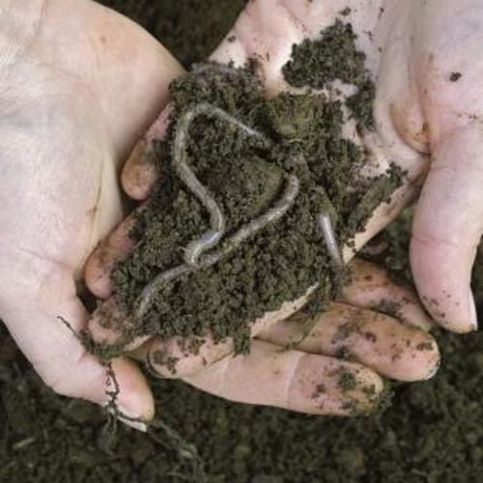
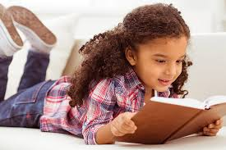
enrich
verb
to improve the quality of something
Notes:
enrich (verb)
Elaboration:
We enrich garden soil by adding worms—the worms give the soil air and nutrients required for healthy plants.
We can enrich our minds by reading to get new ideas.
Think, Pair, Share prompt:
Talk together about a time when reading gave you a new idea.
https://www.finegardening.com/article/earthworms-help-build-your-soil, https://readingeggs.com/articles/2019/01/08/what-is-reading-fluency/

Slide 5
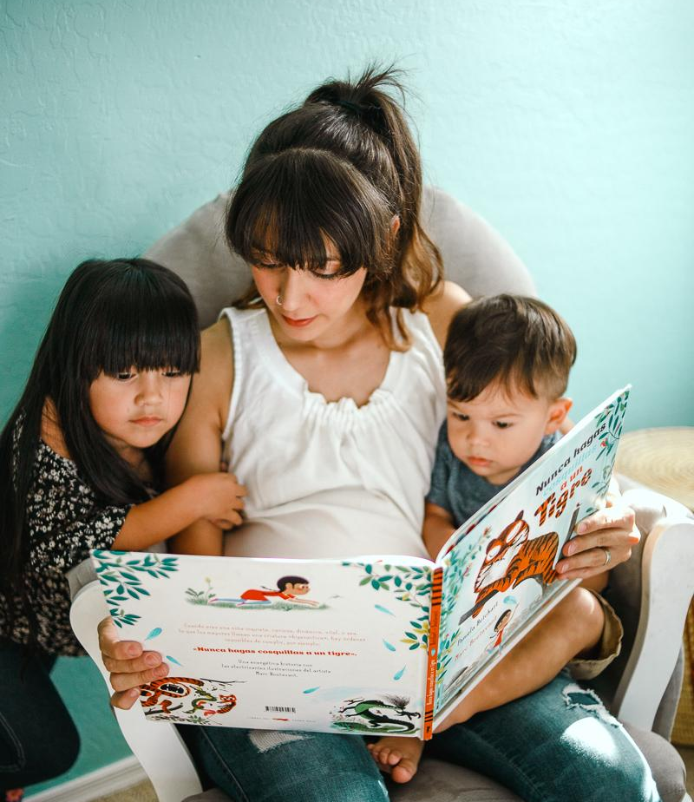
heritage
noun
the cultural history of a group of people
Notes:
heritage (noun)
Elaboration:
Spanish is the language this family speaks at home. It is part of their heritage. The mother speaks Spanish and passes the language, part of her heritage, on to her children.
Along with language, a person’s heritage might also include ways of cooking and eating, traditions, and ways of communicating. For example, you could say that “Storytelling is part of my heritage,” if your family includes storytellers through the generations.
https://www.chicanamama.com/family-spanish-reading-project-with-sol-book-box/

Slide 6

immigration
noun
the act of moving to one country from another
Notes:
immigration (noun)
Elaboration:
We have seen the word “immigrant”—someone who comes from one place to settle permanently in another place. We can see that “immigration” is related to the word “immigrant.” When we talk about immigration, we often refer to groups of people who settle in a new country. We can use this word to describe, for example, how the immigration of people from _____ [use a classroom-appropriate place] to the United States makes the country a more diverse and interesting place.
Think, Pair, Share prompt:
What are some ways that immigration makes a place more interesting? What do immigrants bring?
https://whoswholegal.com/features/australias-immigration-programme

Slide 7
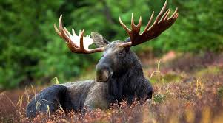
population
noun
a particular group or type of people (or animals) living in an area
Notes:
population (noun)
Elaboration:
Maine has a large population of moose. There are many of them in our state!
Think, Pair, Share prompt:
What is a question you have about the population of our school, or about the population of Maine?
https://nhrabbitreports.org/species/new-england-cottontail, https://www.outdoors.org/articles/amc-outdoors/packlist/how-many-moose-are-in-new-england-fall-is-a-good-time-to-look

Slide 8
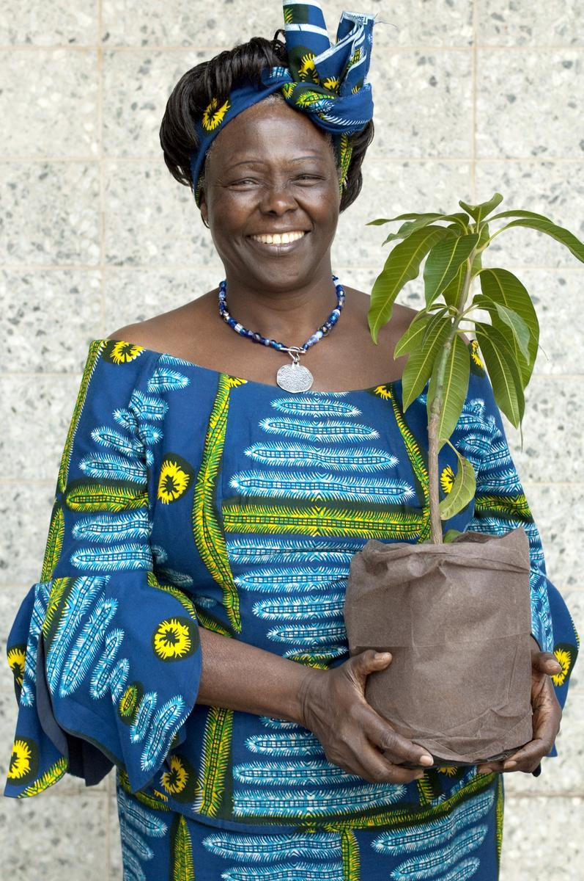
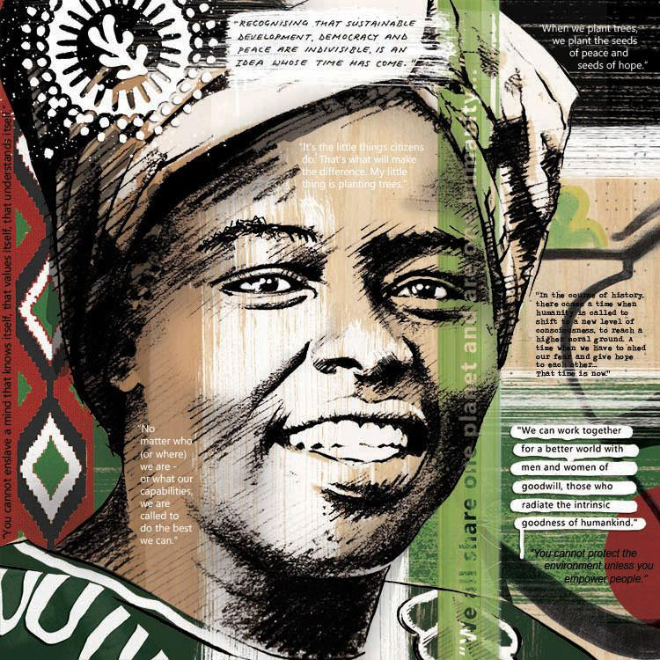


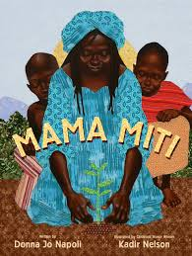
portrait
noun
a short biography or an image of a person
Notes:
portrait (noun)
Elaboration:
Here are some portraits of Wangari Maathai. One is a photograph, and one is a collage by the artist Eleanor Turvey. You could also say that these books are also portraits, because they each tell a story of her life.
Think, Pair, Share prompt:
If someone were going to make a portrait of you, what would you want them to include? What media would you like them to use?
https://womenscenter.unc.edu/2016/03/inspiration-for-womens-history-month-wangari-maathai/, https://eleanorturvey.com/product/wangari-maathai-one-humanity/

Slide 9
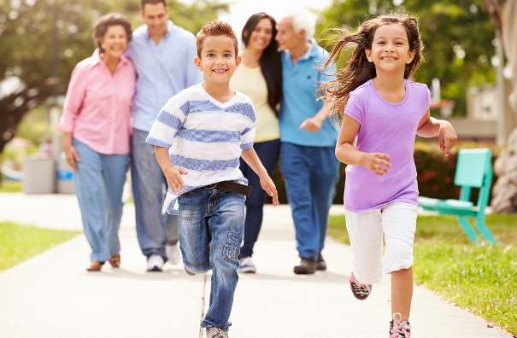
thrive
verb
to grow and develop well
Notes:
thrive (verb)
Elaboration:
Exercise and fresh air are two things that help people of all ages thrive—to live happy, healthy lives.
Think, Pair, Share prompt:
What else can you think of that helps people thrive?
https://www.cancer.org/latest-news/fun-and-fitness-for-the-whole-family.html

