Slide 1
Possessive Nouns
Vocabulary & Language Week 6, Days 3-4

Slide 2

Abuela’s Weave

Slide 3
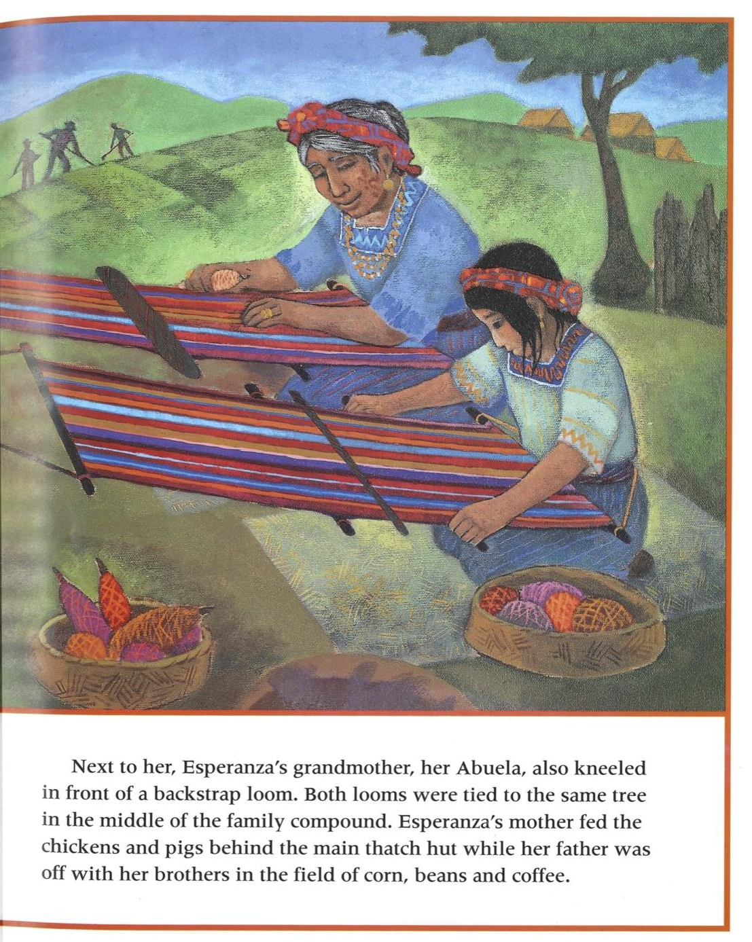
Next to her, Esperanza’s grandmother, her Abuela, also kneeled in front of a backstrap loom.

Slide 4
Next to her, Esperanza’s grandmother, her Abuela, also kneeled in front of a backstrap loom.

Slide 5
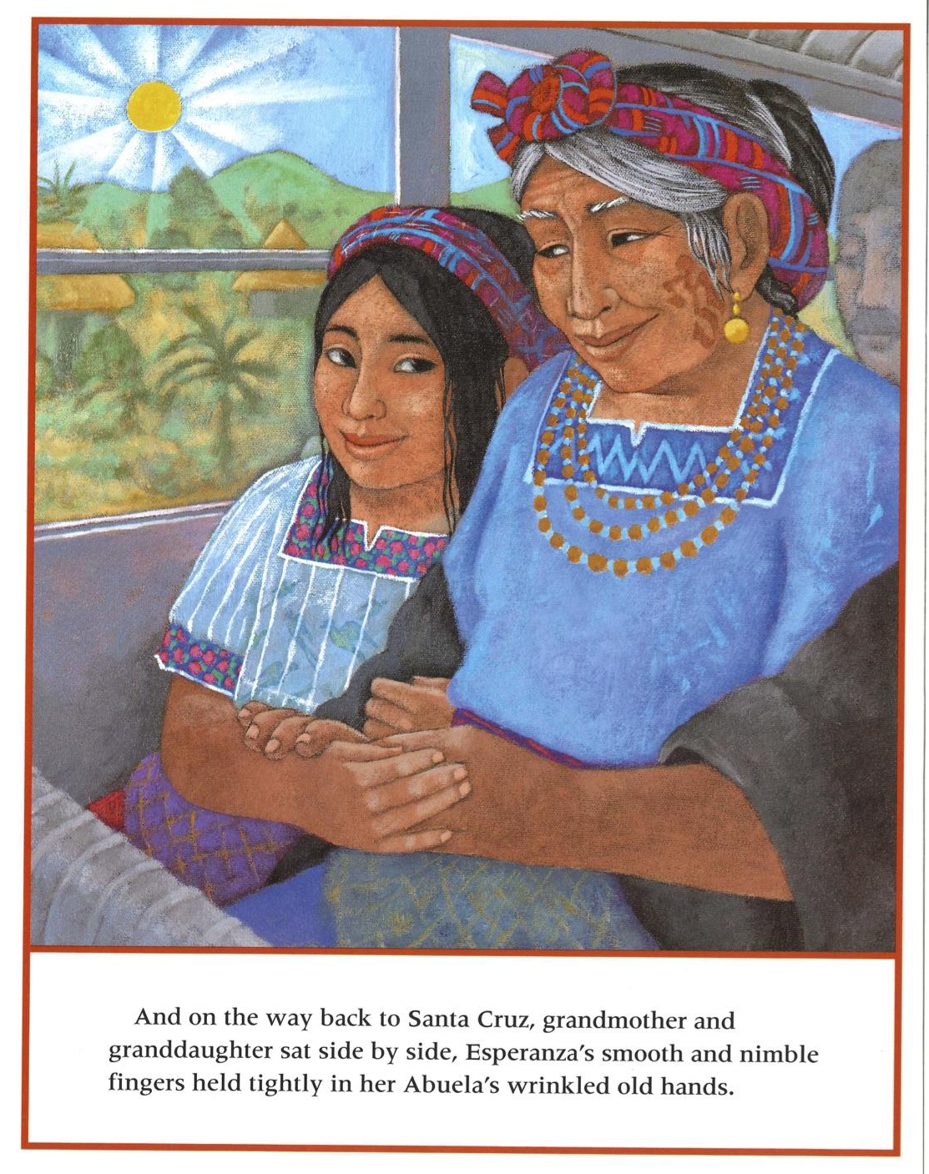
And on the way back to Santa Cruz, grandmother and granddaughter sat side by side, Esperanza’s smooth and nimble fingers held tightly in her Abuela’s wrinkled old hands.

Slide 6
And on the way back to Santa Cruz, grandmother and granddaughter sat side by side, Esperanza’s smooth and nimble fingers held tightly in her Abuela’s wrinkled old hands.

Slide 7
Your turn!
You will write two sentences that include possessive nouns.
Write a sentence that includes a possessive noun. The possessive could show the relationship between two people or could show that someone owns something.
Write a second sentence that includes a possessive noun.

