Slide 1
Who Lives in Maine?
Looking at Maps and Data
Text Talk Week 6, Day 1

Slide 2
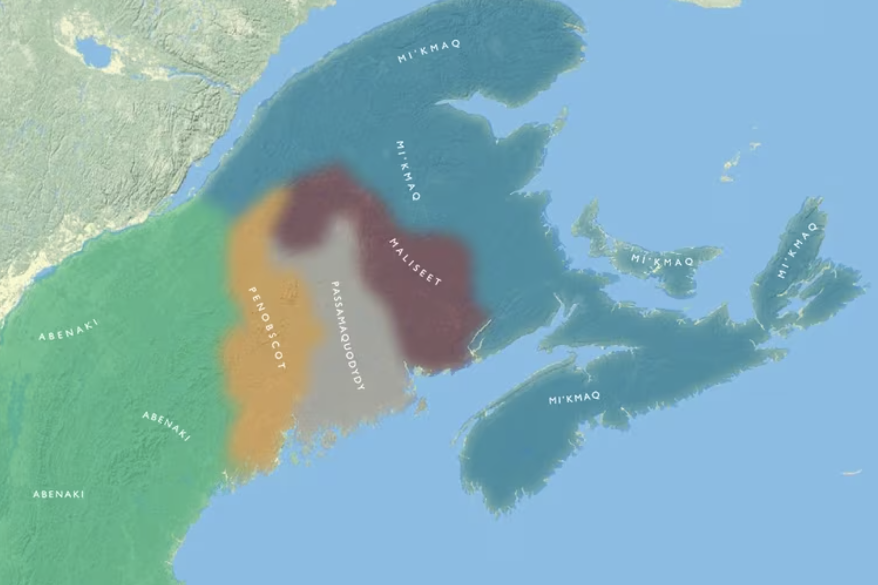
Interactive Map of the Wabanaki Homeland.

Slide 3
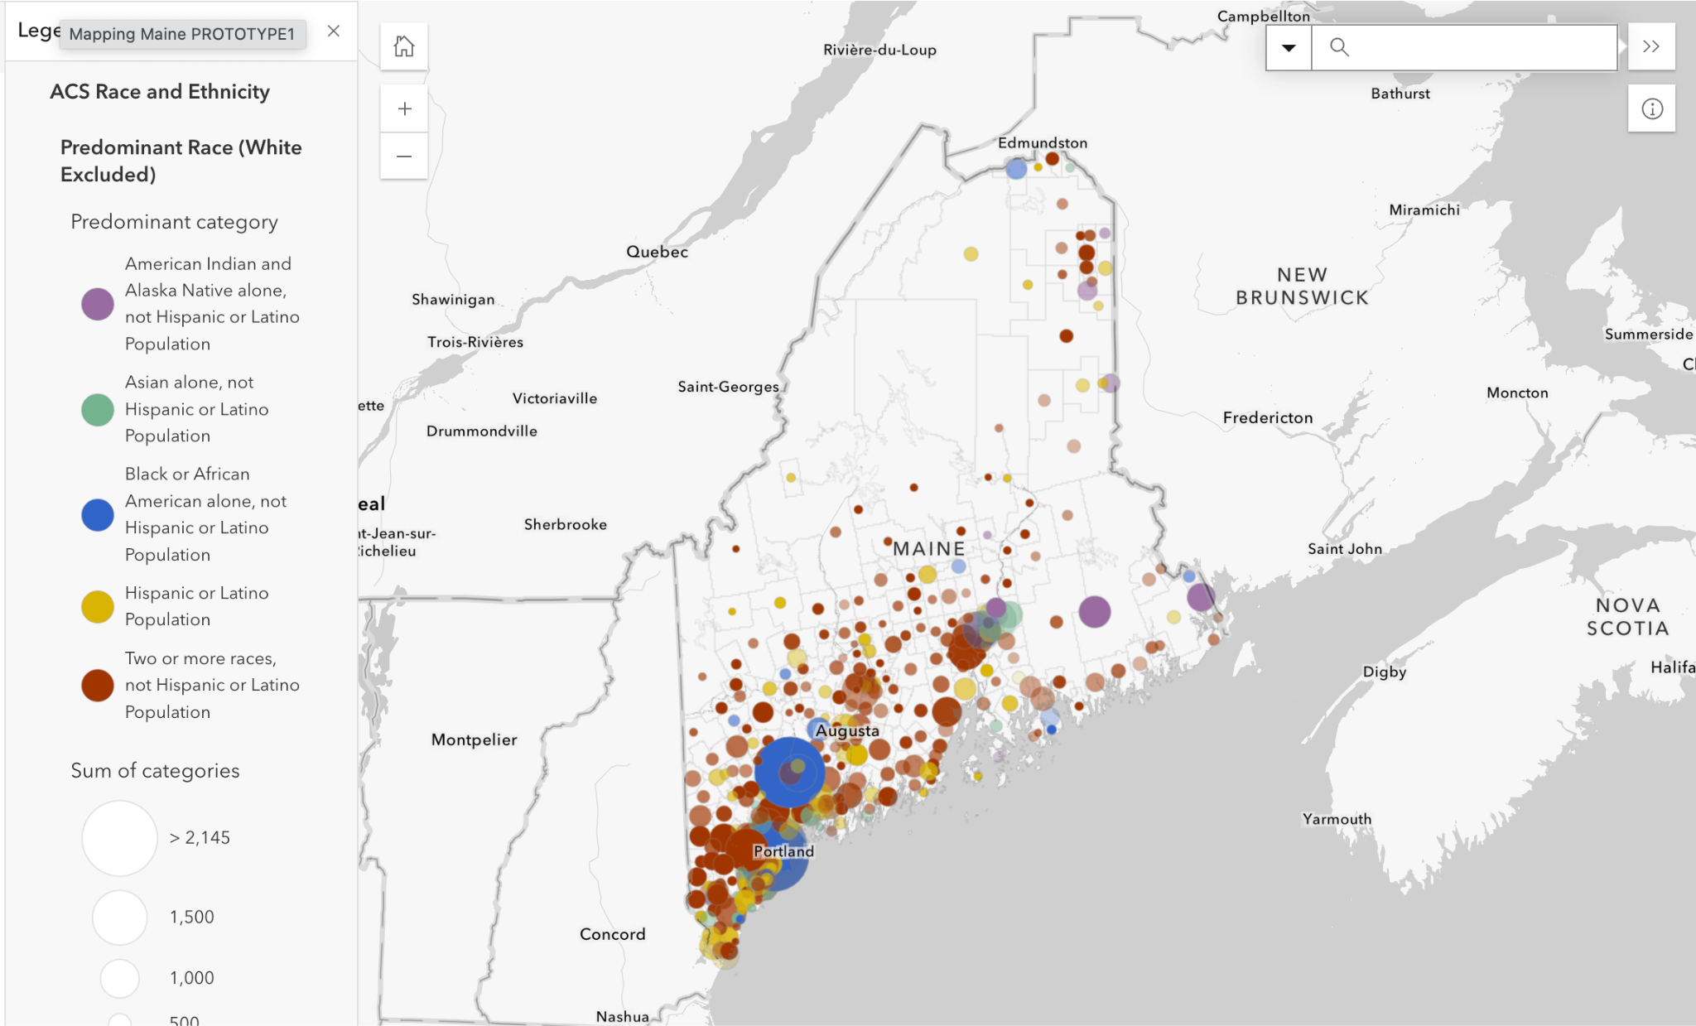

Slide 4
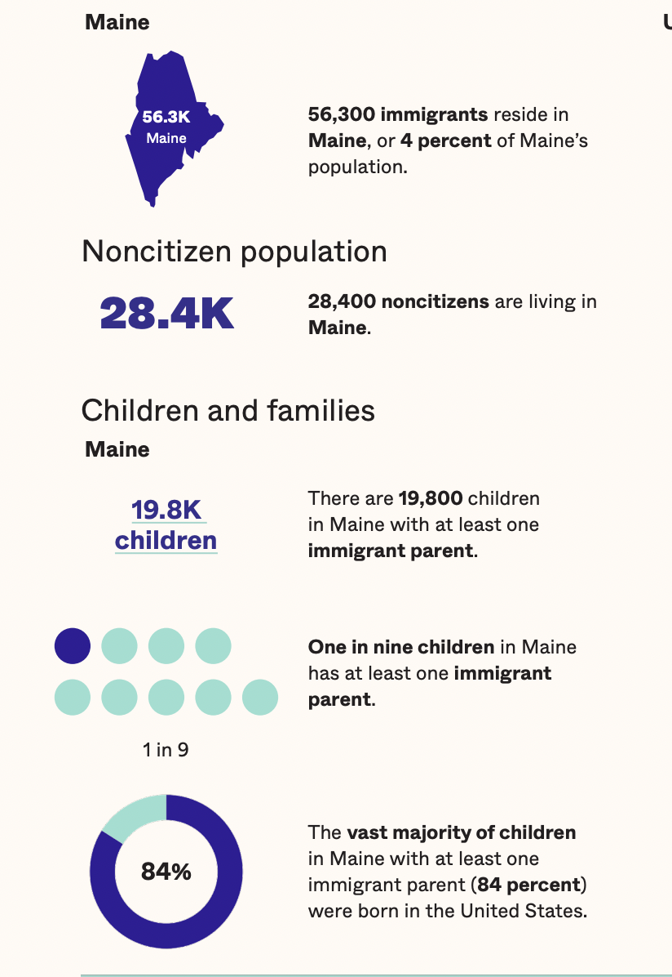

Slide 6
Citations
Slide 2: Abbe Museum https://peopleofthefirstlight.org/maps/map1.html
Slide 3: https://www.pcritp.me/node/131 Mapping Maine Communities
Slide 4: Vera Institute of Justice https://vera-institute.files.svdcdn.com/production/downloads/publications/ME_Immigrant_Population_Profile.pdf?dm=1748636149
Resources
https://map.americanimmigrationcouncil.org/locations/maine/

Slide 7
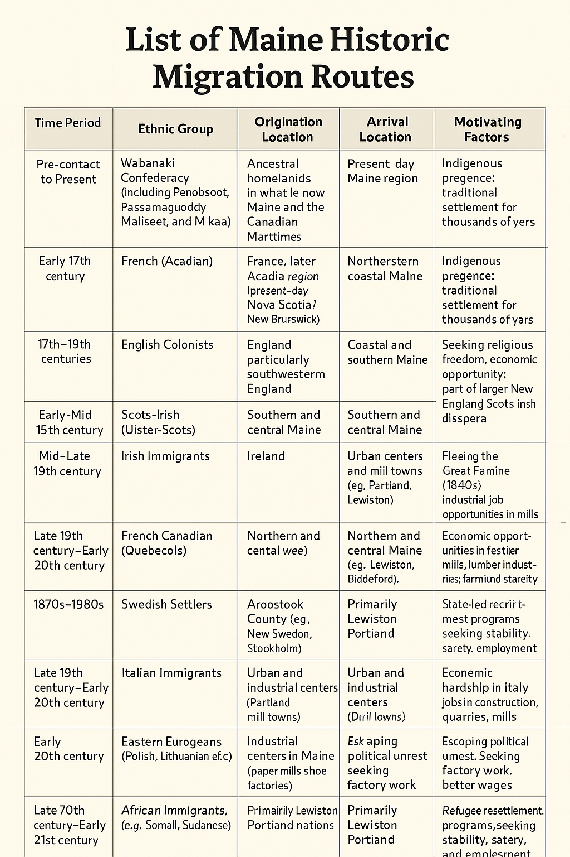
Information on historical Maine immigration for Teachers.
Created by by Chatgpt with information from
MyHeritageWiki https://www.myheritage.com/wiki/Maine_historical_migration_routes

