Slide 1

Immigrant Grandmothers Mural
Text Talk Week 6, Day 3

Slide 2
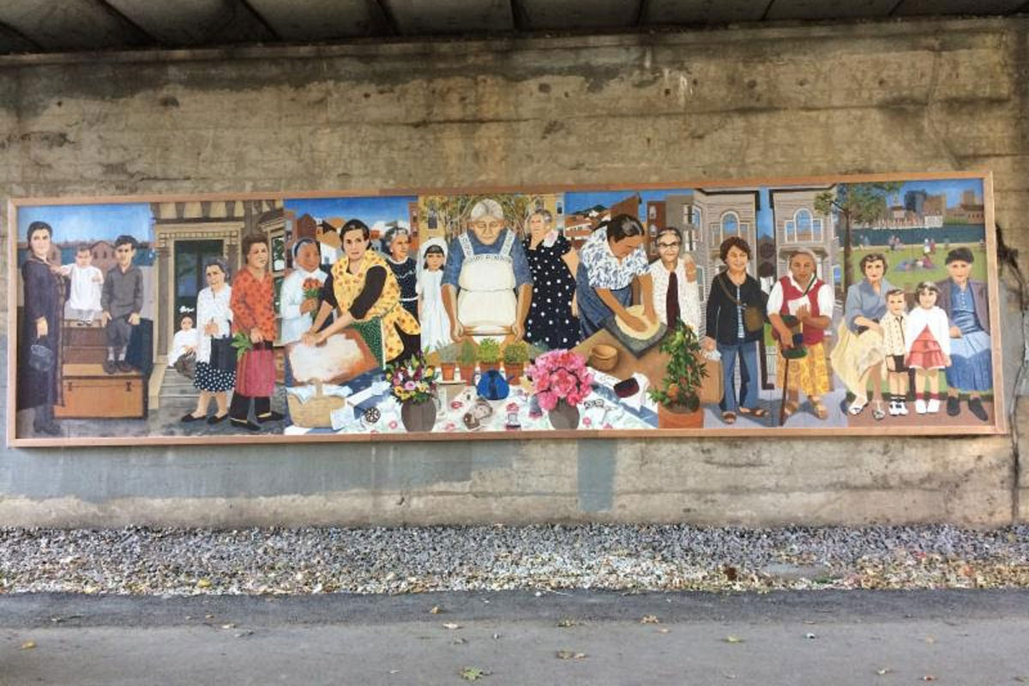
Immigrant Grandmothers Mural
Mayor’s Mural Crew, Massachusetts, December, 2017

Slide 3
Immigrant Grandmothers Mural
Before the mural was painted, people who live in Boston were asked to send in photos of their grandmothers for the project. People also brought in objects that belonged to their ancestors, such as prayer beads, jewelry, and old keys. The artists in the Mural Crew looked at these objects as they were painting.

Slide 4
Diane Barsotti is one neighbor who sent in photos of her grandmothers. She called her mother’s mother “Nonni American” because she was her first grandmother to immigrate to the United States. She is shown in the mural wearing an apron and making pasta. She called her father’s mother “Nonni Italy” because she lived longer in Italy before coming to Boston. She is shown in a passport photo sitting on the table in the mural.

