Slide 1
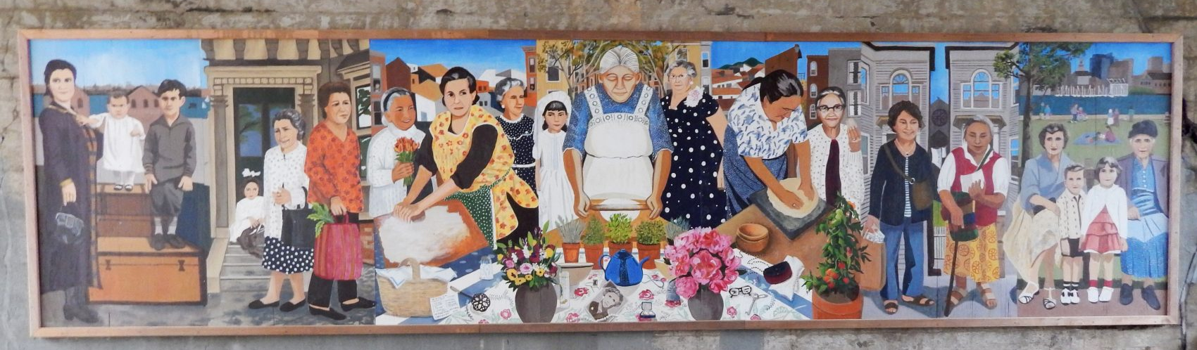
Grandmothers Biographies
Research Studio Week 6

Slide 2
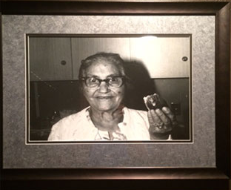

ANTOINETTA DIMARINO
Antoinetta came to the U.S. from the province of Avellino in Italy at 25 years old. She raised six children and was a proud grandmother of twenty-five. She worked full-time as a seamstress while raising her family in Boston. Every Easter, she brought her family together for a traditional breakfast of pizza chena, hard boiled eggs, and many other traditional treats.

Slide 3
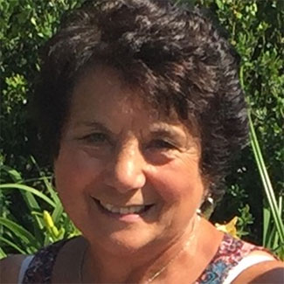
ROSE TINO DELLO RUSSO
Rose came to the US from Italy in 1958 when she was 10 years old. She owned a fabric store, Tino’s Fabrics, for many years. Currently she works at a school and volunteers for the elderly.

Slide 4
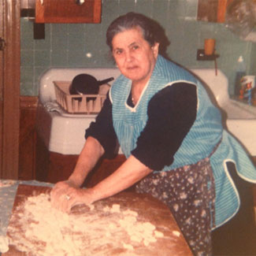
TERESA LYONS
Teresa lived the first half of her life in Castelcivita, a mountain village in southern Italy. In 1953, she arrived in the US where she worked at the old gum ball factory and made a home first on Everett and then Haynes Street. A visit to “Nonni's” usually involved a meal of her handmade fusilli, gnocchi, or ravioli.

Slide 5
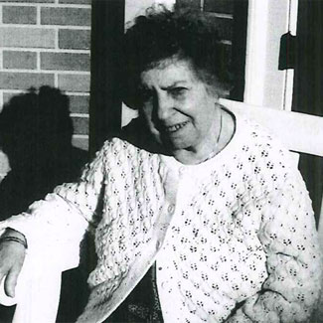
MARIE ANTOINETTE DENTE
Marie was born on July 24, 1905, to Italian immigrants, Elesio and Concetta Dente. Marie lived on Maverick Street where she met her husband, Louis I. Battaglia, who she married in 1931. Together they had three sons: Louis, Paul, and Thomas. When her husband died, Marie began working as a stitcher at Hallmark Curtain Co. Marie was two months short of her 99th birthday when she died, still residing on Maverick Street. She left behind 7 grandchildren and 10 great grandchildren. She was a homemaker, daily churchgoer, and great mother all her life.

