Slide 1
Words with Multiple Meanings
Vocabulary & Language Week 5, Days 3-4

Slide 2
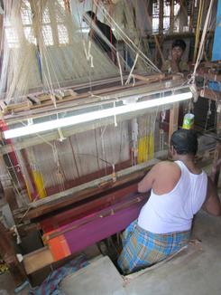
weave
verb
to lace together threads to create a fabric
Notes:
https://design-altruism-project.org/2012/09/01/desperately-seeking-sari/, https://www.textileschool.com/270/major-fabric-weaving-patterns/

Slide 3

weave
noun
the pattern or construction of a fabric
Notes:
https://design-altruism-project.org/2012/09/01/desperately-seeking-sari/, https://www.textileschool.com/270/major-fabric-weaving-patterns/

Slide 4
I am going to weave these threads to make a hammock.
This fabric has an interesting weave.

Slide 5
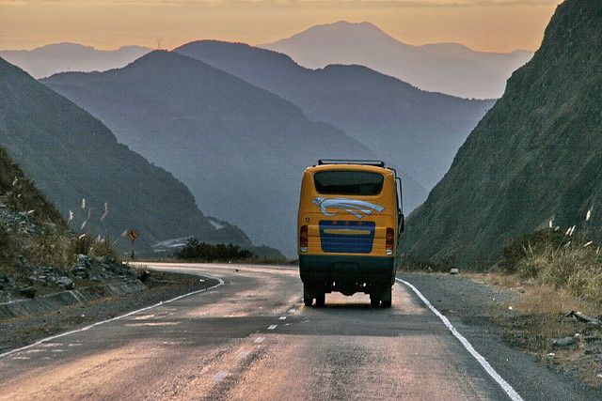
journey
noun
long trip from one place to another
Notes:
https://jessieonajourney.com/tips-for-bus-travel-in-south-america/

Slide 6
journey
verb
to go on a trip, to travel
Notes:
https://jessieonajourney.com/tips-for-bus-travel-in-south-america/

Slide 7
Who will go on the journey with you?
Did they journey a long way to get there?

Slide 8
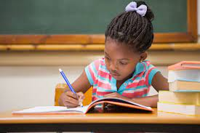
individual
adjective
referring to one person
Notes:
https://www.familyeducation.com/life/cognitive-psychological-development/i-need-help-my-five-year-old-writes-backward

Slide 9
Marcos is an individual. There is no one like him.
The children are doing their own individual work.

Slide 10
Words with Multiple Meanings
Choose one of the words we explored yesterday: weave, journey, or individual.
Write two sentences with that word, one showing each meaning of the word.

