Slide 1
Weekly Words
Unit 3, Week 5
Notes:
arrange: to put in a certain order
devote: to commit to something, to keep working hard at it
generation: all of the people born and living at about the same time, or all of the people of about the same age
layer: to arrange something out flat on top of something else
reveal: to show something that was unknown
textile: a woven fabric
tradition: belief or custom that is handed down
weave (v): to lace together threads to create a fabric; (n): the pattern or construction of a fabric

Slide 2
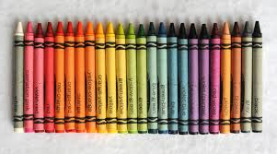
arrange
verb
to put in a certain order
Notes:
arrange (verb)
Elaboration:
Someone decided to arrange these crayons in a particular order, according to the rainbow. Objects can be arranged this way—by color—or by any other order, such as by number, by size, in alphabetical order, or by how often something gets used. People decide to arrange things in certain ways for different reasons.
Think, Pair, Share prompt:
Think about the place where we keep _____ [supplies for Studios, books, writing and drawing tools, coats and backpacks, etc; name a place appropriate for the classroom] OR Think about where your family keeps groceries.
Describe to your partner how things are arranged. Why are they arranged that way?
http://www.jennyscrayoncollection.com/2015/07/no-24p-crayola-crayons.html

Slide 3

devote
verb
to commit to something, to keep working hard at it
Notes:
devote (verb)
Elaboration:
Yoko Miwa and her band are musicians. They devote themselves individually to playing their instruments as well as they can, and, collectively, to playing well together. They also devote a lot of time to practicing!
Think, Pair, Share prompt:
Why might it be important for a musician to devote herself to practicing?
Photo by Caroline Alden, https://artsparksmusic.com/yoko-miwa-trio/

Slide 4
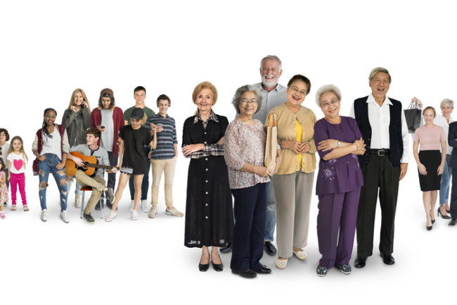
generation
noun
all of the people born and living at about the same time, or all of the people of about the same age
Notes:
generation (noun)
Elaboration:
This photo shows people grouped by generation: with older people in front, teenagers in the back, younger children behind them, and people in between on the side.
Think, Pair, Share prompt:
How many generations of people do you have in your family now?
How many generations live together with you?
https://www.discovermagazine.com/the-sciences/so-you-know-what-generation-you-belong-to-what-does-that-even-mean

Slide 5
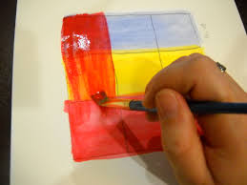
layer
verb
to arrange something out flat on top of something else
Notes:
layer (verb)
Elaboration:
We saw this word, “layer,” as a noun in Unit 2: a layer of dirt. Now we can use it as a verb—an action of putting something on top of something else.
Look how this person layers the paint, one color right on top of another. Layering the paint creates a special effect of more complex colors.
Think, Pair, Share prompt:
What might you layer on a bed? Why?
https://maggynitla.com/2012/12/03/tutorial-layering-acrylic-paint-colors/

Slide 6
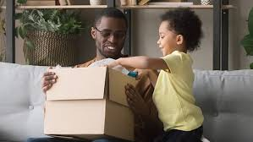

reveal
verb
to show something that was unknown
Notes:
reveal (verb)
Elaboration:
Opening a box reveals what’s inside.
Opening a book reveals its story!
Think, Pair, Share prompt:
When the curtain opens, what might it reveal? What’s behind that curtain?
https://www.todaysparent.com/family/activities/cool-subscription-boxes-for-kids/, https://www.wallpaperflare.com/red-window-curtains-theatre-waiting-stage-performance-space-wallpaper-ainz

Slide 7
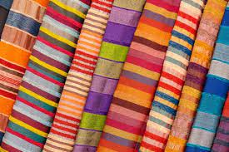
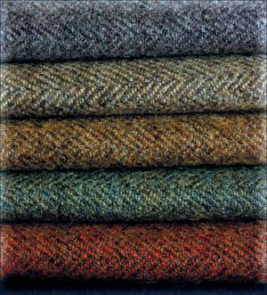
textile
noun
a woven fabric
Notes:
textile (noun)
Elaboration:
Textiles come in endless colors and patterns. Often, the weave of a textile follows the traditions of a community—its designs, colors, and what the threads are made of.
Think, Pair, Share prompt:
Most of our clothing is made of textiles. Describe a textile you are wearing. What do you like about it?
https://www.unep.org/events/online-event/accelerating-sustainability-textile-value-chain-inspiring-action-and-behaviour, https://slotweedride.wordpress.com/2011/05/01/what-is-tweed/

Slide 8
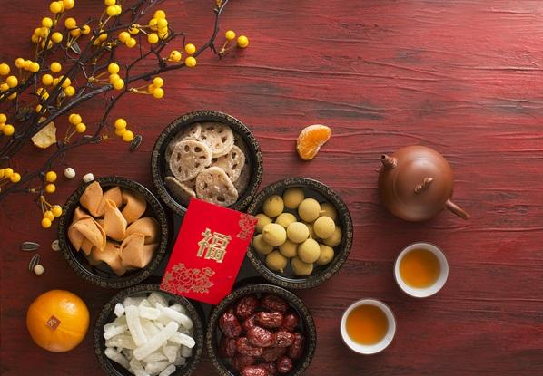
tradition
noun
belief or custom that is handed down
Notes:
tradition (noun)
Elaboration:
At celebrations or holidays, people follow certain traditions. They may eat certain foods, sing certain songs, tell certain stories, wear certain kinds of clothing, and do certain activities. At the Lunar New Year, people often exchange red envelopes with coins inside, as a promise of good fortune for the coming year.
Whole group prompt:
Tell your partner about something you celebrate and some of the traditions you follow.
https://homestay.cambridgenetwork.com/blog/preparing-for-chinese-new-year-homestay-happenings/

Slide 9
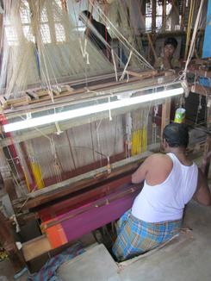
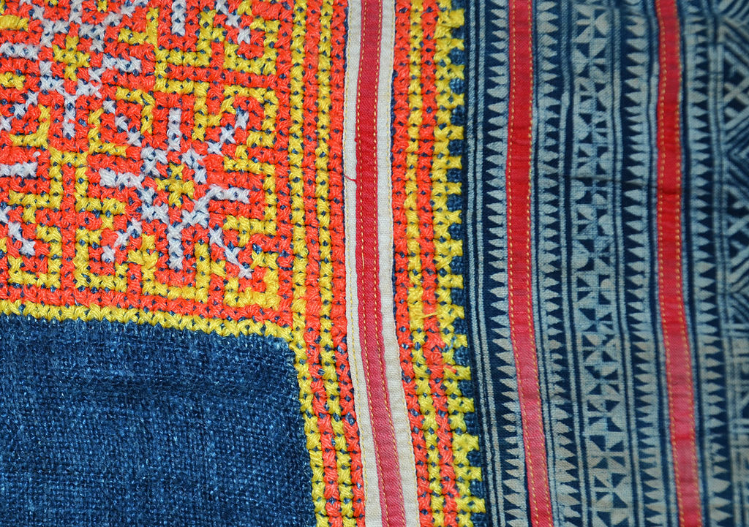
weave
verb
to lace together threads to create a fabric
noun
the pattern or construction of a fabric
Notes:
weave (verb, noun)
Elaboration:
People all around the world weave fabric by hand, on very simple cardboard box looms, and on very complex looms. Most of the clothes we wear are made from fabric that has been woven on machine looms. No matter how it’s done, weaving happens when threads going two different directions are laced together—over, under, over, under—to make a single piece of cloth.
We can describe the noun, weave, by saying that it is colorful, or striped, or thick, or made of cotton.
Think, Pair, Share prompt:
If you could weave something, what would it be? How would you use it? What kind of yarn, ribbon, or string would you use to weave it? What colors would you use?
https://design-altruism-project.org/2012/09/01/desperately-seeking-sari/, https://www.textileschool.com/270/major-fabric-weaving-patterns/

