Slide 1
Hung Liu Artwork
Text Talk Week 5, Day 3

Slide 2
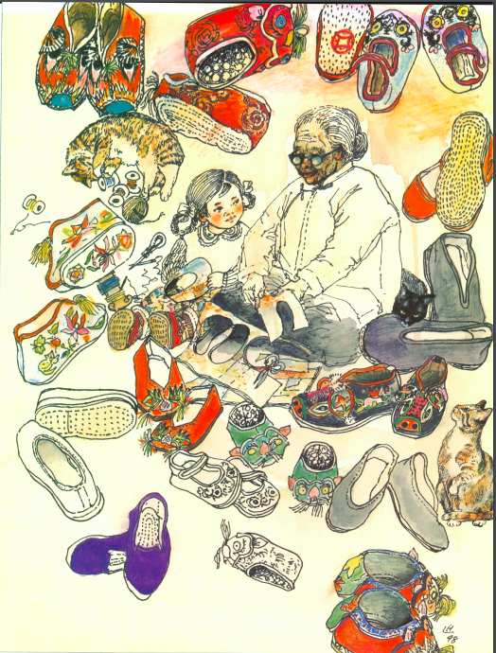
“I Honor My Grandmother, Wang Ju-shou”

Slide 3
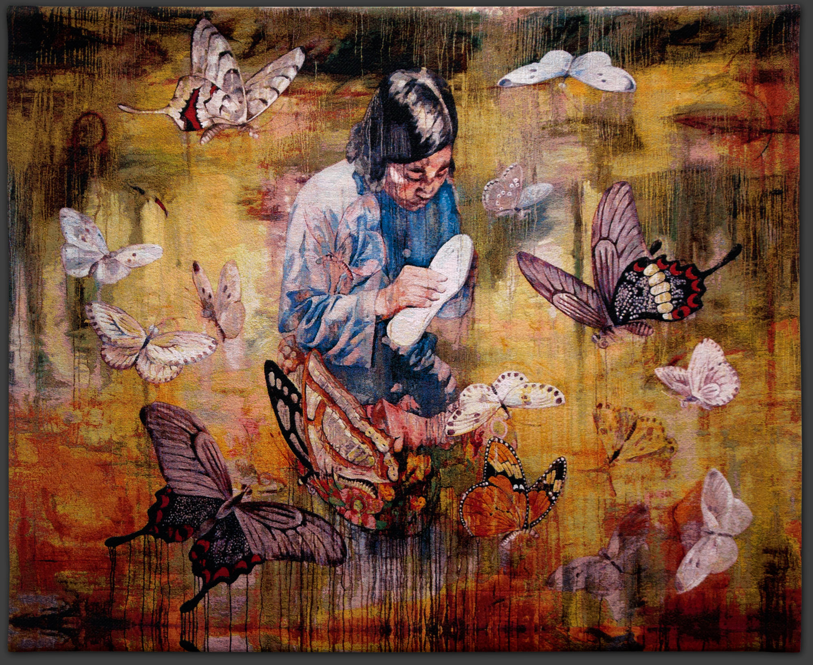
Madame
Shoemaker

Slide 4
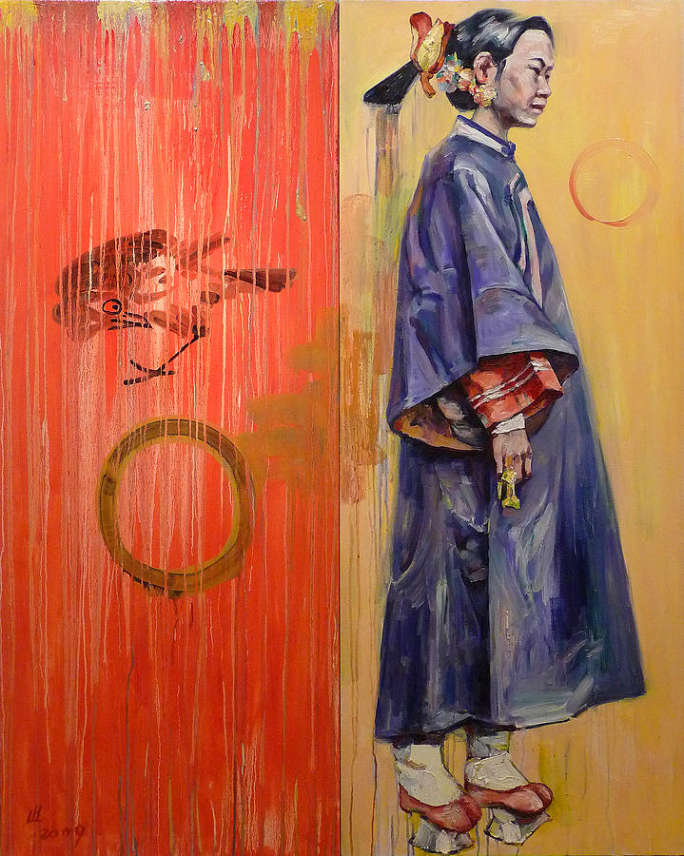
Platform Shoes

Slide 5
Citations
Slide 2: from Honoring Our Ancestors, “I Honor My Grandmother, Wang Ju-shou”
Slide 3: http://www.magnoliaeditions.com/wp-content/uploads/2012/11/Hung-Liu-madame-shoemaker-tap.jpg
Slide 4: https://fineartamerica.com/featured/platform-shoes-hung-liu.html

