Slide 1
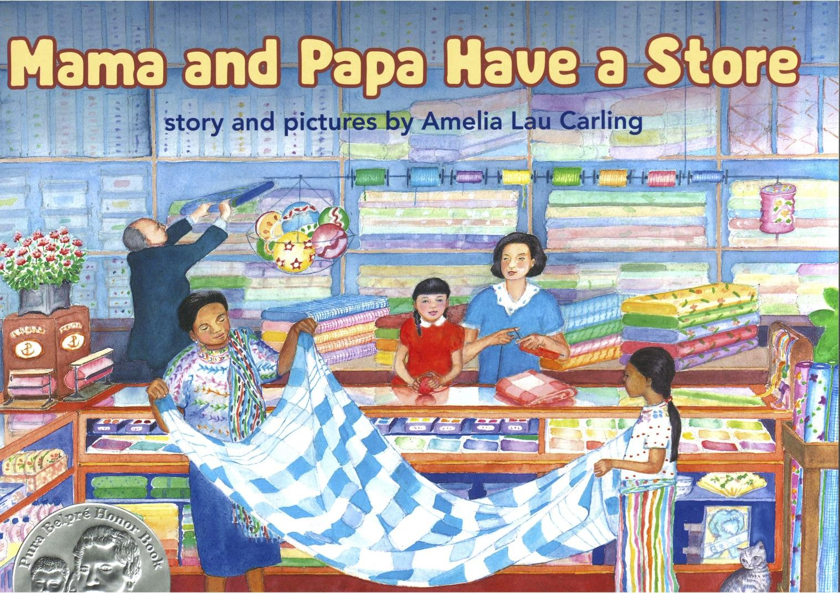
Unit 3 Mid-Unit Assessment
Mama and Papa Have a Store
Text excerpt and illustration, with audio
Unit 3, Week 5

Slide 2

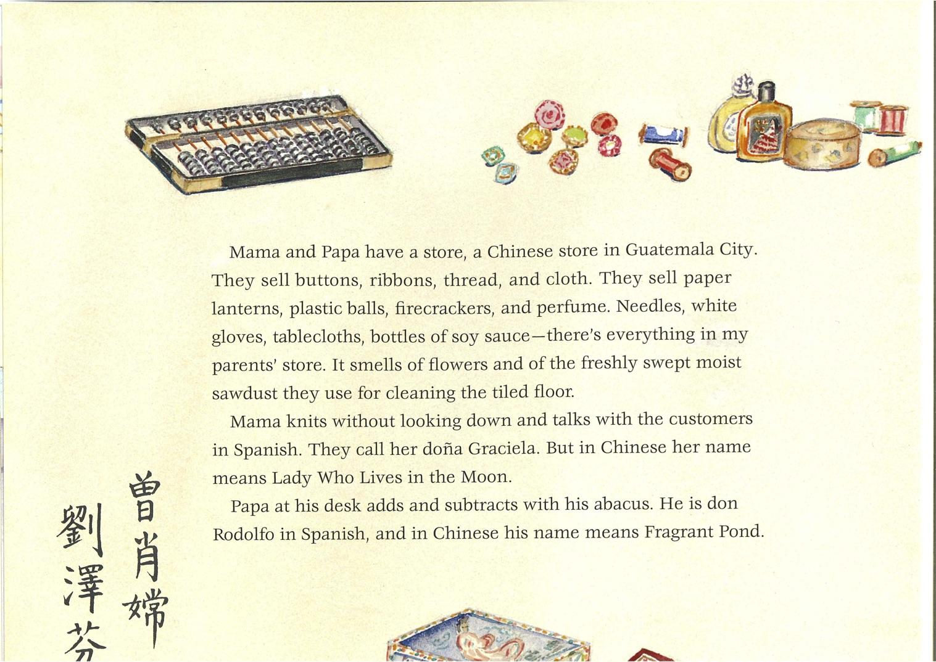
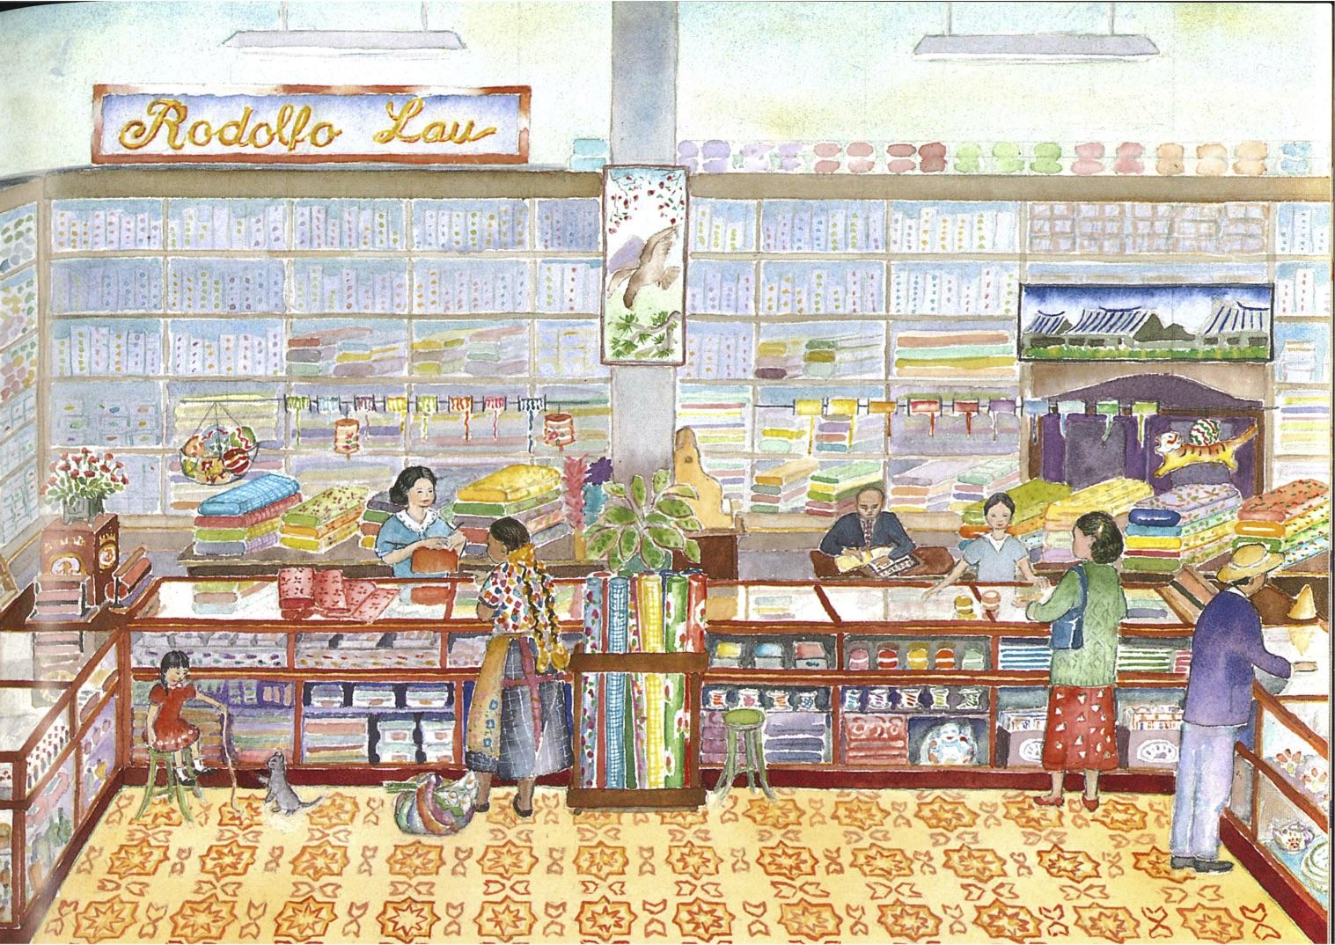

Slide 3
Mama and Papa have a store, a Chinese store in Guatemala City. They sell buttons, ribbons, thread, and cloth. They sell paper lanterns, plastic balls, firecrackers, and perfume. Needles, white gloves, tablecloths, bottles of soy sauce—there’s everything in my parents’ store. It smells of flowers and of the freshly swept moist sawdust they use for cleaning the tiled floor.
Mama knits without looking down and talks with the customers in Spanish. They call her doña Graciela. But in Chinese her name means Lady Who Lives in the Moon.
Papa at his desk adds and subtracts with his abacus. He is don Rodolfo in Spanish, and in Chinese his name means Fragrant Pond.

