Slide 1
Images of Condensation
Science and Engineering Week 5, Lesson 1

Slide 2
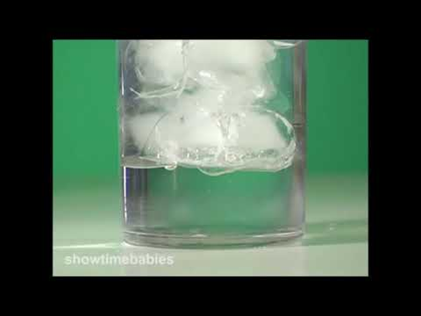

Slide 3
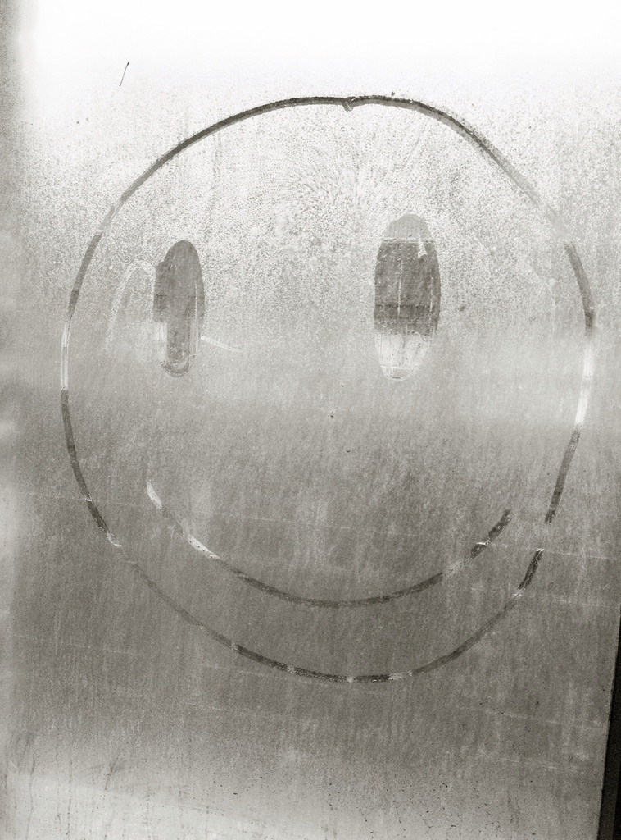
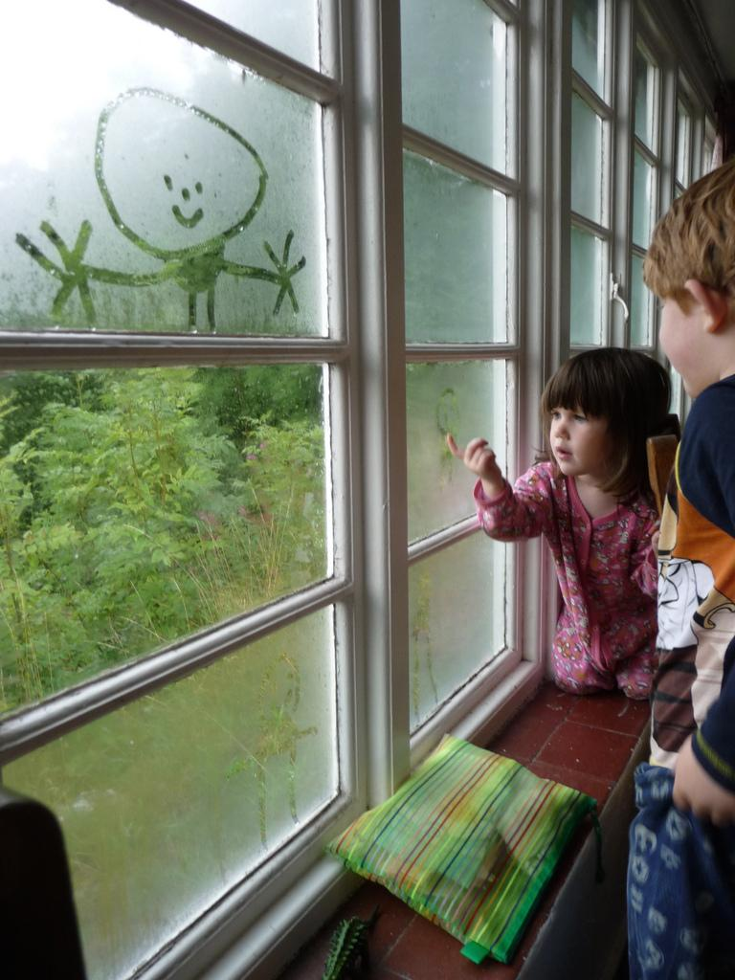

Slide 4
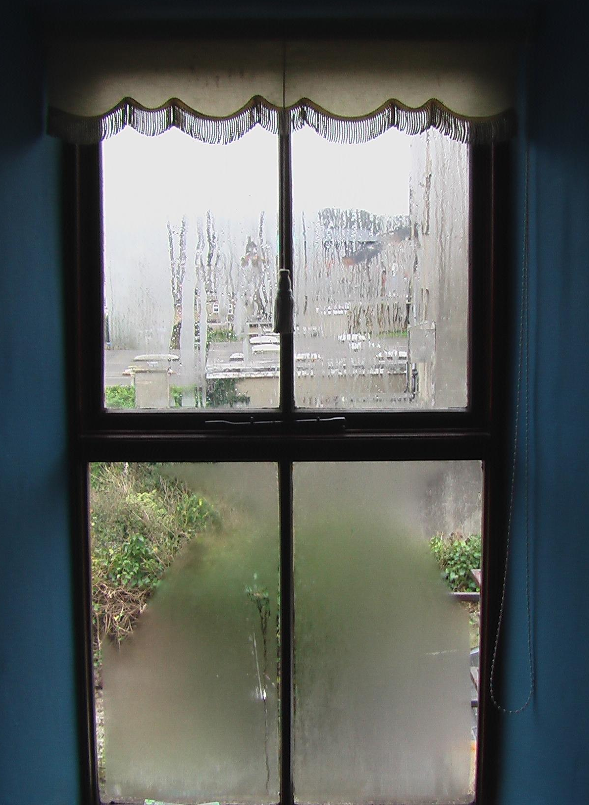

Slide 5
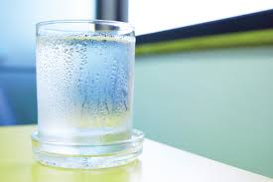

Slide 6
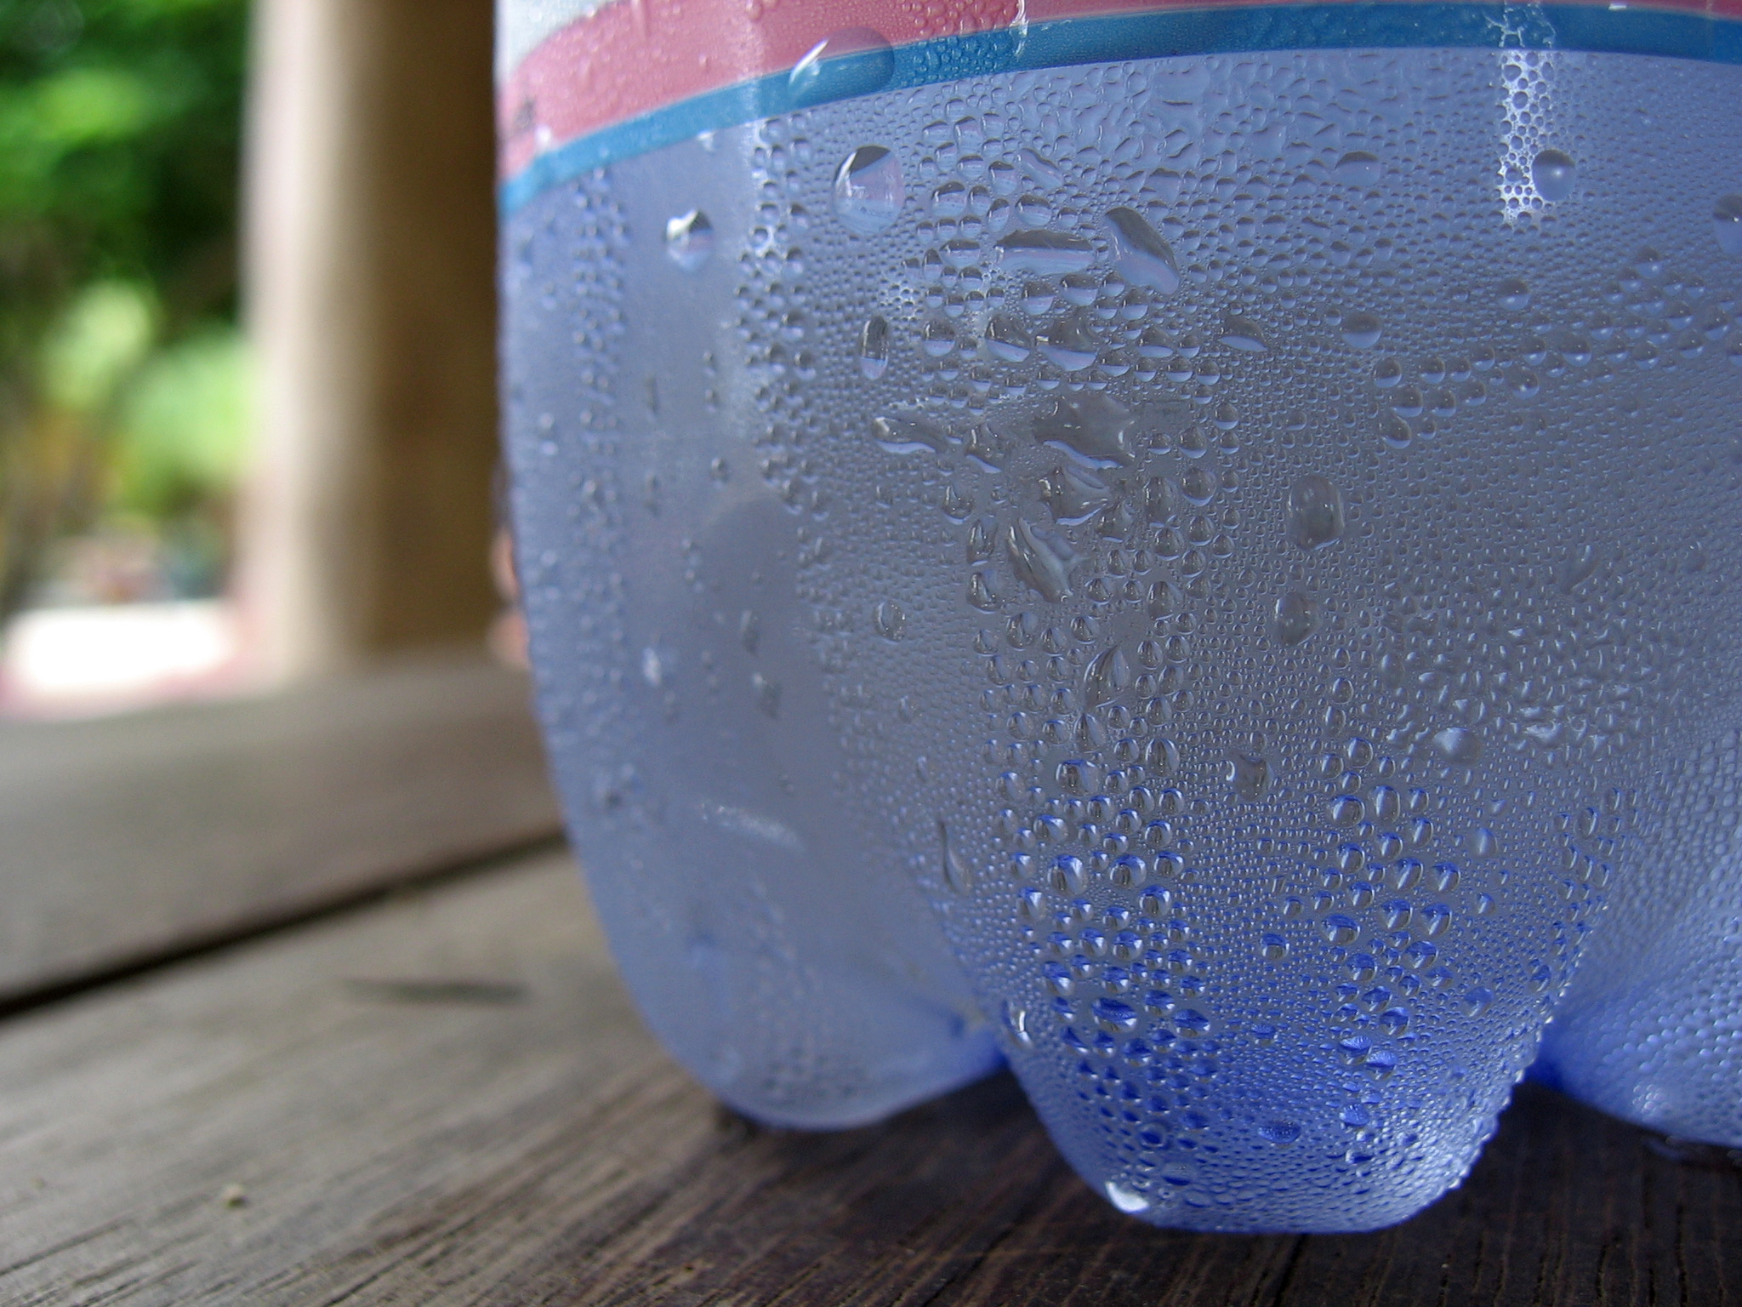

Slide 7
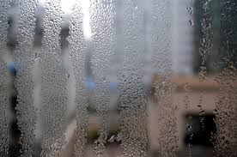

Slide 8
Citations
Slide 2 video: https://www.youtube.com/watch?v=2EaDKZ2NnB4
Slide 3: https://www.flickr.com/photos/renaissancechambara/7108758079, https://www.flickr.com/photos/jodydigger/20932908175
Slide 4: https://commons.wikimedia.org/wiki/File:Window_in_Ireland.jpg
Slide 5: http://factsheets.okstate.edu/documents/fapc-203-strategies-to-reduce-moisture-condensation-in-food-facilities/
Slide 6: https://commons.wikimedia.org/wiki/File:Condensation_on_water_bottle.jpg
Slide 7: http://www.windowsonlineuk.co.uk/blog/double-glazing-get-condensation-inside/

