Slide 1
Poem Titles and Shapes
Writing Unit 3, Week 4, Day 3

Slide 2

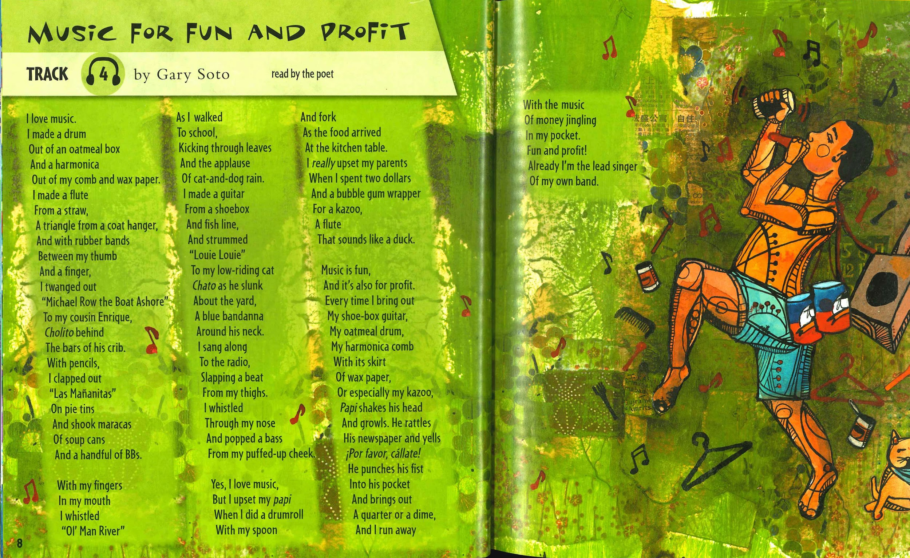


Slide 3
A Blank White Page
by Francisco X. Alarcón
is a meadow
after a snowfall
that a poem
hopes to cross

Slide 4

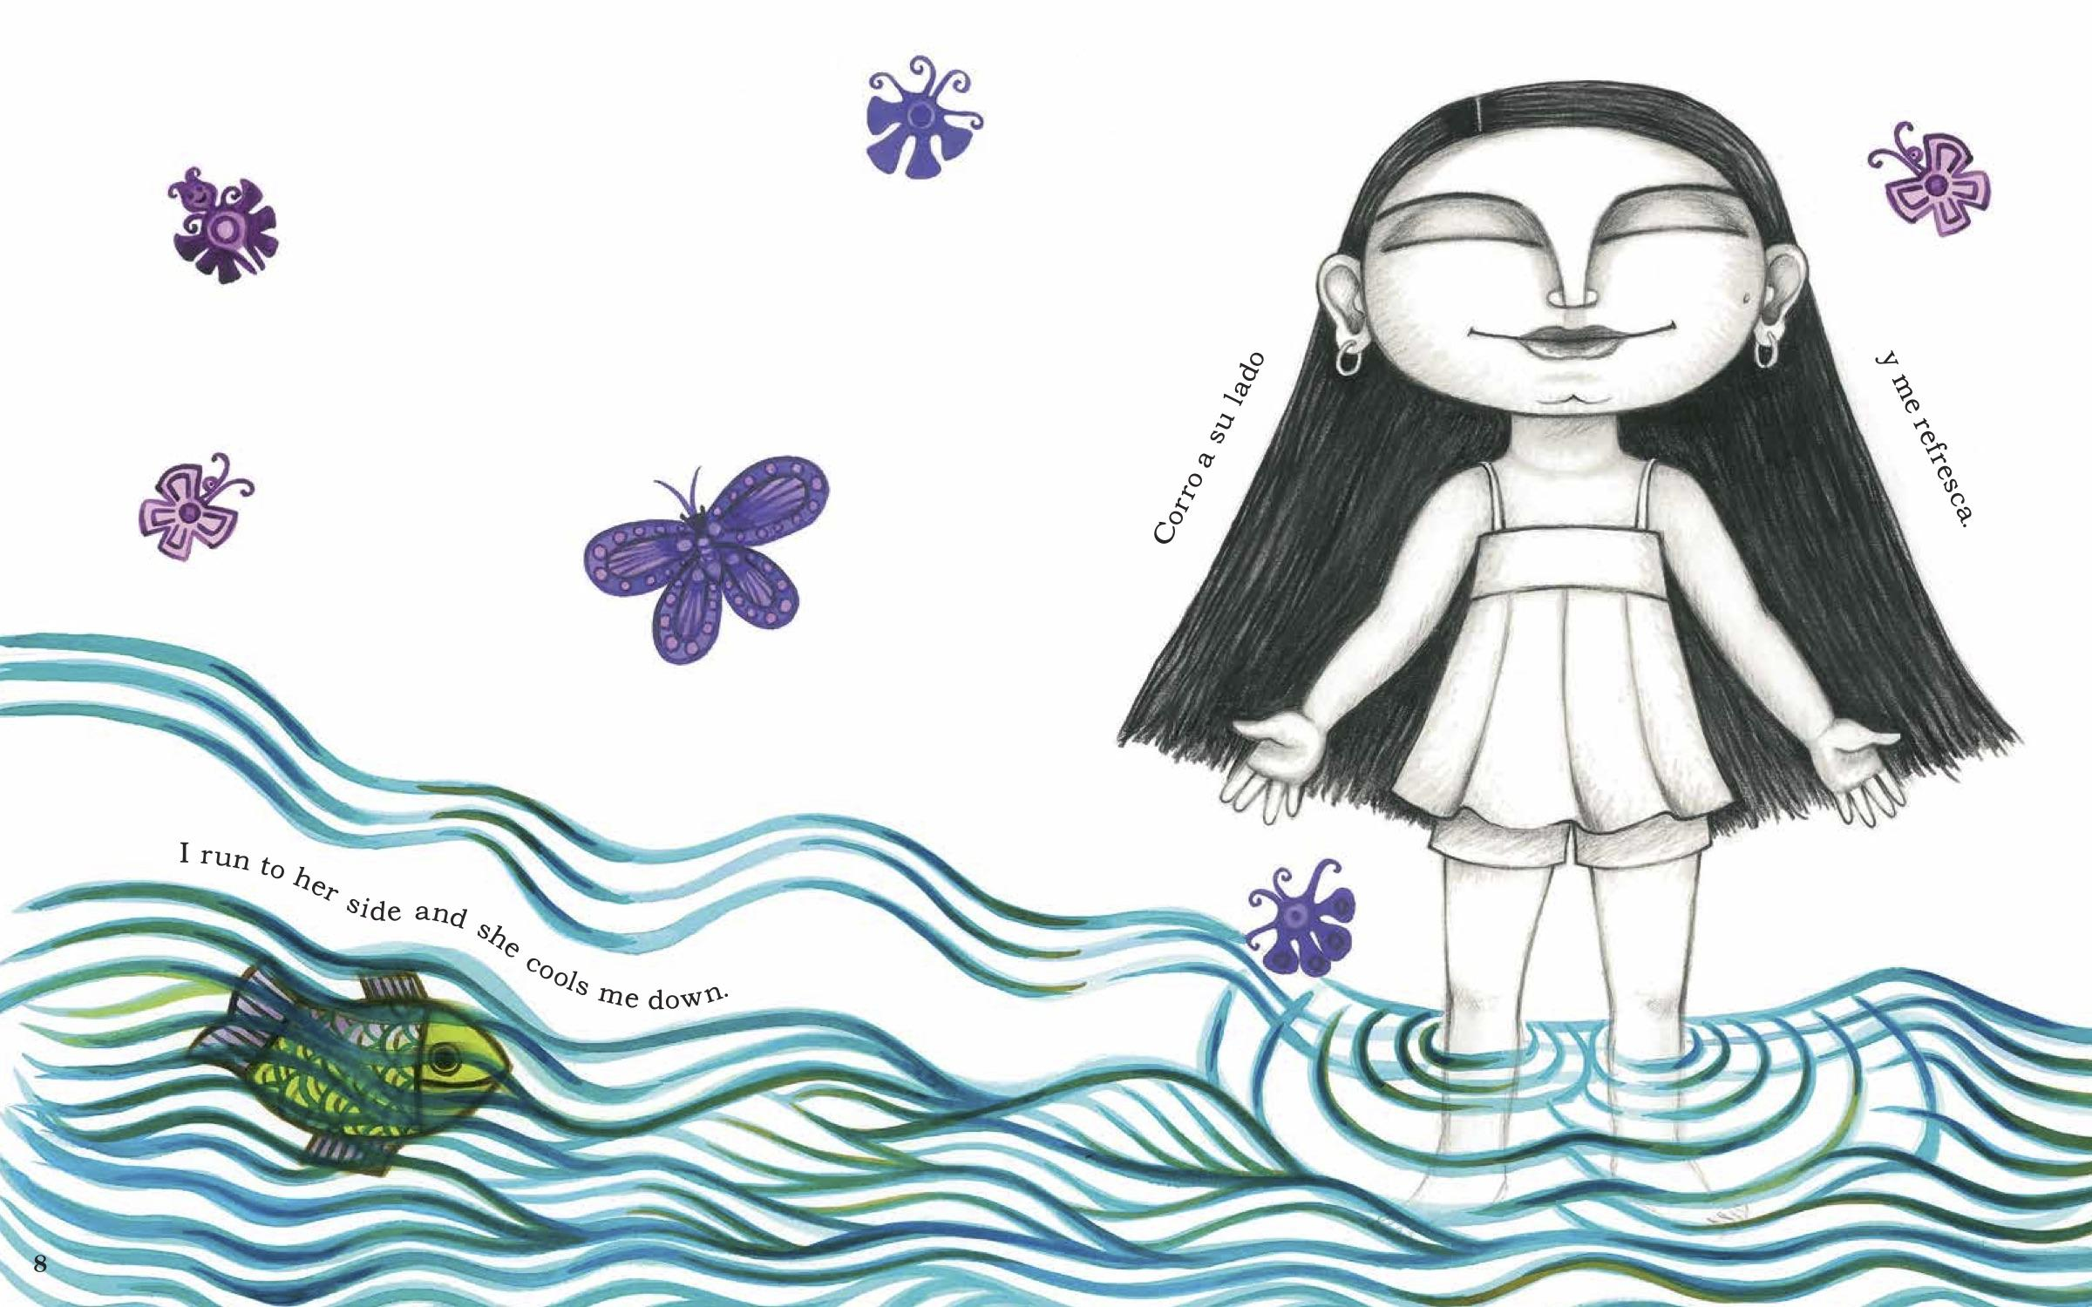

Slide 5
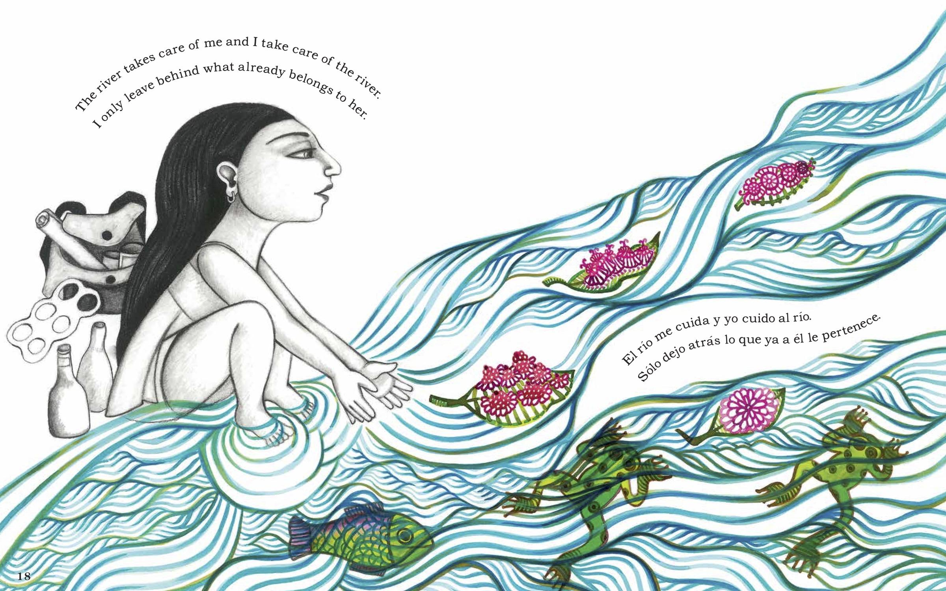

Slide 6
Taking root in windy sand
is not an easy
way
to go about
finding a place to stay.
A ditchbank or wood's-edge
has firmer ground.
In a loose world though
something can be started—
a root touch water,
a tip break sand—
Mounds from that can rise
on held mounds,
a gesture of building, keeping,
a trapping
into shape.
Firm ground is not available ground.
Dunes
by A.R Ammons

