Slide 1
Weekly Words
Unit 3, Week 4
Notes:
anticipation: the feeling of being hopeful or nervous about something that will soon happen
collective: relating to a group of individuals, considered all together
determined: focused on achieving a goal
homage: a way to show respect for something or someone
humanity: all people
individual: referring to one person
legacy: lasting reputation or impact
reputation: the way a person or thing is thought of by others

Slide 2

anticipation
noun
the feeling of being hopeful or nervous about something that will soon happen
Notes:
anticipation (noun)
Elaboration:
The balloon is going to burst! We can see this child’s anticipation in the way she holds her ears. What kind of anticipation does she feel? Maybe excited, maybe nervous, maybe some of both!
Think, Pair, Share prompt:
Imagine you are traveling to a new place or going to see your family far away. What does your anticipation feel like?
https://www.loonerpop.com/watch/balloon-explosion-hd-blow-to-pop-with-plastic-suit_BSBtl5O4AiZUsGE.html?lang=english

Slide 3
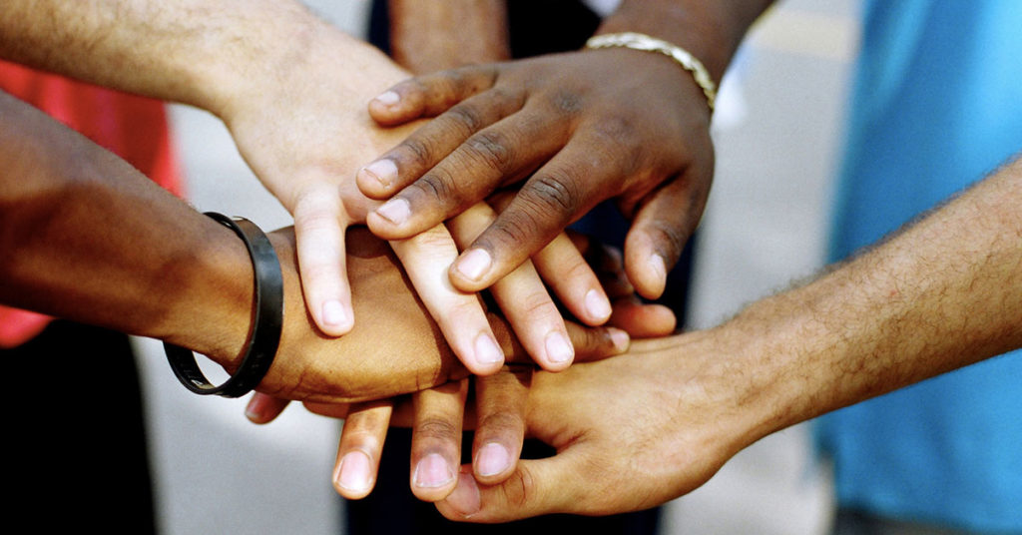
collective
adjective
relating to a group of individuals, considered all together
Notes:
collective (adjective)
Elaboration:
When we make a collective decision, we think about all the people involved and what is good for the whole group, not only about what each person wants.
Think, Pair, Share prompt:
What is one example of a collective decision we have made in our classroom to make it a good place for all learners?
https://blog.medicalgps.com/7-essentials-for-physician-practices-it-starts-with-a-daily-huddle/

Slide 4
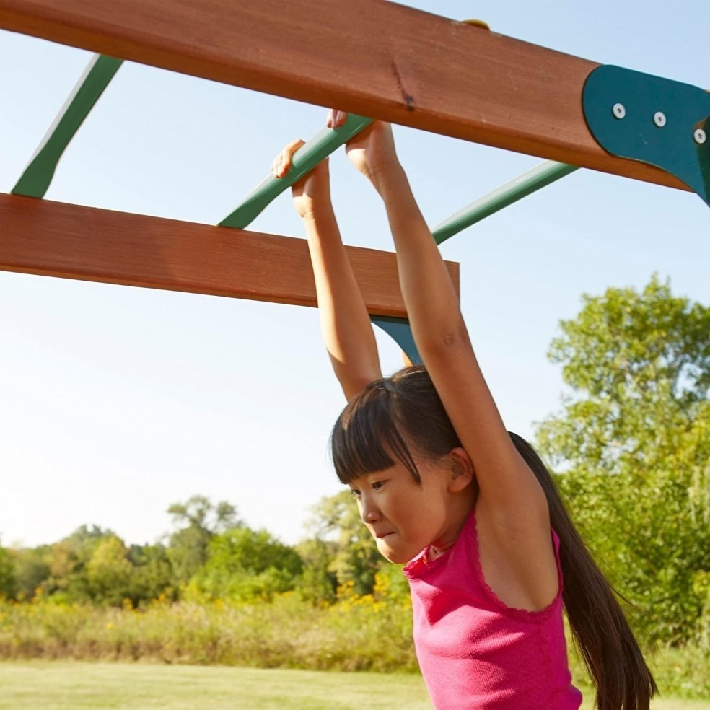
determined
adjective
focused on achieving a goal
Notes:
determined (adjective)
Elaboration:
This child has to be determined to master the climbing bars. She has decided that she is going to do it, and she does not look like she is going to give up.
Think, Pair, Share prompt:
Can you think of a time when you or someone you know has been determined to do something? Try to think of something that seemed really hard, and that you had to promise yourself that you were going to do anyway.
https://foter.com/7-science-based-benefits-of-monkey-bars-playtime

Slide 5

homage
noun
a way to show respect for something or someone
Notes:
homage (noun)
Elaboration:
In their book, Dream Street, two cousins, the writer Tricia Elam Walker and the artist Ekua Holmes, pay homage to the neighborhood they love and where they grew up. They give respect to a place they love through writing and collages.
Think, Pair, Share prompt:
Who is someone or what is a place you would give homage to? What would you do to show your respect for that person or place?
Cover of Dream Street, Tricia Elam Walker and Ekua Holmes

Slide 6
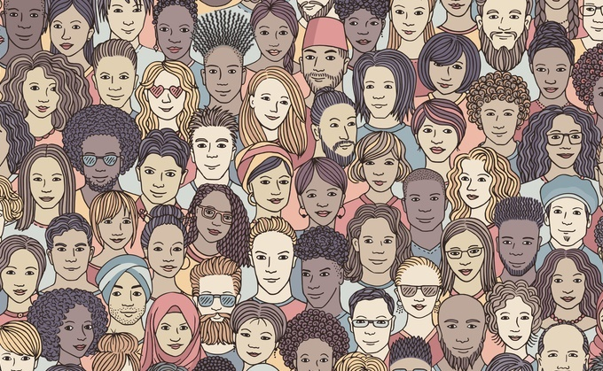
humanity
noun
all people
Notes:
humanity (noun)
Elaboration:
When we talk about humanity, we are referring to all people, all around the world. We might think about a wish for humanity, such as for happiness for all humanity, or for peace between all countries.
Think, Pair, Share prompt:
What is something that you think is important for humanity—all people—to think about or to do?
https://www.filmsforaction.org/articles/all-i-ask-is-that-you-see-my-humanity-which-means-seeing-the-humanity-in-all-people/

Slide 7
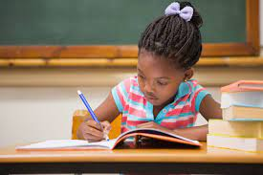
individual
adjective
referring to one person
Notes:
individual (adjective)
Elaboration:
Sometimes we work on a collective task, all together, like when we wrote a letter to _____ to advocate for _____. [Refer to the Unit 1 project or another group endeavor.]
Other times I ask you to do an individual task—to do something all by yourself—like an assessment.
Think, Pair, Share prompt:
Think of an individual activity you have done, briefly describe it, and talk about how you felt about it.
https://www.familyeducation.com/life/cognitive-psychological-development/i-need-help-my-five-year-old-writes-backward

Slide 8
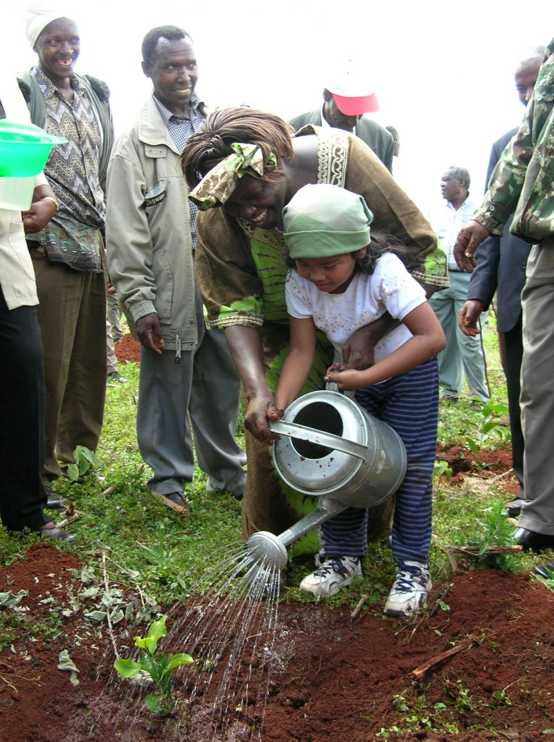
legacy
noun
lasting reputation or impact
Notes:
legacy (noun)
Elaboration:
In Kenya and all around the world, people plant trees to protect the health of the environment for all living things. This is part of the legacy of Wangari Maathai—the impact she has through her life and work.
[If known and relevant, make a connection to the person for whom the school is named: Our school is named for _____, who _____; a commitment to education/equal rights/etc. is part of their legacy.]
Think, Pair, Share prompt:
What legacy can you imagine having? You could say, “I want my legacy to be that _____.”
https://www.goldmanprize.org/blog/green-belt-movement-wangari-maathai/

Slide 9
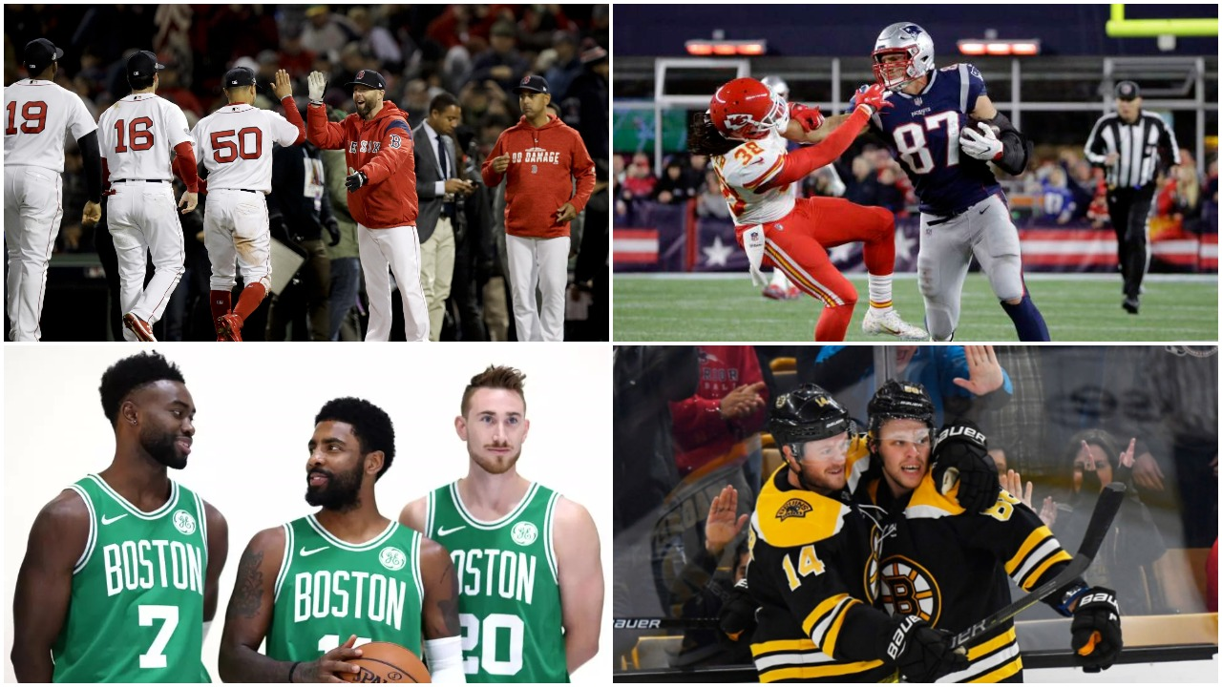
reputation
noun
the way a person or thing is thought of by others
Notes:
reputation (noun)
Elaboration:
The New England have a reputation for being a place where sports are important to many people. Even people who don’t really watch sports can say that New England is known for this.
Think, Pair, Share prompt:
Can you think of a place that has a reputation for something special—a good place to eat, a good place to play, a good place to visit in the summer? What is the place, and what is its reputation?
https://www.bostonsbigfour.com/this-week-in-boston-sports/

