Slide 1
Words with Multiple Meanings
Vocabulary & Language Week 4, Days 3-4

Slide 2

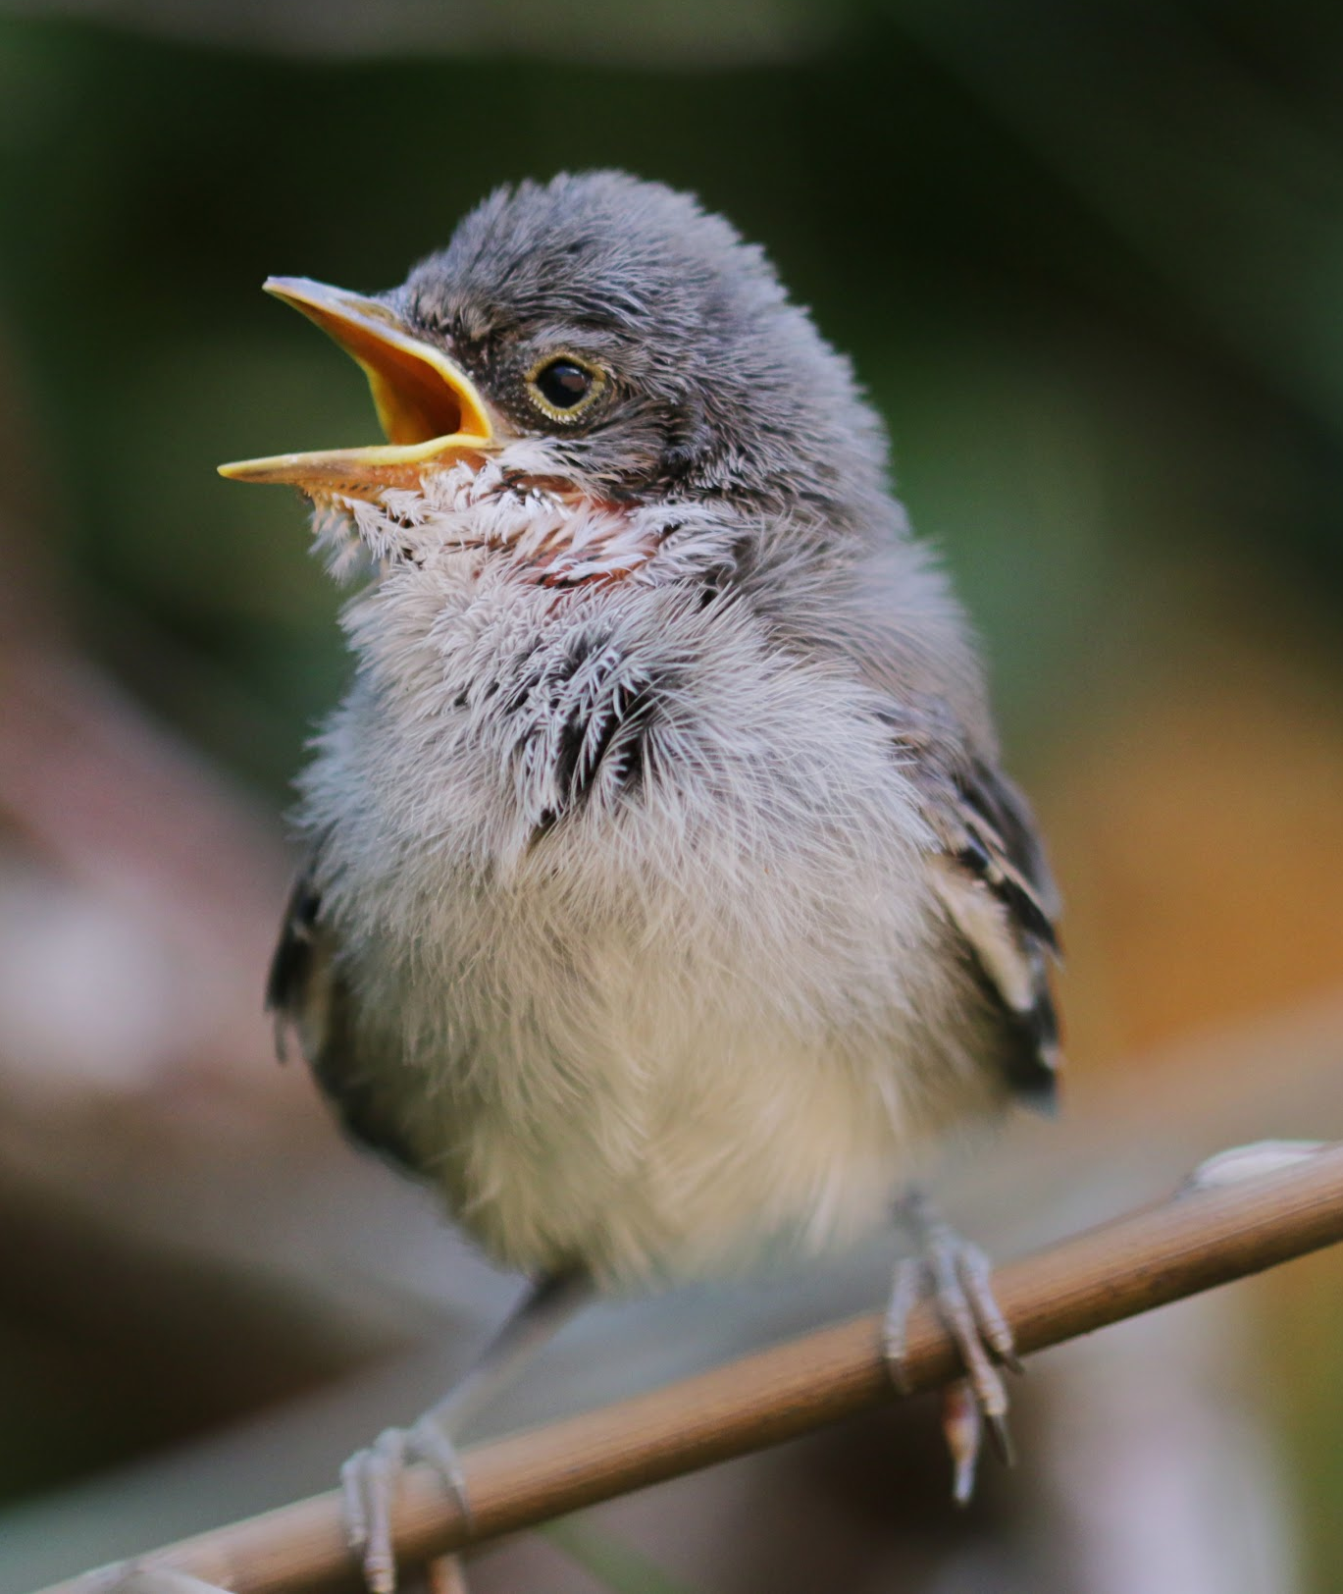
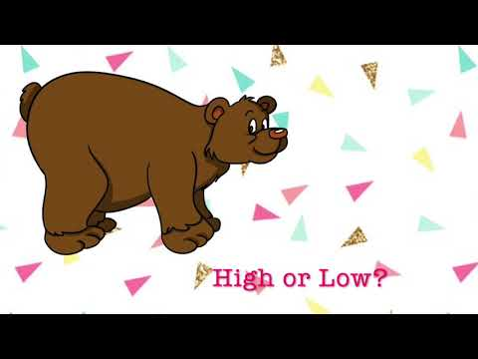
pitch
noun
the high or low quality of a sound
Notes:
images: google images
sounds: https://www.youtube.com/watch?v=V9yp99xGP6s

Slide 3
She will pitch the baseball.
That teapot makes a sound with a high pitch.

Slide 4
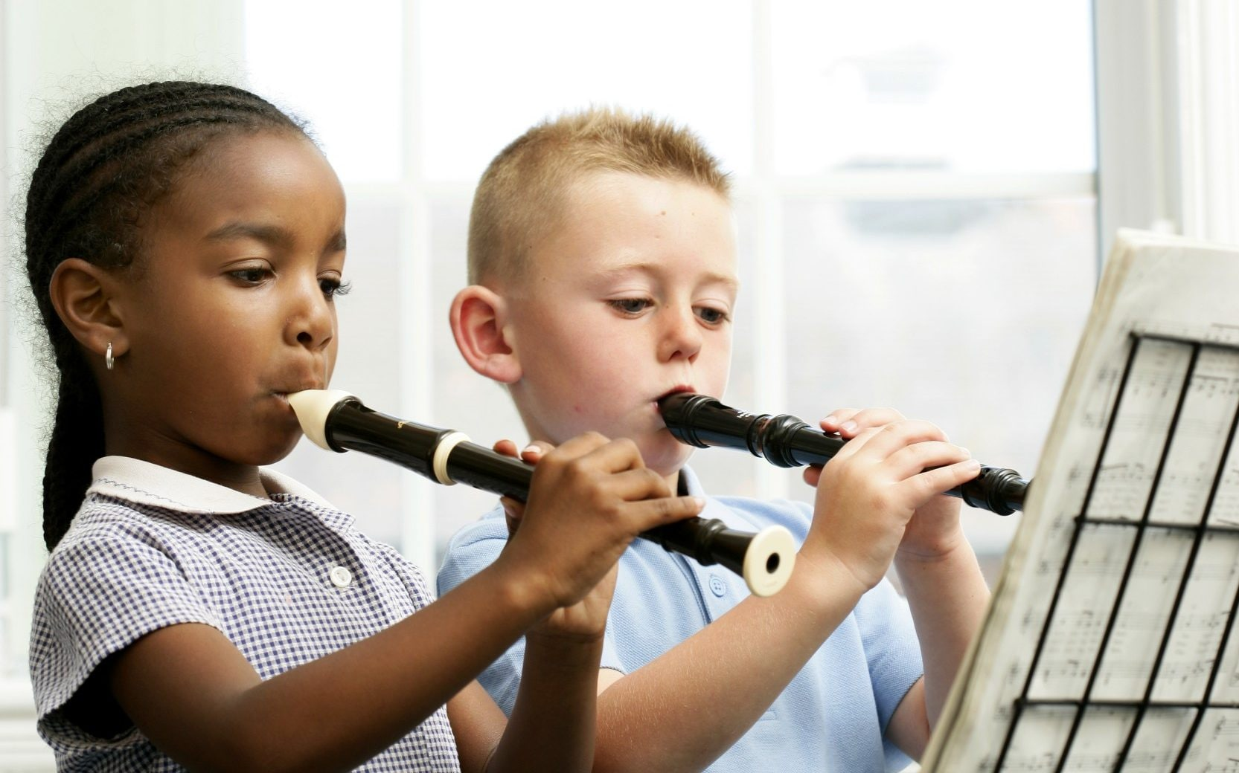

tune
noun
musical sounds with a melody and sometimes harmony
Notes:
https://www.telegraph.co.uk/music/news/wind-instruments-perfectly-safe-cant-band-play/

Slide 5
What is the name of that tune you played?
We need to tune our instruments so that they sound the same.

Slide 6
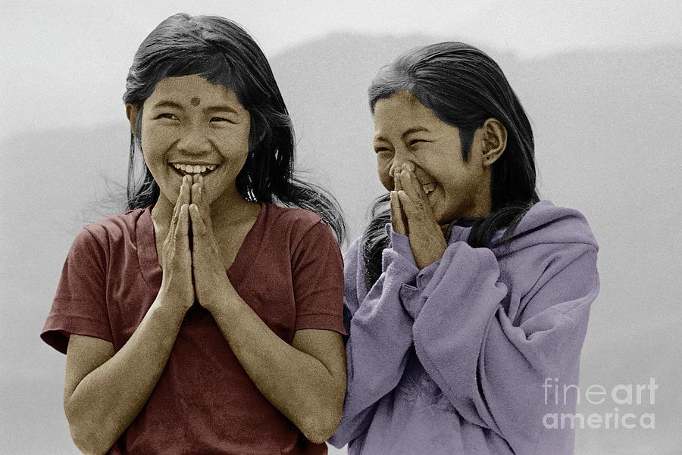
custom
noun
a way of acting that is usual for a person or group
Notes:
https://fineartamerica.com/featured/nepali-girls-namaste-greeting-himalayas-craig-lovell.html

Slide 7
Those are custom sneakers. There are not any other ones like them.
It is our custom to greet each other with a handshake.

Slide 8
Words with Multiple Meanings
Choose one of the words we explored yesterday: pitch, tune, or custom.
Write two sentences with that word, one showing each meaning of the word.

