Slide 1

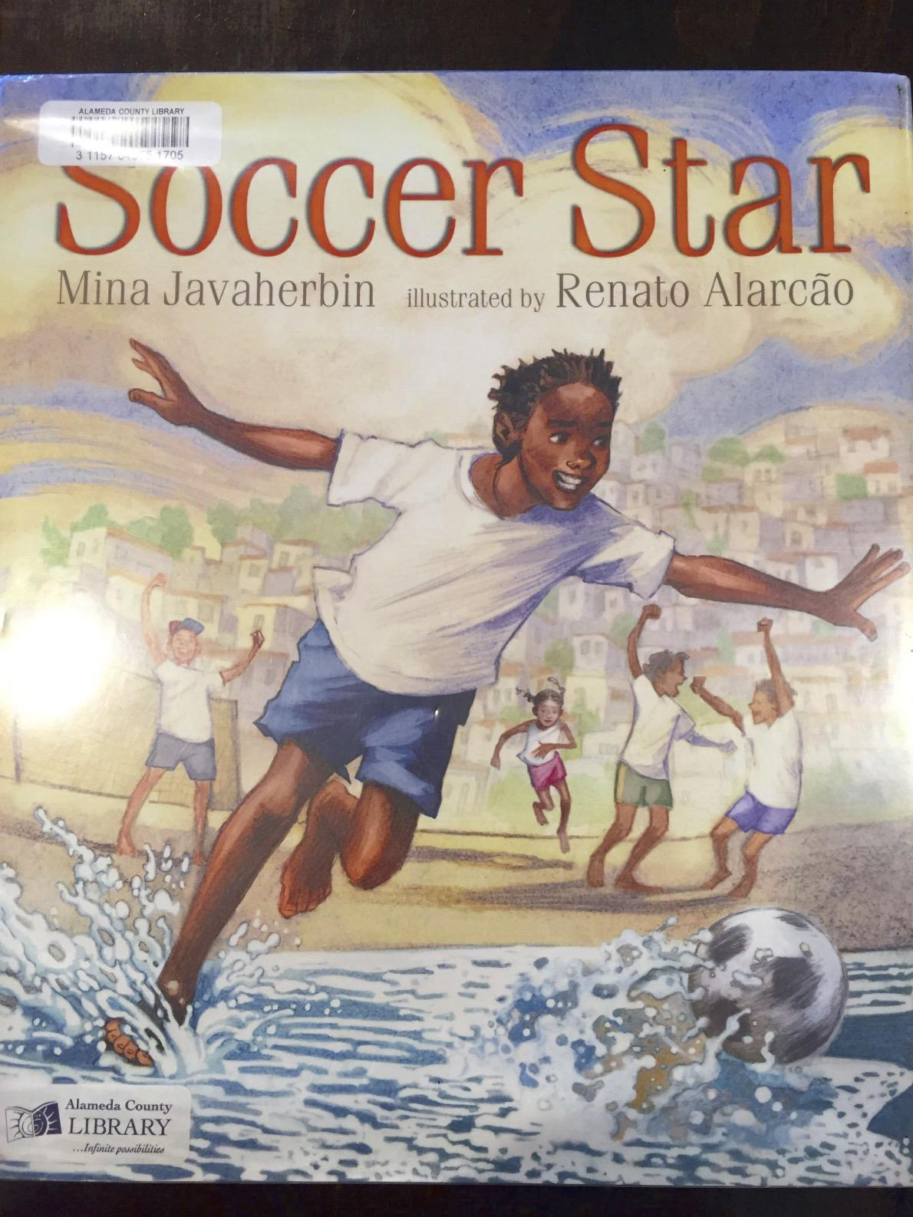

Slide 2
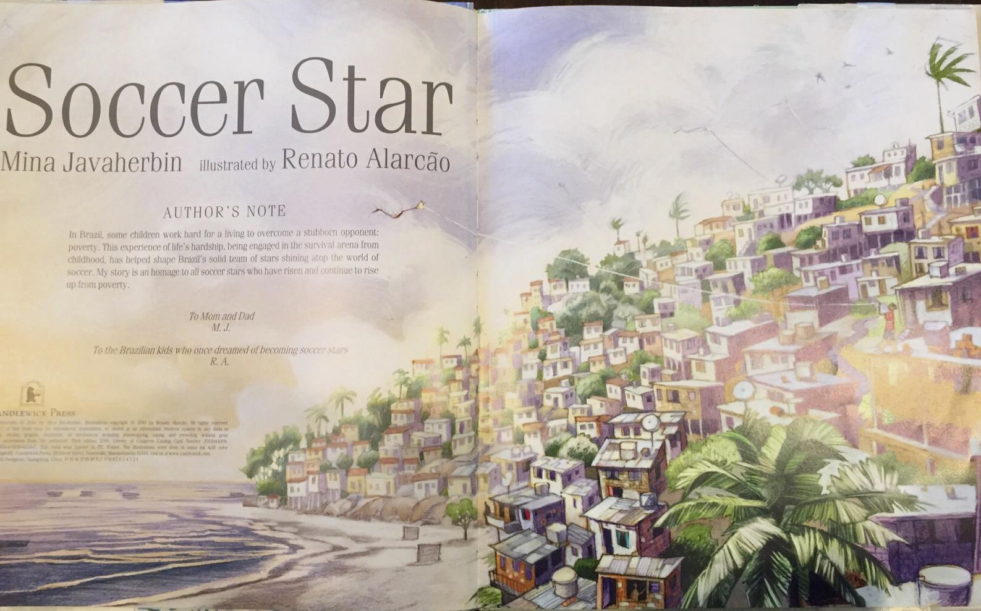

Slide 3
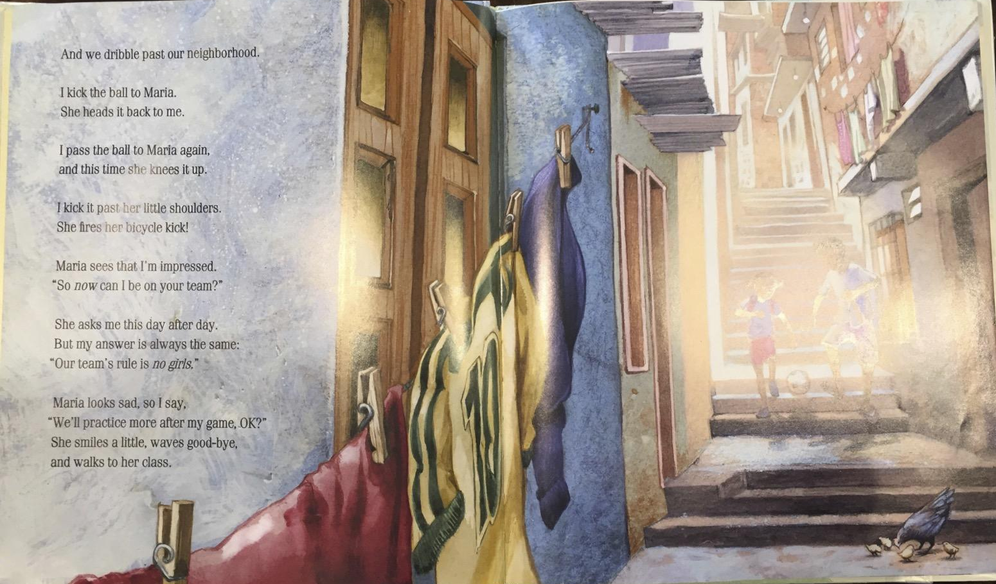

Slide 4
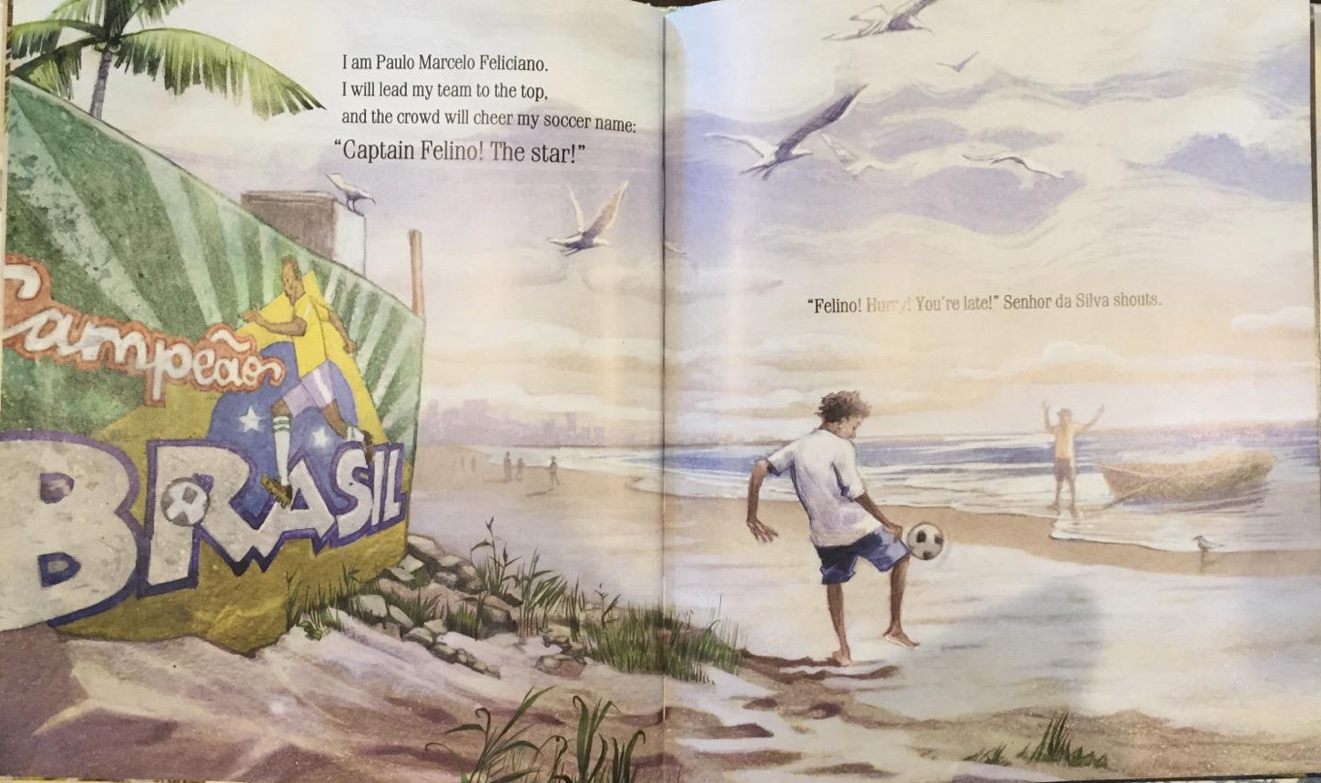

Slide 5
Public Art in Brazil
Text Talk Week 4, Day 5

Slide 6
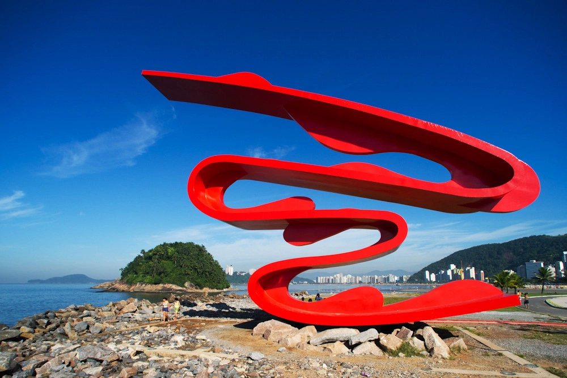
Artist: Tomie Ohtake
Escultura Tomie Ohtake, São Paulo

Slide 7
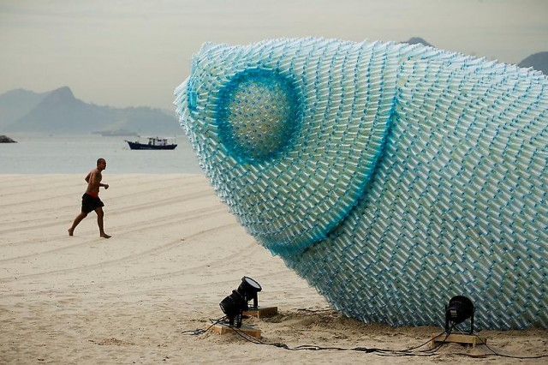
temporary fish sculpture made from discarded plastic bottles
Rio de Janeiro (artist unknown)

Slide 8
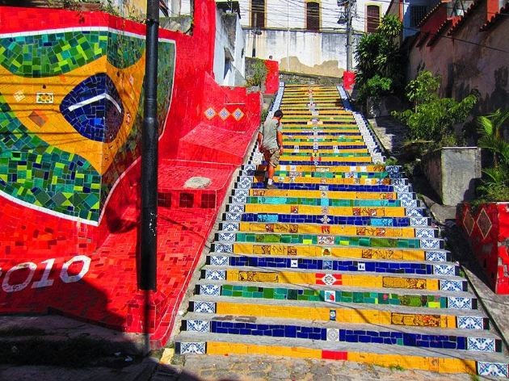
Escadaria Selaron
stairway linking the Santa Teresa and Lapa districts, Rio de Janeiro (Jorge Selaron)

Slide 9
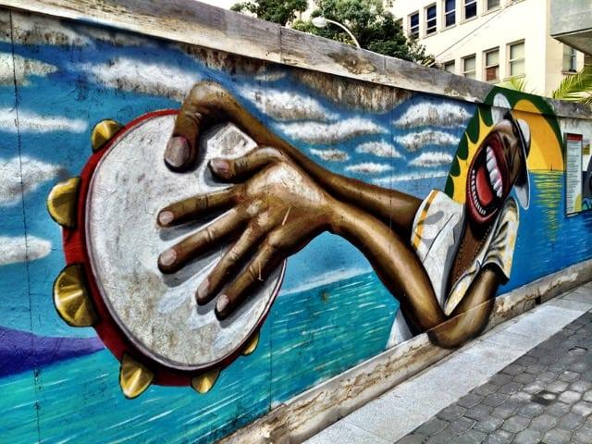
Mural at the base station of the Sugarloaf Mountain cable-car,
Rio de Janiero (artist unknown)

Slide 10
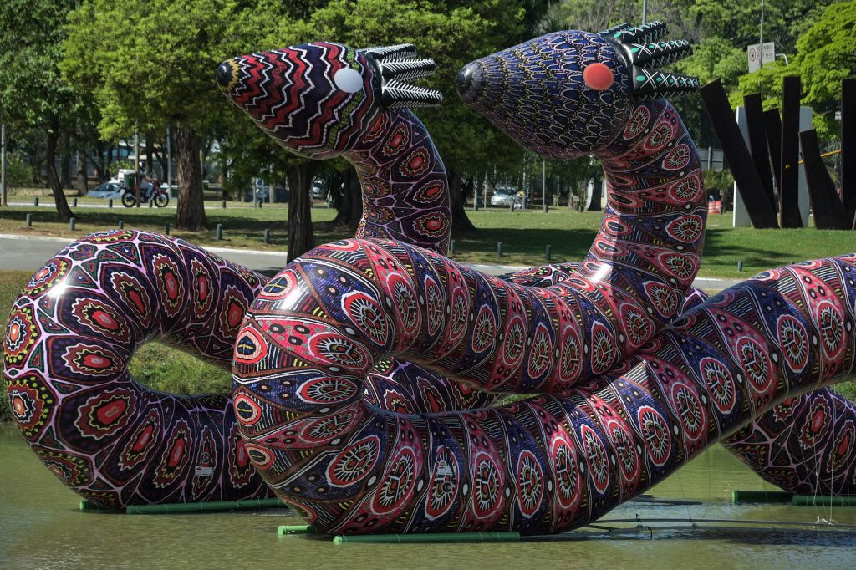
Artist: Jaider Esbell
sculpture installed as part of the Bienal de São Paolo

Slide 11
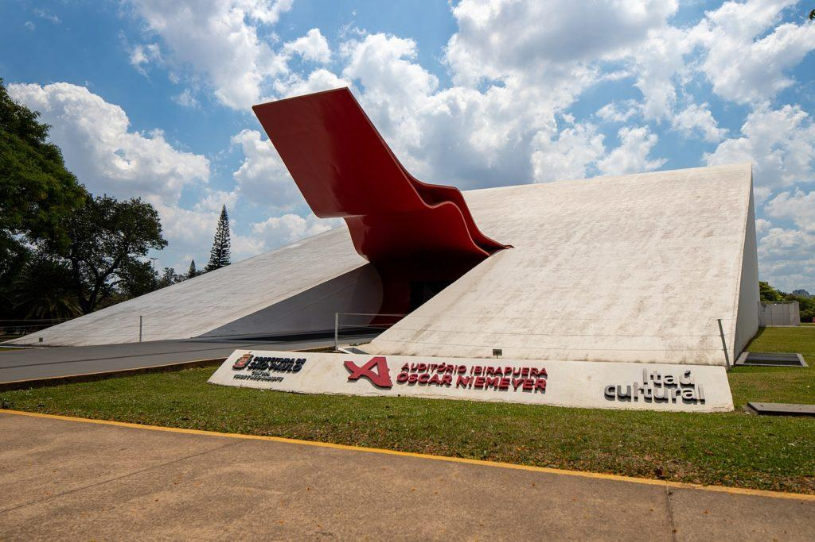
Architect: Oscar Niemeyer
Parque Ibirapuera Museum entrance, São Paolo

Slide 12
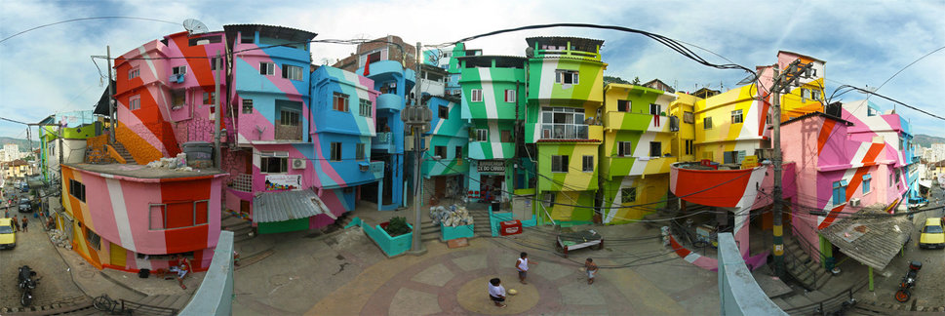
Artists: Haas & Hahn, Favela Painting Foundation
Santa Marta, Rio de Janeiro

Slide 13
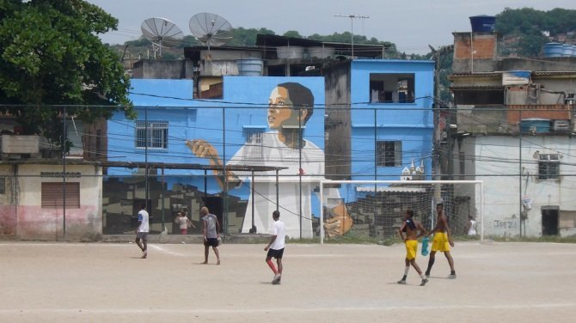
“Boy With a Kite”
Artists: Haas & Hahn, Favela Painting Foundation
Vila Cruzeiro, Rio de Janeiro

Slide 15
Citations
Slide 6: https://casaclaudia.abril.com.br/arte/obra-publica-de-tomie-ohtake-e-restaurada-em-santos/
Slide 7: http://www.thisiscolossal.com/2012/06/giant-fish-sculptures-made-from-discarded-plastic-bottles-in-rio/
Slide 8: https://www.fodors.com/news/photos/the-15-most-magical-outdoor-stairways-in-the-world
Slide 9: https://velvetescape.com/street-art-in-rio-de-janeiro/
Slide 10: https://news.artnet.com/opinion/the-34th-sao-paulo-biennial-review-2015655
Slide 11: https://www.discoverwalks.com/blog/sao-paulo/top-10-facts-about-the-ibirapuera-park-in-sao-paulo/
Slide 12: http://www.favelapainting.com/
Slide 13: https://www.huffingtonpost.com/entry/favela-painting-foundation-is-using-art-to-rejuvenate-brazils-slums_us_57b70004e4b00d9c3a16f179

