Slide 1
Art in Brazil
Text Talk Week 4, Day 3

Slide 2
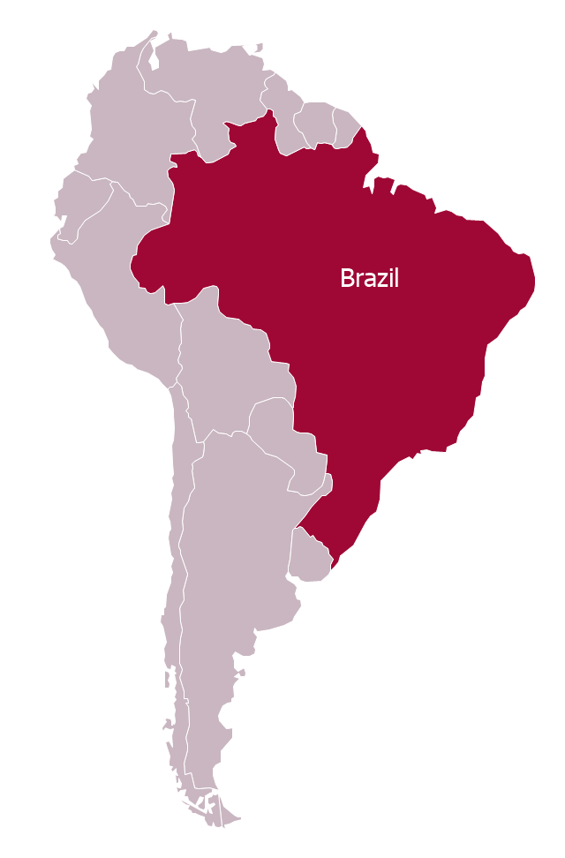
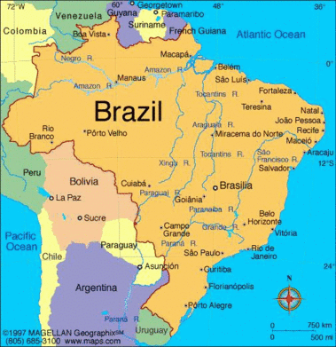
Maps of Brazil

Slide 3
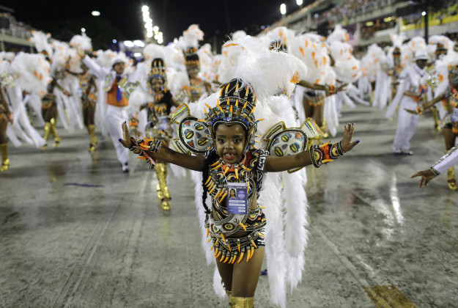
Child dancing in Carnival in Rio de Janeiro

Slide 4
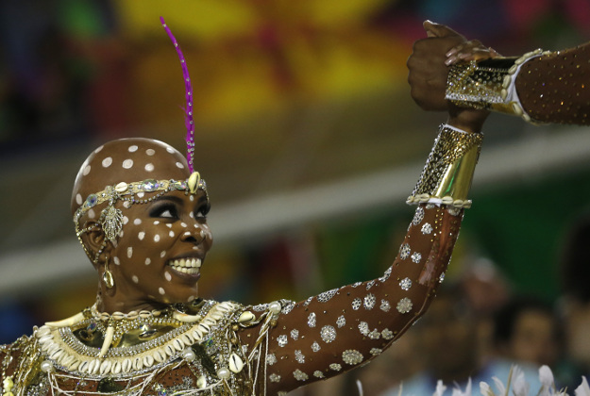
Performer at Carnival in Rio de Janeiro

Slide 5
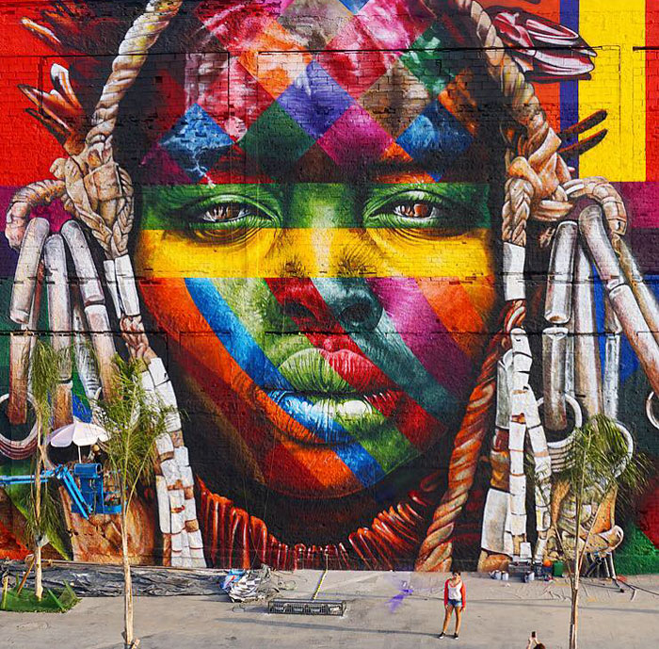
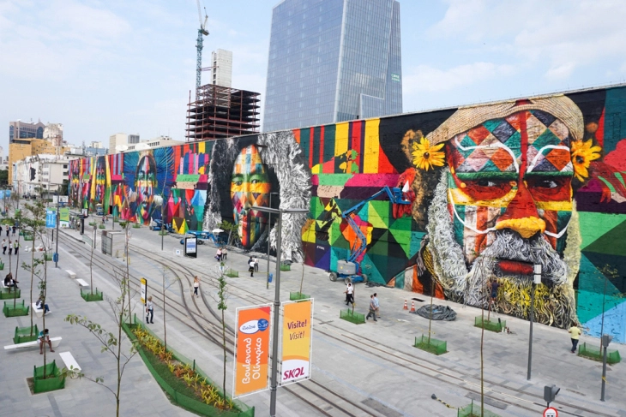
Eduardo Kobra’s “Las Etnias” (The Ethnicities),
painted for the 2016 Olympic Games in Rio de Janeiro

Slide 6
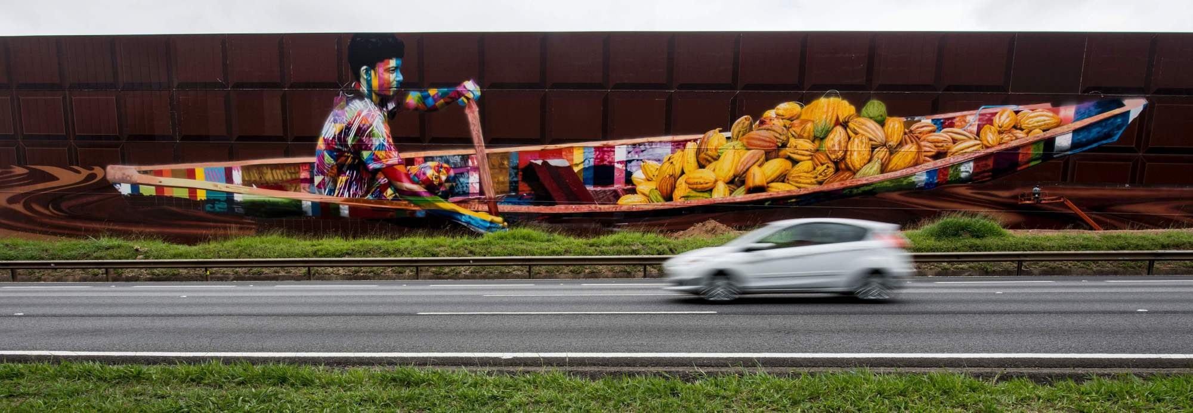
Eduardo Kobra’s mural outside of the Cacau Show factory, Sao Paolo,
the largest mural in the world

Slide 7
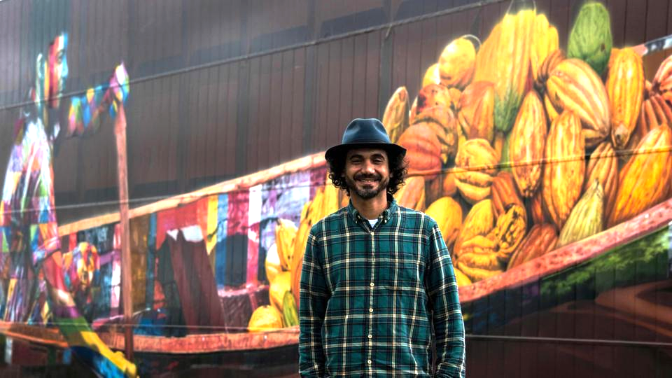
Eduardo Kobra

Slide 8
Art Everywhere!
Brazil has a rich history of expressing ideas through the arts. The “arts” include music, visual art, theater, dance, literature, and martial arts. Brazil’s famous Carnival is an important celebration that comes alive through the arts. Each year, around two million people take to the streets of the city Rio de Janeiro to enjoy music, dance, and costumes. Even soccer, the most popular sport in Brazil, has a connection to the the arts! Many people say that the Brazilian way of playing soccer is graceful. They say that’s because the soccer moves are influenced by Samba dance and Brazil’s martial arts, Capoeira.

Slide 9
Citations
Slide 2: https://conceptdraw.com/a1242c3/preview; http://www.brazil-travel-northeast.com/maps-of-brazil.html
Slides 3 and 4: https://www.lonelyplanet.com/news/2016/02/09/around-the-world-in-8-images-photos-of-the-day-4/
Slide 5: https://www.boredpanda.com/world-largest-mural-street-art-las-etnias-the-ethnicities-eduardo-kobra-rio-olympics-brazil/; https://hiddenartdesign.files.wordpress.com/2016/08/kobra-todos_somos_um-1_sml.jpg?w=730&h=487
Slide 6: https://www.japantimes.co.jp/news/2017/04/14/world/offbeat-world/brazilian-street-artist-paints-biggest-ever-mural/#.WlWhUFQ-fBI
Slide 7: http://www.hindustantimes.com/art-and-culture/brazilian-artist-paints-the-world-s-biggest-ever-mural-in-sao-paulo/story-mpfJHjeA87i3bW4kD1DC9H.html

