Slide 1
Weekly Words
Unit 3, Week 3
Notes:
belief: an idea that is accepted as true; a strong opinion
compare: to notice similarities and differences
difference: a way that things are not alike
emotion: feeling
faith: confidence and belief in
journey (n): long trip from one place to another; (v): to go on a trip, to travel
similarity: a way that things are alike
worldview: a way of thinking about the world, a person’s whole perspective

Slide 2
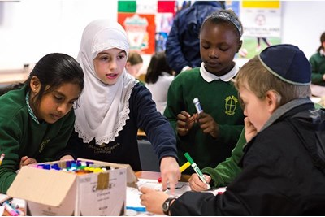
belief
noun
a strong opinion; an idea that is accepted as true
Notes:
belief (noun)
Elaboration:
We hold our beliefs inside ourselves. We make decisions and act according to our beliefs.
People in many communities hold the belief that the best way to solve problems is with cooperation; others hold the belief that each person needs to solve their own problems.
Your teacher has a strong belief that _____ [all children can learn].
Think, Pair, Share prompt:
What is one belief that is important to you? What do you think is true?
https://www.headteacher-update.com/best-practice-article/religion-culture-and-diversity/185375/

Slide 3
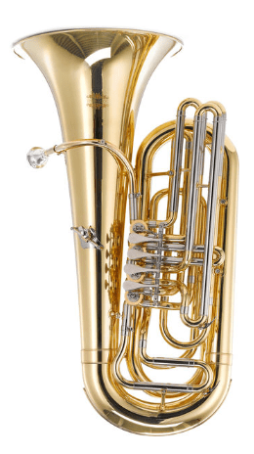
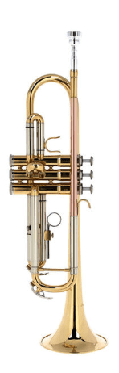
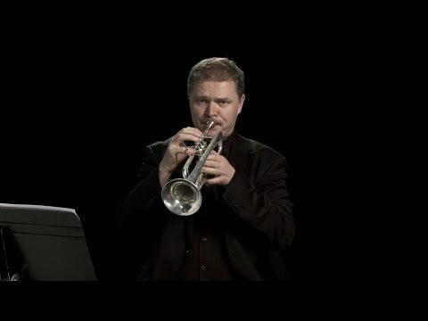

compare
verb
to notice similarities and differences
Notes:
compare (verb)
Elaboration:
We can compare all kinds of things: foods, shoes, people, ideas, places, activities like sports, or works of art. When we compare, we notice both the qualities that are the same and those that are different.
Here are two instruments, a tuba and a trumpet. Let’s listen. [Play each clip (each only a few seconds).]
Think, Pair, Share prompt:
Compare these two instruments. Think about how they look and how they sound. Name the similarities and the differences you notice.
https://www.thomann.de/blog/en/7-brass-instruments-differences-in-sound-and-playing-style/

Slide 4
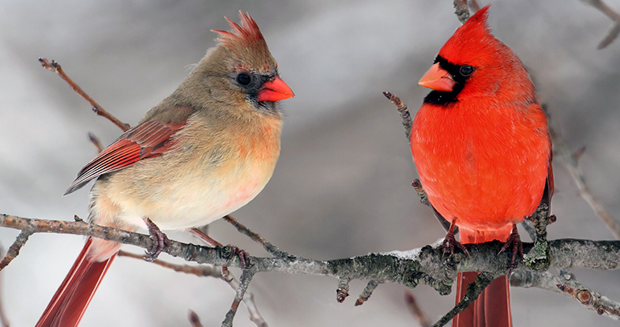
difference
noun
a way that things are not alike
Notes:
difference (noun)
Elaboration:
These are two of the same kind of bird; they are cardinals. The one on the left is a female and the one on the right is a male. That’s one difference, something that is not alike. What other differences can we find?
Think, Pair, Share prompt:
What are some differences between you and your partner?
https://www.wildaboutbirds.com/read/backyard-birds/northern-cardinal

Slide 5
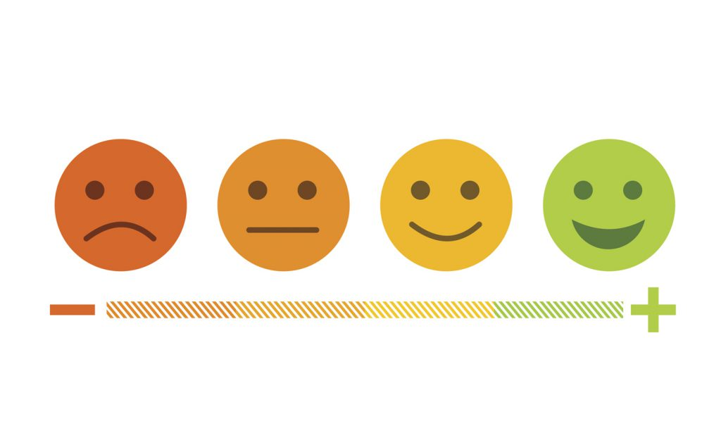
emotion
noun
feeling
Notes:
emotion (noun)
Elaboration:
We have many, many different emotions, or feelings, and we experience them in response to things that happen or things we are thinking about. I might have an emotion of sadness because my friend moved away; I might have an emotion of joy or excitement when we get to visit each other again! There are no emotions that are good or bad; they are just the ways we feel.
Whole group prompt:
Name one emotion, and say when you have felt that way.
https://www.psychologicalscience.org/news/releases/the-emotions-we-feel-may-shape-what-we-see.html

Slide 6
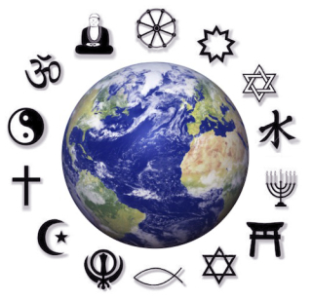
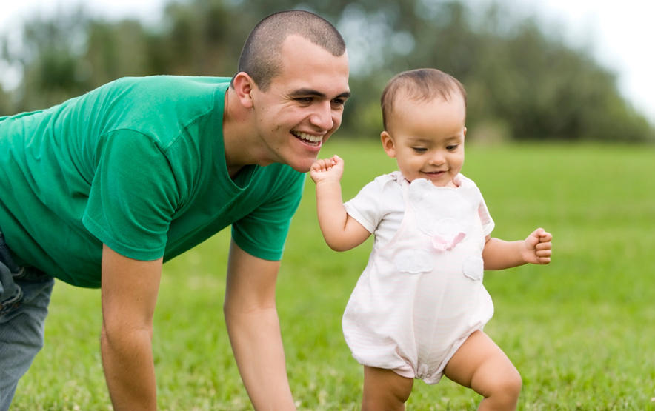
faith
noun
confidence and belief in
Notes:
faith (noun)
Elaboration:
Faith is related to “belief.” Having faith is about believing in something we cannot see. We can have faith in others, in ourselves, and in ideas.
These marks around the earth are symbols that represent different faiths. You might see one or more that you recognize.
This little one is just learning to walk independently. The grown up is letting the toddler go on their own, with faith that they will do it!
Think, Pair, Share prompt:
What connections do you make to this word? What do you have faith in—what do you believe in?
https://billtammeus.typepad.com/my_weblog/2020/04/4-22-20.html, https://www.babycenter.com/baby/baby-development/baby-milestone-walking_6507

Slide 7
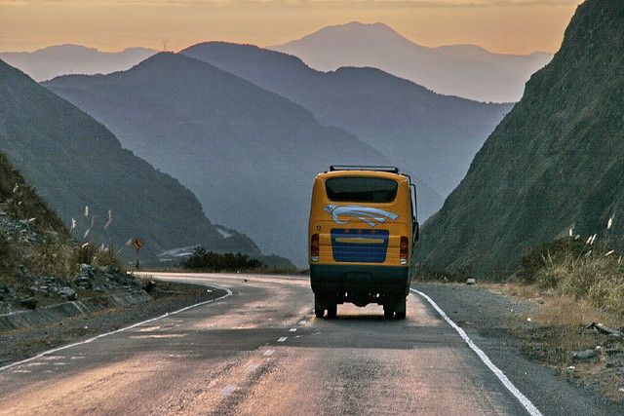
journey
noun
long trip from one place to another
verb
to go on a trip, to travel
Notes:
journey (noun and verb)
Elaboration:
This word can be used as a noun—a long trip from one place to another—or as a verb—to travel.
The people on this bus are taking a journey in South America. It looks like they are journeying through mountains.
Think, Pair, Share prompt:
Try to use the word as both a noun and a verb!
If you were to go on a journey, where might you go?
How would you journey to that place?
https://jessieonajourney.com/tips-for-bus-travel-in-south-america/

Slide 8
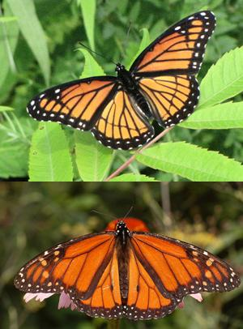
similarity
noun
a way that things are alike
Notes:
similarity (noun)
Elaboration:
These are two different kinds of butterflies: a monarch on the top, and a viceroy on the bottom. There are things about them that are alike. Let’s name some of these similarities…
Think, Pair, Share prompt:
What are some similarities between you and your partner?
https://science-u.org/experiments/magnificent-mimicry.html

Slide 9
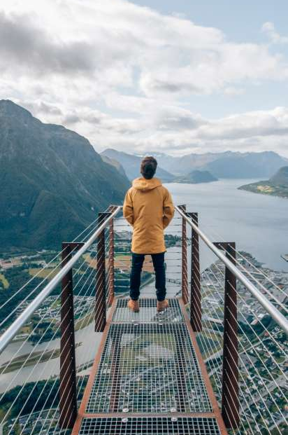
worldview
noun
a way of thinking about the world, a person’s whole perspective
Notes:
worldview (noun)
Elaboration:
Worldview is a compound word—two smaller words put together: “world” and “view.”
This person is looking out to a wide environment, and maybe also having thoughts about the places they see, communities, and ideas, and how they all go together and make sense. Part of my worldview is appreciating what different people can learn from each other.
Think, Pair, Share prompt:
Think back to the drum dream girl. Can you describe her worldview? What did she believe about how things could be?
https://www.visitnorway.com/places-to-go/fjord-norway/northwest/andalsnes/

