Slide 1
Root Words
Vocabulary & Language Week 3, Days 3-4

Slide 2
inference

Slide 3
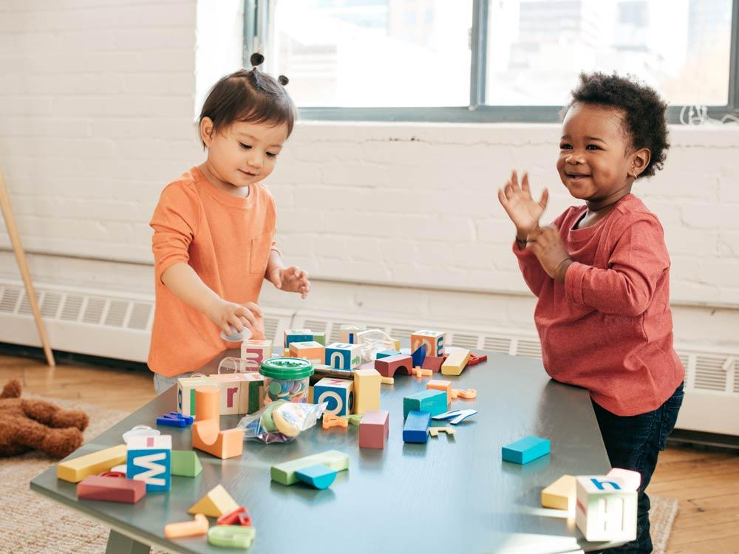
infer
verb
to make a guess based on facts and observation
Notes:
https://raisingchildren.net.au/autism/school-play-work/play-learning/playing-with-others-autistic-children

Slide 4
inference

Slide 5
rhythmic

Slide 6
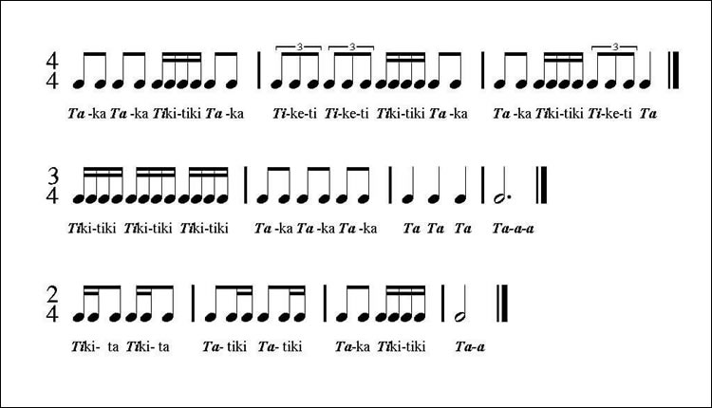
rhythm
noun
regular, repeated pattern of sound
Notes:
https://banddirector.com/brass/trombone/learn-to-practice-step-1-say-in-rhythm-stay-in-rhythm/

Slide 7
rhythmic

Slide 8
They made a comparison between two books.

Slide 9
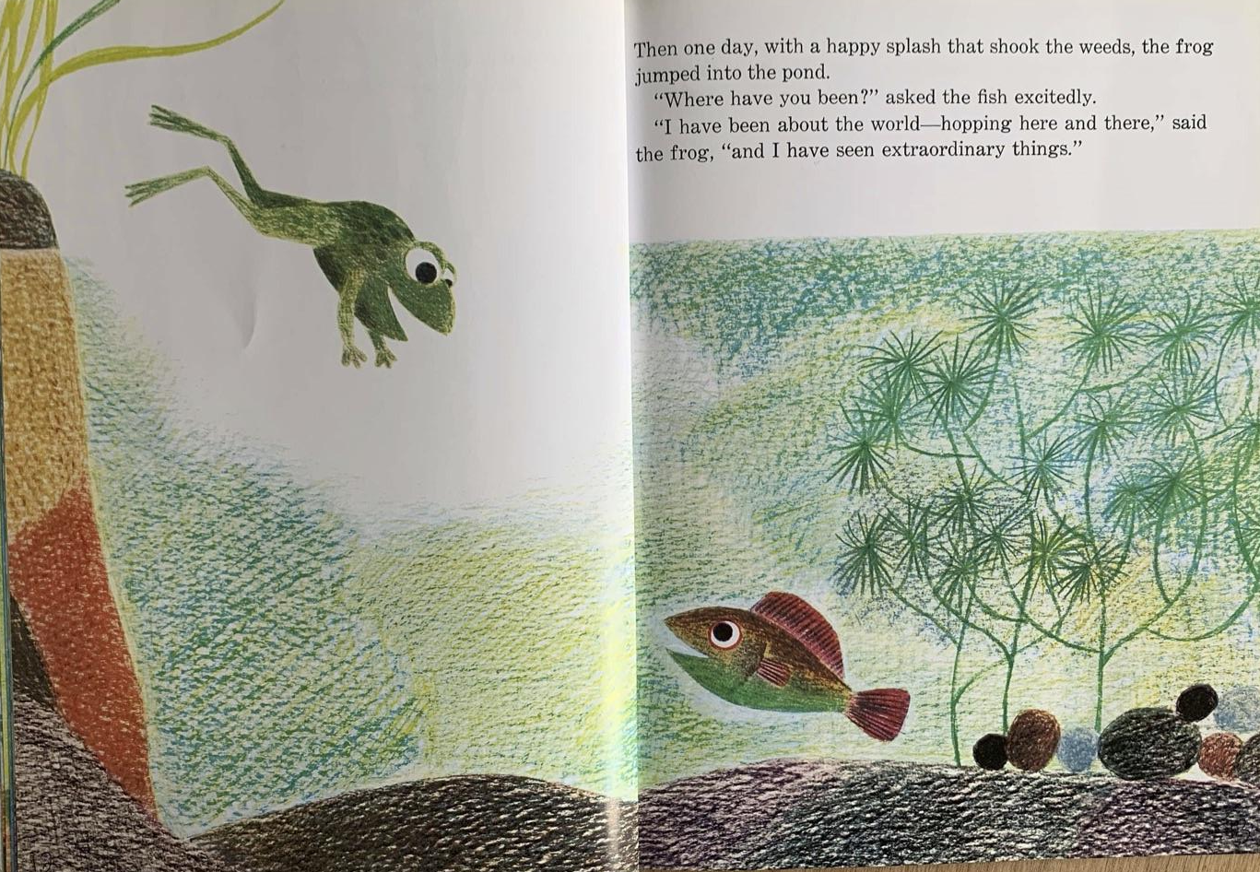
compare
verb
to notice similarities and differences
Notes:
From Fish is Fish, written and illustrated by Leo Lionni

Slide 10
They made a comparison between two books.

Slide 11
The song made me feel emotional.

Slide 12

emotion
noun
feeling
Notes:
https://www.psychologicalscience.org/news/releases/the-emotions-we-feel-may-shape-what-we-see.html

Slide 13
The song made me feel emotional.

