Slide 1
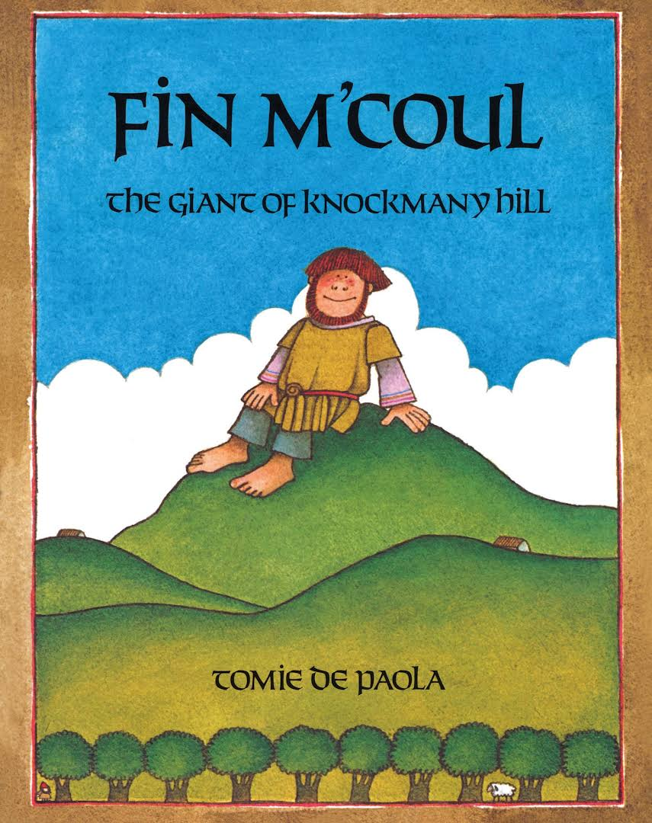
Fin M’Coul
The Giant of Knockmany Hill
text excerpt, page 19
Text Talk Week 3, Day 1

Slide 2
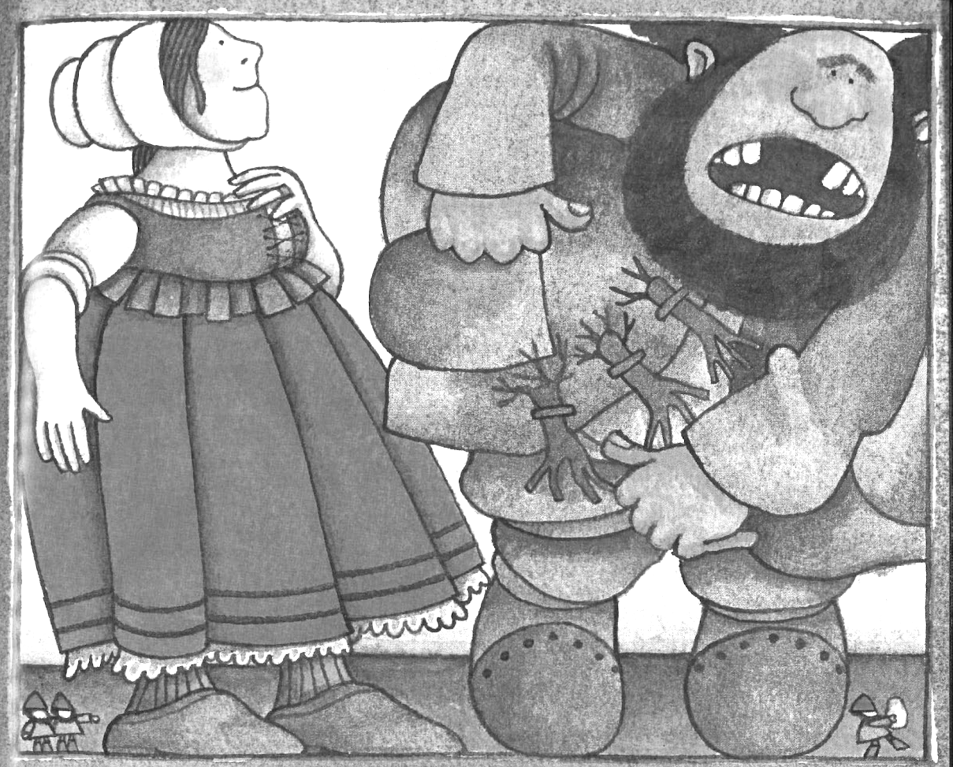
“That’s Fin’s bread,
The only kind he eats,” said Oonagh.
“Is it a bit too tough for you?”
“Too tough for me?” shouted Cucullin.
“I should say not. Just give me another.”
Cucullin chomped into another loaf…
And, into another frying pan.
“I’ll not have a tooth left in my mouth, woman.
There’s two more out!”
Cucullin hollered even louder.

