Slide 1
Comparing Music
Text Talk Week 3, Day 5

Slide 2

Anacaona
The Buena Vista Sisters Club
“Mambo Mambi”

Slide 3
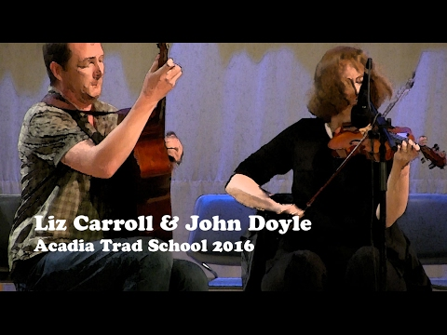
Liz Carroll & John Doyle
“Tuttle’s Reel”

Slide 4
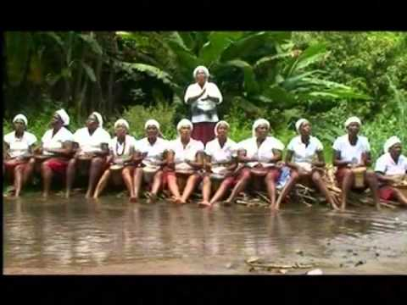
Tradison di Terra
“Mora na Fora”

Slide 5
Citations
Slide 2: https://www.youtube.com/watch?v=NvjdJw1Aj10
Slide 3: https://www.youtube.com/watch?v=5U2Mcpt7WNY
Slide 4: https://www.youtube.com/watch?v=sD8QBh-NiG8

