Slide 1
Images and Music of Cape Verde
Text Talk Week 3, Day 2

Slide 2
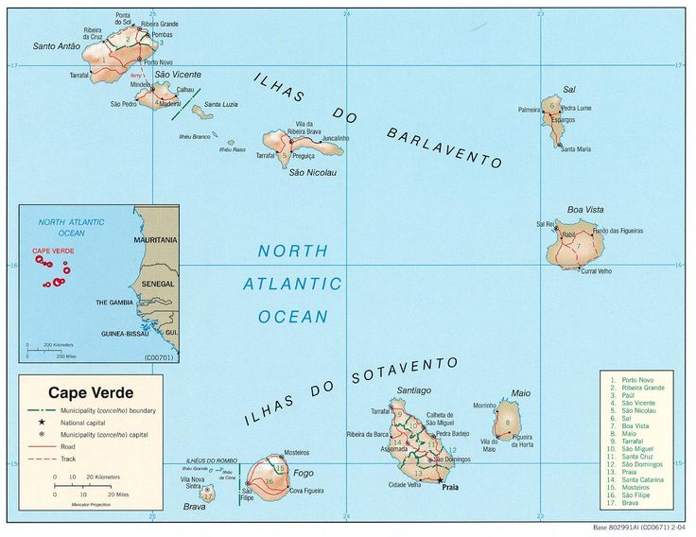
Map of
Cape Verde

Slide 3
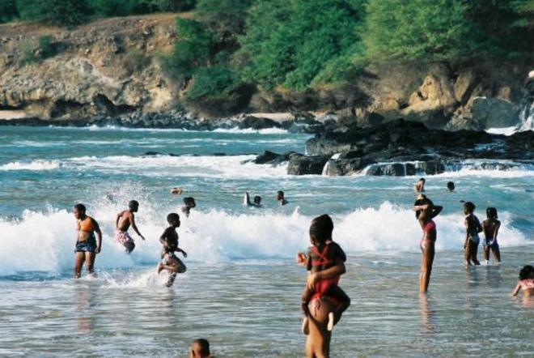
Tarrafal Beach

Slide 4
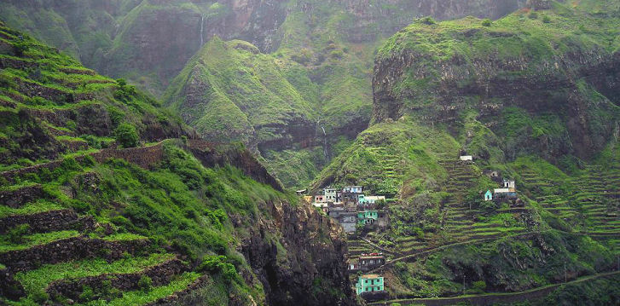
Valley in Santo Antao

Slide 5
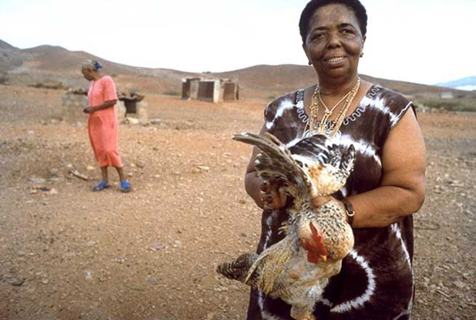
Cesária Évora

Slide 6
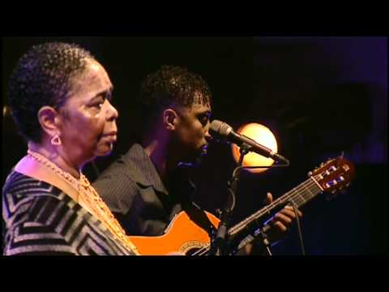

Slide 7
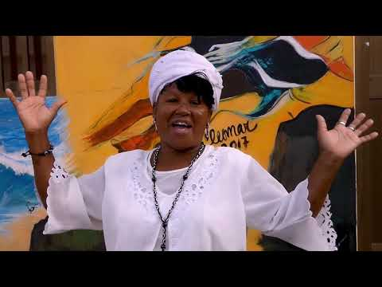

Slide 8
Citations
Slide 2: https://www.pinterest.co.uk/explore/cape-verde-map/
Slide 3: http://www.classic-sailing.co.uk/destinations/cape-verde-sailing
Slide 4: http://caboverdesite.com/santo-antao/en/index.php
Slide 5: http://www.electrovoice.com/news-details.php?id=234
Slide 6: Cesaria Evora - Sodade (https://www.youtube.com/watch?v=dNVrdYGiULM)
Slide 7: Varela Monteiro Bodinho Ft Batucaderas"tradicao (https://www.youtube.com/watch?v=yjP9yk_qvEg)

