Slide 1

Water Rolls, Water Rises excerpt
by Pat Mora
Writing Unit 3 Week 2 Day 2

Slide 2

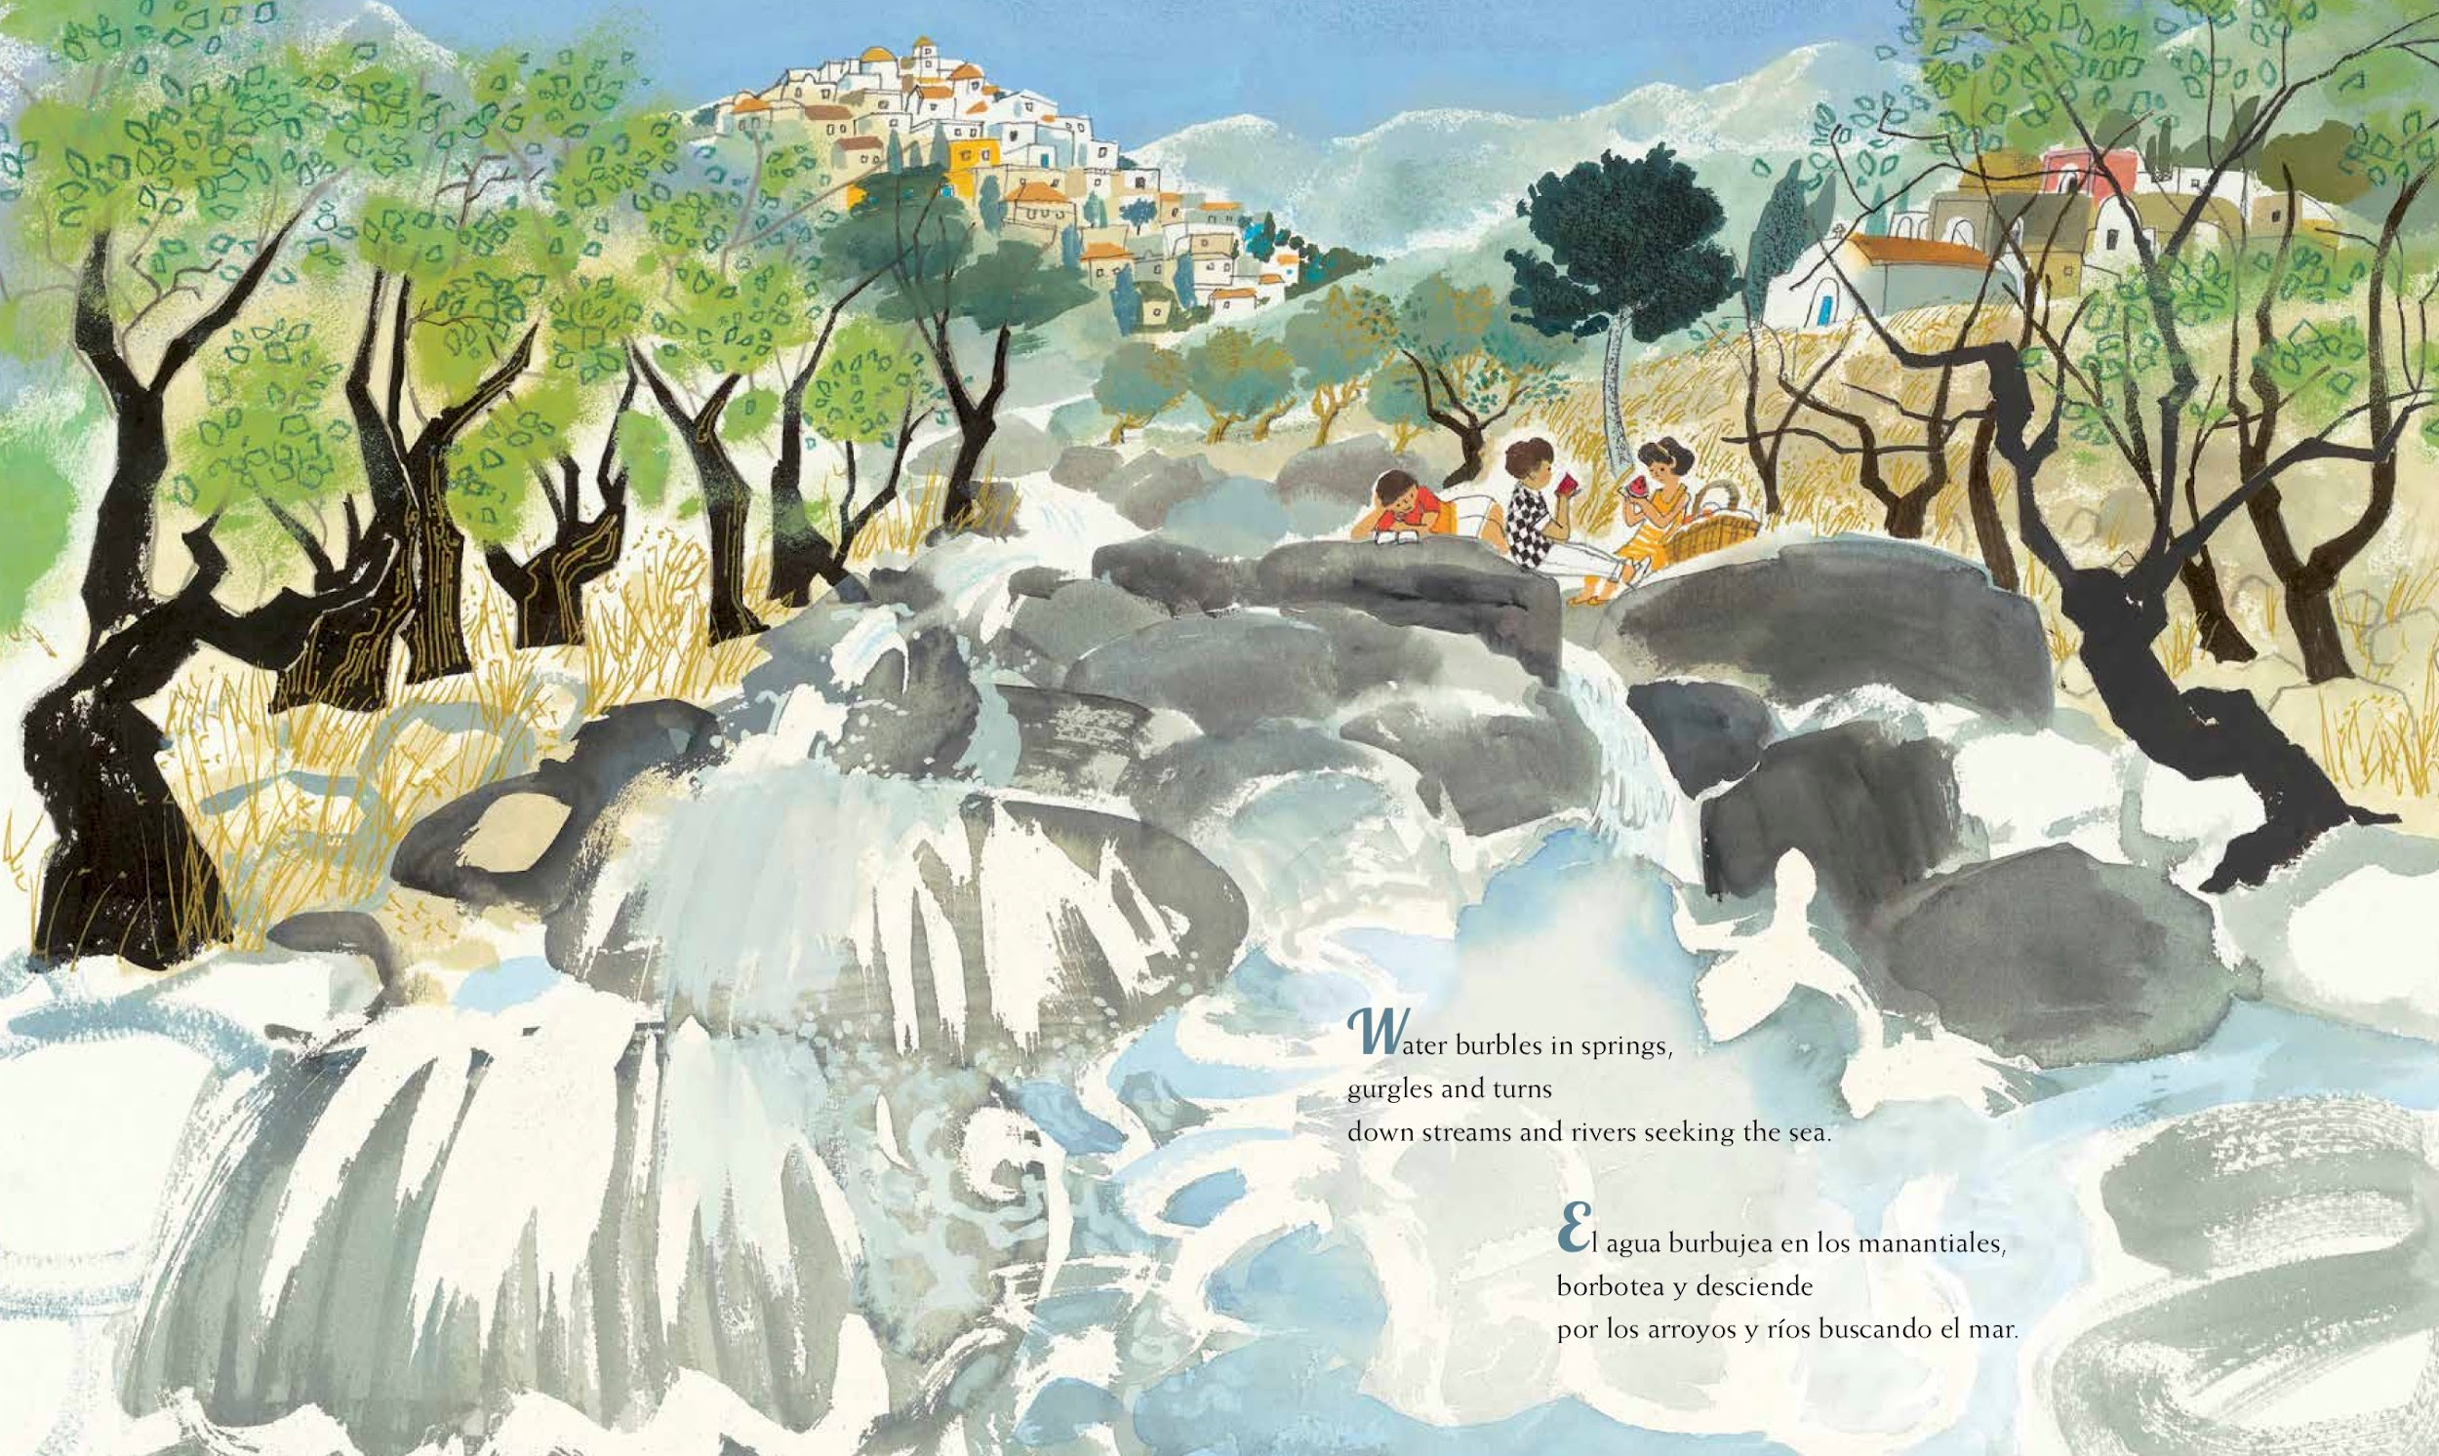

Slide 3
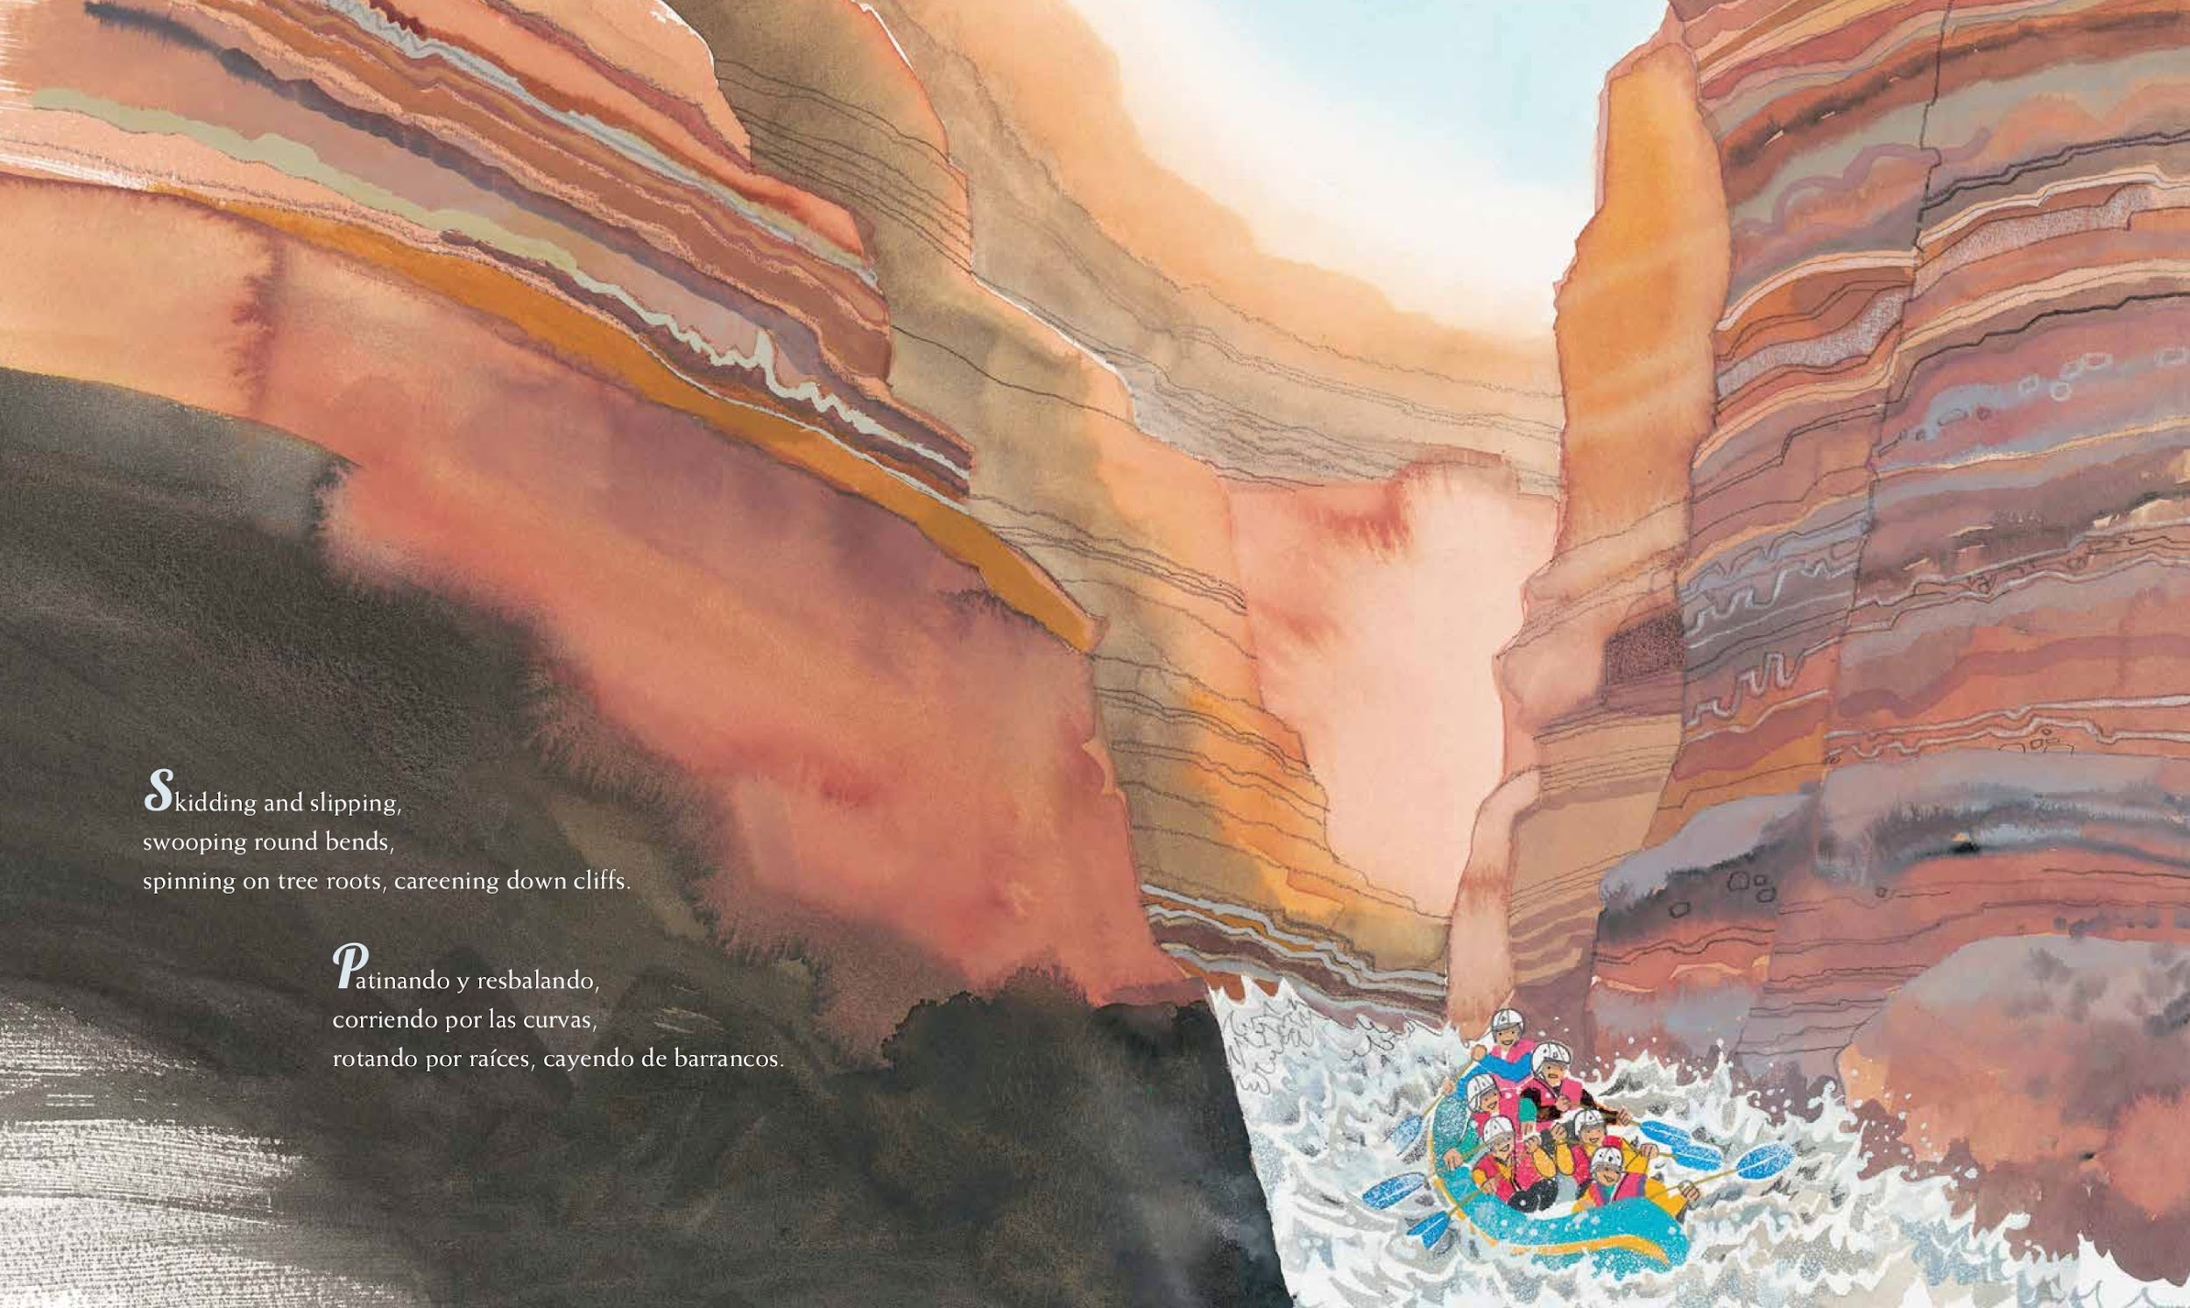

Slide 4
