Slide 1

“Things”
by Eloise Greenfield
Writing Unit 3 Week 2 Days 1 and 4

Slide 2
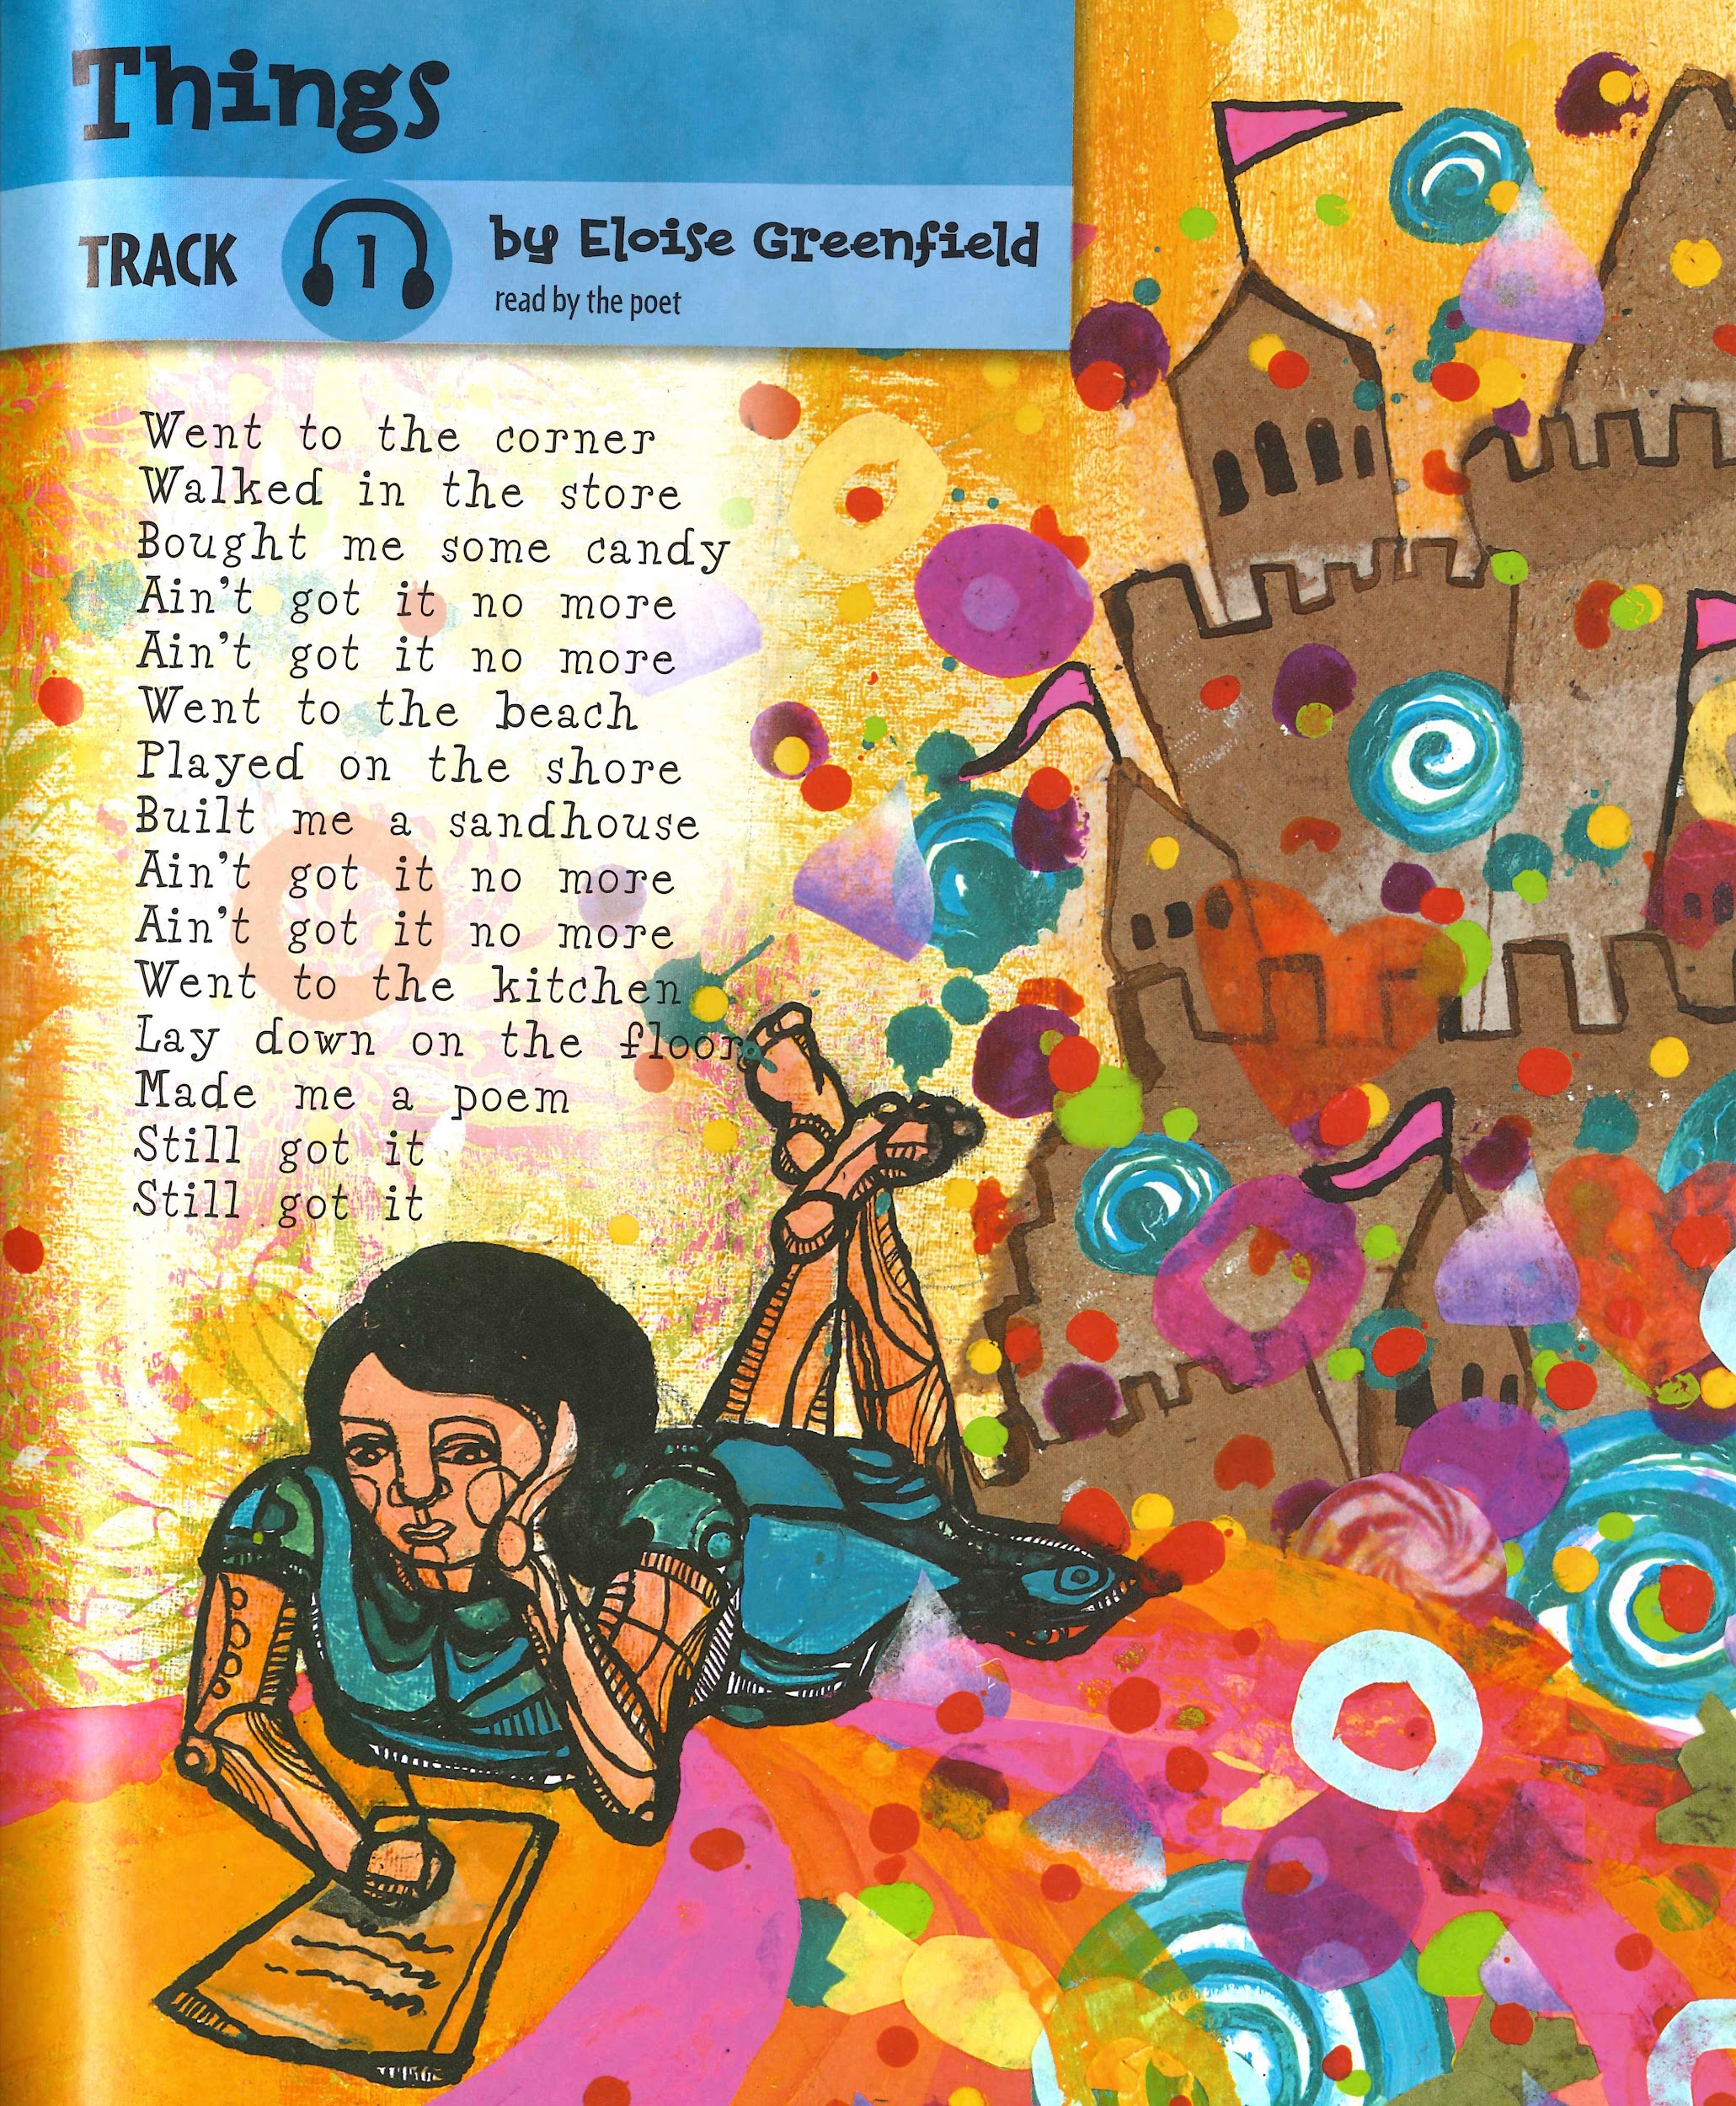
Things
by Eloise Greenfield
Went to the corner
Walked in the store
Bought me some candy
Ain’t got it no more
Ain’t got it no more
Went to the beach
Played on the shore
Built me a sandhouse
Ain’t got it no more
Ain’t got it no more
Went to the kitchen
Lay down on the floor
Made me a poem
Still got it
Still got it

Slide 3
Ain’t got it no more
Ain’t got it no more
Still got it
Still got it

Slide 4
The first five lines talk about buying candy at the store.
1 | Went to the corner
2 | Walked in the store
3 | Bought me some candy
4 | Ain’t got it no more
5 | Ain’t got it no more

Slide 5
The next five lines talk about building a sandhouse.
6 | Went to the beach
7 | Played at the shore
8 | Built me a sandhouse
9 | Ain’t got it no more
10 | Ain’t got it no more

Slide 6
The last five lines talk about writing a poem.
11 | Went to the kitchen
12 | Lay down on the floor
13 | Made me a poem
14 | Still got it
15 | Still got it

Slide 7
Things
by Eloise Greenfield
Went to the corner
Walked in the store
Bought me some candy
Ain’t got it no more
Ain’t got it no more
Went to the beach
Played on the shore
Built me a sandhouse
Ain’t got it no more
Ain’t got it no more
Went to the kitchen
Lay down on the floor
Made me a poem
Still got it
Still got it

