Slide 1
Rhythm
Writing Unit 3 Week 2 Day 5

Slide 2

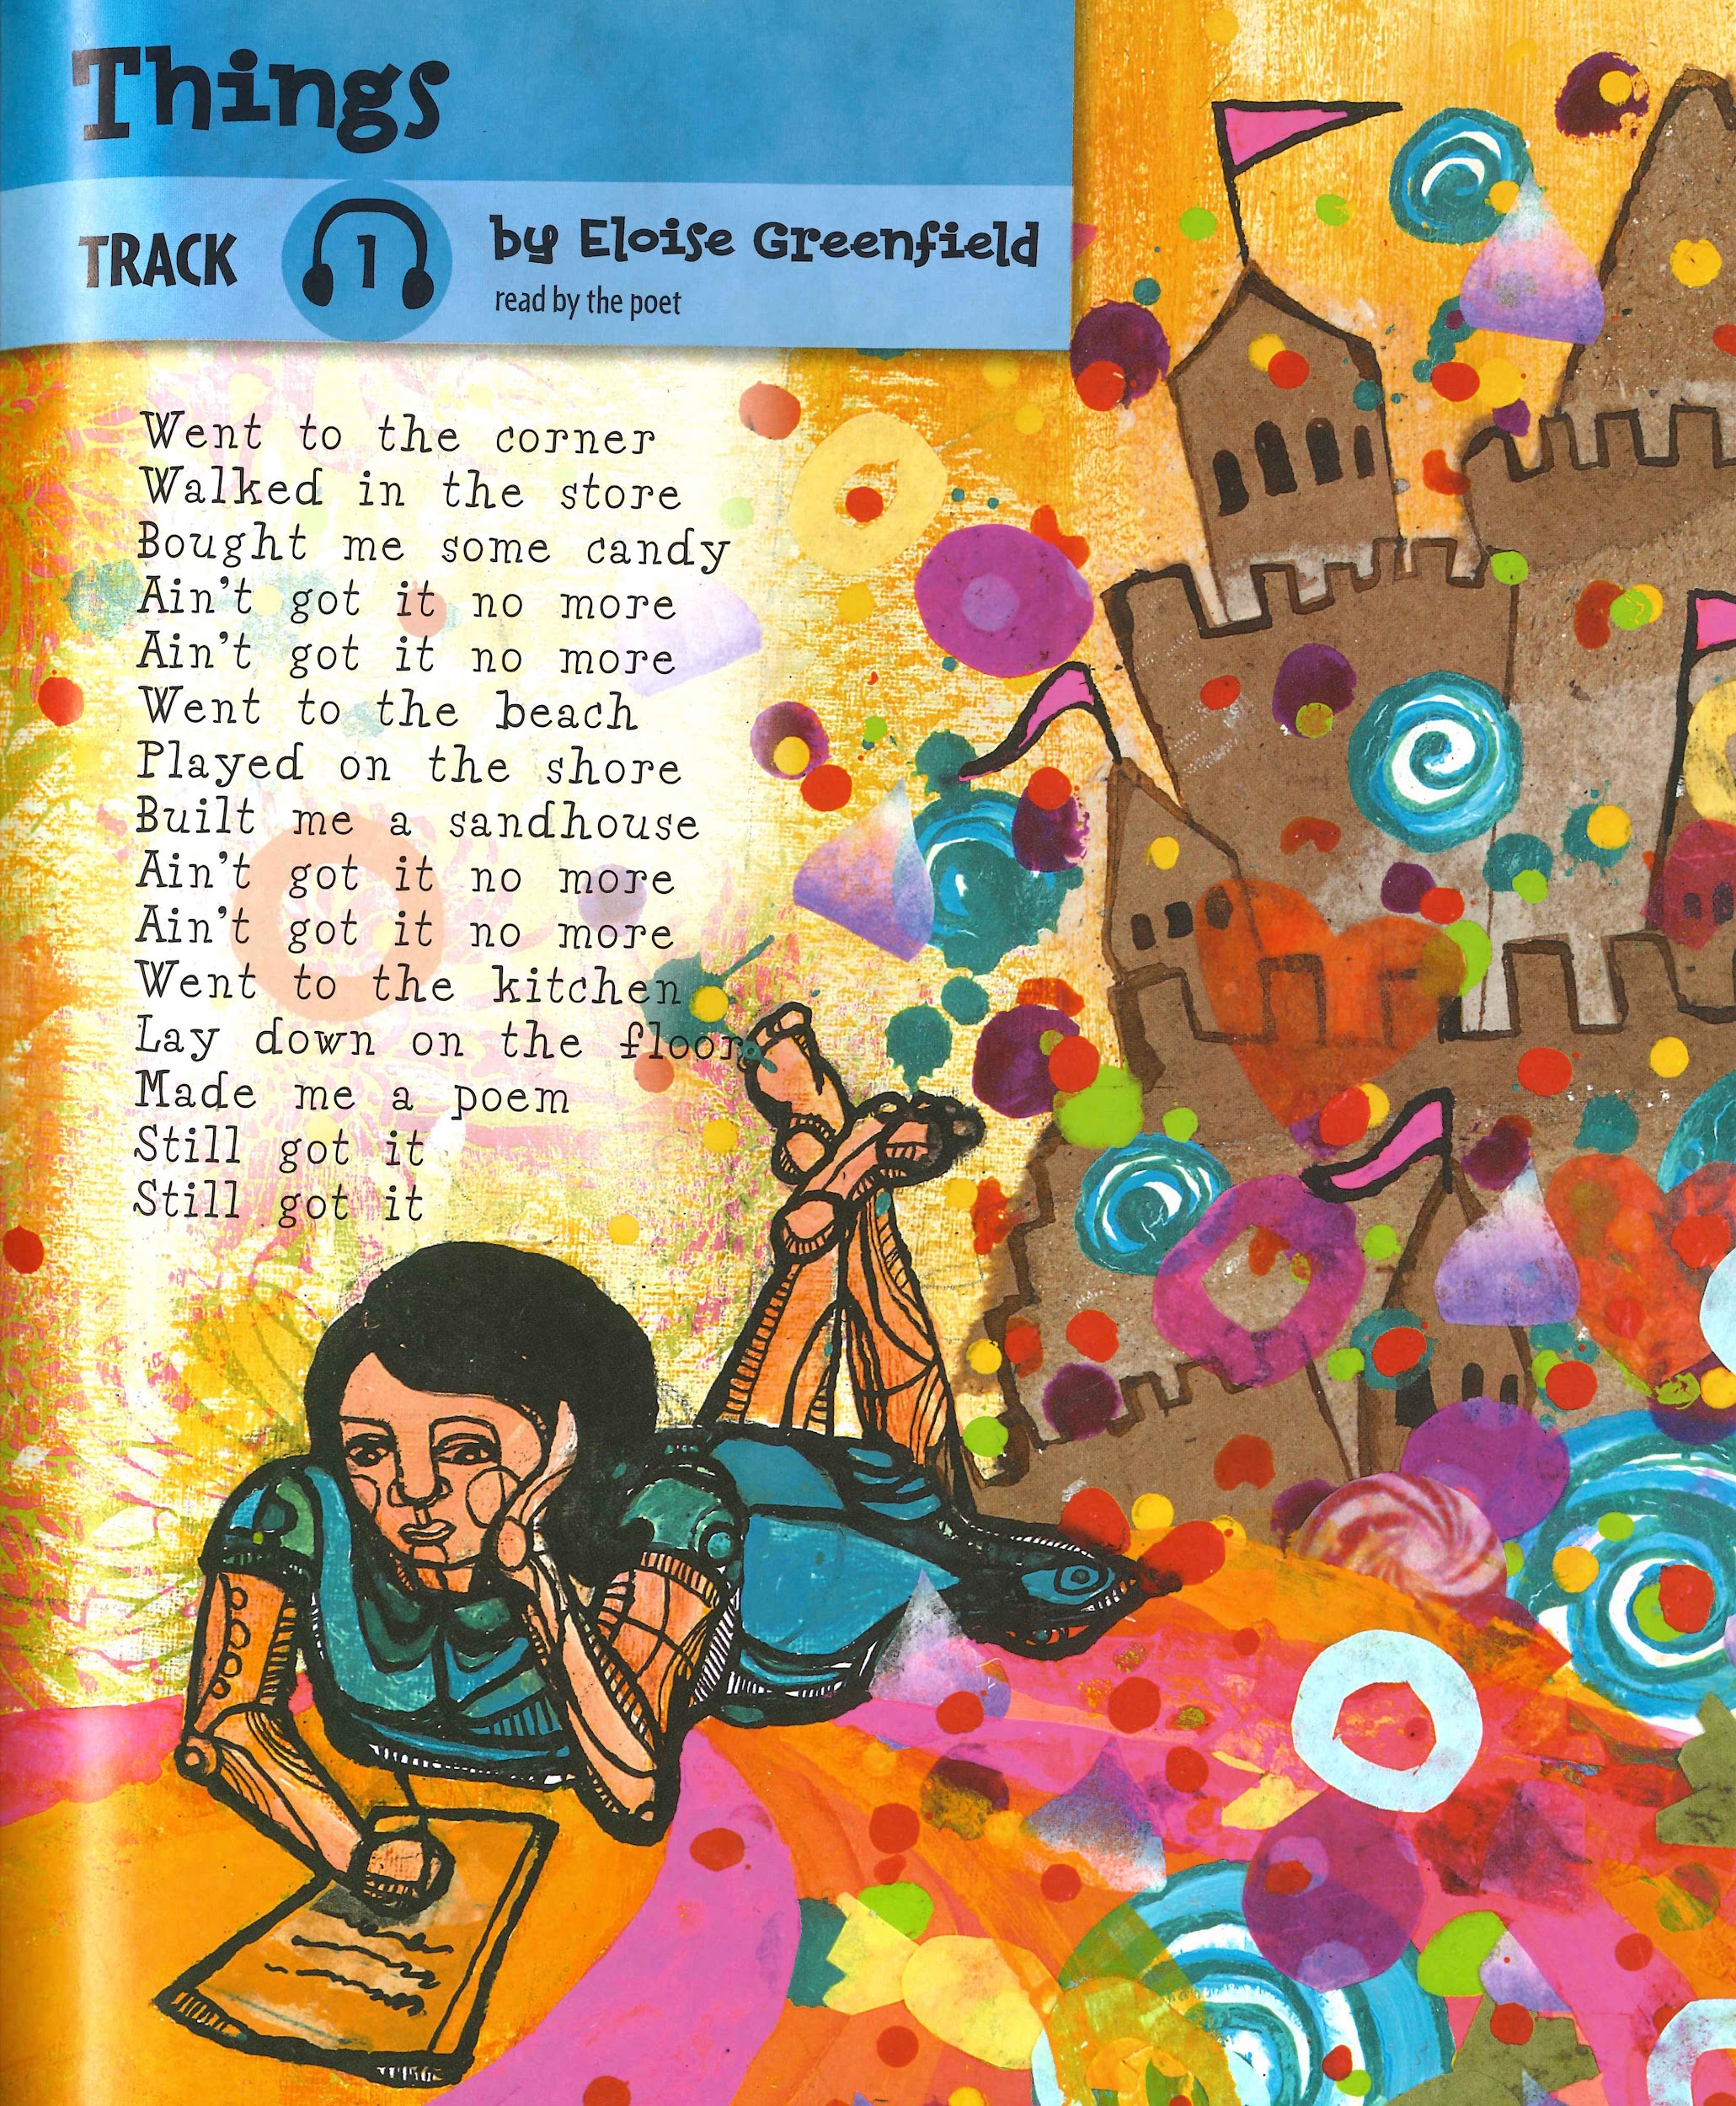
Things
by Eloise Greenfield
Went to the corner
Walked in the store
Bought me some candy
Ain’t got it no more
Ain’t got it no more
Went to the beach
Played on the shore
Built me a sandhouse
Ain’t got it no more
Ain’t got it no more
Went to the kitchen
Lay down on the floor
Made me a poem
Still got it
Still got it

Slide 3
1 | Went to the corner

Slide 4
1 | Went to the corner | 5
2 | Walked in the store
3 | Bout me some candy
4 | Ain’t got it no more
5 | Ain’t got it no more

Slide 5
In the first stanza each line has 4 or 5 beats.
1 | Went to the corner | 5
2 | Walked in the store | 4
3 | Bought me some candy | 5
4 | Ain’t got it no more | 5
5 | Ain’t got it no more | 5

Slide 6
In the second stanza each line has 4 or 5 beats.
6 | Went to the beach | 4
7 | Played at the shore | 4
8 | Built me a sandhouse | 5
9 | Ain’t got it no more | 5
10 | Ain’t got it no more | 5

Slide 7
The rhythm changes in the last stanza. The last two lines have only 3 beats.
11 | Went to the kitchen | 5
12 | Lay down on the floor | 5
13 | Made me a poem | 5
14 | Still got it | 3
15 | Still got it | 3

Slide 8
A Blank White Page
by Francisco X. Alarcón
is a meadow
after a snowfall
that a poem
hopes to cross

Slide 9
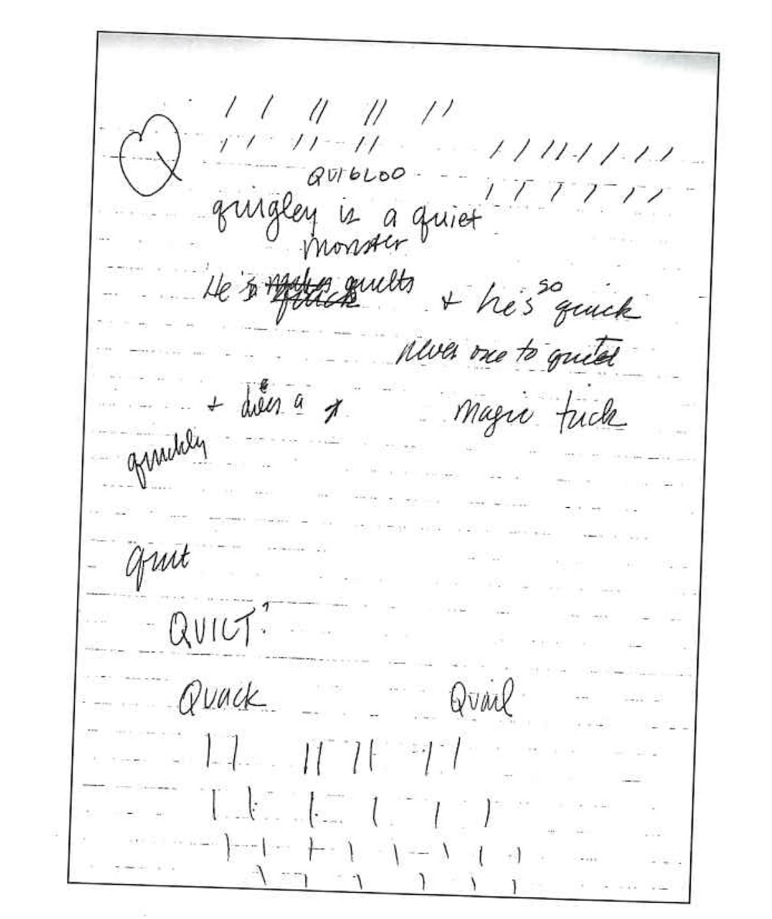
I had to figure out the exact number of beats in each line of verse that I was rhyming.
My trick was to make dashes on a piece of paper
for each beat, which was equal to one syllable.
“Dogs don’t wear sneakers” is five beats long,
“and pigs don’t wear hats” is another five beats,
“and dresses look silly on Siamese cats” is eleven
beats. That makes one verse.
This became my formula for the rest of the book.
It’s like doing a puzzle; that’s why I love to rhyme.

