Slide 1


“Ham ‘N’ Eggs”
by A Tribe Called Quest
Writing Unit 3 Week 2 Day 3

Slide 2
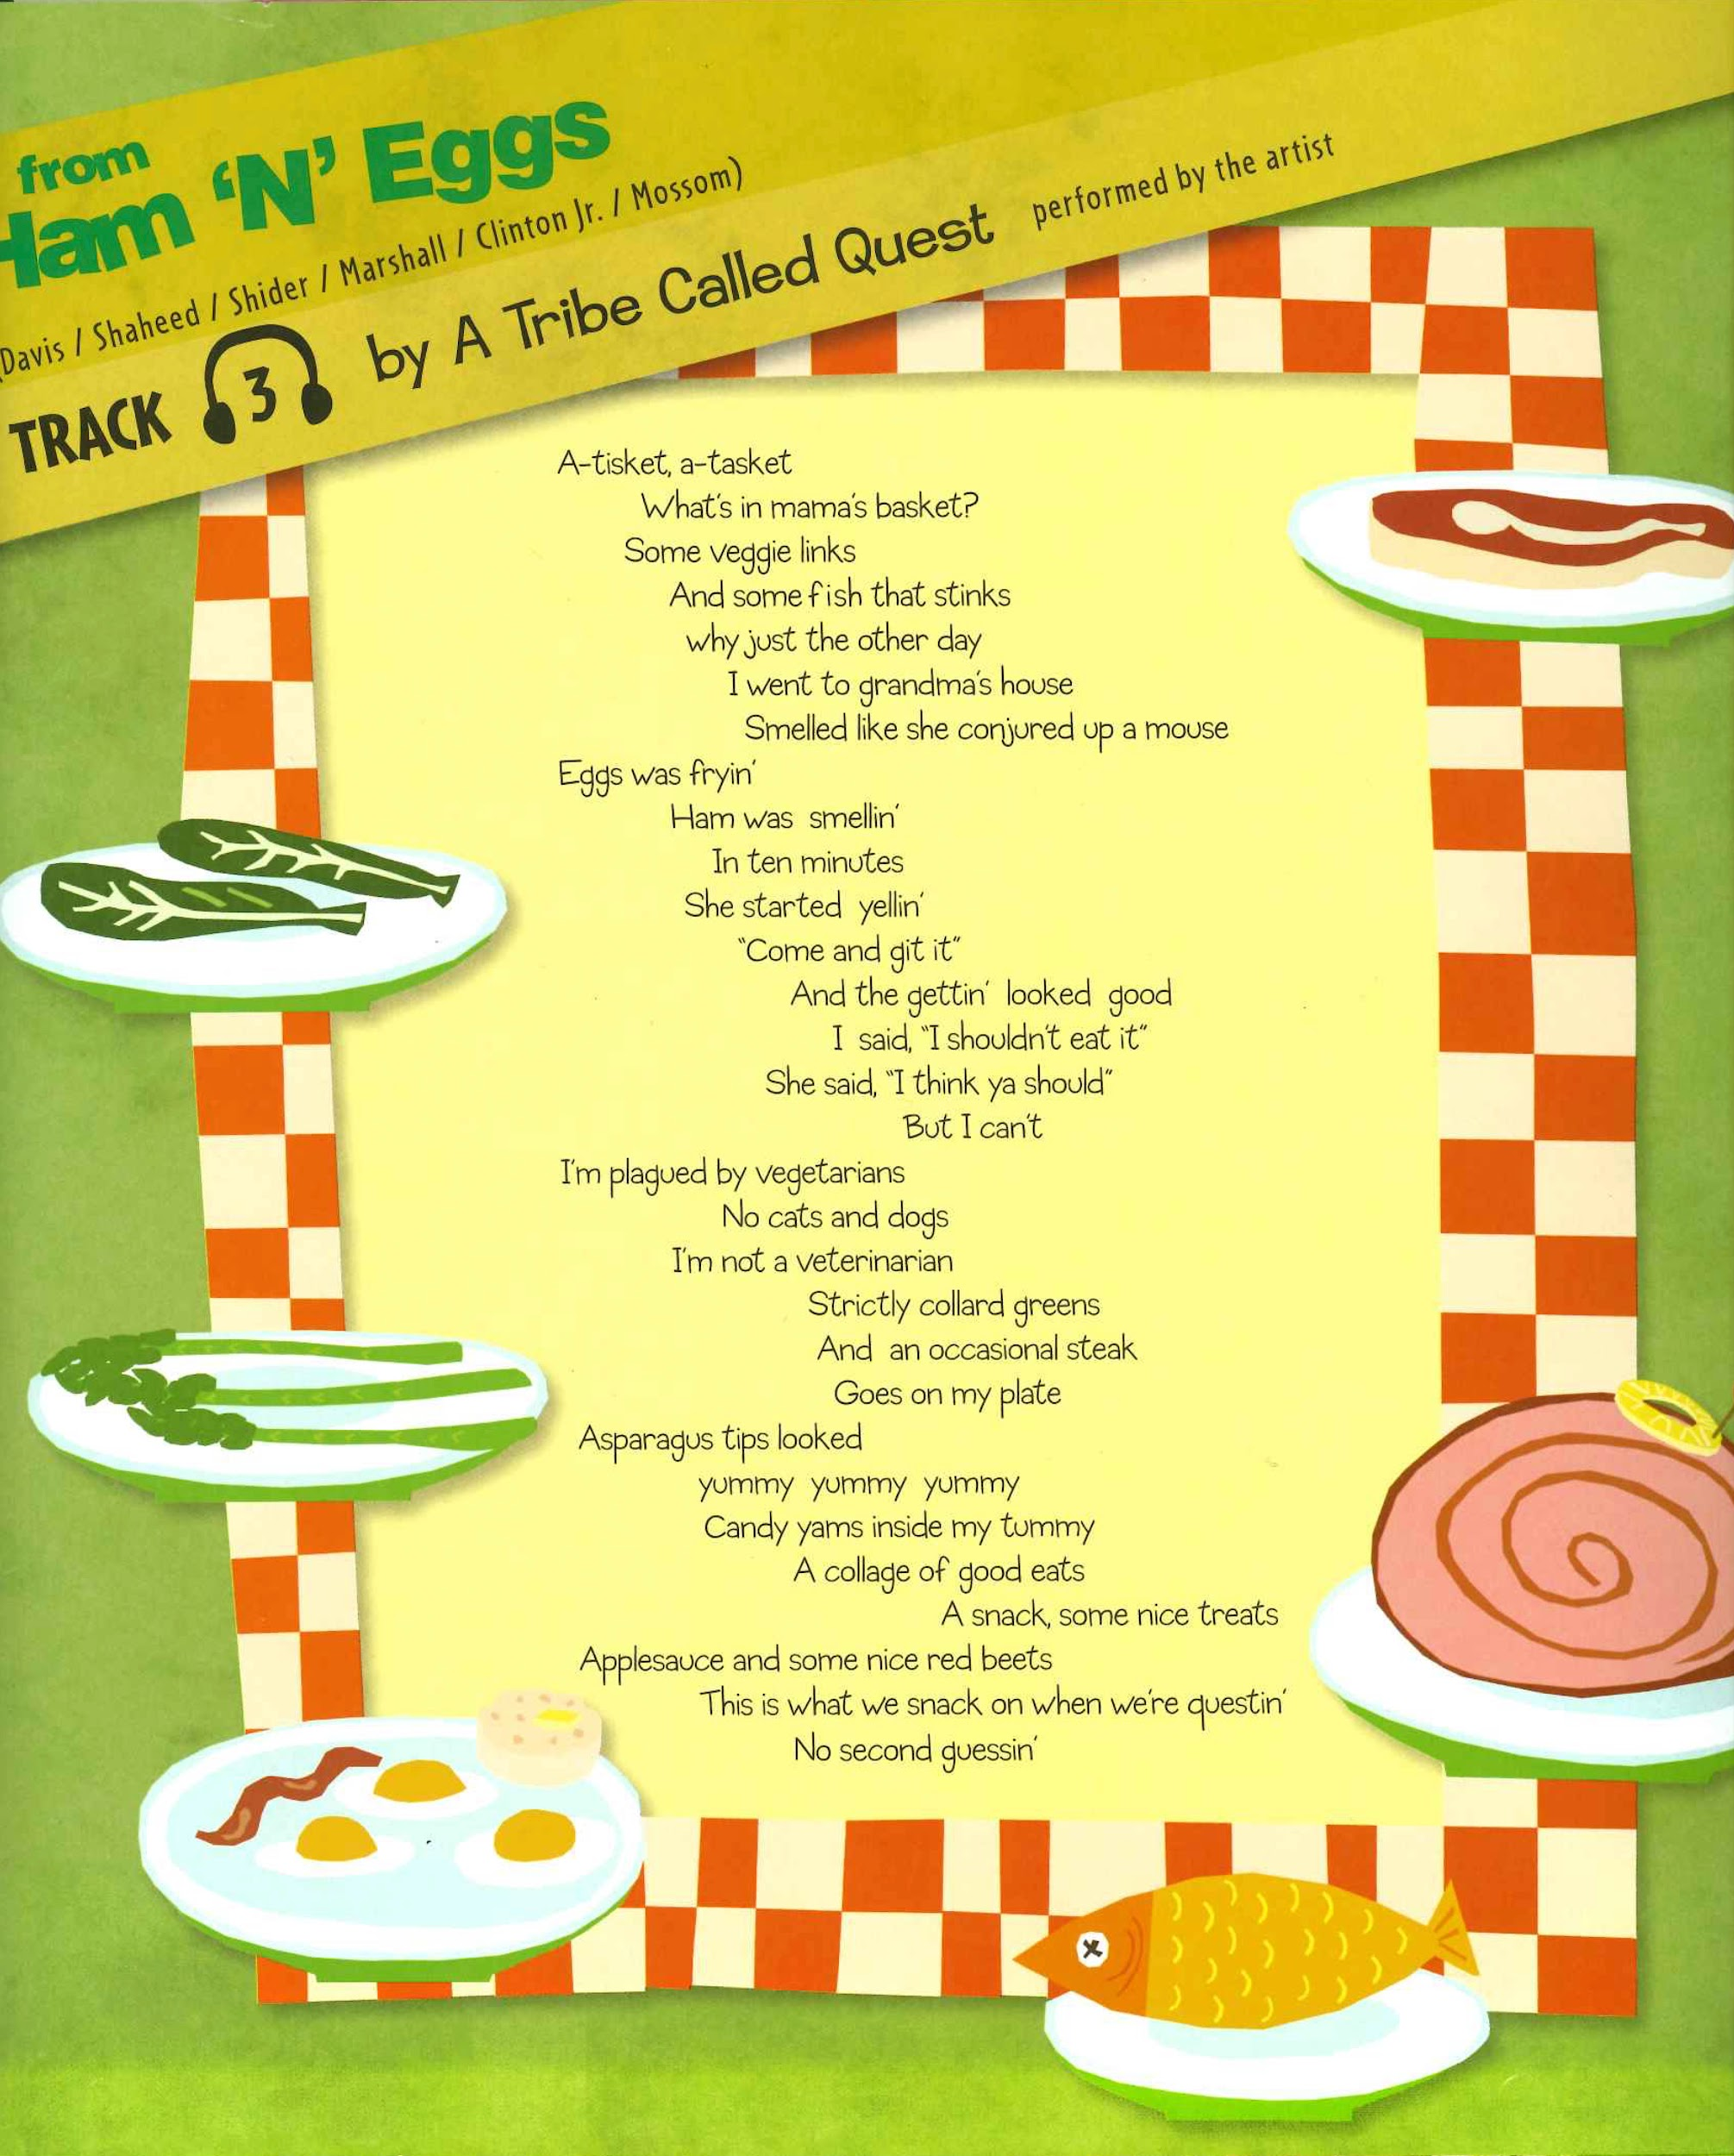

Slide 3
from “Ham ‘N’ Eggs”
A Tribe Called Quest
A-tisket, a-tasket
What’s in mama’s basket?
Some veggie links
And some fish that stinks
why just the other day
I went to grandma’s house
Smelled like she conjured up a mouse
Eggs was fryin’
Ham was smellin’
In ten minutes
She started yellin’
“Come and git it”
And the gettin’ looked good
I said, “I shouldn’t eat it”
She said, “I think ya should”
But I can’t
I’m plagued by vegetarians
No cats and dogs
I’m not a veterinarian
Strictly collard greens
And an occasional steak
Goes on my plate
Asparagus tips looked
yummy yummy yummy
Candy yams inside my tummy
A collage of good eats
A snack, some nice treats
Applesauce and some nice red beets
This is what we snack on when we’re questin’
No second guessin’

