Slide 1
Weekly Words
Unit 3, Week 2
Notes:
beat: a repeated sound, as played on a drum
evoke: to bring forward in the mind or in action
melody: the main tune of the music
pitch: the high or low quality of a sound
rhythm: regular, repeated pattern of sound
tempo: speed that a piece of music is played
tune: musical sounds with a melody and sometimes harmony
volume: amount of sound; loudness

Slide 2
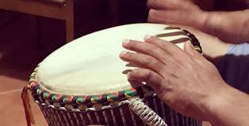

beat
noun
a repeated sound,
as played on a drum
Notes:
beat (noun)
Elaboration:
If you are listening to music and clapping along, you are usually clapping to the beat. Let’s try it.
[Click on the video to play the audio, and have children clap, stomp, or tap to the beat.]
Think, Pair, Share prompt:
Tell your partner: how did you know when to clap your hands? How did you find the beat?
Replay recording so children can reference it.
https://lynnemp.medium.com/match-forward-to-the-beat-of-your-own-drum-c8f431f2d49e

Slide 3

evoke
verb
to bring forward in the mind or in action
Notes:
evoke (verb)
Elaboration:
Maybe people find that the ocean evokes feelings of calm, especially the sound of waves lapping at the shore. For other people, the ocean might evoke the feeling of wanting to run and jump right in!
Think, Pair, Share prompt:
Close your eyes. Imagine yourself in a busy park, with noise around you. What feeling does that evoke in you?
https://www.livescience.com/38163-where-beach-sand-comes-from.html

Slide 4
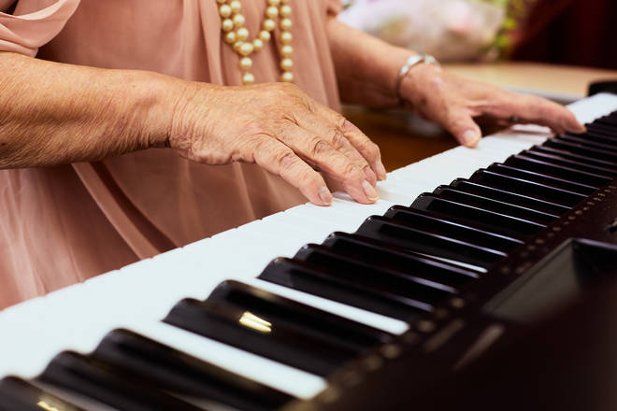
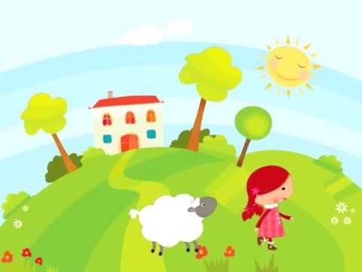
melody
noun
the main tune of the music
Notes:
melody (noun)
Elaboration:
This person is playing a piece of music on the piano. Even though she is playing many notes and sounds, there is a strong tune you could hum along to—the main part of the music. That’s called the melody.
I’m going to play a popular melody; see if you can guess the song. [Click on the video to play just the audio.]
How did you know the song?
Think, Pair, Share prompt:
Tell your partner about a song you love. Sing a little bit of it.
How does that melody make you feel?
https://www.classicfm.com/music-news/piano-practice-key-to-eternal-youth/

Slide 5

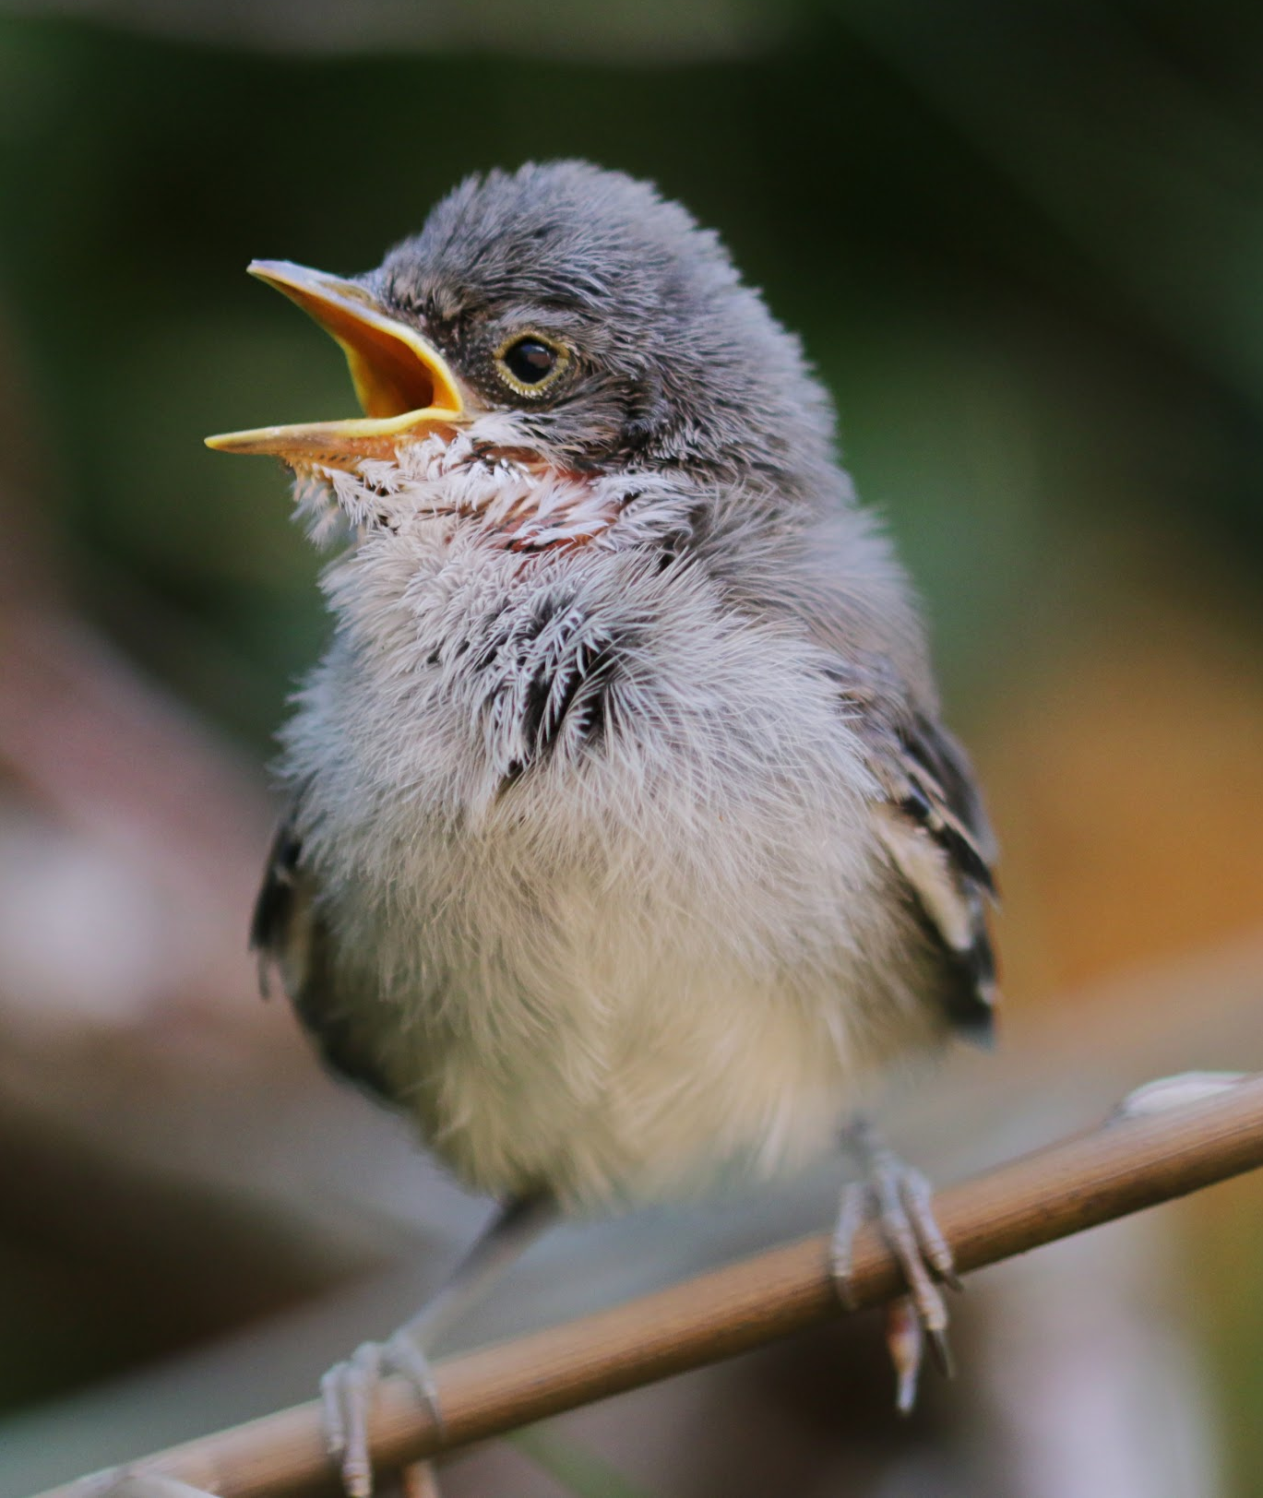

pitch
noun
the high or low quality of a sound
Notes:
pitch (noun)
Elaboration:
This word has lots of meanings you may have heard. In baseball, one player throws a pitch to the batter. A hill can have a steep pitch [make a hand gesture]. In music, the pitch is how high or low a sound is.
Whole group prompt:
Let’s listen to some sounds together and identify them as high and low. [Click on each image to play the just the audio, not the video.]
images: google images
sounds: https://www.youtube.com/watch?v=V9yp99xGP6s

Slide 6
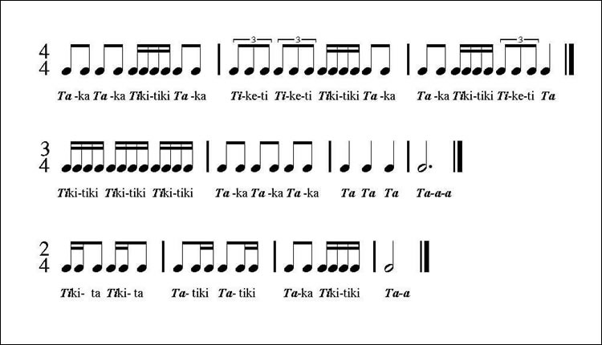
rhythm
noun
regular, repeated pattern of sound
Notes:
rhythm (noun)
Elaboration:
You can speak a rhythm, write a rhythm, play a rhythm. Let’s try this one.
Indicate and read the bottom rhythm, having children repeat after each phrase:
Tiki-ta Tiki-ta | Ta-tiki Ta-tiki | Ta-ka tiki-tiki | Ta - ah
This is how the rhythm is written as musical notes.
Think, Pair, Share prompt:
Can you create your own rhythm and teach it to your partner?
https://banddirector.com/brass/trombone/learn-to-practice-step-1-say-in-rhythm-stay-in-rhythm/

Slide 7
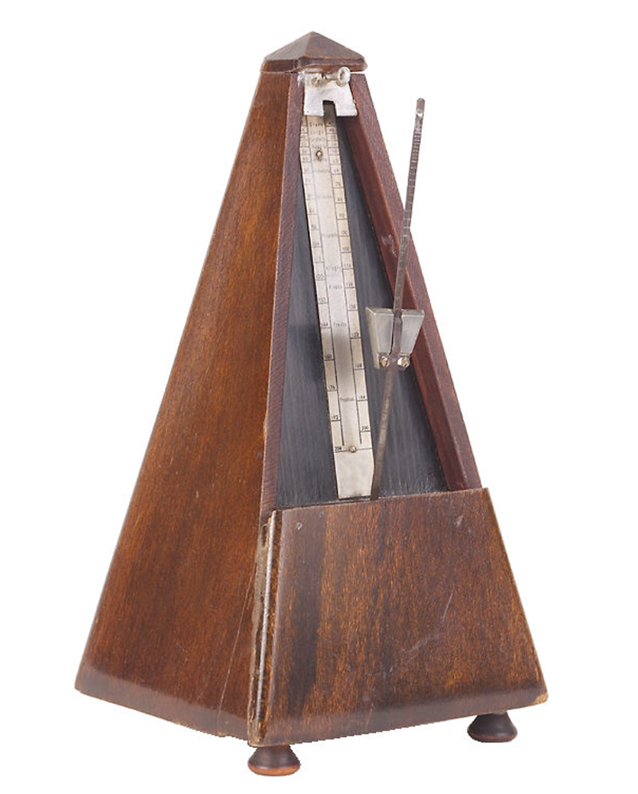
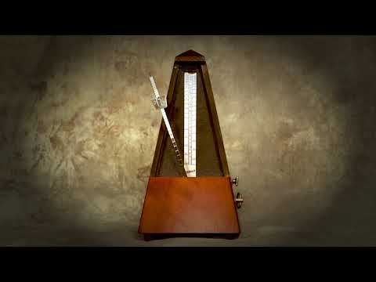
tempo
noun
speed that a piece of music is played
Notes:
tempo (noun)
Elaboration:
Many things can go fast or slow or at medium speed. In music, we call this the tempo. A metronome is a tool that musicians use to keep their tempo steady. They set it at a particular speed, and the little arm goes back and forth at this same speed without stopping or changing, making a clicking noise as it moves back and forth. Let’s see how it works.
[Play the video.]
You can also keep the tempo by tapping your knee with your hand, or tapping your foot.
Think, Pair, Share prompt:
Do you prefer music with a fast tempo or a slow tempo? Why?
https://www.oxfordlearnersdictionaries.com/definition/english/metronome

Slide 8
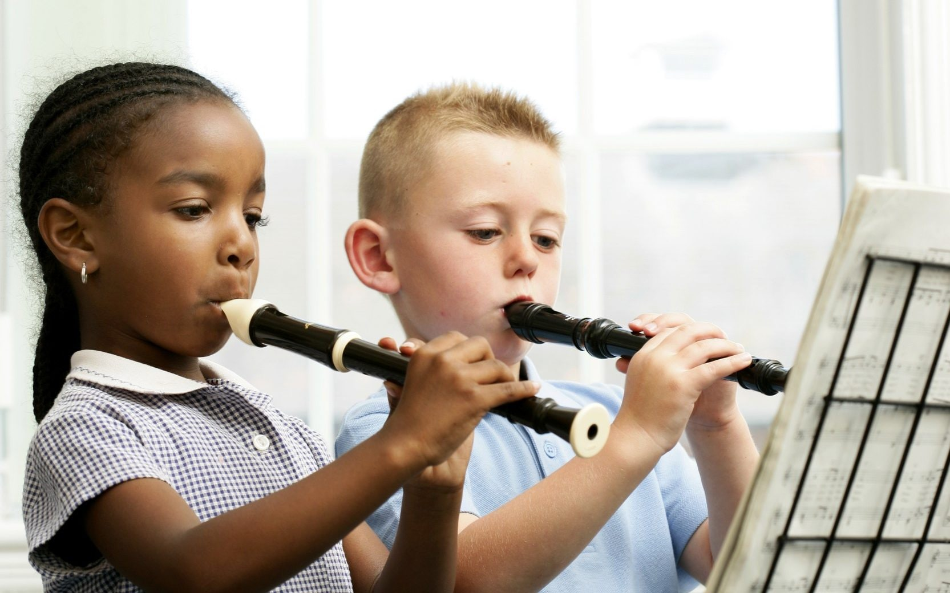

tune
noun
musical sounds with a melody and sometimes harmony
Notes:
tune (noun)
Elaboration:
These children are learning to play an instrument called a recorder. They are probably starting with a very simple tune so they can learn where to put their fingers to make the sounds and how to read the music. That tune can also be called the melody. Let’s listen.
[Click on the video, just to play the audio.]
Think, Pair, Share prompt:
If you could play any instrument, what is a tune might you like to play? Try to hum that tune to your partner.
https://www.telegraph.co.uk/music/news/wind-instruments-perfectly-safe-cant-band-play/

Slide 9
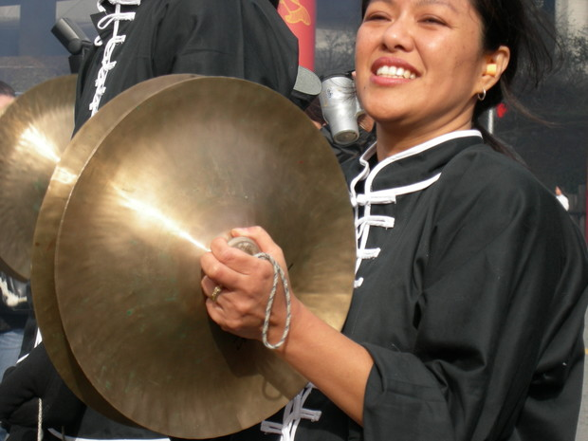
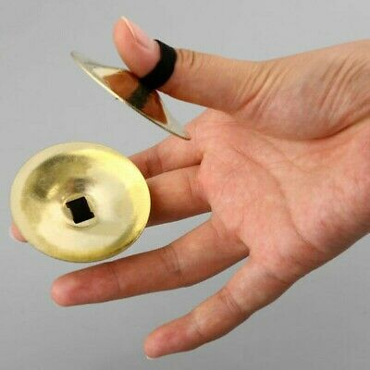


volume
noun
amount of sound; loudness
Notes:
volume (noun)
Elaboration:
We use our voices at different volumes in the classroom depending on what we are doing. When we are in Studios, our voices tend to be at a higher, or louder, volume than when we are writing or working in Stations.
Think, Pair, Share prompt:
Look at the images. Describe what you see.
https://www.wpr.org/sound-cymbals

