Slide 1
Reflexive Pronouns
Vocabulary & Language Week 2, Days 3-4

Slide 2
myself | herself | ourselves
yourself | oneself | yourselves
himself | itself | themselves

Slide 3
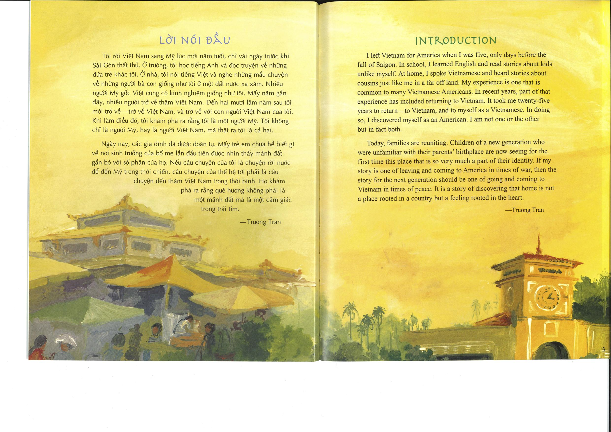


Slide 4
It took me twenty-five years to return—to Vietnam, and to myself as a Vietnamese. In doing so, I discovered myself as an American.

Slide 5
Read the following sentences.
What is the reflexive pronoun?
What is the subject that the reflexive pronoun refers to?
Pedro was singing to himself.
The kids played by themselves.

Slide 6
Is this what you found?
The reflexive pronoun is highlighted.
The subject is underlined.
Pedro was singing to himself.
The kids played by themselves.

Slide 7
Your turn!
Choose 3 reflexive pronouns.
Write 3 sentences, each using a different reflexive pronoun.
Circle the reflexive pronoun in each sentence.
Underline the subject of each sentence.
myself | herself | ourselves
yourself | oneself | yourselves
himself | itself | themselves

